Slide 1
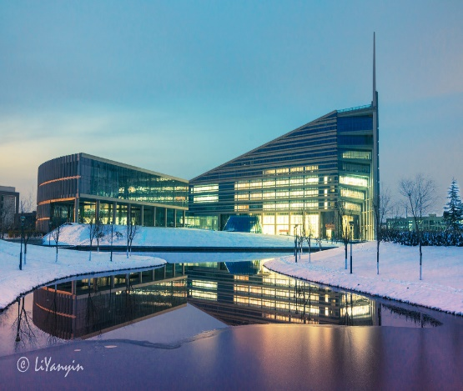
Face Anti-spoofing via
Deep Local Binary Patterns
Lei Li
Northwestern Polytechnical University
Shaanxi, China

Slide 2
Layout
Background
Proposed Method
Results and Discussion
Conclusion and Future Work

Slide 3
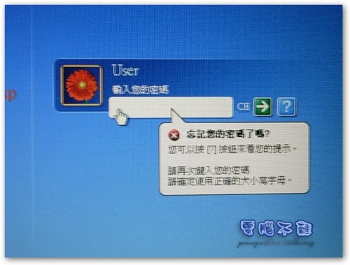
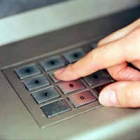
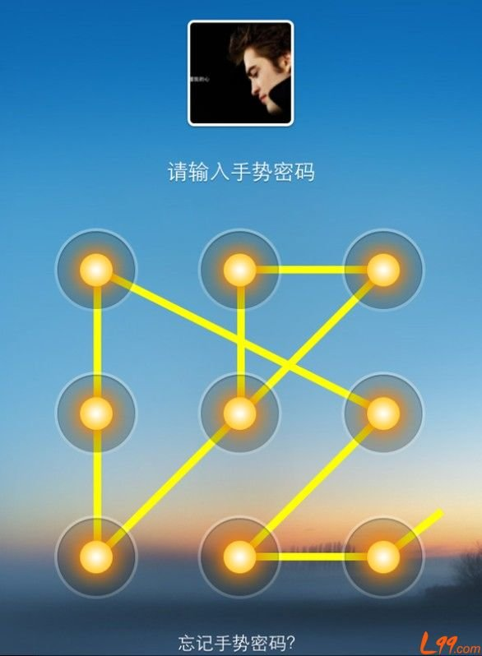
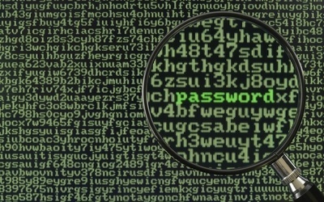
Background
Complex Password: Mobile Phone、PC、ATM.

Slide 4
Background

Slide 5
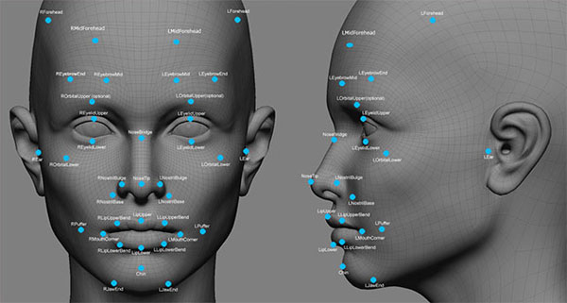
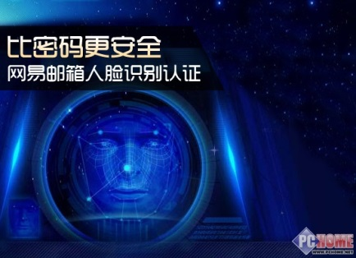
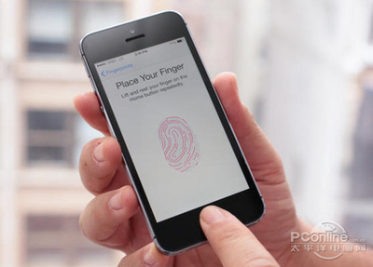
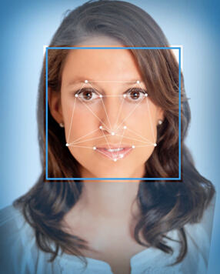
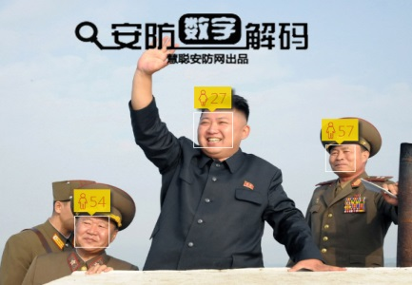
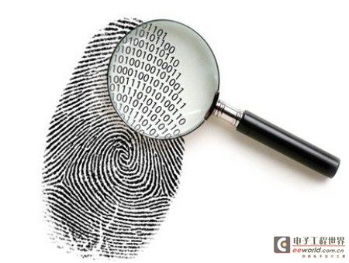
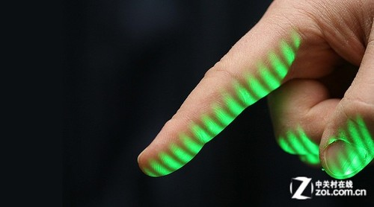
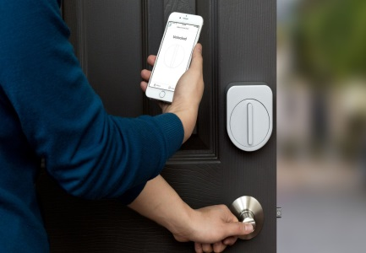
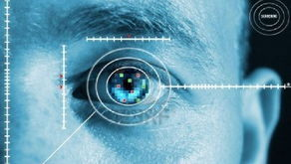
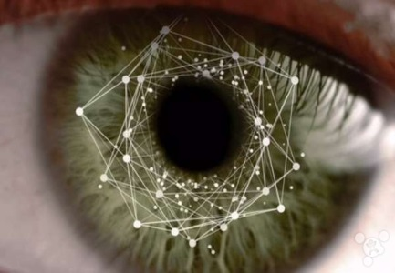
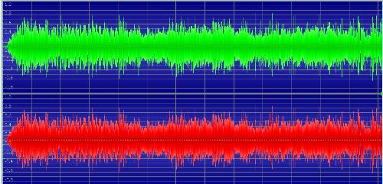
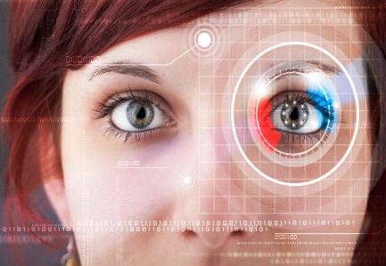
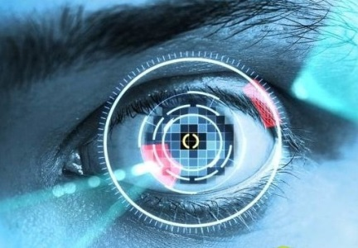
Background
Face recognition
Fingerprint
Voice recognition
Iris recognition

Slide 6
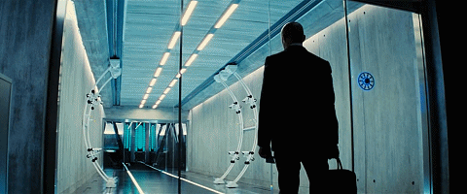
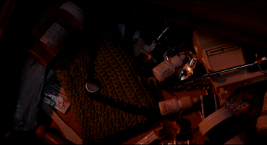
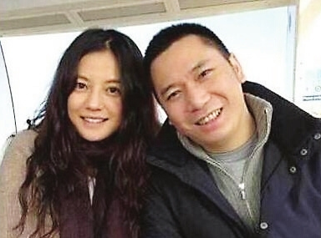
Background
Spoofing attack: Using some illegal ways to get the permission of a biometric system. Biometric systems are vulnerable to spoofing attack.
Chinese News

Slide 7
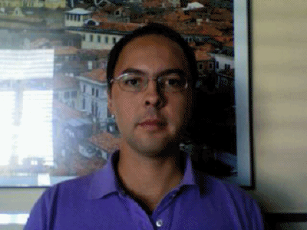
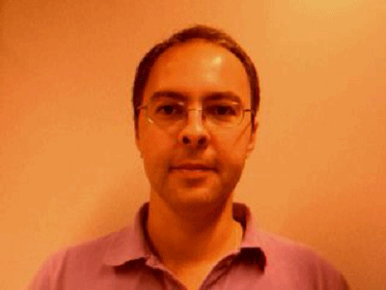
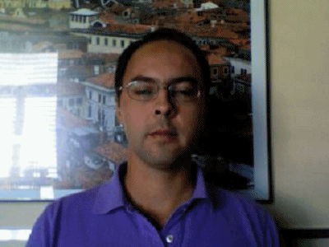
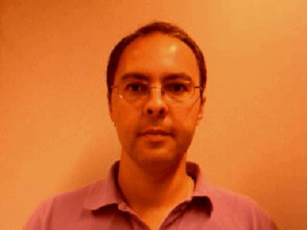
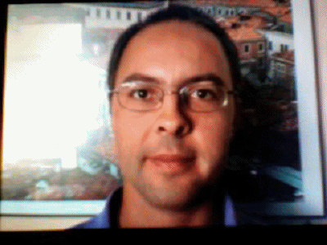
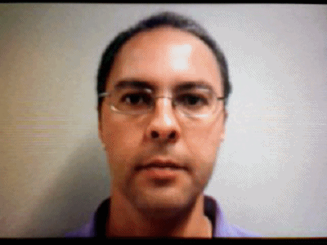
Background
Replay-Attack Database: Released in 2012; Photo attack, mobile phone attack, iPad attack; 50 clients.
Real client:
Fake client:

Slide 8
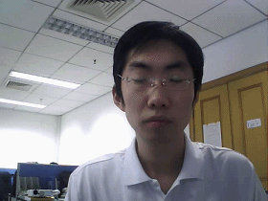
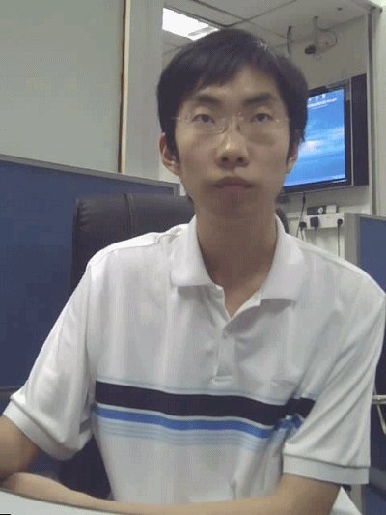
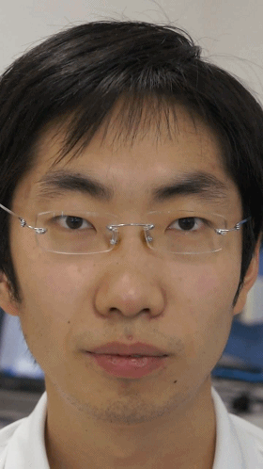
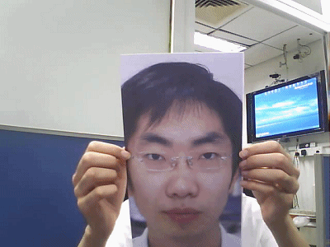
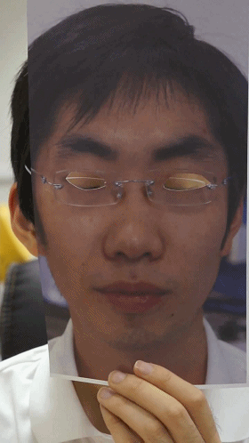
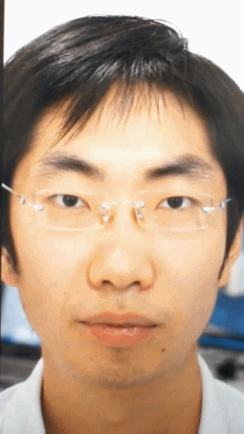
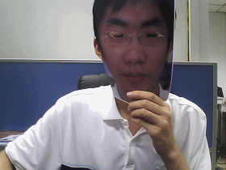
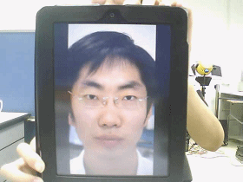
Background
CASIA Database: Released in 2012; Photo attack, cut photo, Replayed video; 50 clients.
Real client:
Fake client:

Slide 9
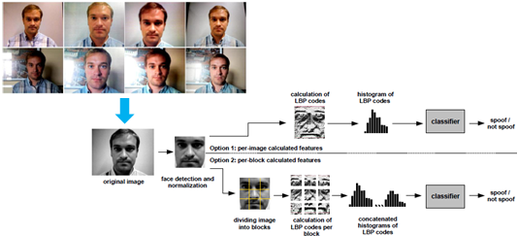
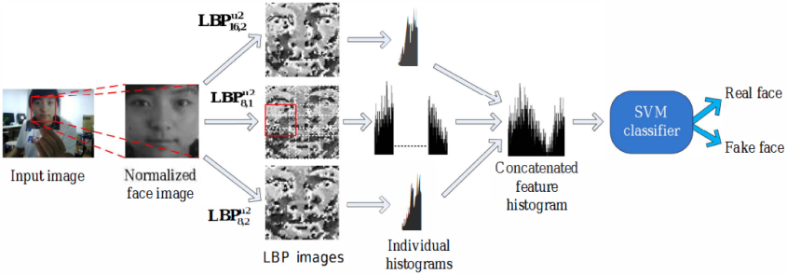
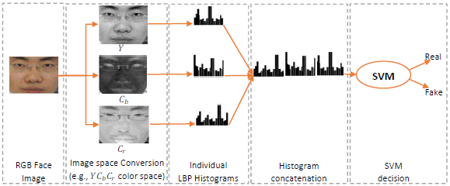
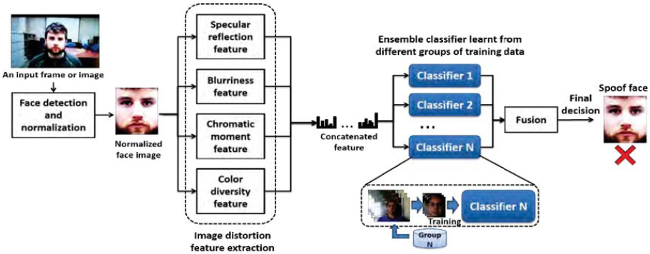
Background
Many methods were proposed.
Based on Motion
Based on Image Analysis
Based on Texture

Slide 10
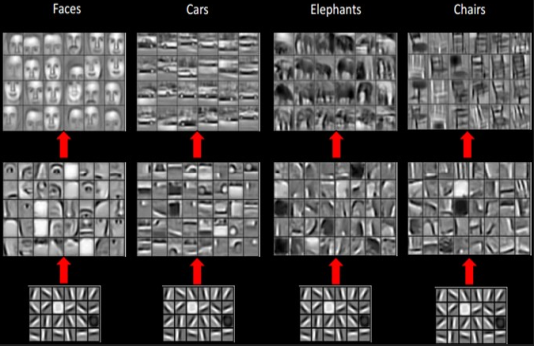
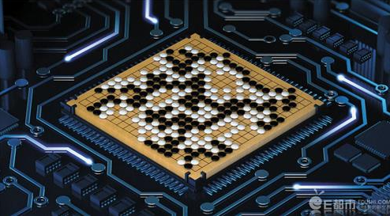
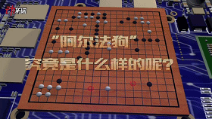
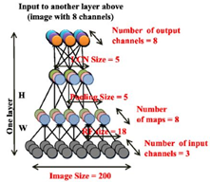
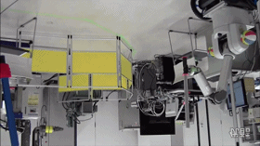
Background
In computer vision, many deep learning methods have been proposed and got some good performances. How about in face spoofing detection?

Slide 11
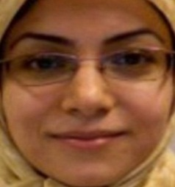
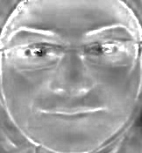
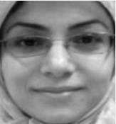
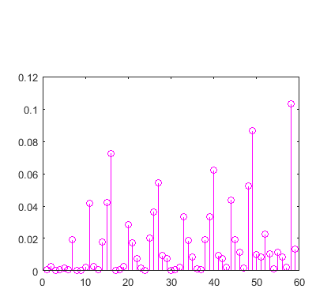
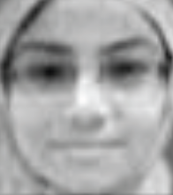
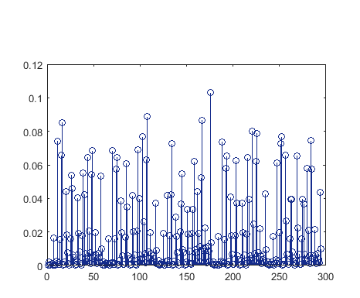
Proposed Method
224×224
Conv Layer
Relu Layer
FC Layer
M-pool
…
…
..
..
..
Fake or
Real face
Face image
Color Space
Part I: The CNN model.
Dropout
＋
…
－
Concatenation
SVM
Convolutional feature maps
LBP maps
Statistical histograms
Part II: Extract LBP features from the convolutional maps.
Fig 1. Architecture of Face Anti-spoofing based on CNN&LBP. Part I is the CNN model fine-tuned on VGG-face. Part II is the main idea of extracting the LBP features from the convolutional feature maps and concatenating the LBP features into one vector.

Slide 12
Proposed Method

Slide 13
Results and Discussion
Extract different color spaces

Slide 14
Results and Discussion
Combine different color spaces

Slide 15
Results and Discussion

Slide 16
Conclusion and Future Work
Combined the deep learning with hand-crafted features for face spoofing detection;
Extracted the LBP features from different con-volutional layers;
Explored different color spaces and combined them together
In next work, we will test the effectiveness of other hand-crafted features and set up an end-to-end model for deep learning and hand-crafted features.

Slide 17
THE END!
Questions?

