Slide 1
Test-Time Adaptation for Out-of-distributed Image Inpainting
Chajin Shin, Taeoh Kim, Sangjin Lee, Sangyoun Lee
Image and Video Pattern Recognition LAB
Electrical and Electronic Engineering Dept, Yonsei University

Slide 2
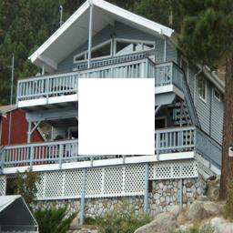
Image Inpainting
$$x_{d}$$
$$M$$

Slide 3
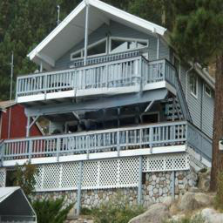
Image Inpainting
Inpainting
[ , ]
$$[x_{d},M]$$
$$G(⋅)$$
$${\overline{x}}_{d}=G([x_{d},M])$$

Slide 4
Problems
Out-of-Distributed Images
No Training Images for Out-of-Distributed Images
Test Time Adaptation

Slide 5
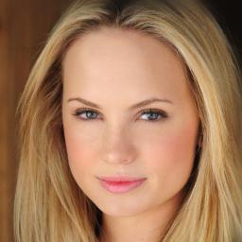
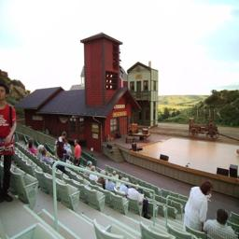
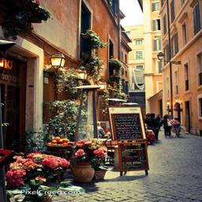
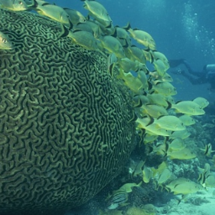
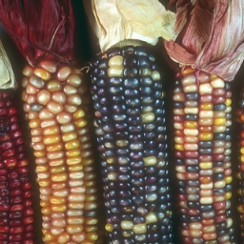
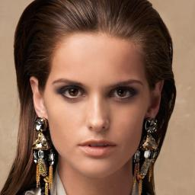
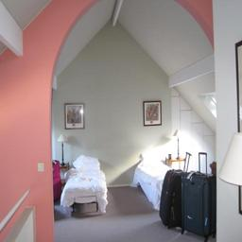
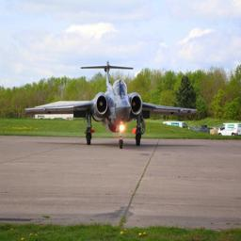
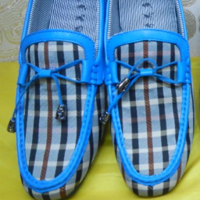
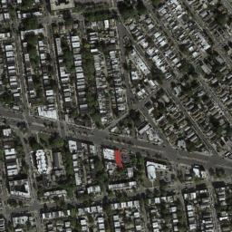
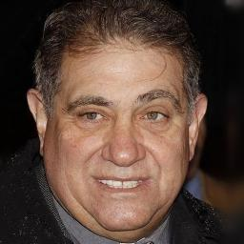
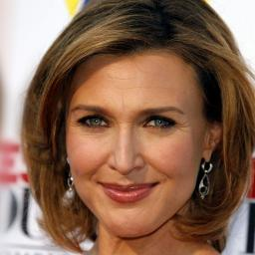
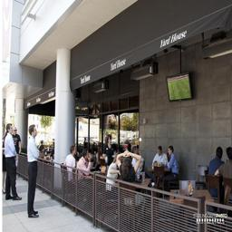
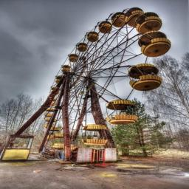
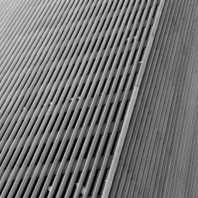
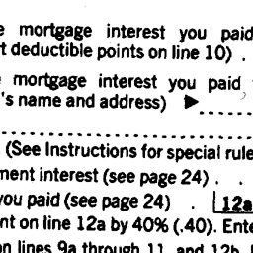
Out of distribution
Training
Inference
Domain Gap
celebA-HQ
Places365
Others
celebA-HQ : Progressive Growing of GANs for Improved Quality, Stability, and Variation
Places365 : Places: A 10 million Image Database for Scene Recognition

Slide 6
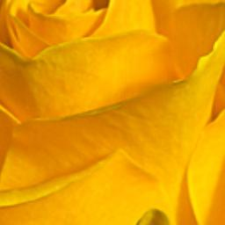
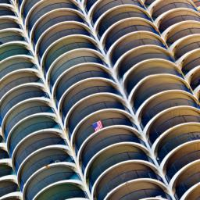
Out of distribution
Input Image
Gated Conv
EdgeConnect
AdaFill (Ours)
Gated Conv : YU, Jiahui, et al. “Free-Form Image Inpainting with Gated Convolution” (ICCV 2019)
Edgeconnect : K Nazeri, et al. “Edgeconnect Generative image inpainting with adversarial edge learning” (Arxiv, preprint 2019)

Slide 7
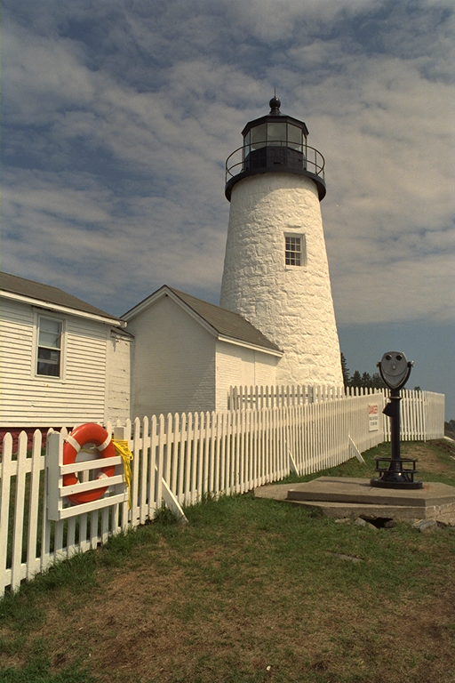
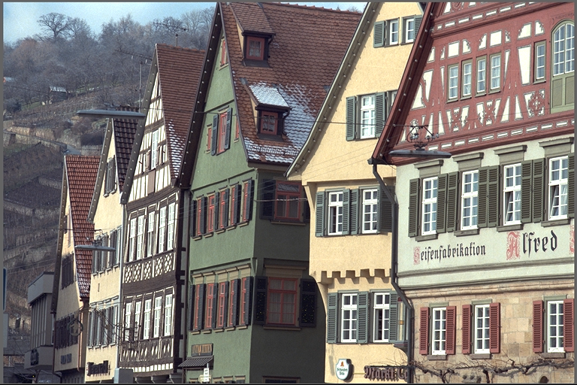
Having Only a Single Test Image
Internal Similarity

Slide 8
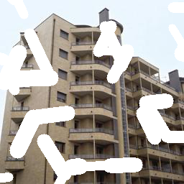
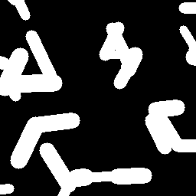
Proposed Method
What we only have …
Pretrained Inpainting Network
Random Mask Generating Algorithm
$$+$$
$$x_{d}$$
$$M_{p}$$

Slide 9
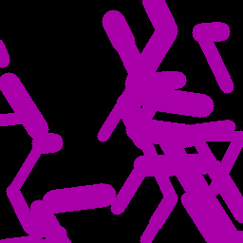
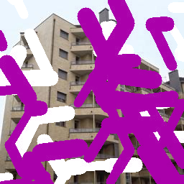
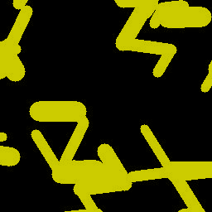
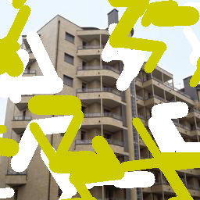
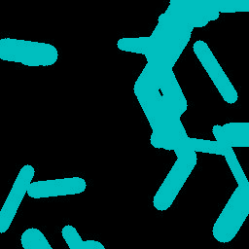
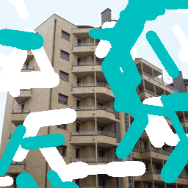
Proposed Method
Training
$$+$$
$$=$$
$$x_{d}$$
$$M_{c_{i=0, 1, 2, …}}$$
$$x_{dd_{i=0, 1, 2, …}^{′}}$$

Slide 10
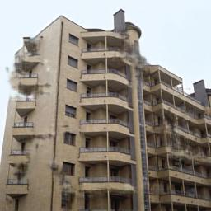
Proposed Method
Training
$$G$$
$$[x_{dd_{i=0, 1, 2, …}^{′}},M_{c_{i=0, 1, 2, …}}]$$
$$\overline{x}$$

Slide 11
Proposed Method
Training
$$+$$
$$=$$
$$\overline{x}$$
$$M_{p}$$
$${\overline{x}}_{d}$$

Slide 12
Proposed Method
Training
L1 Loss
$$x_{d}$$
$${\overline{x}}_{d}$$

Slide 13
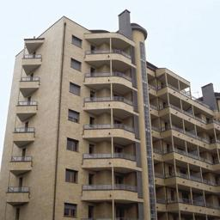
Proposed Method
Inference
$$G$$
$$[x_{d},M_{p}]$$
$$\hat{x}$$

Slide 14
Proposed Method
Network
Network G
BN: Batch Normalization
Conv-BN-ReLU
3x3, 64, h, w
ResBlk: Residual Block
Conv-BN-ReLU
3x3, 128, h/2, w/2
NN: Nearest Neighbor 2x Upsampling
Conv
3x3, 256, h/4, w/4
1000 iteration
ResBlk x 8
Pretrained using Places365 dataset
BN-ReLU
NN-Conv-BN-ReLU
3x3, 128, h/2, w/2
NN-Conv-BN-ReLU
3x3, 64, h, w
Conv-Tanh
3x3, 3, h, w

Slide 15
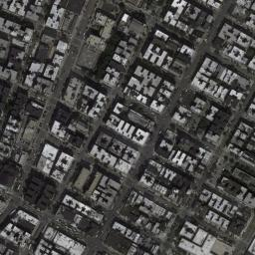
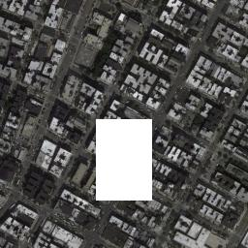
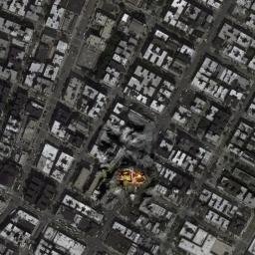
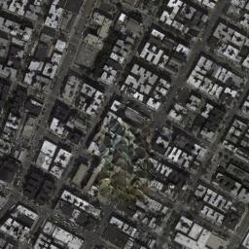
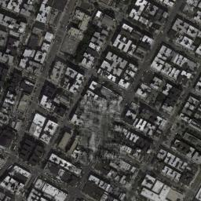
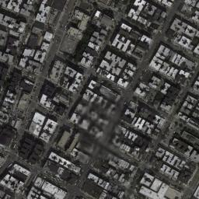
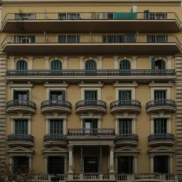
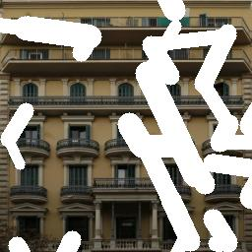
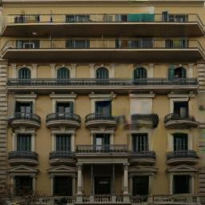
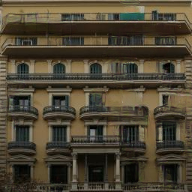
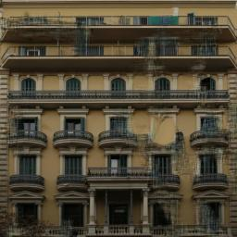
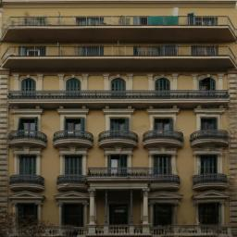
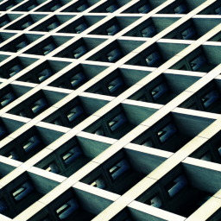
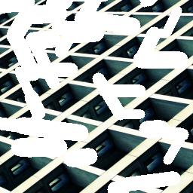
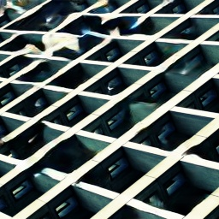
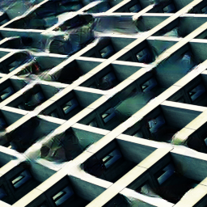
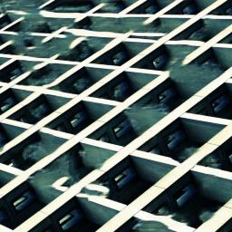
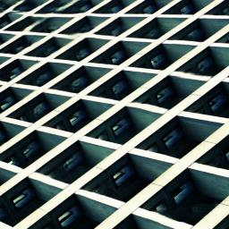
Experimental Results
Qualitative Results
GT
Input
Gated Conv
EdgeConnect
DIP
AdaFill (Ours)

Slide 16
Experimental Results
Qualitative Results
GT
Input
Gated Conv
EdgeConnect
DIP
AdaFill (Ours)

Slide 17
Experimental Results
Quantitative Results
Gated Conv : YU, Jiahui, et al. “Free-Form Image Inpainting with Gated Convolution” (ICCV 2019)
Edgeconnect : K Nazeri, et al. “Edgeconnect Generative image inpainting with adversarial edge learning” (Arxiv, preprint 2019)
DIP : Ulyanov, et al. “Deep image prior” (CVPR 2018)

Slide 18
Thank you for listening
Email: chajin@yonsei.ac.kr
Source code: https://github.com/ChajinShin/AdaFill-Image_Inpainting

