Slide 1
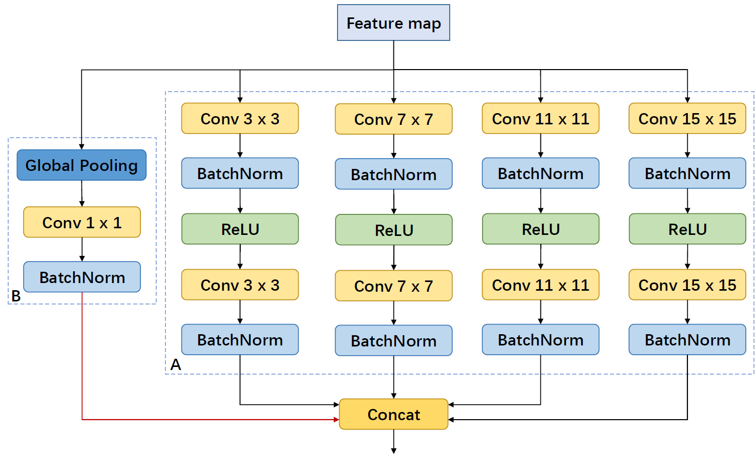
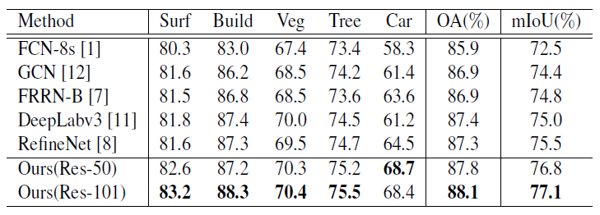
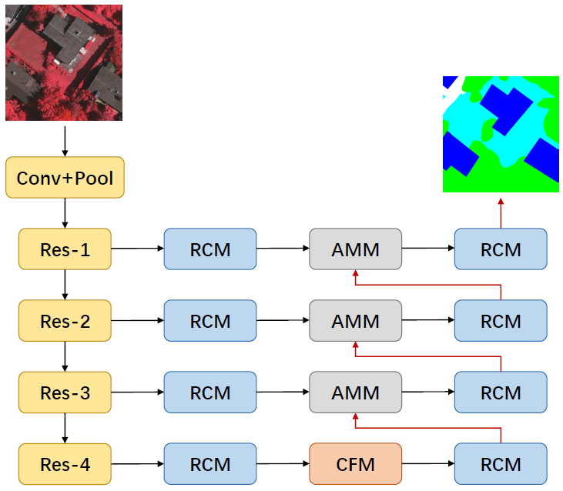
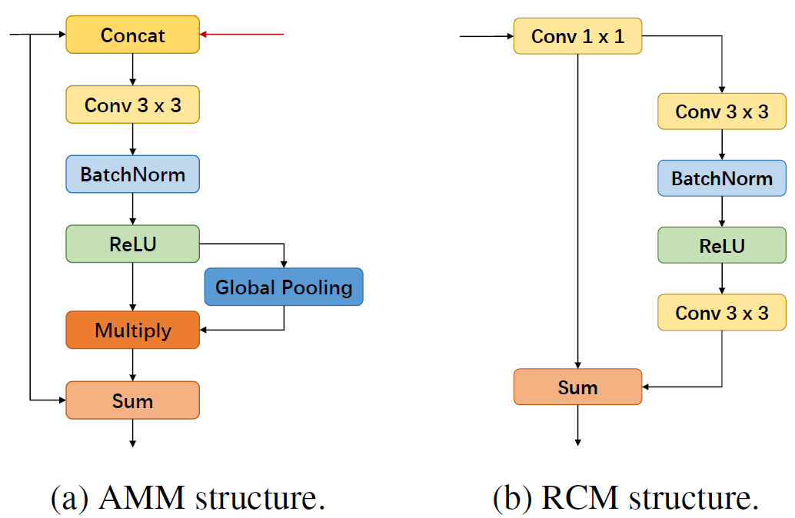
CONTEXT AGGREGATION NETWORK FOR SEMANTIC LABELING IN AERIAL IMAGES
Wensheng Cheng, Wen Yang, Youqi Pan, Haowen Guo, Yu Cheng
School of Electronic Information, Wuhan University, Wuhan 430072, China
Introduction
MODULEs
METHODS
FCN builds an end-to-end model to output a feature map directly and gets promising results. Although it achieves much better performance than other models, there exists two limitations. Firstly, the feature map size is greatly reduced due to consecutive downsampling operations, so the final feature map is coarse. Secondly, it uses features extracted by backbone network directly, without exploiting features efficiently and lacking the ability to capture multiscale features. Hence, for objects with multiple scales, it can’t recognize them well. This problem is severer in aerial images due to the large scale variations and complex scenes.
Fig. 2 shows Context Fuse Module(CFM) structure, and Fig. 3 presents Attention Mix Module(AMM) and Residual Convolutional Module(RCM) structure.
We propose Context Aggregation Network for semantic labeling in aerial images. This network adopts encoder-decoder architecture with skip connections. We adopt ResNet as the backbone network. Context Fuse Module is added to the last convolutional layer of ResNet to exploit multi-scale features more efficiently. Attention Mix Module is applied to fuse different level features with channel attention mechanism. Residual Convolutional Module is used to further refine features and get more accurate result.
EXPERIMENTS
Architecture
Results on ISPRS dataset(class IoU, OA, mIoU). Surf: impervious surface. Build: buildings. Veg: ow vegetation. OA: Overall pixel classification accuracy.
Fig.1 shows proposed Context Aggregation Network architecture, based on Context Fuse Module(CFM), Attention Mix Module(AMM) and Residual Convolutional Module(RCM).
Fig.2 Context Fuse Module(CFM).
CONTRIBUTION
In summary, our contributions are:
We design a Context Fuse Module to aggregate context information, propose an Attention Mix Module to combine multi-level features, and employ a Residual Convolutional Module to further refine features.
Based on these models, we propose a Context Aggregation Network for semantic labeling in aerial images. Experiments on the large-scale ISPRS Vaihingen 2D Semantic Labeling Challenge dataset demonstrate the effectiveness of our proposed modules.
Fig.1 Context Aggregation Network.
Fig.3 AMM and RCM architecture.

