Slide 1
Exploring Pre-training with Alignments for
RNN Transducer based End-to-End Speech Recognition
Hu Hu^{1,2}, Rui Zhao¹, Jinyu Li¹, Liang Lu¹, Yifan Gong¹
¹Microsoft Speech and Language Group, Redmond, WA, USA
²Georgia Institute of Technology, Atlanta, GA, USA

Slide 2
Overview
RNN Transducer
RNN-T Pre-training with Alignments
Encoder pre-training
Whole network pre-training
Experiments
Evaluation on 3,400-hour Cortana dataset
Evaluation on very large scale 65,000-hour production dataset
Analysis and Conclusions

Slide 3
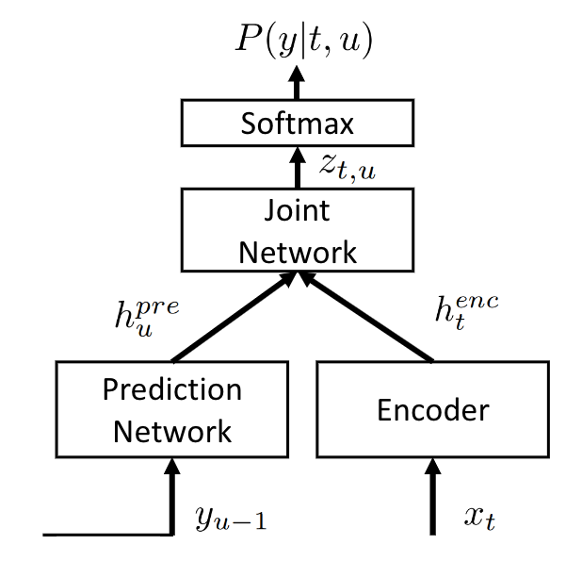
RNN Transducer (RNN-T) model review
An extension of CTC model
Remove output independence assumption of CTC by introducing the prediction network.
Combine AM and LM
Encoder is like AM: the input is the acoustic features.
Prediction network is like LM: the input is the previous non-blank output labels.
Good at online streaming speech recognition.
But very difficult to train, due to its complicated model structure and the synchronous decoding constraint.
RNN Transducer Model

Slide 4
RNN-T Pre-training
To train RNN-T model well, pre-training is a common solution to leverage the training difficulties.
A widely used pre-training approach:
Use well-trained CTC model to initialize the encoder, and a well-trained RNN based language model to initialize the prediction network.
However, the output of CTC is a series of spikes, separated by the <blank>.
We proposed two different pre-training approaches with the use of alignment information:
Encoder pre-training.
Whole network pre-training.

Slide 5
RNN-T Pre-training Strategy 1: Encoder Pre-training
Only pre-train the encoder, the other parts are randomly initialized.
Using external alignments information to train a classification model at first. The cross entropy (CE) criterion is used here.
The pre-trained encoder model without the last layer is used to initialize the encoder in RNN-T.
RNN-T
training
CE
training
Joint
Network
Encoder
Prediction
Network
RNN-T model

Slide 6
RNN-T Pre-training Strategy 2: Whole Network Pre-training
Three-dimension output tensor of RNN-T
frame # X output tokens # X label dimension.
Initialize both the encoder and prediction network at the same time
Different from the traditional AM training.
2-dimension output vs. 3-dimension output.
Need to carefully design the corresponding label tensor from alignments.
We proposed three different methods to design the three-dimension label tensor
?
CE training
CE pre-training
AM
RNNT

Slide 7
RNN-T Pre-training Strategy 2: Whole Network Pre-training (Cont’d)
A | A | A | B | B | s | C | C
A | A | A | B | B | s | C | C
A | A | A | B | B | s | C | C
A | A | A | B | B | s | C | C
ф | ф | ф | ф | ф | ф | ф | ф
Example utterance: ‘A B <space> C ’
Alignment: ‘A A A B B <space> C C ’ (8 frames)
‘ф’ means <blank>
y1
y1 (all align):
Set all output target grids to the one-hot vector corresponding to its alignments.
Ignore the output token level information.
y2 (correct decoding):
Consider decoding process.
Can get correct inference results if directly do decoding on y2. (decoding path shows)
y3 (align path - sp blank)
Keep no-blank part of y2, to solve the ‘<blank> dominating’ problem.
Set short-pause (<space> less than 3 frames) to <blank>.
A | A | A
ф | ф | ф | B | B
 |  |  | ф | ф | s
 |  |  |  |  | ф | C | C
 |  |  |  |  |  | ф | ф
y2
A | A | A
 |  |  | B | B
 |  |  |  |  | s/ф
 |  |  |  |  |  | C | C
y3

Slide 8
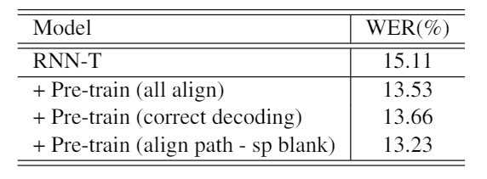
Experiments
We tested our approaches on two datasets
3,400-hour Cortana dataset
65,000-hour Microsoft Production dataset
Results on 3,400-hour Cortana dataset
Encoder pre-training achieves 28% relative word error rate reduction than training from the scratch.
Whole network pre-training achieves 10%-12% relative word error rate reduction than training from the scratch.
Encoder pre-training shows better performance than whole network pre-training.
Encoder Pre-training
Whole network Pre-training

Slide 9
Experiments (Cont’d)
Results on 65,000-hour Microsoft Production dataset
Encoder pre-training achieves
10% relative word error rate reduction than training from the scratch.
8% relative word error rate reduction than widely used CTC-RNNLM pre-training approach.

Slide 10
Time Latency Analysis
RNN-T models have alignment time-delay compared with the ground truth. (avg delay = 9)
The proposed pre-training strategies significantly reduce the time latency during the evaluation stage.
Encoder pre-training: reduce from 9 to 6.
Whole network pre-training: reduce from 9 to 5.
Distribution of output word-piece time discrepancy

Slide 11
Conclusions
Training RNN-T model from the scratch does not lead to the best optimization point. Good pre-training can significantly improve the performance of RNN-T model.
Our proposed approaches have advantages over other methods
On Cortana dataset (3,400 hours):
28% relative word error rate reduction by encoder pre-training than training from the scratch.
12% relative word error rate reduction by whole network pre-training then training from the scratch.
On very large scale production dataset (65,000 hours):
10% word error rate reduction than training from the scratch.
8% word error rate reduction than widely used CTC-RNNLM pre-training approach.
Significantly reduce the RNN-T model time latency.

Slide 12
Thank you!

