Slide 1
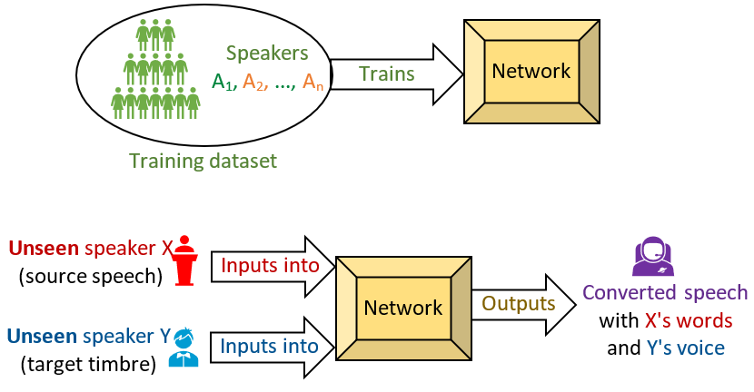
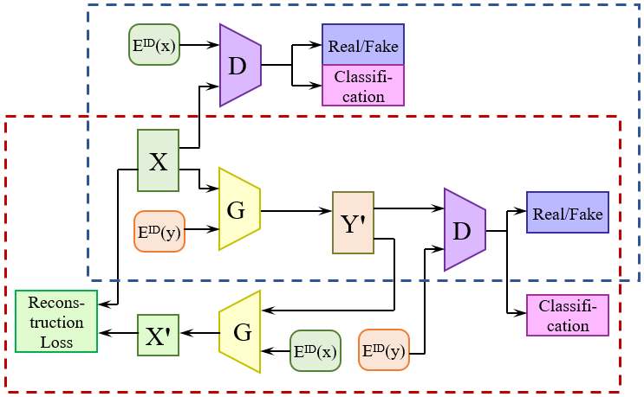
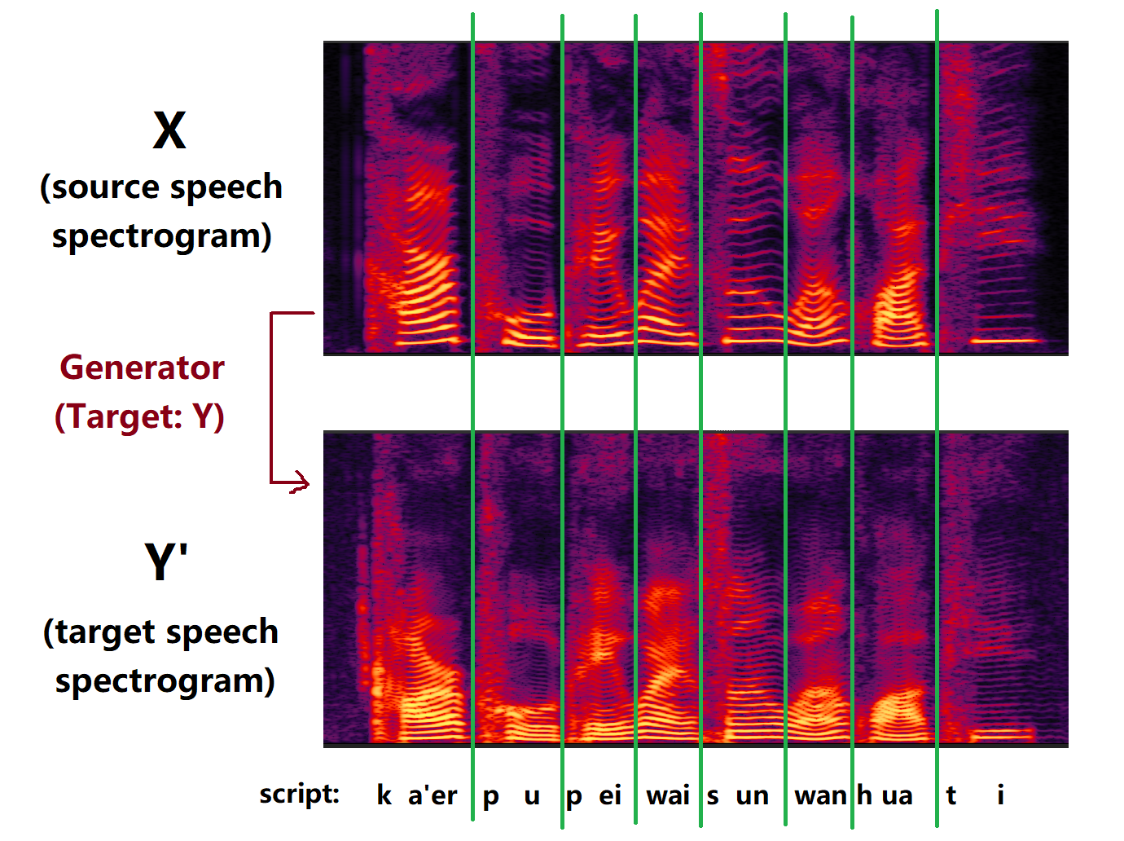
ONE-SHOT VOICE CONVERSION USING STAR-GAN
Ruobai Wang, Yu Ding, Lincheng Li, Changjie Fan
Netease FuXi AI Lab, Hangzhou, China
{wangruobai, dingyu01, lilincheng, fanchangjie}@corp.netease.com
Fig. 1 One-shot voice conversion
Abstract
We propose a one-shot voice conversion method that converts timbres of speech from or to unseen speakers. The network can be trained with multilingual speech dataset without text. Its voice quality is rated higher than StarGAN-VC baseline.
1. Introduction
Voice conversion (VC) is a technique that converts the speaker’s timbre (acoustic features) of a speech to another person’s, without changing the words the speaker said.
2. Network Structure
The pipeline of our StarGAN-based voice conversion system is described in Fig. 2.
The generator and discriminator are trained in turn.
The upper part (blue block) shows the training process of D with G fixed. D is expected to classify the original spectrogram X as real and spoken by speaker X, while the generated spectrogram Y’ as fake.
The lower part (red block) shows the training process of G with D fixed. G is expected to generate a spectrogram Y’ that makes D classify it as real and spoken by speaker Y, and reconstruct a spectrogram X’ which is as close to X as possible.
3. Main Contributions
Supporting unseen speakers
We use GST (global style token) network to embed the timbre of speakers. We train the GST network to generate one-hot vectors for the speakers in the dataset. Therefore, for unseen speakers, the embedding vector can be regarded as a linear combination of timbres in the dataset.
Improvements on StarGAN-VC network
We changed the bottleneck layer of the generator from 5-channel Conv2D layer to a Softmax layer, which helps converting the position of formants. We also used 96-point spectral envelope instead of 36-point MFCC to reduce the noise.
4. Experimental Results
Our proposed method has outperformed StarGAN-VC, which in our experiment is the most stable state-of-the-art non-ASR VC methods.
Results of MOS test:
Reconstruction Quality: Our method > StarGAN-VC Baseline
Conversion Quality:
Our method (convert to speakers in training set) > Baseline
Our method (cross-gender, one-shot conversion) > Baseline
Our method (same-gender, one-shot conversion) ≈ Baseline
(notice that StarGAN-VC baseline always converts to a seen speaker)
Fig. 2 Flow chart of our VC network
G is the generator, and D is the discriminator of GAN.
X is the spectrogram of speech spoken by x.
E^{ID}(x) is the embedding of speaker x.
X’ and Y’ are spectrograms converted towards timbre x and y.
Fig. 3 Spectrogram example of VC network
StarGAN-based VC methods preserves the prosody of speech.
The time alignment of phonemes does not change, while F0 and formants are converted.

Slide 2
ONE-SHOT VOICE CONVERSION USING STAR-GAN
Ruobai Wang, et. al.
Fig. 1 One-shot voice conversion
Fig. 3 Spectrogram example of VC network
StarGAN-based VC methods preserves the prosody of speech.
The time alignment of phonemes does not change, while F0 and formants are converted.
Abstract
We propose a one-shot voice conversion method that converts timbres of speech from or to unseen speakers. The network can be trained with multilingual speech dataset without text. Its voice quality is rated higher than StarGAN-VC baseline.
1. Introduction
Voice conversion (VC) is a technique that converts the speaker’s timbre (acoustic features) of a speech to another person’s, without changing the words the speaker said.

Slide 3
ONE-SHOT VOICE CONVERSION USING STAR-GAN
Ruobai Wang, et. al.
2. Network Structure
The pipeline of our StarGAN-based voice conversion system is described in Fig. 2.
The generator and discriminator are trained in turn.
The upper part (blue block) shows the training process of D with G fixed. D is expected to classify the original spectrogram X as real and spoken by speaker X, while the generated spectrogram Y’ as fake.
The lower part (red block) shows the training process of G with D fixed. G is expected to generate a spectrogram Y’ that makes D classify it as real and spoken by speaker Y, and reconstruct a spectrogram X’ which is as close to X as possible.
Fig. 2 Flow chart of our VC network
G is the generator, and D is the discriminator of GAN.
X is the spectrogram of speech spoken by x.
E^{ID}(x) is the embedding of speaker x.
X’ and Y’ are spectrograms converted towards timbre x and y.

Slide 4
ONE-SHOT VOICE CONVERSION USING STAR-GAN
Ruobai Wang, et. al.
2. Network Structure
The pipeline of our StarGAN-based voice conversion system is described in Fig. 2.
The generator and discriminator are trained in turn.
The upper part (blue block) shows the training process of D with G fixed. D is expected to classify the original spectrogram X as real and spoken by speaker X, while the generated spectrogram Y’ as fake.
The lower part (red block) shows the training process of G with D fixed. G is expected to generate a spectrogram Y’ that makes D classify it as real and spoken by speaker Y, and reconstruct a spectrogram X’ which is as close to X as possible.
Fixed
Fig. 2 Flow chart of our VC network
G is the generator, and D is the discriminator of GAN.
X is the spectrogram of speech spoken by x.
E^{ID}(x) is the embedding of speaker x.
X’ and Y’ are spectrograms converted towards timbre x and y.

Slide 5
ONE-SHOT VOICE CONVERSION USING STAR-GAN
Ruobai Wang, et. al.
2. Network Structure
The pipeline of our StarGAN-based voice conversion system is described in Fig. 2.
The generator and discriminator are trained in turn.
The upper part (blue block) shows the training process of D with G fixed. D is expected to classify the original spectrogram X as real and spoken by speaker X, while the generated spectrogram Y’ as fake.
The lower part (red block) shows the training process of G with D fixed. G is expected to generate a spectrogram Y’ that makes D classify it as real and spoken by speaker Y, and reconstruct a spectrogram X’ which is as close to X as possible.
Fixed
Fig. 2 Flow chart of our VC network
G is the generator, and D is the discriminator of GAN.
X is the spectrogram of speech spoken by x.
E^{ID}(x) is the embedding of speaker x.
X’ and Y’ are spectrograms converted towards timbre x and y.

Slide 6
ONE-SHOT VOICE CONVERSION USING STAR-GAN
Ruobai Wang, et. al.
3. Main Contributions
Supporting unseen speakers
We use GST (global style token) network to embed the timbre of speakers. We train the GST network to generate one-hot vectors for the speakers in the dataset. Therefore, for unseen speakers, the embedding vector can be regarded as a linear combination of timbres in the dataset.
Improvements on StarGAN-VC network
We changed the bottleneck layer of the generator from 5-channel Conv2D layer to a Softmax layer, which helps converting the position of formants. We also used 96-point spectral envelope instead of 36-point MFCC to reduce the noise.
4. Experimental Results
Our proposed method has outperformed StarGAN-VC, which in our experiment is the most stable state-of-the-art non-ASR VC methods.
Results of MOS test:
Reconstruction Quality: Our method > StarGAN-VC Baseline
Conversion Quality:
Our method (convert to speakers in training set) > Baseline
Our method (cross-gender, one-shot conversion) > Baseline
Our method (same-gender, one-shot conversion) ≈ Baseline
(notice that StarGAN-VC baseline always converts to a seen speaker)

Slide 7
ONE-SHOT VOICE CONVERSION USING STAR-GAN
Ruobai Wang, et. al.
Demo: Converting to speakers of different gender and language
 | Source | Target | StarGAN-VC Baseline | In-dataset Conversion | One-shot Conversion | Script of source speech
Example 1 |  |  |  |  |  | Ka'erpu pei waisun wan huati.
Example 2 |  |  |  |  |  | Jiayucunyan bie zai yongbao wo.
Example 3 |  |  |  |  |  | Bao ma peigua bo luo an, Diaochan yuan zhen Dong weng ta.

