Slide 1
Applicability limitations of differentiable full-reference image-quality metrics
Maksim Siniukov, Dmitriy Kulikov, Dmitriy Vatolin
Video Group
Moscow State University, Graphics&Media Lab

Slide 2
Introduction
Full-reference image quality metrics are designed to mimic the subjective judgment of the human eye
Metrics are commonly used to evaluate the quality of compressed images and videos in such major areas as codec comparison
In this work we highlight the vulnerabilities of several popular metrics by proposing a method, designed to increase their values and make them inconsistent with subjective quality
M. Siniukov et al., “Applicability limitations of differentiable full-reference image-quality metrics,” in Abbreviated DCC, 2023
Notes:
Full-reference image quality metrics are commonly used to evaluate the quality of compressed images and videos in such major areas as codec comparison. In this work we highlights
the vulnerabilities of several popular metrics and propose an analysis of hacking detection properties of each metric

Slide 3
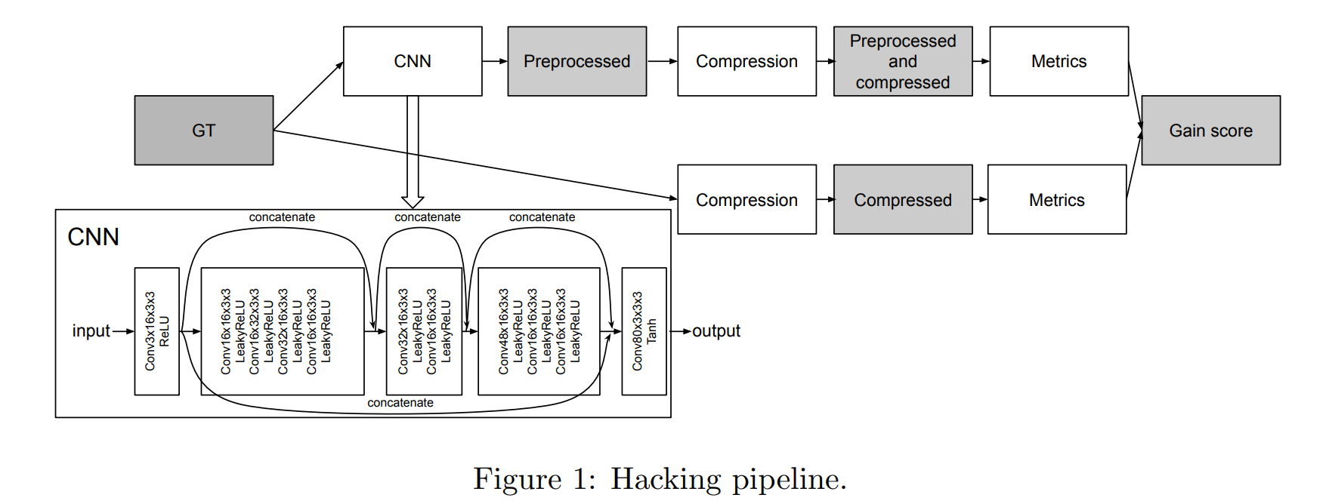
Proposed Method
To show the vulnerability we generate two images:
Compressed with DiffJPEG with no preprocessing
Preprocessed with one-for-all-images neural network and then compressed using DiffJPEG. Transformation is learned to increase metrics values
M. Siniukov et al., “Applicability limitations of differentiable full-reference image-quality metrics,” in Abbreviated DCC, 2023
Notes:
For each metric we created and trained a specialised Resnet-based neural net. This net was used as a preprocessing step before DiffJPEG. The resulting image was compared with an image, compressed with DiffJPEG with no preprocessing. If the metric value was higher for the preprocessed image, while subjective evaluations gave the opposite result - then the metric had a vulnerability

Slide 4
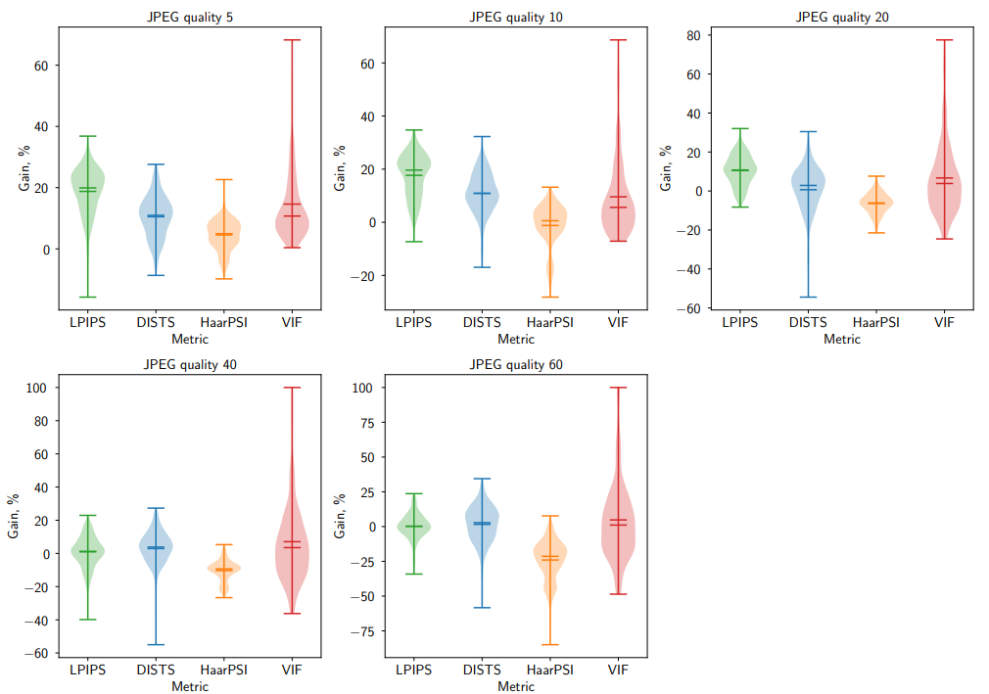
Results Gain
LPIPS, DISTS, HaarPSI, and VIF were proven to be vulnerable
Metrics-gain distribution
M. Siniukov et al., “Applicability limitations of differentiable full-reference image-quality metrics,” in Abbreviated DCC, 2023
Notes:
We applied our method to the wide range of quality factor values, ranging from 5 to 60. Our results indicate that LPIPS, DISTS, HaarPSI, and VIF are all vulnerable to hacking. Specifically, we were able to increase VIF values by up to 20%, making it the most vulnerable metric

Slide 5
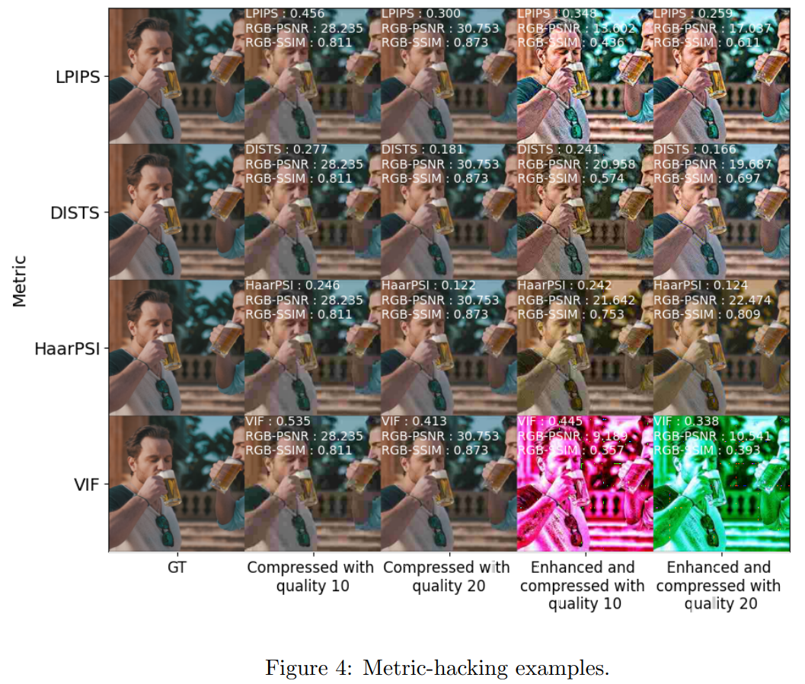
Results Hacking examples
Visual results of metrics hacking
M. Siniukov et al., “Applicability limitations of differentiable full-reference image-quality metrics,” in Abbreviated DCC, 2023
Notes:
Visual results of metric hacking. In case of HaarPSI and VIF hacking leads to significant drops in visual quality

Slide 6
Subjective Evaluation
Subjective scores are inconsistent with metrics values
 | metrics gain | subjective Bradley-Terry(TC / C) | hacked images percentage chosen as the best
 |  |  | by metric | by people
DISTS | 5.21% | 1.176/0.583 | 73.8% | 22.4%
LPIPS | 12.67% | 0.714/0.357 | 90% | 32.2%
HaarPSI | -1.03% | 1.367/0.683 | 57.5% | 17.9%
VIF | 12.54% | 3.857/1.929 | 76.3% | 1.3%
Subjective evaluation results
M. Siniukov et al., “Applicability limitations of differentiable full-reference image-quality metrics,” in Abbreviated DCC, 2023
Notes:
We conducted a subjective comparison to verify that metrics evaluate the generated image pairs differently from subjective human-perception scores. The results showed that participants preferred images that were not preprocessed, resulting in low correlation between MOS scores and the values for the examined metrics.
VIF was the worst in terms of correlation with subjective scores, while DISTS performed the best.

Slide 7
Practical Study
Models trained using DiffJPEG can be used in a more practical usecase of JPEG compression.
 | DISTS | LPIPS | HaarPSI | VIF
average gain | 6.31% | 18.94% | 2.03% | 20.4%
Transferability on real JPEG with quality set to 10
M. Siniukov et al., “Applicability limitations of differentiable full-reference image-quality metrics,” in Abbreviated DCC, 2023
Notes:
We ensured that models trained using DiffJPEG can serve in practice with real JPEG compression by checking that gain is still present .
In the future they can also become a part of specifically designed encoders(such as AV1) as a preprocessing step that yields higher metric scores when comparing JPEG encoders.

Slide 8
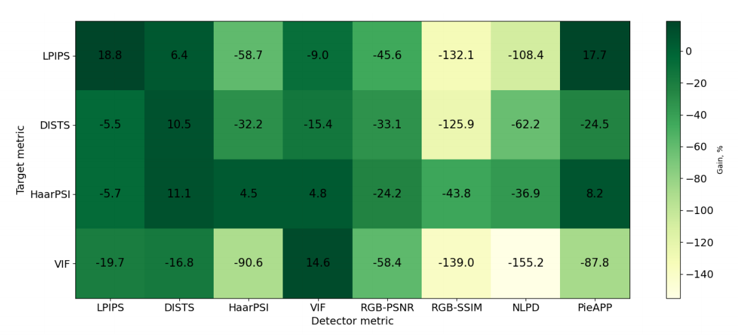
Hacking Generalization and Detection
We can reliably detect hacking using other metrics values
Hacking detection heatmap
M. Siniukov et al., “Applicability limitations of differentiable full-reference image-quality metrics,” in Abbreviated DCC, 2023
Notes:
Hacking detection can be implemented by comparing metric results to subjective evaluations. Other metric values may also reveal whether the target metric was hacked.
PSNR and SSIM were found to be the best hacking detectors.

Slide 9
Conclusion
Analyzed LPIPS, DISTS, HaarPSI, VIF metrics and discovered their vulnerabilities
Shown inconsistency between objective metrics and subjective quality
Verified the transferability of gain on real JPEG images
Proposed a method for image hacking detection
M. Siniukov et al., “Applicability limitations of differentiable full-reference image-quality metrics,” in Abbreviated DCC, 2023
Notes:
Analyzed LPIPS, DISTS, HaarPSI, VIF metrics and discovered their vulnerabilities
Shown inconsistency between objective metrics and subjective quality
Verified the transferability of gain on real JPEG images
Proposed a method for image hacking detection

