Slide 1
TokenMotion: Motion-Guided Vision Transformer For Video Camouflaged Object Detection Via Learnable Token Selection
15 April 2024
Zifan Yu, Erfan Bank Tavakoli, Meida Chen, Suya You, Raghuveer Rao, Sanjeev Agarwal, Fengbo Ren

Slide 2
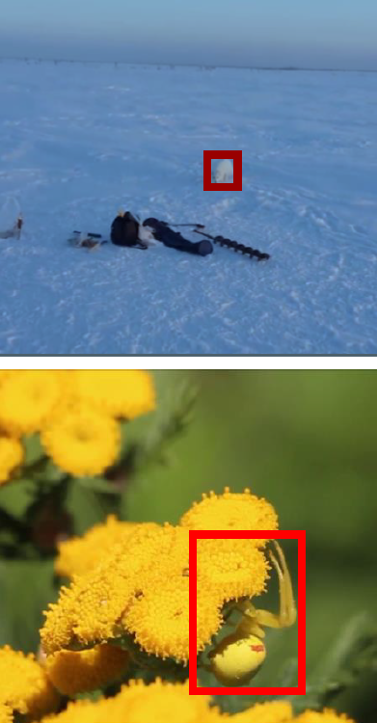
Introduction: COD, VCOD
Camouflaged Object Detection (COD) is a challenging task in computer vision since the target objects have similar and indistinguishable color/texture information from their surrounding environments
Video Camouflaged Object Detection (VCOD) is more challenging as a result of irregular motion patterns of the camera and objects in videos
Notes:
Camouflage object detection is a troublesome task for computer vision since the target objects have similar and indistinguishable texture information from their surrounding environment. The irregular motion patterns of the camera and objects in videos make VOD more challenging. （the upper image is a fox and the bottom image is a spider）

Slide 3
Existing works of VCOD
Optical Flow based methods: Explicit estimation of optical flows as motion estimation:
inaccurate
error is accumulated over the time
Feature based methods: Implicit estimation of motion by calculating the correlation of image features:
inaccurate and blurred segmentation of the edges/boundary of target objects
noise introduced by surrounding non-target moving objects
Notes:
VCOD remains an uncharted task due to its challenges, and there has been very limited work on VCOD in the literature. Some of them explicitly estimate optical flows as input, where the estimation may not be accurate, and its error is accumulated over the final object segmentation. SLTNet implicitly estimates motion by calculating the correlation of features extracted from neighbor frames, where the visual features of neighbor frames are extracted individually. This results in inaccurate and blurred segmentation of the edges/boundary of target objects, and noise introduced by surrounding non-target objects heavily deteriorates the prediction results.

Slide 4
developed Approach: TMnet
This work presents a simple, yet efficient ML transformer-based VCOD model named “TMNet” (TokenMotion)
Learnable token selection to extract motion-guided features consisting of texture and motion features
A Token Selection Module (TSM), which is fully differentiable via a reparameterization method
Joint training with pixel location-aware segmentation loss
Task-wise tokens carry discrimination information for the decoder as well as inter-frame motion guidance for feature extraction inside the encoder
Notes:
This work presents a simple, yet efficient ML transformer-based VCOD model named “TMNet” (TokenMotion), which includes learnable token selection to extract motion-guided features consisting of texture and motion features. A token selection module, which is full differentiable via reparameterization method. Joint training with pixel lcation-aware segmentation loss. Task-wise tokens carry discrimintation information for the decoder as well as inter-frame motion guidance for feature extraction inside the encoder.

Slide 5
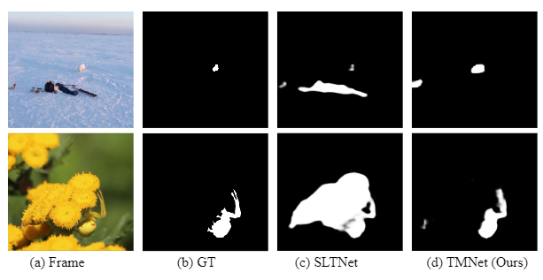
Example results
Compared to SOTA method SLTNet, our method TMNet outperforms the SOTA with clearer boundaries of objects and less noise from surrounding objects
Notes:
Compared to SOTA method SLTNet, our method TMNet outperforms the SOTA with clearer boundaries of objects and less noise from surrounding objects

Slide 6
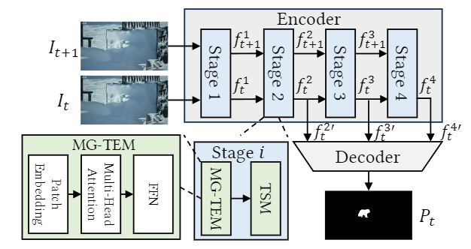
Methodology: Pipeline:
Pipeline:
A motion-guided ML transformer-based encoder and a neighbor connection decoder
Encoder extracts features in four stages, and each stage includes a Motion-Guided Token Extraction Module (MG-TEM), and a Token Selection Module (TSM)
Notes:
Our TMNet contains a motion-guided ML transformer-based encoder and a neighbor connection decoder, a neighbor connection decoder. Encoder extracts features in four stages, and each stage includes a motion-guided token extraction module (MG-TEM), and a Token Selection Module(TSM).

Slide 7
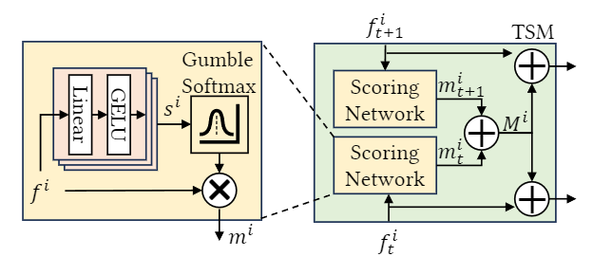
Methodology: TSM
Token Selection Module (TSM):
Verified Hypothesis: inactivating unimportant tokens has no effect on the performance of the final tasks[1].
Existing work: using a scoring layer to estimate the importance of each token and replace the unimportant tokens with scores under a certain threshold with the corresponding tokens in another modality stream
Problems: the threshold-based scoring function is not differentiable for training, and this structure fails to truly learn task-wise important tokens
[1]Yikai Wang, Xinghao Chen, Lele Cao, Wenbing Huang, Fuchun Sun, and Yunhe Wang, “Multimodal token fusion for vision transformers,” in 2022 CVPR.
Notes:
Our TSM is based on hypothesis: the motion between frames can be well presented by important tokens. Some existing work has proven that: unimportant tokens has no effect on the performance of the final tasks. Existing work using a scoring layer to estimate the importance of token and select the important tokens by a threshold-based scoring function， which is not fully differentiable

Slide 8
Methodology: TSM (con.)
Token Selection Module (TSM):
Scoring Network: includes a stack of linear layers, each linear layer is followed by a Gaussian Error Linear Unit (GELU) layer
Two numbers are used for each of the N tokens to denote the probability of being sampled as 0 or 1
The binary selection mask is generated by sampling a Bernoulli distribution
Notes:
The scoring network mute the unimportant tokens and keep the important tokens. Gumble softmax help doing reparameterization to make the process fully differentiable.

Slide 9
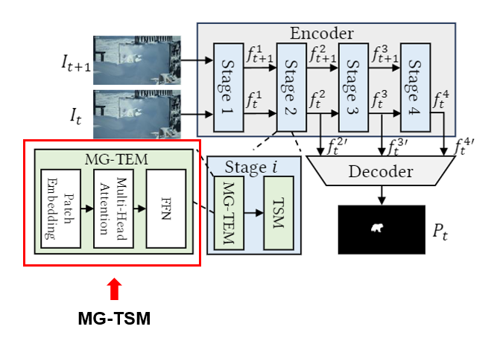
Methodology: mg-tEm
Motion-Guided Token Extraction Module (MG-TEM)
Hypothesis: the motion information from the frame is preserved in its corresponding masked tokens
Motion-wise feature or motion information is the implicit variation of texture and intensity on target objects caused by object or camera motion instead of traditional motion information like optical flow
Notes:
Our hypothesis is the motion information from the frame is preserved in its corresponding masked tokens. We define that Motion-wise feature or motion information is the implicit variation of texture and intensity on target objects caused by object or camera motion instead of traditional motion information like optical flow. Get the motion involved between frames by selecting important tokens, and supervised by segmentation loss.

Slide 10
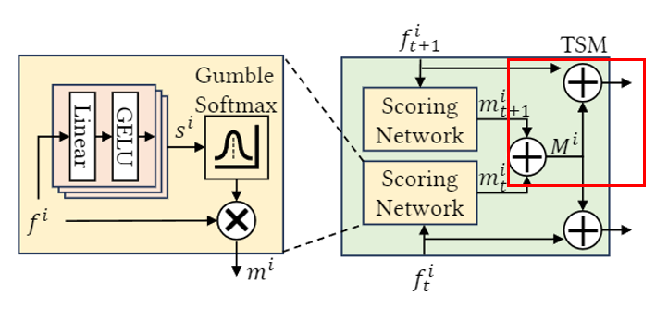
Methodology: MG-TEM (con.)
Motion-Guided Token Extraction Module (MG-TEM)
Feature fusing: fusing texture features f with the masked tokens of the following neighbor frames by element-wise addition
Notes:
The texture features are fused together with masked tokens of neighbor frames and current frames as the input for the next stage by element-wise addition.

Slide 11
Methodology: decoder (con.)
CNN Decoder:
Neighbor Connection Decoder (NCD) is utilized to generate the prediction outputs[2]
NCD with group-reversal attention (GRA) is more dependable than a densely or short connection decoder, which fails to generate results with fine-grained object edges
Pixel location aware loss: weighted cross-entropy loss and weighted intersection-over-union loss increase the weight of hard detected pixels instead of treating every pixel equally
[2]Deng-Ping Fan, Ge-Peng Ji, Ming-Ming Cheng, and Ling Shao, “Concealed object detection, IEEE Transactions on Pattern Analysis and Machine Intelligence,
Notes:
CNN decoder: Neighbor Connection Decoder (NCD) is utilized to generate the prediction outputs.
NCD with group-reversal attention (GRA) is more dependable than a densely or short connection decoder, which fails to generate results with fine-grained object edges
Pixel location aware loss: weighted cross-entropy loss and weighted intersection-over-union loss increase the weight of hard detected pixels instead of treating every pixel equally
in this part, the decoder are same with SLTNet and SINetV2 but the SLTNet has two paralleled shared-weight decoder but we have one.

Slide 12
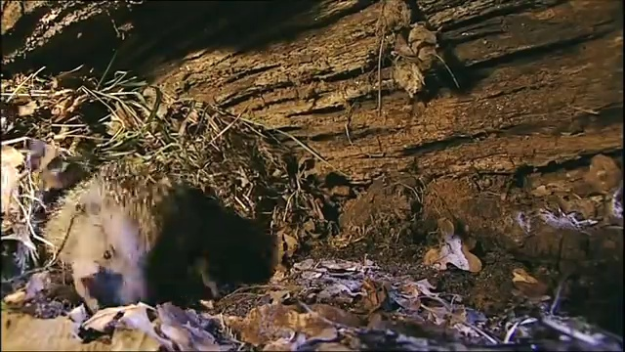
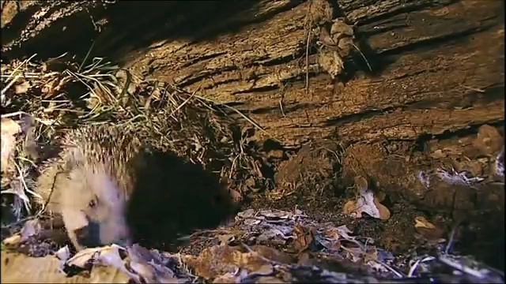
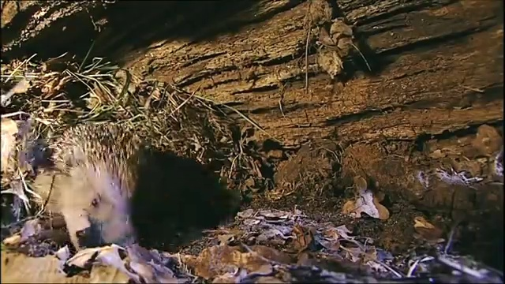
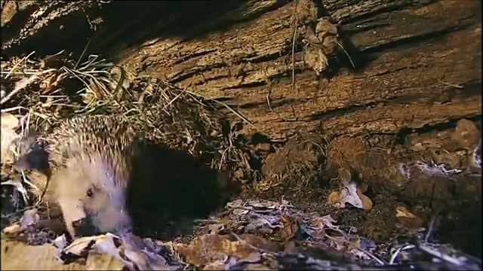
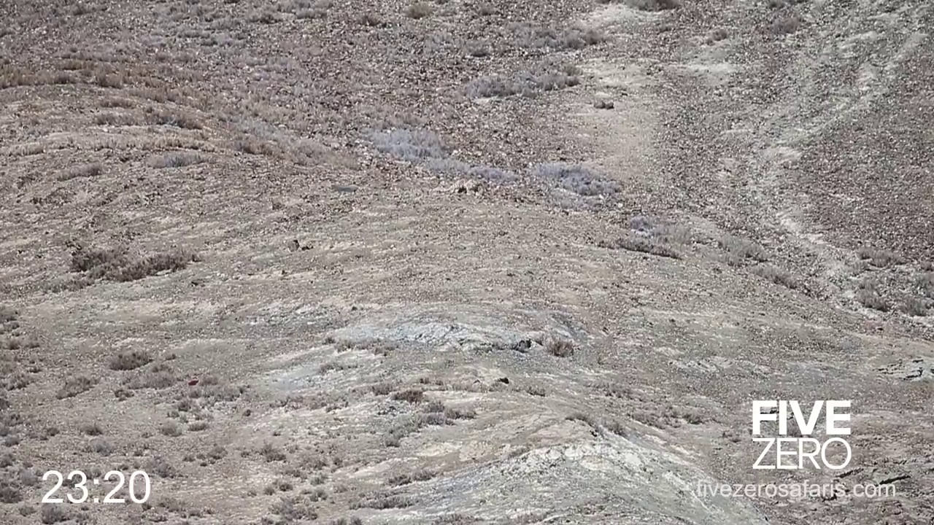
Experiments: Dataset
MoCA-Mask dataset:
87 video sequences. 16 sequences for testing.
The original MoCA dataset downsampled the videos every 5th frame.
Notes:
The original MoCA dataset downsampled the videos every 5th frames. SLTNet generates the pseudo labels for every frame in the training but for testing, it still utilize the downsampled frames. We followed the experiment settings. 71 video sequence are used for training, and 16 sequences for testing.

Slide 13
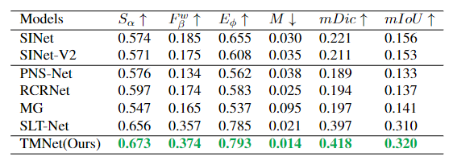
Experiments: results
Quantitative Results:
TMNet outperforms current state-of-the-art methods, especially by 1.7% on the S measure, 1.7% on the F measure, and 2.1% on mDic. (Up arrow means greater is better, and down arrow means lower is better)
Notes:
As a results of bug in our experiment code, we present the unexpected high numeric results in our original paper. After correcting the problem. Our method outperforms the state-of-the-art method, especially 1.7% on Smeasure, 1.7% on weight F measure, and 2.1% on mDic.

Slide 14
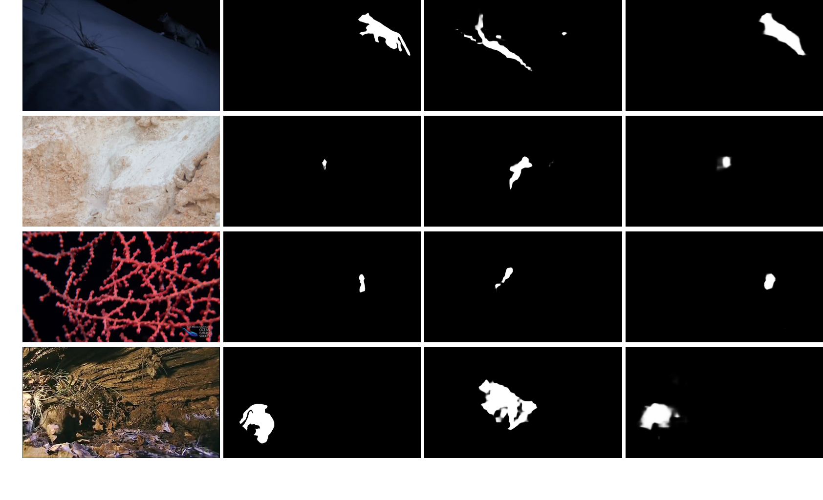
Experiments: results
Qualitative Results
Notes:
Our method retrieves camouflaged obects with clearer boundaries and accurate location.

Slide 15
Conclusions
Presents a simple, yet efficient VCOD method “TMNet” (TokenMotion)
Based on advanced ML transformer techniques
Learnable token selection to extract motion-guided features consisting of texture and motion features
A Token Selection Module (TSM), which is fully differentiable via a reparameterization method
Joint training with pixel location-aware segmentation loss
Task-wise tokens carry discrimination information for the decoder as well as inter-frame motion guidance for feature extraction inside the encoder
It outperforms the existing state-of-the-art methods by a 1.7% improvement in weighted F-measure, an 1.7% enhancement in S-measure, and a 2.1% boost in mean Dice.
Notes:
Presents a simple, yet efficient VCOD method “TMNet” (TokenMotion) via end-to-end token selection. It outperforms the existing state-of-the-art methods by a 1.7% improvement in weighted F-measure, an 1.7% enhancement in S-measure, and a 2.1% boost in mean Dice.

