Slide 1
SPARCOM Sparsity-based super-resolution correlation microscopy ICASSP 2017
Oren Solomon­¹, Maor Mutzafi², Yonina C. Eldar¹ and Mordechai Segev²
¹Electrical Engineering Department, Technion, Israel
²Physics Department and Solid State Institute, Technion, Israel

Slide 2
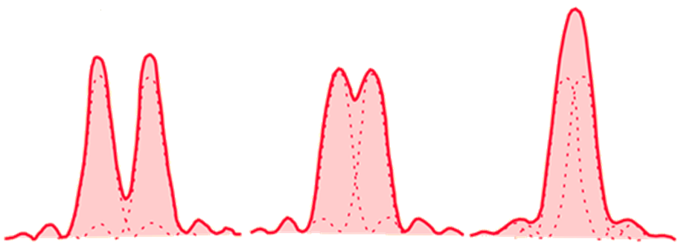
The Diffraction Limit
In diffractive optical imaging, spatial resolution is proportional to half the imaging wavelength:
$$DL=\frac{λ}{2NA}$$
Resolved
Resolution limit
Unresolved
Image taken from: http://hyperphysics.phy-astr.gsu.edu/hbase/phyopt/diflim.html
Image taken from: http://www.kurzweilai.net/the-nobel-prize-in-chemistry-2014-beyond-the-diffraction-limit-in-microscopy
Notes:
Diffraction limit is the smallest distance such that we can still distinguish between the point sources

Slide 3
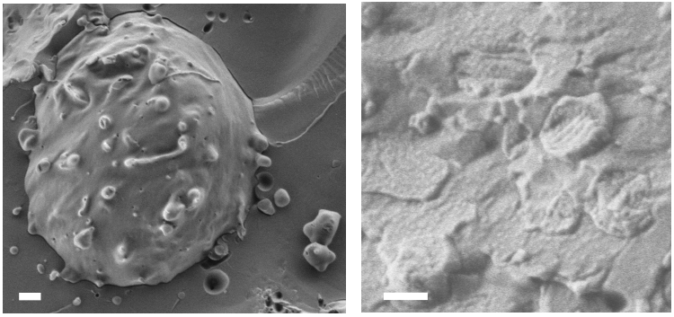
So, what can we do?
Use Cryo Electron Microscopy!
1$μm$
400nm
Life is dynamic! No dynamics in electron microscopy.
Images curtesy of the Yeshayahu Talmon‘s group, Technion, Israel

Slide 4
Outline
Super resolution fluorescence microscopy
Beating the diffraction limit
Super-resolution optical fluctuation imaging
SPARCOM: Sparsity-based super resolution correlation microscopy
Outline of the method
Super-resolution in correlation space
Results
Simulations
Experiments
Summary

Slide 5
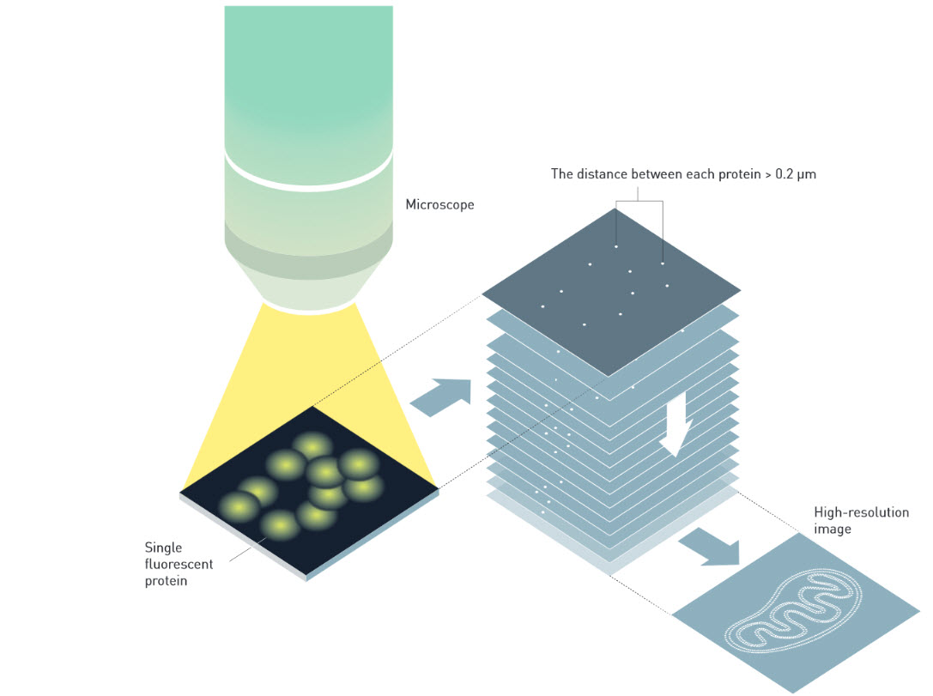
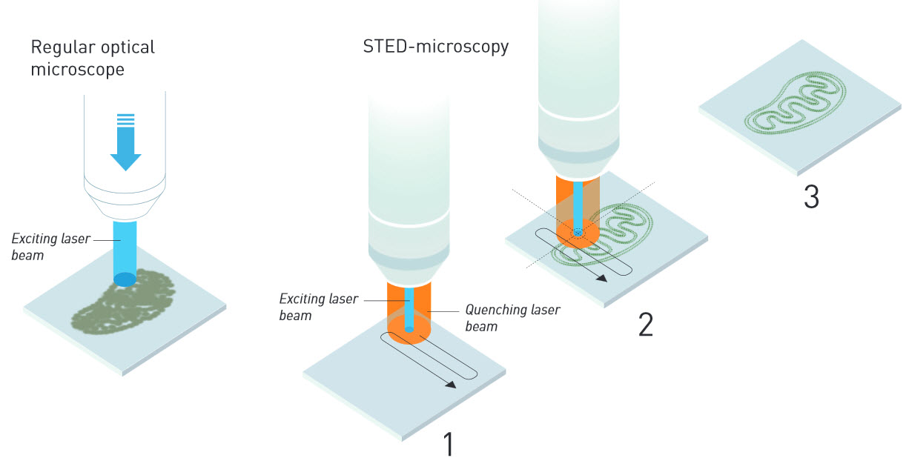
The solution (and Nobel Prize)
Super resolution in optical fluorescence microscopy
The imaged object is composed of point-emitters (fluorescent proteins)
Super-localization microscopy
E. Betzig et al., Science 313, 5793 (2006).
S. Hell et al., Optics Letters 19, 11 (1994).
M. J. Rust et al., Nat. Methods. 3, 10 (2006).
Images taken from: http://www.kurzweilai.net/the-nobel-prize-in-chemistry-2014-beyond-the-diffraction-limit-in-microscopy

Slide 6
Super Localization Microscopy
Key idea: Enforce structure
Devise a new measurement process – Each spot contains only a single emitter
Spatial resolution of ~20nm
Main limitation
Acquisition process requires > 10000 frames to collect all molecules correctly
Limited temporal resolution

Slide 7
Super Resolution Optical Fluctuation Imaging (SOFI)
T. Dertinger, et al. PNAS 106, 52 (2009)
Key idea:
Use temporal statistics to reduce PSF size and reject out-of-focus light
Point Spread Function (PSF) = Response of the optical system to a point source
Typical number of required frames: ~100 - 1000

Slide 8
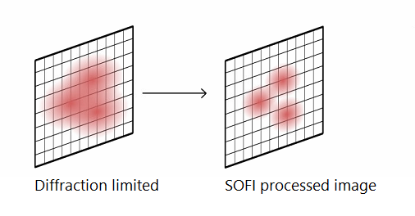
The SOFI principle
By allowing the emitters to overlap we can reduce the imaging cycle.
Basic signal model
$$J\left(r, t\right)=\sum_{k=1}^{L}{δ\left(r−rk\right)}sk(t)$$
Assuming spatially non-varying PSF, $u(r)$
$$I\left(r,t\right)=\sum_{k=1}^{L}{u\left(r−rk\right)}sk(t)$$
Statistical calculations for each pixel, e.g. temporal - correlations:
High order statistics require exponentially larger number of frames
Practical resolution enhancement over the diffraction limit by a factor of 2
$$G_{f}\left(r,0\right)=\sum_{k=1}^{L}{u^{2}\left(r−rk\right)}{G_{s}}_{k} (0)$$
Can we achieve temporal resolution similar to SOFI while improving its spatial resolution?

Slide 9
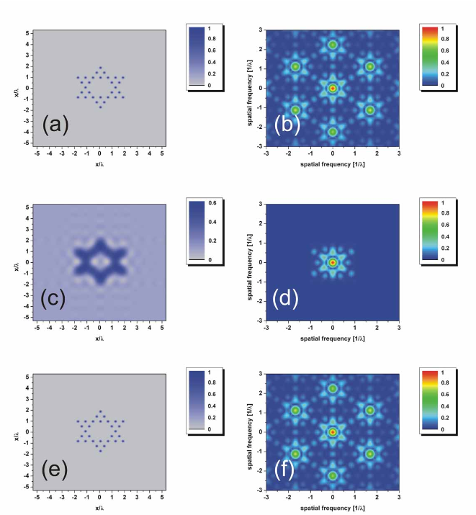
Origins of SPARCOM: Exploiting Structure in the Data
Collaboration between Yonina Eldar, Oren Cohen and Mordechai Segev from the Technion
Exploiting sparsity in data was demonstrated in several areas:
Coherent Diffraction Imaging
Ankylography
Ptychography
Exploiting sparsity leads to sub-diffraction reconstruction
By exploiting sparsity we overcome the loss of high frequencies and phase information
Gazit , et al. Opt. Express 17, 26 (2009)
Szameit, et al. Nat. Mater. 11, 5 (2012)
Mutzafi, et al. Nat. Commun. 6 (2015)
Sidorenko, et al. Nat. Commun. 6 (2015)
Oren, et al. Optica 3, 3 (2016)
Notes:
Intuition: Prior that the number of holes is small – sparsely distributed in the object High frequency content is lost due propagation = low pass filtering in space
Recovery of lost spectral content – ill posed problem By exploiting a sparsity regularizer – we condition the problem properly
Perform bandwidth extrapolation of lost high frequency content

Slide 10
SPARCOM: Sparsity-based Super Resolution Correlation Microscopy
Exploiting structure: Each image is composed of point emitters.
“Relax” the PALM/STORM condition for a single emitter per diffraction limited spot
Acquired signal model
$$I\left(r,t\right)=\sum_{k=1}^{L}{u\left(r−rk\right)}sk(t)$$
Signal model
$$y\left(t\right)=As(t)$$
$A$ is a known dictionary
Depends on PSF estimation from SOFI cross-correlations
$s(t)$ has only L non-zero elements and the rest are zero

Slide 11
Why use correlations?
Motivation
We are interested in the support of the emitters – recovery in correlation domain
Key concept – “Pushing the limits of sparse support recovery using correlation information”
Additional prior: Uncorrelated emissions of emitters
Maximum support recovery from measurements of length $m$
Single measurement vector (SMV) – $m/2$
Multiple measurement vectors (MMV) – $O(m)$
Uncorrelated entries – $O\left(m^{2}\right)$
Additional benefits
Robustness to noise
Robustness to constant background illumination
Reduced number of needed frames for image recovery
Pal, et al. IEEE TSP 63, 3 (2015)

Slide 12
Correlations in practice
Estimated correlation matrix of the data $y\left(t\right)$:
$$R_{y}=\frac{1}{T}\sum_{t=1}^{T}{(y_{t}−\overline{y_{t}}){(y_{t}−\overline{y_{t}})}^{H} }$$
In correlations space
$$Ry=ARsAH+N$$
Assuming uncorrelated emissions, i.e.
$$E\left\{sk\left(t\right)sl\left(t+τ\right)\right\}=0, k≠l, τ≥0$$
Consequence: $Rs$ is diagonal with an L-sparse diagonal, $rs$
Sparsity pattern is recovered in correlations space
Temporal average
Emitters autocorrelation matrix
Movie autocorrelation matrix
Noise

Slide 13
SPARCOM Algorithm
Reweighted LASSO minimization
$$\min_{r_{s}≥0}{λ||Wrs||1+\frac{1}{2}{\left\|Ry−\sum_{l=1}^{N2}{ala_{l}^{H}}r_{s}^{l}\right\|}_{F}^{2}}$$
$f\left(r_{s}\right)=\frac{1}{2}{\left\|Ry−\sum_{l=1}^{N2}{ala_{l}^{H}}r_{s}^{l}\right\|}_{F}^{2}$ - smooth and differentiable
Efficient implementation in the discrete Fourier domain
The final high-resolution image is reconstructed from the recovered variance values of $rs$

Slide 14
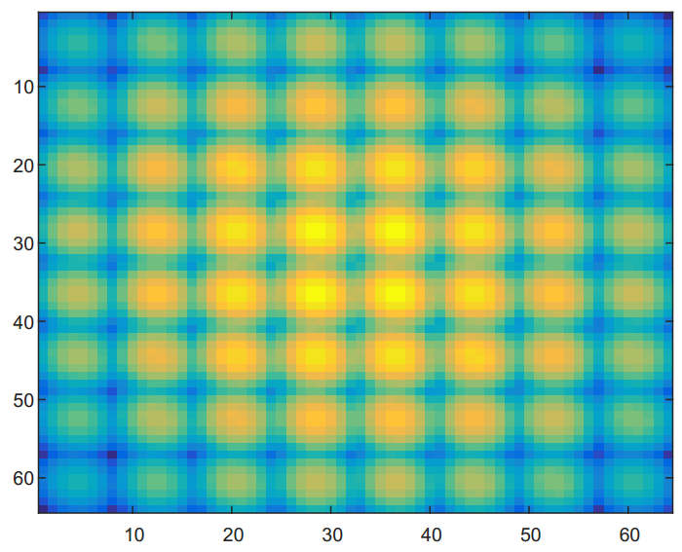
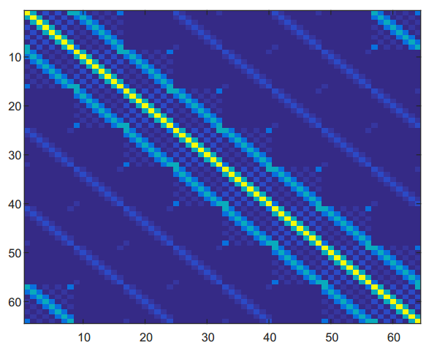
Efficient implementation
Moving to correlations – high numerical complexity.
Exploiting additional structure leads to numerically efficient algorithm
FISTA – gradient based convex minimization
$$∇f\left(x\right)={|A^{T}A|}^{2}x−diag\{{A_{}^{T}R}_{y}A\}$$
Gradient has unique matrix-vector multiplication structure in discrete Fourier domain
Matrix is Block Circulant with Circulant Blocks (BCCB)
Admits FFT based matrix-vector multiplication operations
Space domain, $|A^{T}A|^{2}$
Discrete Fourier domain, $|A^{T}A|^{2}$

Slide 15
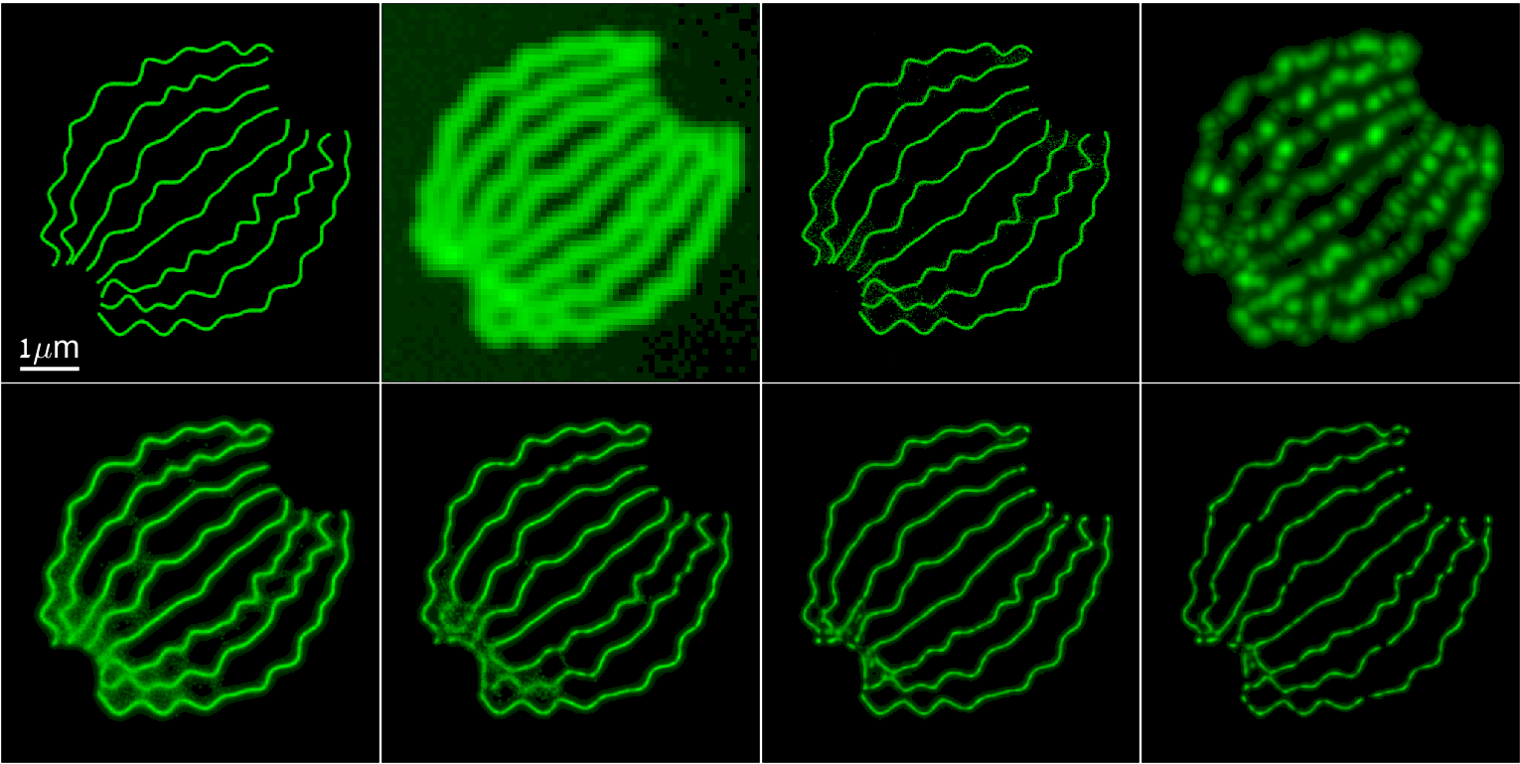
Results: Realistic Simulation
Data taken from: http://bigwww.epfl.ch/smlm/datasets/index.html
Ground truth
Diffraction limited
STORM 12000 F
SOFI XC4 361 F
FALCON 361 F
FALCON 60 F
SPARCOM 361 F
SPARCOM 60 F
FALCON: M. Junhong, et al. Scientific reports 4, 2014 (2014)

Slide 16
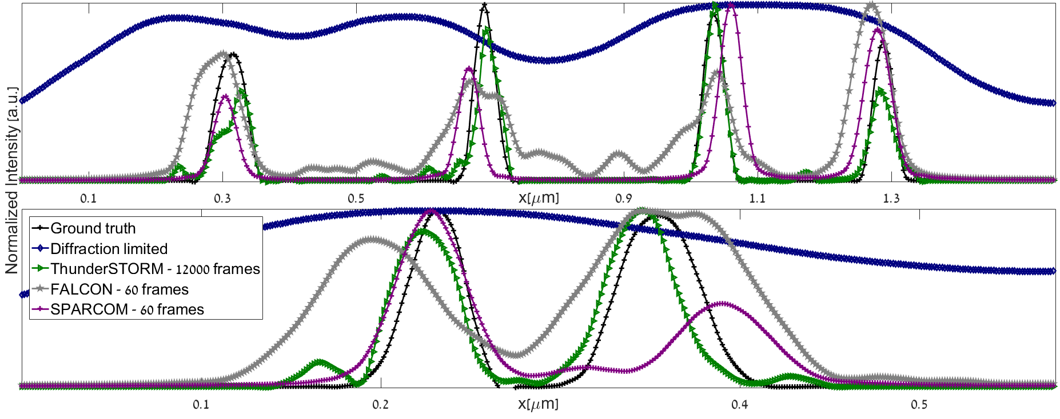
Intensity Profiles
$$122.4nm$$
$$162.7nm$$
Similar resolution to STORM – 200 times faster!

Slide 17
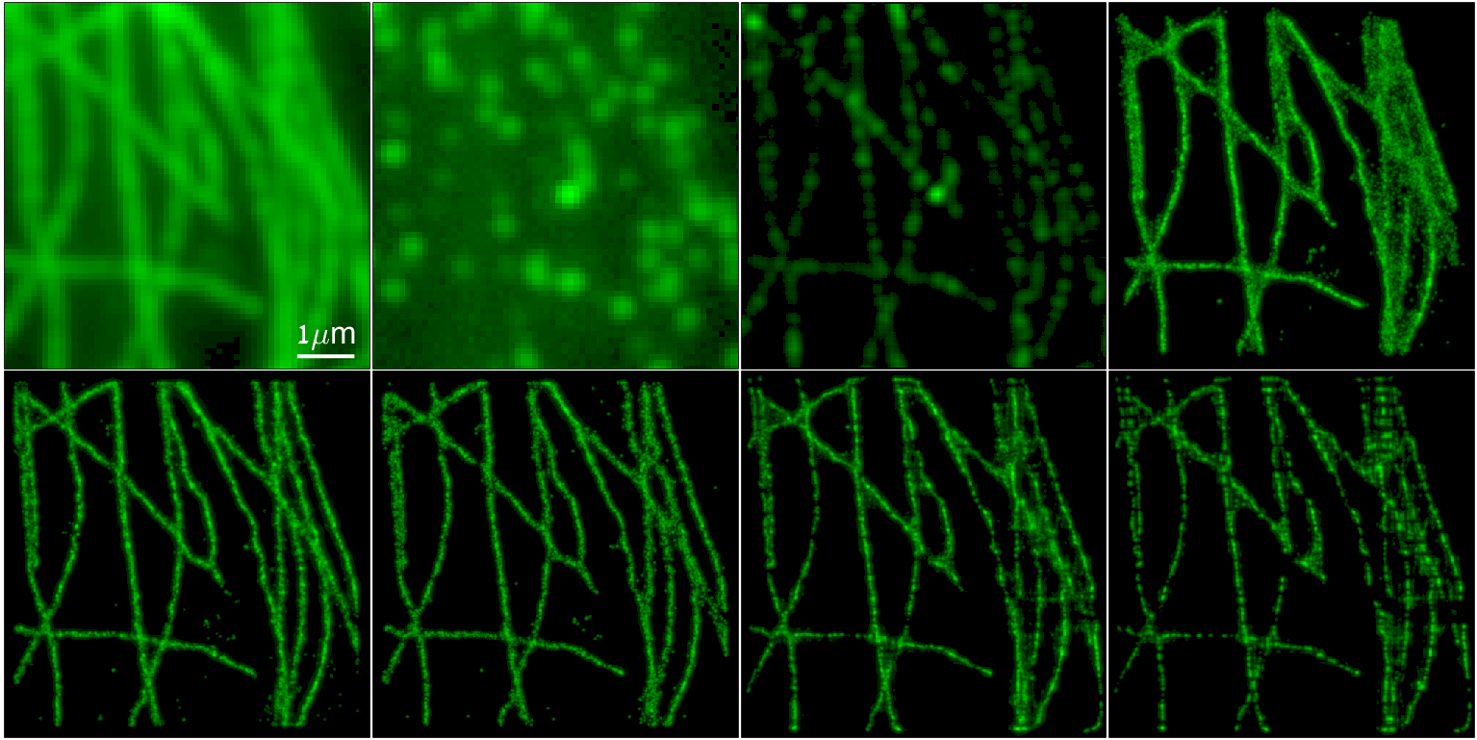
Results: Experimental Data
Data taken from: http://bigwww.epfl.ch/smlm/datasets/index.html
Diffraction limited
Single frame
SOFI XC4
STORM 500 F
FALCON 500 F
FALCON 50 F
SPARCOM 500 F
SPARCOM 50 F

Slide 18
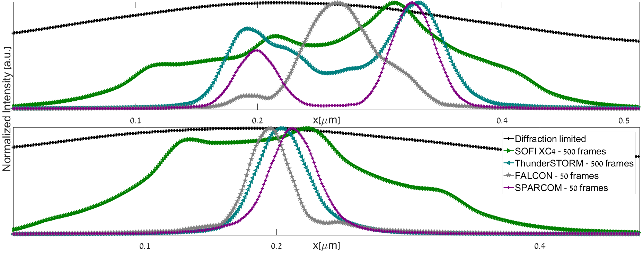
Intensity Profiles
Two Clearly visible features!
Distance between
peaks = 127nm
Similar FWHM ~40nm

Slide 19
Density test

Slide 20
Summary
SPARCOM exploits two kinds of structural information
Sparse distribution of point emitters
Uncorrelated emissions
We are interested in support recovery – not light intensities!
Spatial resolution similar to low density STORM
Better support detection than other sparsity based methods
Only several tens – several hundreds of frames needed for reconstruction!
The Vision:
Facilitate real time capturing of intra-cellular dynamics with sub-diffraction resolution

