Slide 1
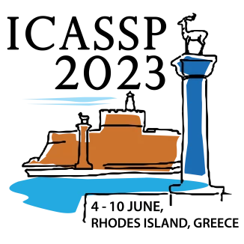
Cognitive Systems and Information Processing Group
CUSTOMIZED AUTOMATIC
FACE BEAUTIFICATION
Wang Chen¹, Peizhen Chen¹, Weijie Chen², Luojun Lin ¹Fuzhou University, Fuzhou China
²Zhejiang University, Hangzhou, China
ICASSP, the Greek island of Rhodes,
June. 2023

Slide 2
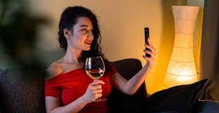
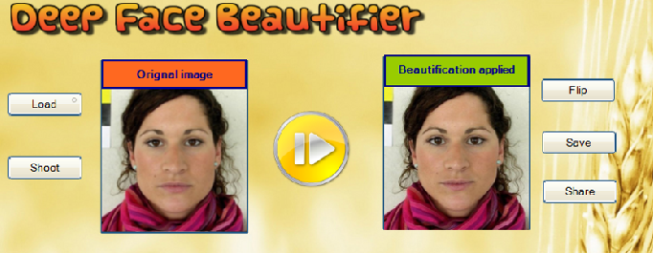
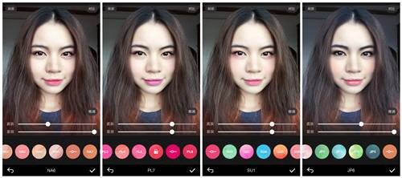
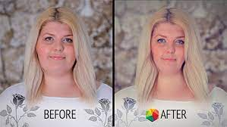
Background
The attractive face plays an important role in our social life, and especially with the advent of mobile Internet, various applications have emerged, such as dating websites, live broadcasts, short videos, and so on. There is an urgent need for face beautification techniques.

Slide 3
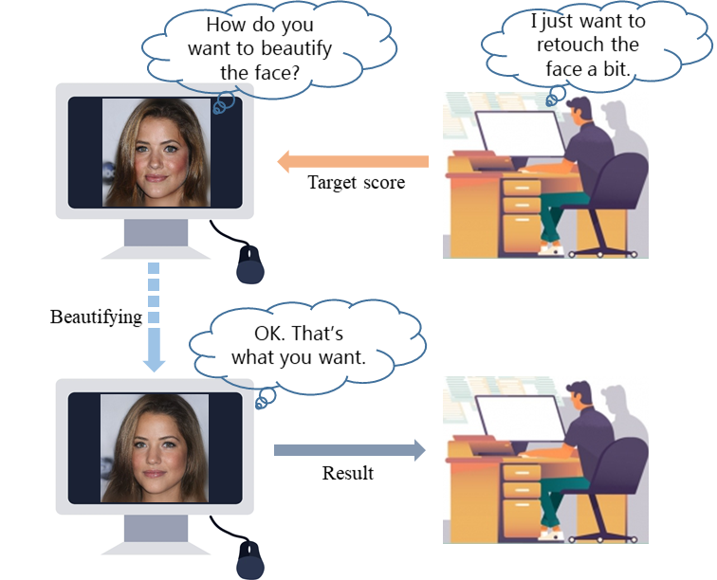
Motivation
Most of existing face beautification methods usually do not take into account the user aesthetic preferences when editing facial images.
Users tend to customize their face
Beautification requirements.
StyleGAN has achieved considerable success in image editing tasks.
The facial beauty prediction(FBP) model has captured human esthetic information so that it can be used for face beautification.

Slide 4
Solution
We develop a new task, namely, Customized Automatic Face Beautification.
We propose a Human Esthetics Guided StyleGAN Inversion (HEGS inversion) method.

Slide 5
Solution
Preliminaries: start from generating code
Encode each input face into the latent code via an encoder with weights of
Image Reconstruction: from code to image
The generator
The generator’s original weights
Refined face
Content code
Appearance code
Due to the low dimension of the content code, which may cause most of fine-grained information to be lost, so we use encoder get an appearance code .

Slide 6
Solution
StyleGAN Inversion: from image to code
To retouch the face in -space, we employ a set of loss functions to guide StyleGAN inversion that the content code is optimized towards user preferences.
The learning rate
The weights of losses

Slide 7
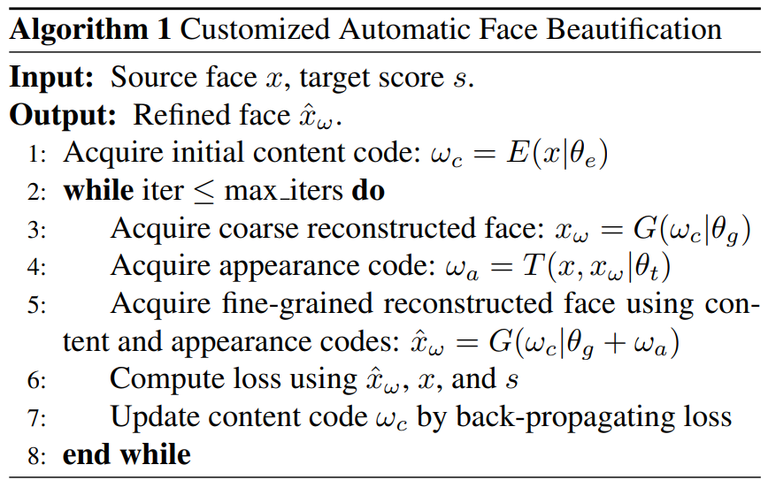
Solution
StyleGAN Inversion: from image to code
In each iteration, the edited content code follows the sequence
to generate the retouched face. This kind of coarse to finegrained refinement is iterated until convergence.

Slide 8
Experiments
Evaluation criterion. We define a new criterion, namely beauty to preservation (BTP), to evaluate the beautification effect in terms of a given target score.
Evaluation data. Faces selected from the Internet and the CelebA-HQ dataset.
Pre-trained model. All models are pre-trained and fixed weights in our experiments. The FBP model is inherited from a AlexNet model pre-trained on the SCUT-FBP5500 dataset.

Slide 9
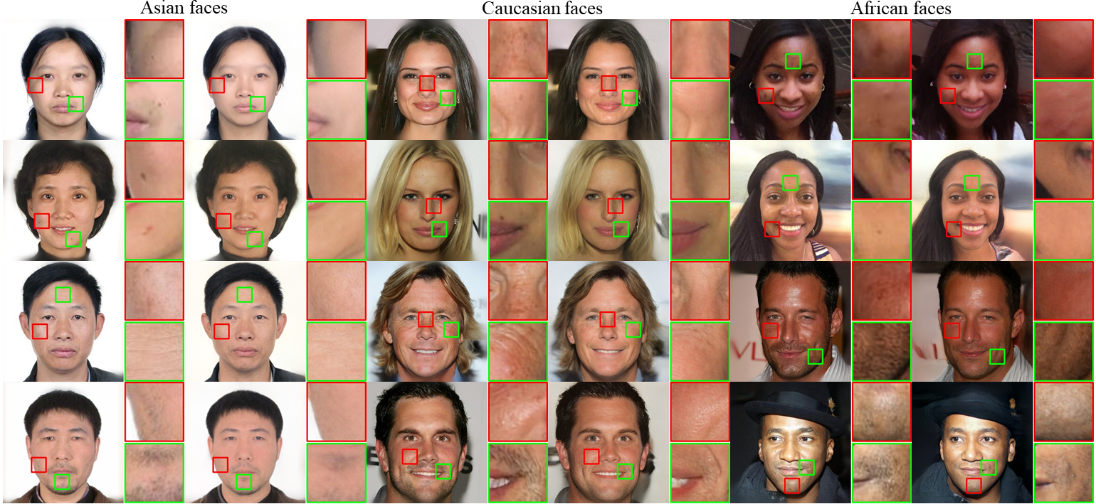
Experiments
Results on different race.

Slide 10
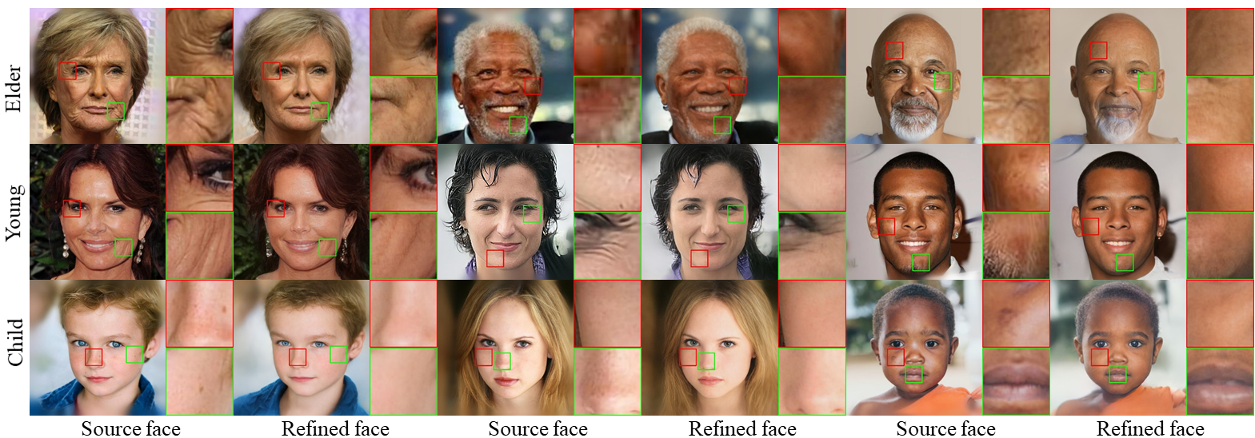
Experiments
Results on different gender and age groups.

Slide 11
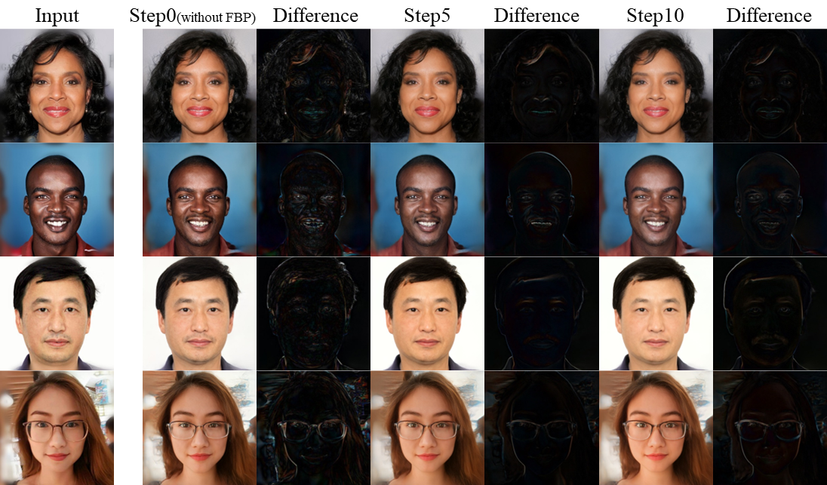
Experiments
Results on different time steps.

Slide 12
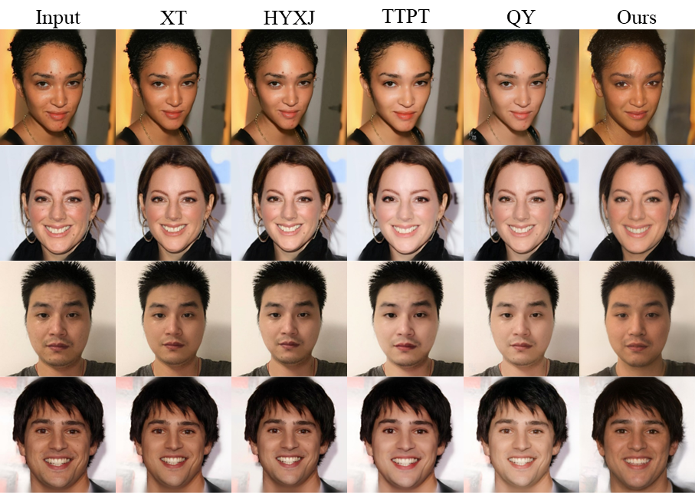
Experiments
Comparison with other methods.
 | XT | HYXJ | TTPT | QY | Ours
BTP | 0.2227 | 0.2025 | 0.1985 | 0.2091 | 0.1865

Slide 13
Conclusion
We define a new task, namely Customized Automatic Face Beautification, which aims to beautify facial images according to the user aesthetic preferences.
We propose a Human Esthetics Guided StyleGAN Inversion method to achieve the above new task, which is the first work of Face Beautification based on GAN inversion.
We design a new evaluation criterion to quantify the effect of face beautification algorithms that measures ID preservation and beautification effect simultaneously.
Our work provides insights on whether FBP, a subjective task, can be learned through machine learning, from a model inversion perspective. This has implications for the FBP community and aesthetic cognitive psychology.

Slide 14
Thanks

