Slide 1
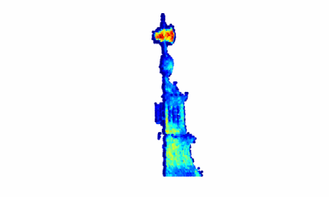
3D reconstruction using single-photon Lidar data exploiting the widths of the returns
J. Tachella¹, Y. Altmann¹, J.Y. Tourneret² and S. McLaughlin¹
¹School of Engineering and Physical Sciences, Heriot-Watt University, Edinburgh, UK
²INP-ENSEEHIT-IRIT-TeSA, University of Toulouse, Toulouse, France

Slide 2
Outline
The single-photon Lidar data 3D reconstruction problem
Challenges
State-of-the-art
New Bayesian 3D reconstruction algorithm
Multiple surfaces per pixel
Broadening of the instrumental response
Highly-scattering media
Experiments using real Lidar data
Long range (kilometres)
Underwater

Slide 3
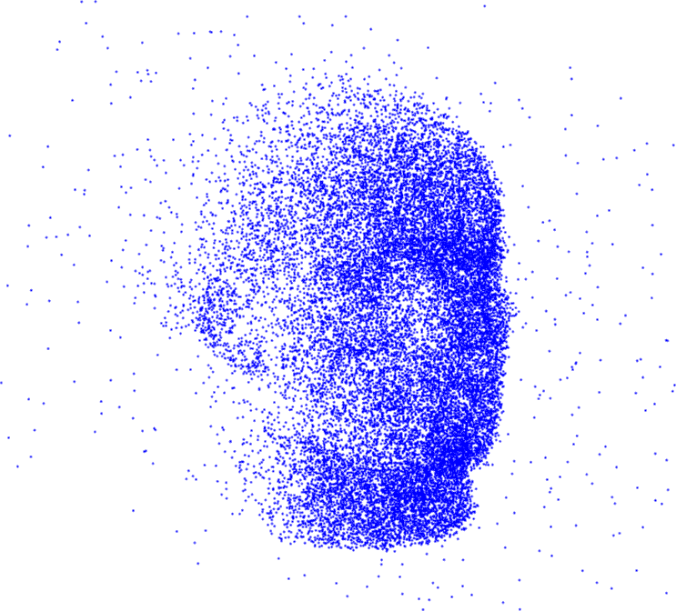
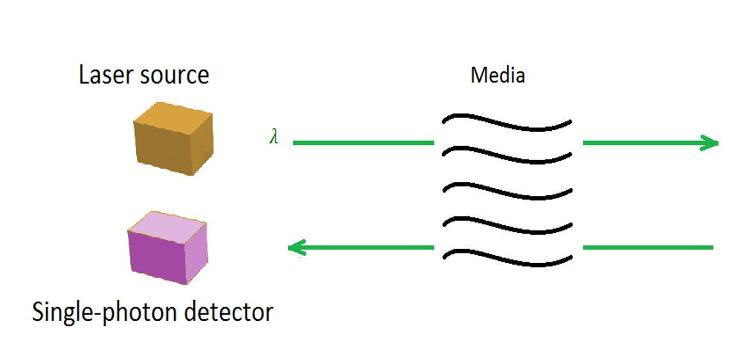
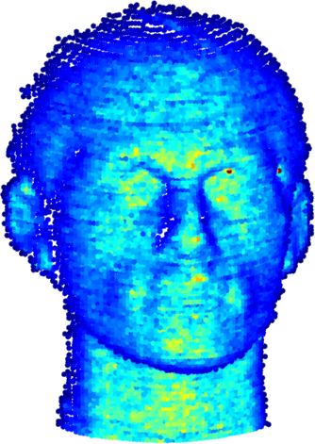
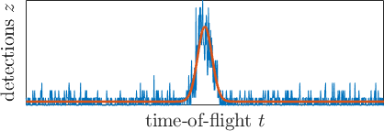
Single-photon Lidar
1. Time-of-flight-based imaging
raw data
3D surface
2. Classical observation model
$$z_{t}∼Poisson\left(s_{t}+b\right)$$
$$s_{t}=r_{0} h\left(t−t_{0}\right)$$
$∀$ $t=1,…, T$
$$r_{0}h(t−t_{0})$$

Slide 4
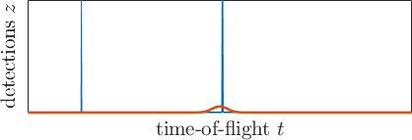
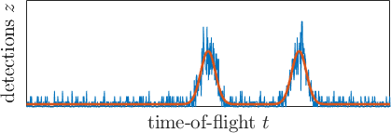
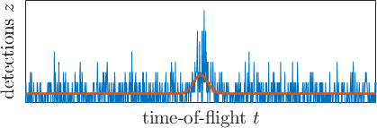
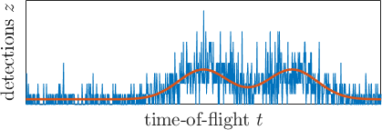
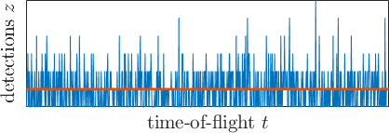
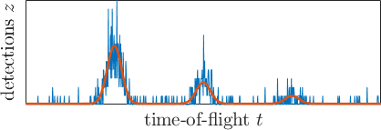
Challenges
Few detected photons $s_{t}≪1$
High background $b≫s_{t}$
No target $s_{t}=0$
Multiple surfaces $s_{t}=\sum{r_{n}}h(t−t_{n}$)
Broadening of the IRF $h_{w}(t−t_{n}$)
Highly scattering environments ${e^{−αt_{n}}r}_{n}$
Spatial correlations neighbouring pixels
unknown
dimension
estimate background unmix signals
additional
parameters
to estimate
target detection problem
exponential attenuation
low signal
high background

Slide 5
Recent algorithms
 | Shin (2016) | Altmann (2016) | Shin (2016) | Rapp (2017) | Halimi (2017a) | Halimi (2017b) | Lindell (2018) | Ren (2018) | Tachella (2019) | Proposed method
Few photons
High background
Target detection
Multiple surfaces
Broadening IRF
Attenuating media
MANIPOP algorithm
J. Tachella, Y. Altmann, X. Ren, A. McCarthy, G. S. Buller, J.-Y. Tourneret, and S. McLaughlin,
“Bayesian 3D reconstruction of complex scenes from single-photon Lidar data” SIAM Journal on Imaging Sciences, 2019

Slide 6
General observation model
Photons observed at bin $t$
$$z_{t}∼Poisson\left(s_{t}+b\right)$$
Multiple surfaces + scattering
$$s_{t}=\sum_{n=1}^{N}{{ r}_{n}e^{−αt_{n}}h_{w_{n}}(t−t_{n})}$$
Broadening IRF
$$h_{w_{n}}(t)=h\left(t\right)∗e^{−t^{2}/2w_{n}^{2}}$$
Unknown
$$N$$
$$t_{n}$$
$${ r}_{n}$$
$$w_{n}$$
$$b$$
Known
$$α$$
$$h\left(t\right)$$

Slide 7
Point process model
We model each return as a point in 3D space
$$Φ=\{\left(c_{n},r_{n},w_{n}\right) | n=1,…,N\}$$
where $c_{n}={\left(x_{n},y_{n},t_{n}\right)}^{T}$ $∈ℝ_{}^{3}$
$r_{n}∈ℝ_{+}$
$w_{n}∈(1,+∞)$
$$r_{n}$$
$$w_{n}$$
$$c_{n}$$

Slide 8
Bayesian approach
Prior model:
$p\left(Φ,B\right)=p\left(Φ\right)p(B)$
where ${\left[B\right]}_{i,j}=b_{i,j}$ are the background levels.
Posterior distribution:
$$p\left(Φ,B | Z\right)=\frac{p\left(Z | Φ,B\right)p\left(Φ,B\right)}{p(Z)}$$

Slide 9
Prior distributions
Laser beam
direction
1. Point positions
Prior knowledge:
Correlation between points within a surface
Sparsity in depth
Unknown number of points
Prior distribution: Area interaction process + Strauss process
$$p\left(Φ\right)=f_{1}\left(Φ\right)f_{2}\left(Φ\right)π_{c}\left(Φ\right)$$
Poisson reference measure
Strauss process
Area interaction process

Slide 10
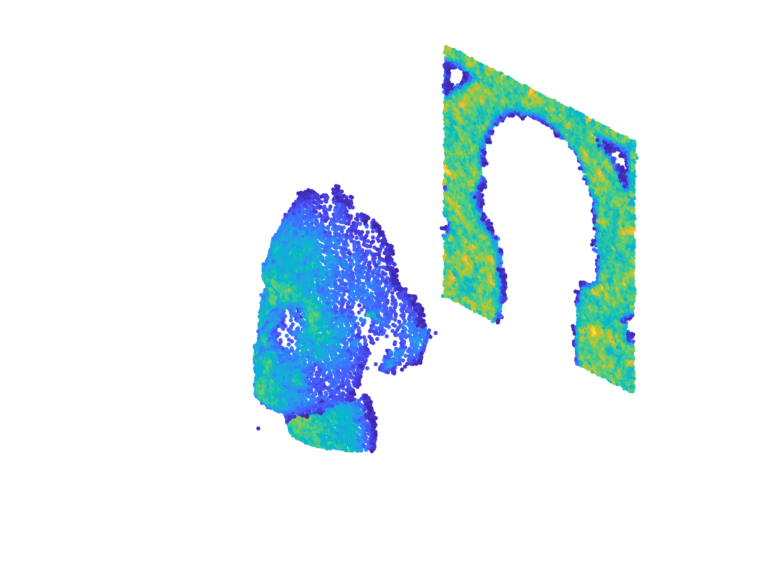
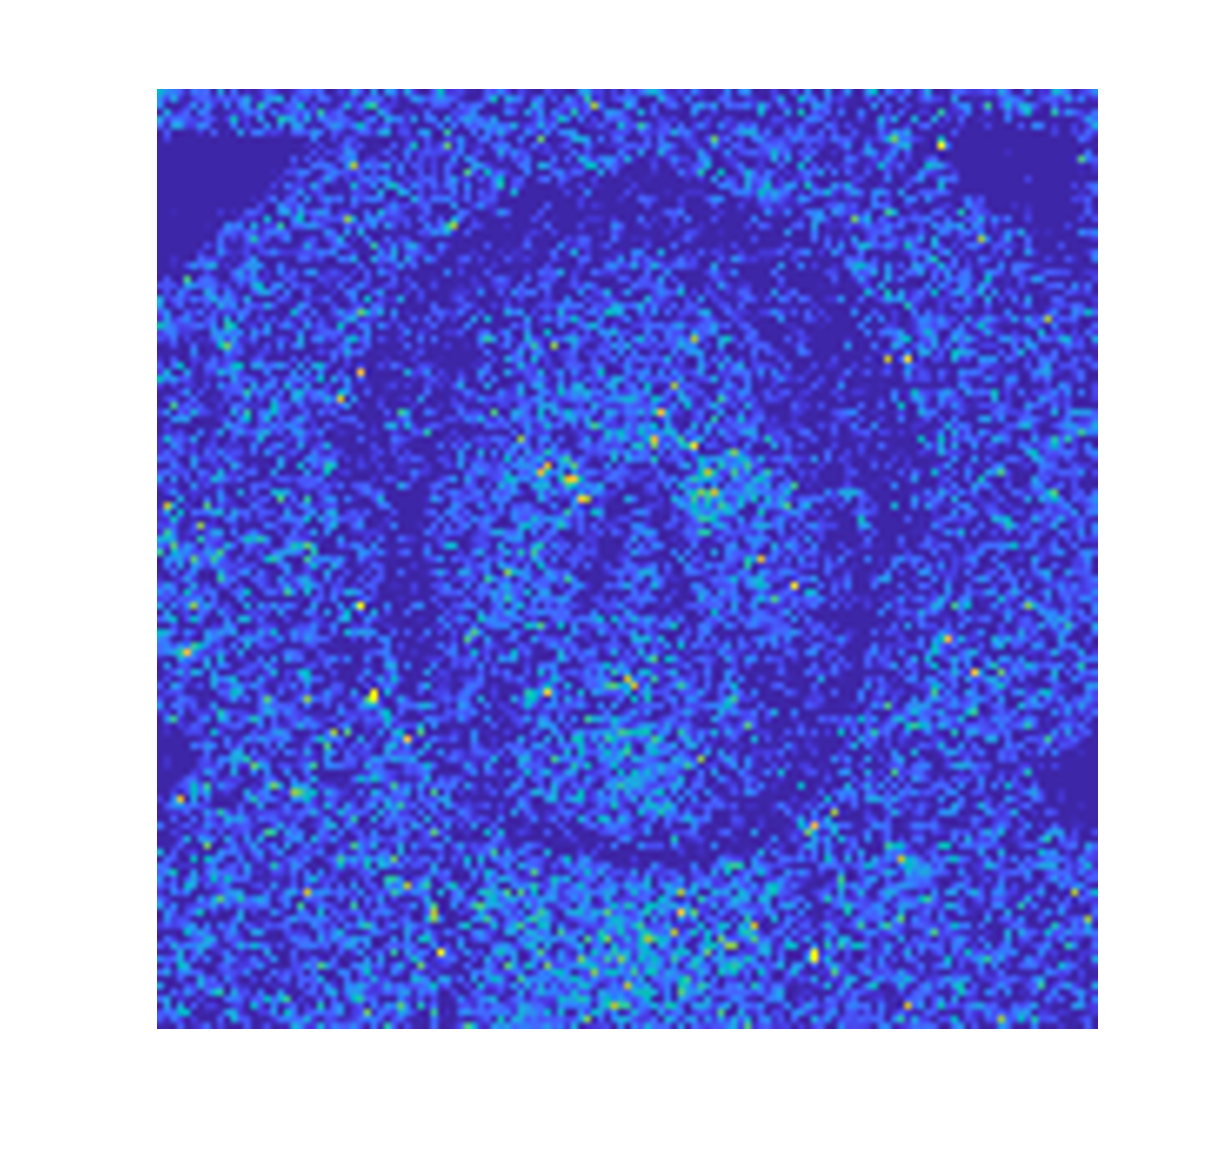
Prior distributions
background illumination
2. Background levels
Prior knowledge:
Correlation between neighbouring points
Positivity constraint
Fixed dimension
target
Prior distribution: Gamma Markov random field
$$p\left(B | α_{B}\right)∝\prod_{i,j}{\frac{b_{i,j}^{α_{B}−1}}{{\overline{b}}_{i,j}^{α_{B}}}}$$
where ${\overline{b}}_{i,j}^{}$ is a low-pass version of $b_{i,j}$
and $α_{B}$ is a hyperparameter
Dikmen and Cemgil (2010) "Gamma Markov random fields for audio source modelling." IEEE Trans. on Audio, Speech, and Language Processing

Slide 11
Prior distributions
Laser beam
direction
$$r_{2}$$
$$r_{3}$$
$$r_{4}$$
$$r_{1}$$
3. Point reflectivity
Prior knowledge:
Correlation between neighbouring points within a surface
Positivity constraint
$$r_{5}$$
$$r_{7}$$
$$r_{8}$$
$$r_{6}$$
Prior distribution: Gaussian Markov random field
$$m_{n}=\log{r_{n}}$$
$$p\left(m | σ_{m},β_{m}\right)∝𝒩(0,σ_{m}^{2}P^{−1})$$
where $P$ is the Laplacian operator w.r.t. the manifold
$σ_{m},β_{m}$ are hyperparameters

Slide 12
Prior distributions
Laser beam
direction
$$w_{2}$$
$$w_{3}$$
$$w_{4}$$
$$w_{1}$$
4. Broadening of IRF
Prior knowledge:
Correlation between neighbouring points within a surface
Positivity constraint
$$w_{5}$$
$$w_{7}$$
$$w_{8}$$
$$w_{6}$$
Prior distribution: Gaussian Markov random field
$${\tilde{w}}_{n}=\log{{(w}_{n}−1)}$$
$$p\left(\tilde{w} | σ_{w},β_{w}\right)∝𝒩(0,σ_{w}^{2}P^{−1})$$
where $P$ is the Laplacian operator w.r.t. the manifold
$σ_{w},β_{w}$ are hyperparameters

Slide 13
Inference
We use the MAP estimator for $Φ$
$$\hat{Φ}={argmax}_{Φ} p\left(Φ,B | Z\right)$$
Minimum mean squared error for $B$
$$\hat{B}=𝔼 \{B|Y\}$$
No analytical expressions available
If we gather samples ${(Φ}^{\left(s\right)},B^{(s)})$according to $p\left(Φ,B | Z\right)$ for $s=1, …, N_{mc}$
$$\hat{Φ}≈{argmax}_{Φ^{(s)}} p\left(Φ^{\left(s\right)},B^{(s)} | Y\right)$$
$$\hat{B}≈\frac{1}{N_{mc}}\sum_{s=1}^{N_{mc}}{B^{(s)}}$$

Slide 14
Reversible jump MCMC
How do we gather samples $Φ^{(s)} ?$
The number of points indicates the dimension of the model
Classical Monte Carlo methods sample a fixed dimensional model
Reversible jump Markov chain Monte Carlo (Green, 1995)
… or MCMC for variable-dimension models

Slide 15
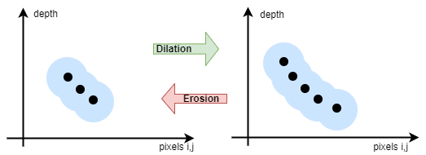
Reversible jump MCMC
Birth: Proposes a new point in 3D space at random
Death: Tries to remove one existing point at random
Shift: Proposes a new position for an existing point
Mark move: Proposes a new mark for an existing point
Split: Separate one existing point into two new ones.
Merge: Fuse two existing points into one.

Slide 16
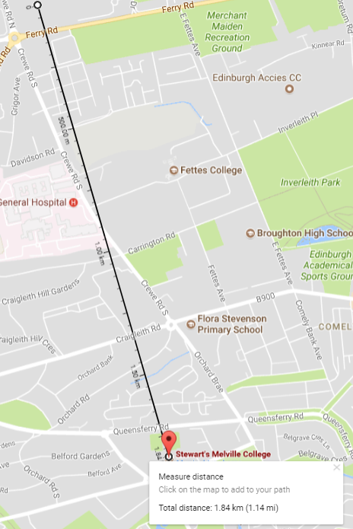
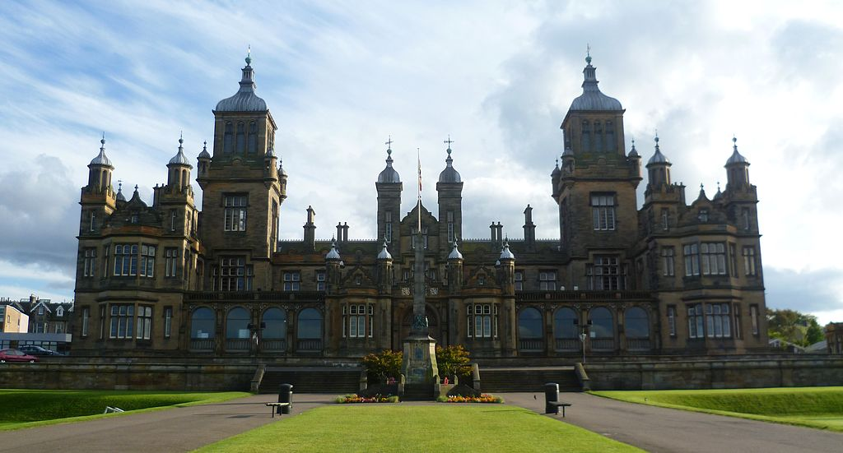
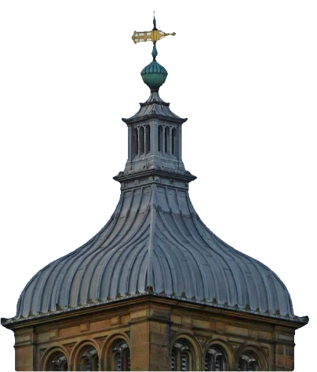
Experiments
Goal: Long range building reconstruction
Data size: 123x96x800
Detections per pixel: 913 photons
Scattering coefficients ($α$): $≈0$
Signal-to-background-ratio: 1.64

Slide 17
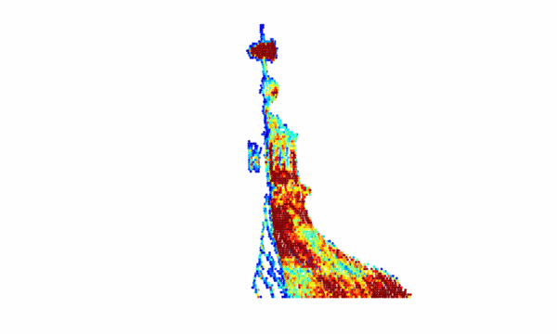
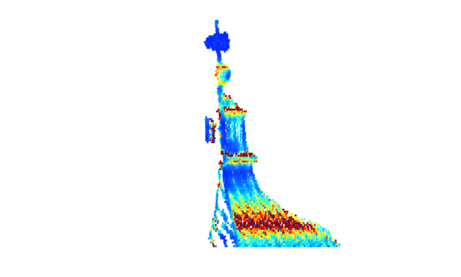
Experiments
Intensity $r_{n}$
Broadening $w_{n}$
Execution time: 195 s

Slide 18
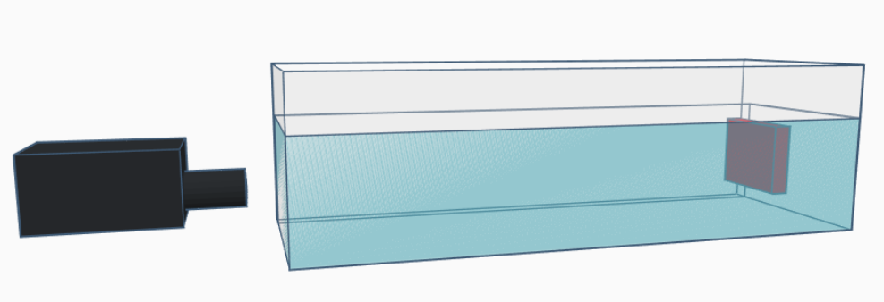
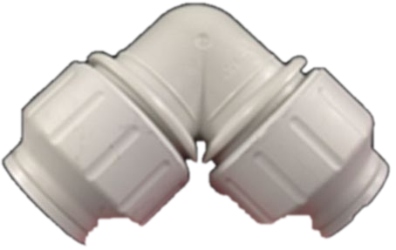
Experiments
Goal: Underwater 3D reconstruction
Data size: 120x120x2500
Scattering coefficients ($α$): 0.6, 3.9 and 4.8
Lidar
Underwater pipe

Slide 19
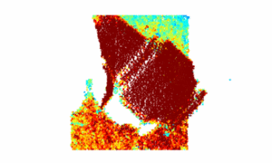
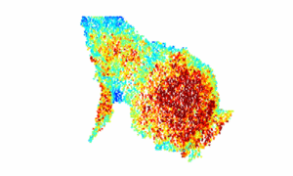
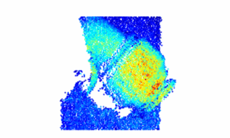
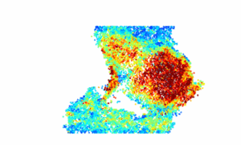
Experiments
$$α=0.6$$
4740 photons per pixel
SBR: 24.2
$$α=3.9$$
282 photons per pixel
SBR: 0.4
$α=4.$8
198 photons per pixel
SBR: 0.05
MANIPOP
Time: 329 s
Time: 263 s
Time: 212 s
Proposed
Time: 410 s
Time: 318 s
Time: 240 s

Slide 20
Conclusions and future work
We adapted MANIPOP to account for peak broadening and underwater conditions
Non-trivial to adapt other existing models
Negligible increase of execution time, similar to optimization-based methods
General structured sparsity formulation
Carefully tailored RJ-MCMC moves
Current work
Real-time reconstruction
Multiple-view 3D reconstruction
Multispectral single-photon Lidar

Slide 21
Contact: jat3@hw.ac.uk Online codes: https://gitlab.com/Tachella
Thanks for your attention!

Slide 22
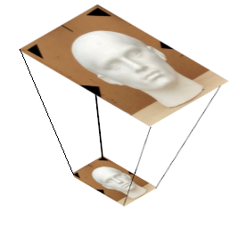
Multiresolution approach
9 times more photons
9 times less points to infer
(almost) same statistics!
If we sum windows of 3x3 pixels
Raw Lidar data
Downsample
K times
Run RJMCMC algorithm
Upsample estimate
Final 3D estimate
K times

