Slide 1
WiFi Action Recognition via Vision-based Methods
Jen-Yin Chang, Kuan-Ying Lee, Kate Ching-Ju Lin*, Winston Hsu
Communication and Multimedia Lab
National Taiwan University, Taipei, Taiwan
Academia Sinica, Taipei, Taiwan*
“WIFI ACTION RECOGNITION VIA VISION-BASED METHODS” - ICASSP2016

Slide 2
Outline
Motivation
Preliminaries
Framework
Experiments
Conclusion

Slide 3
Motivation Preliminaries Framework Experiments Conclusion
Motivation
Preliminaries
Framework
Experiments
Conclusion

Slide 4
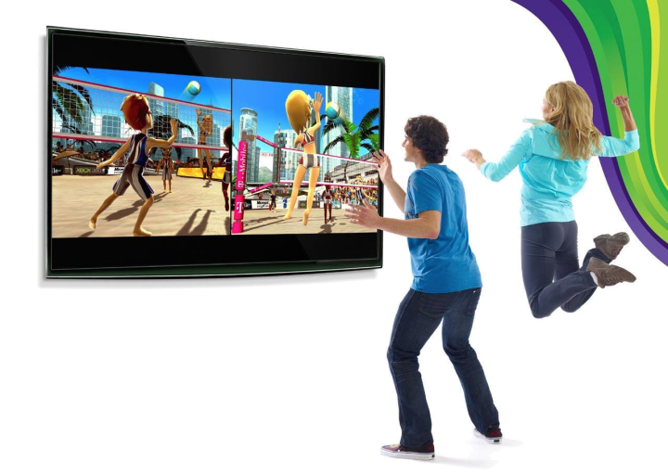
Action Recognition
Motivation Preliminaries Framework Experiments Conclusion
Reference: Images from Google Search
Notes:
elder fall
https://www.windowssearch-exp.com/images/search?q=Falling+with+Elderly+Patients&FORM=RESTAB
play kinect
http://www.dualshockers.com/2010/08/01/the-hype-of-natal-vs-the-reality-of-kinect/
shopper behavior
http://brandshare.us/blog/read/shopper-v.-consumer-why-shopper-behavior-matters
http://www.packageinsight.com/blog/eye-tracking-for-brand-visibility

Slide 5
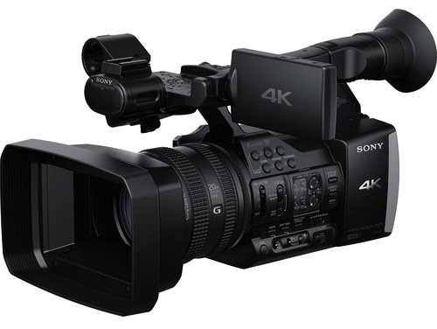
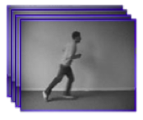
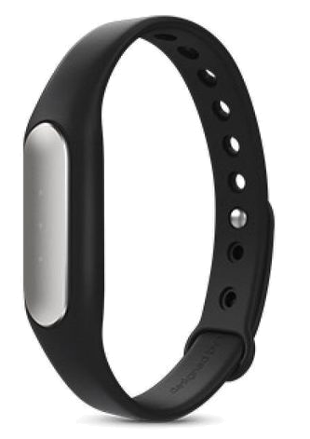
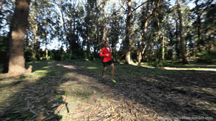
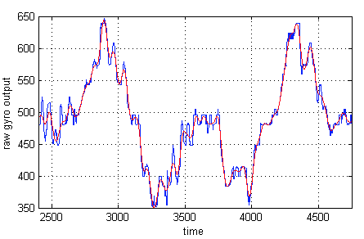
Different Approaches
Motivation Preliminaries Framework Experiments Conclusion
Running
Reference: Images from Google Search
Notes:
An important topic on video understanding, computer vision, elders monitoring, etc
Could be achieved by analyzing videos, sensor data, WiFi signals
run
http://giphy.com/gifs/every-problems-runner-Vd3OOsdcubMZO
camera
http://chinese.vr-zone.com/82003/sony-fdr-ax1-4k-camera-with-2160p-exmor-cmos-show-at-ifa-09042013/
手環
https://tw.mall.yahoo.com/item/%E6%9C%AA%E6%8B%86%E5%B0%81-%E7%8F%BE%E8%B2%A8-%E5%8E%9F%E5%BB%A0%E5%B0%8F%E7%B1%B3%E6%89%8B%E7%92%B0-%E9%81%8B%E5%8B%95%E6%89%8B%E7%92%B0-%E6%99%BA%E6%85%A7%E6%89%8B%E7%92%B0-%E5%B0%8F%E7%B1%B3%E5%AE%98%E7%B6%B2-p092173287775
gyroscope data
http://tom.pycke.be/mav/70/gyroscope-to-roll-pitch-and-yaw
wifi
http://egsimcard.com.tw/

Slide 6
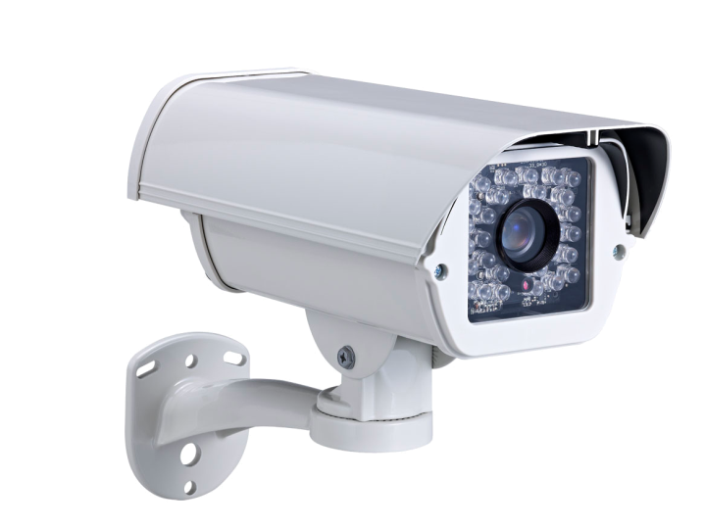
Limitation of Cameras
Motivation Preliminaries Framework Experiments Conclusion
Privacy Issue
Line of Sight
Darkness
Reference: Images from Google Search

Slide 7
Limitation of Sensor Data
Motivation Preliminaries Framework Experiments Conclusion
Inconvenience
shower, etc.
Reference: Images from Google Search

Slide 8
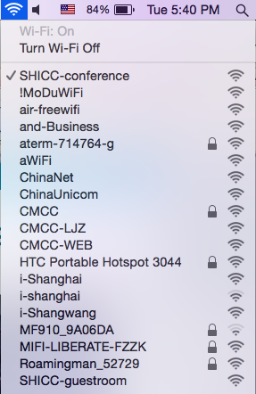
Advantages of WiFi Signals
Motivation Preliminaries Framework Experiments Conclusion
Notes:
through wall
http://sine.ni.com/cs/app/doc/p/id/cs-16238
Almost available everywhere
Better coverage
Work in any places and any light conditions

Slide 9
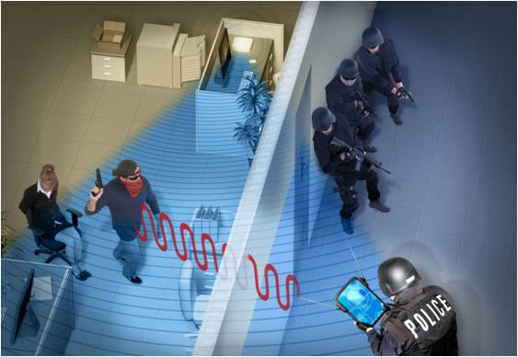
Advantages of WiFi Signals
Motivation Preliminaries Framework Experiments Conclusion
Reference: Images from Google Search
Notes:
through wall
http://sine.ni.com/cs/app/doc/p/id/cs-16238
Almost available everywhere
Better coverage
Work in any places and any light conditions

Slide 10
Motivation Preliminaries Framework Experiments Conclusion
Motivation
Preliminaries
Framework
Experiments
Conclusion

Slide 11
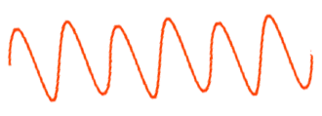
Scenario
Motivation Preliminaries Framework Experiments Conclusion
Transmitter
Signal Analysis
Reflected
signals
Receiver
Reference: Images from Google Search

Slide 12
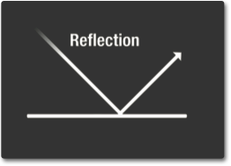
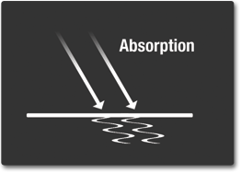
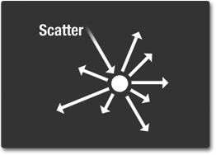
Channel State Information (CSI)
Motivation Preliminaries Framework Experiments Conclusion
Transmitter
Receiver
Reference: Images from Google Search
Notes:
http://missionscience.nasa.gov/ems/03_behaviors.html
mention hardware noise, environmental noise

Slide 13
Motivation Preliminaries Framework Experiments Conclusion
CSI Visualization
Subcarrier
Time

Slide 14
CSI Visualization
Motivation Preliminaries Framework Experiments Conclusion
Stand still
Clap
Box
Notes:
x-axis: samples
y-axis: 30 x 4 subcarriers (different frequencies)

Slide 15
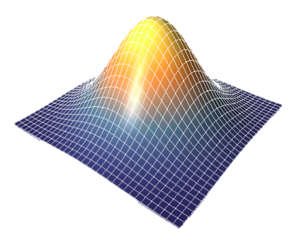
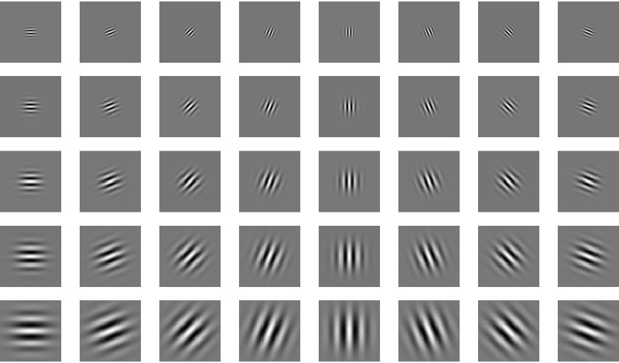
Gabor Filters
Motivation Preliminaries Framework Experiments Conclusion
Different scales
Different orientations
15
Reference: Images from Google Search
Notes:
Gaussian: http://www.imagemet.com/WebHelp6/Content/Images/Gauss3D.png
Gabor: http://dsp.stackexchange.com/questions/25040/whats-the-optimal-filter-size-for-a-2d-gabor-filter

Slide 16
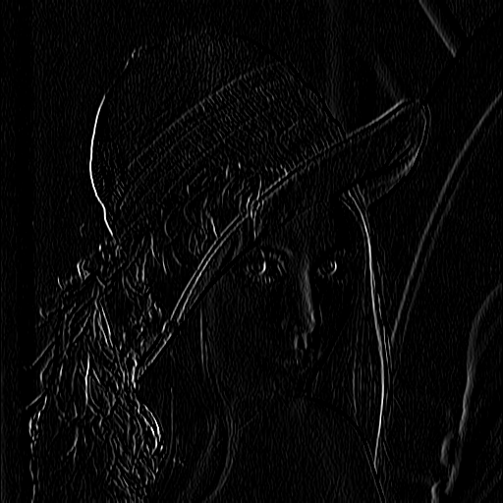
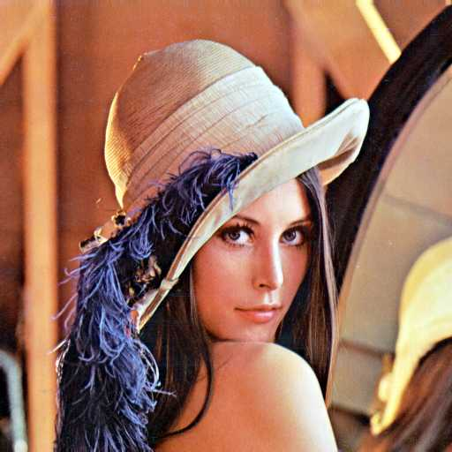
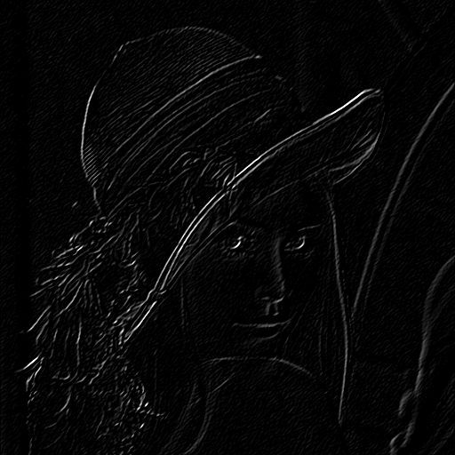
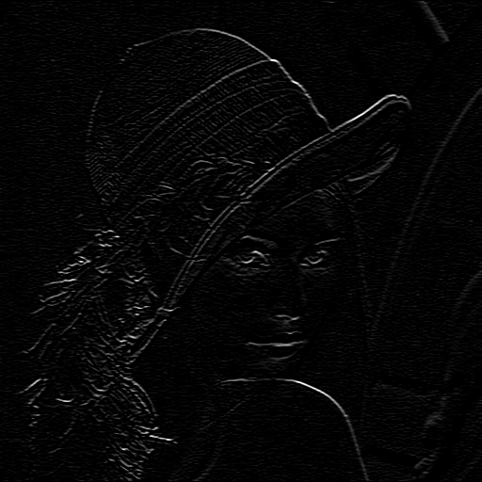
Gabor Filters
Motivation Preliminaries Framework Experiments Conclusion
mean + std
16
Reference: Images from Google Search
Notes:
Gaussian: http://www.imagemet.com/WebHelp6/Content/Images/Gauss3D.png
Gabor: http://dsp.stackexchange.com/questions/25040/whats-the-optimal-filter-size-for-a-2d-gabor-filter

Slide 17
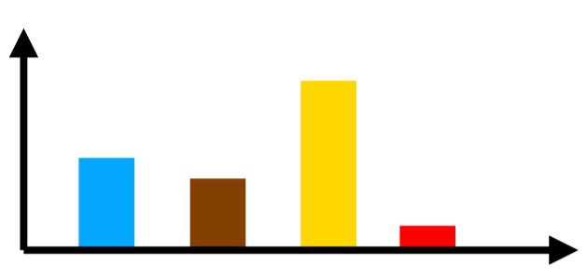
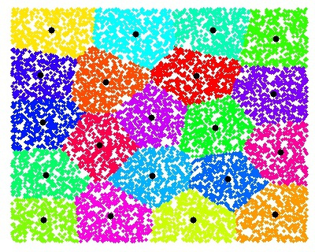
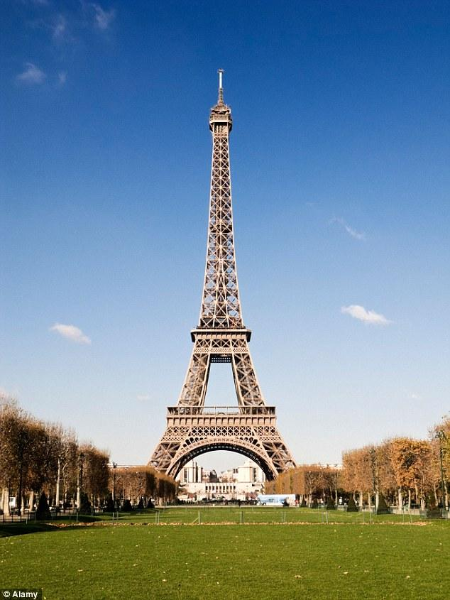
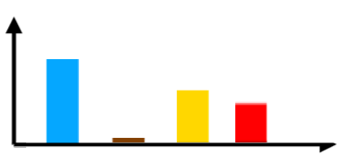
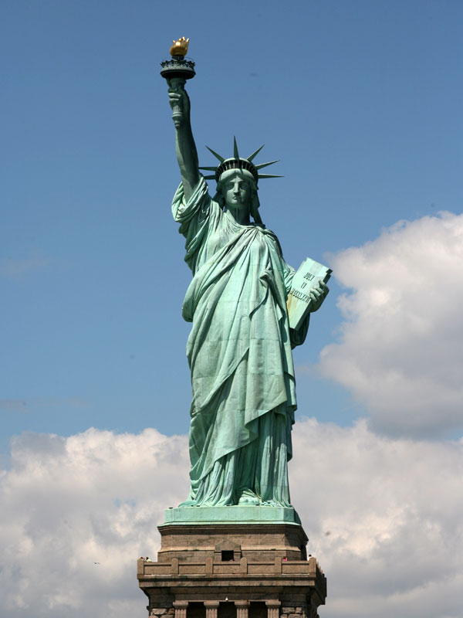
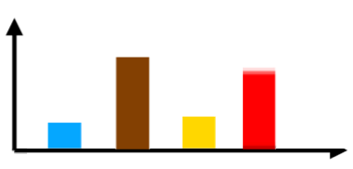
BoW-SIFT
SIFT Feature
K-means
Histogram
Motivation Preliminaries Framework Experiments Conclusion
128-dimension vector
Reference: Images from Google Search
Notes:
http://cs.brown.edu/courses/cs143/proj2/
dots: http://static2.businessinsider.com/image/5195042feab8eae961000007/dots-the-most-basic-app-you-could-imagine-has-been-played-100-million-times-in-16-days.jpg , https://www.google.com.tw/url?sa=i&rct=j&q=&esrc=s&source=images&cd=&ved=0ahUKEwjigsHcqcXLAhVEpZQKHbM5CXsQjBwIBA&url=http%3A%2F%2Fwww.artfromcode.com%2Fwp-content%2Fuploads%2F2008%2F08%2Fdots_01.png&psig=AFQjCNFL6x0HzhGN3Z-Iv-CSOcCrvNPL7w&ust=1458221777859663
eiffel: http://i.dailymail.co.uk/i/pix/2014/11/12/1415793700840_wps_13_AW3MHN_Eiffel_Tower_Paris.jpg
liberty: http://wirednewyork.com/images/city-guide/liberty/liberty.jpg
kmeans: http://www.vlfeat.org/demo/kmeans_2d_rand.jpg

Slide 18
Motivation Preliminaries Framework Experiments Conclusion
Motivation
Preliminaries
Framework
Experiments
Conclusion

Slide 19
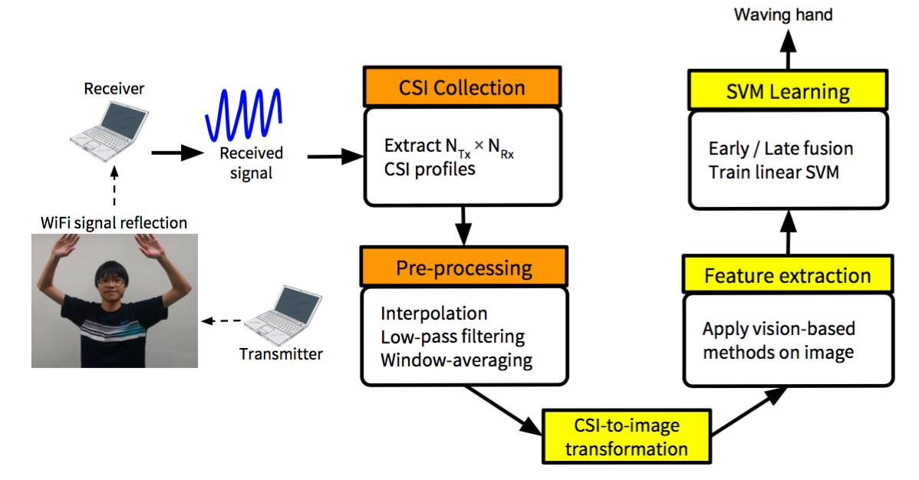
Motivation Preliminaries Framework Experiments Conclusion

Slide 20
CSI Collection
Motivation Preliminaries Framework Experiments Conclusion
Tx: MacBook Pro 2014
Rx: Fujitsu SH560 (with Intel 5300 NIC)
CSI matrix dimension
(N_{tx} x N_{rx} x N_{subcarrier}) x N_{sample} = (2 x 2 x 30) x t

Slide 21
Pre-processing
Motivation Preliminaries Framework Experiments Conclusion
Interpolation
unevenly distributed packets
Low-pass filtering
remove high-frequency noises
Window-averaging
power distributions vary
Notes:
1000 samples / sec

Slide 22
Feature Extraction
Motivation Preliminaries Framework Experiments Conclusion
Gabor filter bank
filter size = 15
feature dimension = N_{orientation} x N_{scale} x {mean, std} = 6 x 8 x 2 = 96
BoW-SIFT
48 centroid
feature dimension = 48

Slide 23
SVM Learning – Feature revisited
Motivation Preliminaries Framework Experiments Conclusion
Transmitter
Receiver
Notes:
Svm: http://www.fast-lab.org/

Slide 24
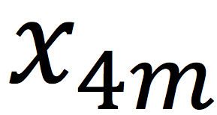
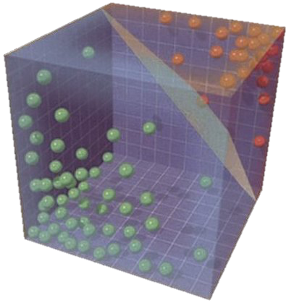
SVM Learning – Early Fusion
Motivation Preliminaries Framework Experiments Conclusion
+
+
+
=
Reference: Images from Google Search
Notes:
Svm: http://www.fast-lab.org/

Slide 25
SVM Learning – Late Fusion
Motivation Preliminaries Framework Experiments Conclusion
Reference: Images from Google Search
Notes:
Svm: http://www.fast-lab.org/

Slide 26
Motivation Preliminaries Framework Experiments Conclusion
Motivation
Preliminaries
Framework
Experiments
Conclusion

Slide 27
Datasets
Motivation Preliminaries Framework Experiments Conclusion
Dataset A
7 actions (Box, Clap, Wave hand, Kick, Quick squat, Jump, Stand still)
6 locations
Dataset B
to compare with KTH
7 actions (Box, Clap Wave hand, Walk, Jog, Run, Stand still)
2 persons
Reference:
KTH – Christian Schuldt et al, “Recognizing human actions: A local svm approach”

Slide 28
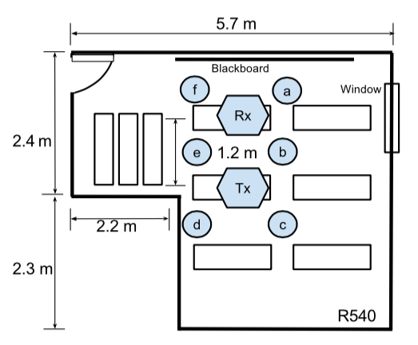
Setting
Motivation Preliminaries Framework Experiments Conclusion
Notes:
Each action is recorded for 5 seconds long
2.4 GHz signals

Slide 29
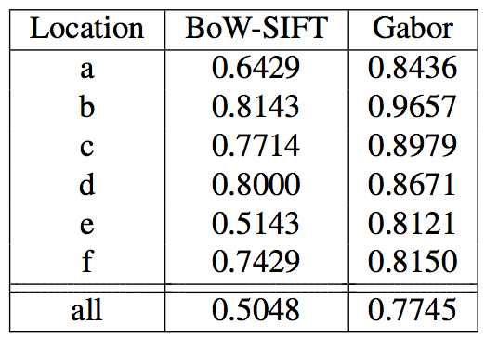
Gabor is better than BoW-SIFT
Motivation Preliminaries Framework Experiments Conclusion
Notes:
Gabor performs better than bow-sift
Given location predicted, actions can be identified more accurately

Slide 30
Location dependency
Motivation Preliminaries Framework Experiments Conclusion
Notes:
Gabor performs better than bow-sift
Given location predicted, actions can be identified more accurately

Slide 31
Location dependency
Motivation Preliminaries Framework Experiments Conclusion
Notes:
Gabor performs better than bow-sift
Given location predicted, actions can be identified more accurately

Slide 32
Late fusion outperforms early fusion
Motivation Preliminaries Framework Experiments Conclusion
Notes:
Late fusion performs better on both datasets, indicating different channels provide richer information

Slide 33
Motivation Preliminaries Framework Experiments Conclusion
Motivation
Preliminaries
Framework
Experiments
Conclusion

Slide 34
Bridging WiFi and Vision
Motivation Preliminaries Framework Experiments Conclusion
The proposed vision-based method achieves accuracy above 85% identifying 7 actions, showing the promising performance of learning-based method
Instead of traditional signal processing, we further aim to discover more general attributes from Wi-Fi signals by DNN-based methods

Slide 35
Thanks!
Questions?
Eric: b99902080@ntu.edu.tw
Ryan: b99902105@gmail.com
“WIFI ACTION RECOGNITION VIA VISION-BASED METHODS” - ICASSP2016
Notes:
Related works comparison? Few data?
Image transformation?
Why transform to colorful image?
Exp on concate 2 visual features?

Slide 36
Appendix

Slide 37
Wi-Fi Action Recognition Principle
Signal properties vary through propagation
power decay
frequency drift
phase shift
Environment alter paths
absorption, scatter and reflection
Action changes environment
different changes with distinct actions

Slide 38
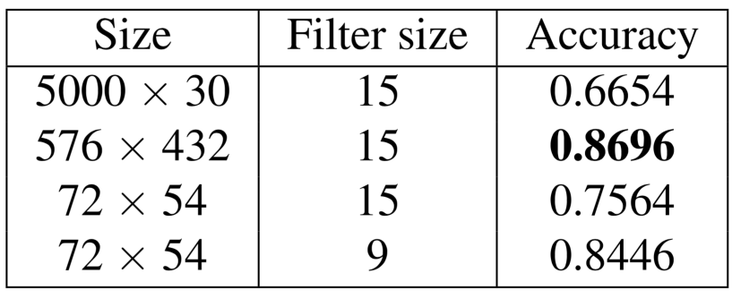
Results on Resolution
Motivation Preliminaries Framework Experiments Conclusion
Performance retains when size decreases
Performance drops when sizes unmatched

Slide 39
Motivation Preliminaries Framework Experiments Conclusion
Doppler Effect
Amplitude
Channel State Information

Slide 40
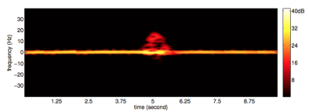
Motivation Preliminaries Framework Experiments Conclusion
Qifan Pu et al., 2013
relative velocity of object and source
require costly computation
Amplitude
Channel State Information

Slide 41
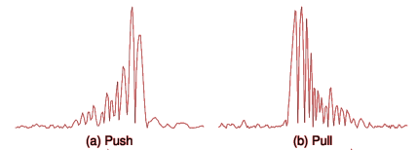
Motivation Preliminaries Framework Experiments Conclusion
Qifan Pu et al., 2013
relative velocity of object and source
require costly computation
Rajalakshmi Nandakumar et al., 2014
changes of signal amplitude
only coarse-grained actions
Channel State Information

Slide 42
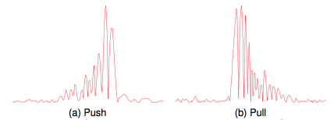
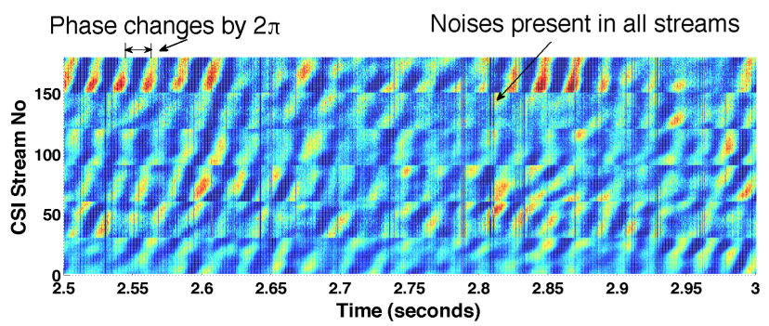
Motivation Preliminaries Framework Experiments Conclusion
Qifan Pu et al., 2013
relative velocity of object and source
require costly computation
Rajalakshmi Nandakumar et al., 2014
changes of signal amplitude
only coarse-grained actions
Wei Wang et al., 2015
more fine-grained information

Slide 43
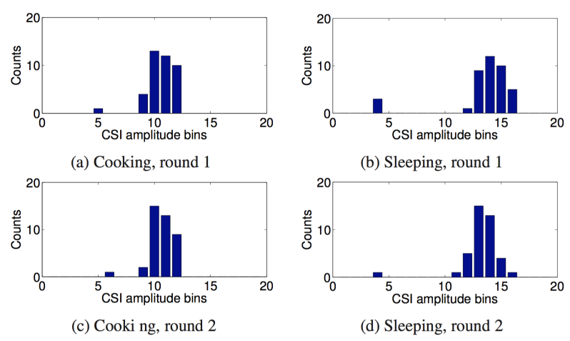
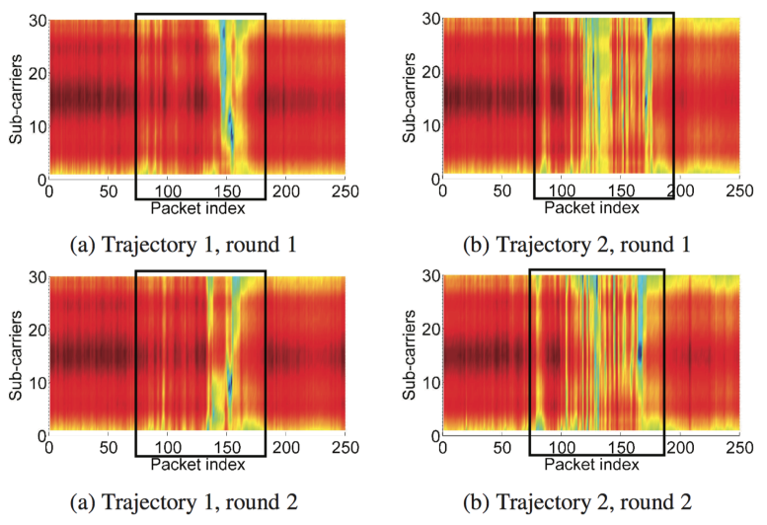
Previous work on CSI
Motivation Preliminaries Framework Experiments Conclusion
Yan Wang et al., 2014 applied CSI distribution/sequence as features to recognize activity/walking trajectory labeled by users

Slide 44
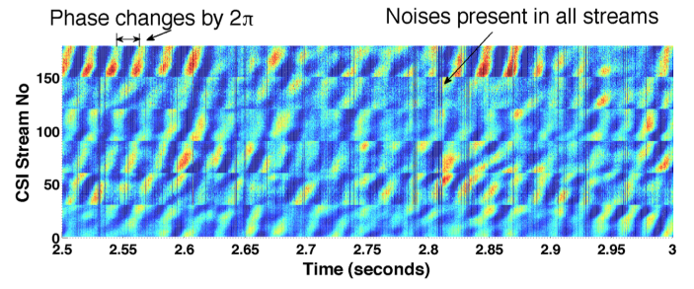
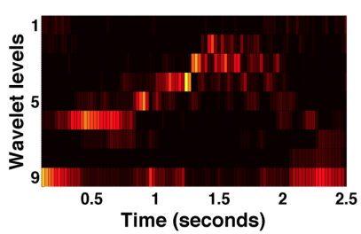
Previous work on CSI (cont.)
Motivation Preliminaries Framework Experiments Conclusion
Wei Wang et al., 2015 proposed a PCA-based denoise method followed by DWT for hand-crafted features

Slide 45
CSI and Texture
Motivation Preliminaries Framework Experiments Conclusion
Faster speed => larger phase change => denser stripes
Actions of different speeds => different textures

Slide 46
Gabor Filters
Motivation Preliminaries Framework Experiments Conclusion
A 2D Gabor filter is a sinusoidal plane wave multiplied by a Gaussian kernel
filters can closely mimic human visual system
particularly appropriate for texture discrimination

Slide 47
SIFT-BoF
Motivation Preliminaries Framework Experiments Conclusion
SIFT
detect and describe key points in an image
each key point as 128-d feature
bow-sift
use K-means to cluster 128-d features to K centroids
assign each key point to the nearest centroid
for each image, build a K-dimensional histogram as feature

Slide 48
Scale Invariant Feature Transform (SIFT)
Local feature = Detector + Descriptor
Detector
Find extremas
Locate keypoints filtering extremas
Descriptor
Orientation Assignment
remove rotation effect
Create descriptor
histogram of orientation

Slide 49
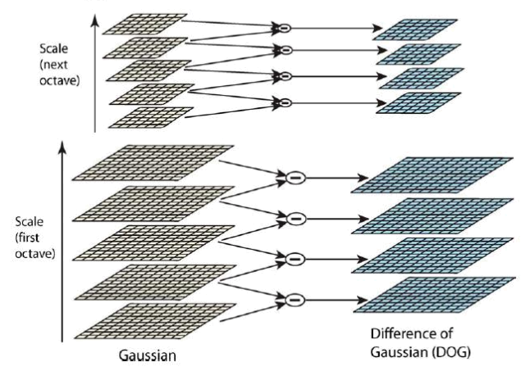
SIFT – Difference of Gaussian
Reference: Images from Google Search

Slide 50
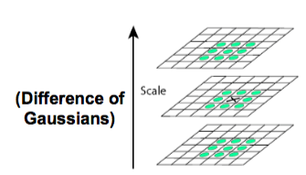
SIFT – Extrema Finding
Reference: Images from Google Search

Slide 51
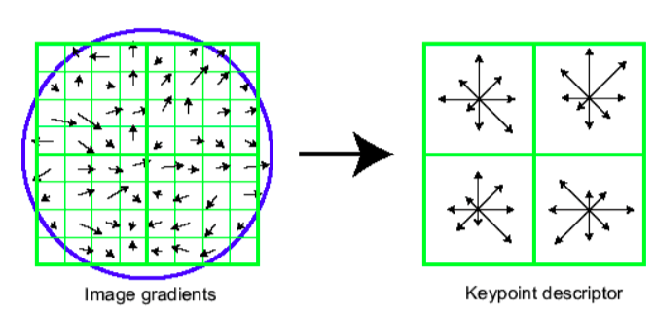
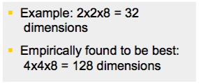
SIFT – Descriptor
Compute gradient orientation histograms of sub-regions
Reference: Images from Google Search

Slide 52
Rooms

Slide 53
Image Transformation
Motivation Preliminaries Framework Experiments Conclusion
Convert CSI into image following Jet colormap

