Slide 1
TIA: A TEACHING INTONATION ASSESSMENT DATASET IN REAL TEACHING SITUATIONS
Shuhua Liu, Chunyu Zhang, Binshuai Li, Niantong Qin, Huanting Cheng, Huayu Zhang*
School of Information Science and Technology, Northeast Normal University, China
*{zhanghy680}@nenu.edu.cn
2024 IEEE International Conference on Acoustics, Speech and Signal Processing
Notes:
Good morning, everyone. I am honored to have the chance to share this work. My name is Chunyu Zhang, a graduate student at Northeast Normal University, China. Our work introduces a Teaching Intonation Assessment Dataset in real teaching situations, aimed at paving the way for significant advancements in the field.

Slide 2
Outline
1
Background
2
Datasets
3
Methodology
4
Conclusion
Notes:
There are four main aspects to this topic, starting from background; Then, I will introduce the TIA dataset; And next, I will show our methodology; Finally, I will conclude this work.

Slide 3
Background
Captures students' attention
Datasets
Right
Teaching
Intonation
Enhances learning enthusiasm
Methodology
Conclusion
Improves teaching effectiveness
Notes:
Firstly, we will come to the background section. So, why we construct TIA dataset? /As educators and researchers, we all know that voice plays an indispensable role in effective teaching and learning. The right teaching intonation /not only captures students' attention, /but also enhances learning enthusiasm, /which greatly improves teaching effectiveness.

Slide 4
Background
However, the lack of datasets has significantly hindered the development of automatic intonation assessment.
Datasets
To end this, we created the TIA dataset, which aims to reflect the intonation of teaching in different disciplines in real situations.
Methodology
Conclusion
Notes:
However, the lack of datasets has significantly hindered the development of automatic intonation assessment. Therefore, the aim of the TIA dataset is to reflect the intonation of different disciplines in real teaching situations.

Slide 5
Background
Datasets
Methodology
Conclusion
Notes:
OK, now, I will introduce our dataset. /We collected classroom recordings from three hundred and ninety-six teachers covering nine different disciplines.

Slide 6
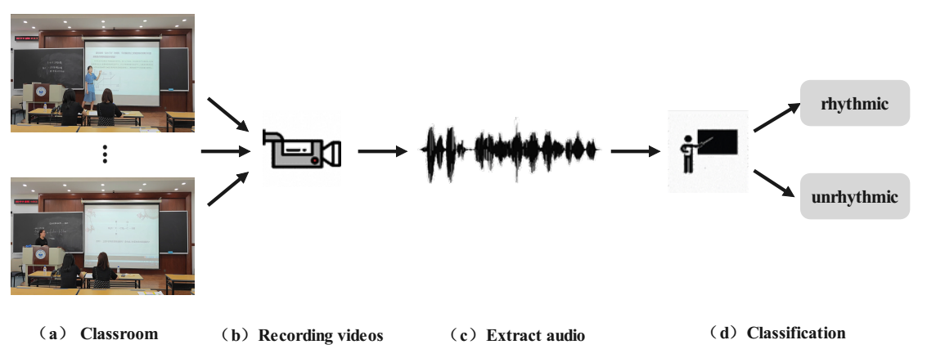
Background
Datasets
Methodology
Conclusion
Notes:
The recordings were extracted with a sampling rate of sixteen kilohertz (16 kHz) audio and split into eleven thousand four hundred and forty-four (11,444) audio samples of fifteen (15) seconds each.

Slide 7
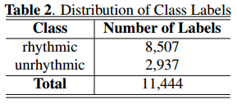
Background
Datasets
Methodology
Conclusion
Notes:
We carefully classified these samples as ‘rhythmic’ and ‘unrhythmic’ based on the scores of the educational experts. This classification process is crucial to ensure the robustness of the dataset in the intonation assessment.

Slide 8
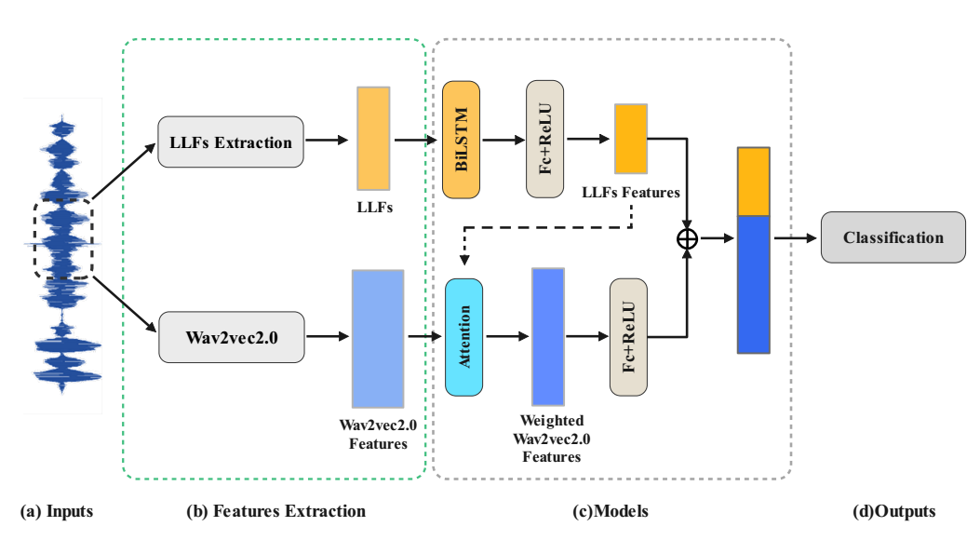
Background
Datasets
Methodology
Conclusion
Notes:
In this section, I will introduce our methodology. /In order to effectively utilize the TIA dataset, we propose the Teaching Intonation Assessment Model, called TIAM.

Slide 9
Background
$$x_{l}=librosa(x)$$
Datasets
Methodology
$$x_{w} = Wav2vec2.0(x)$$
Conclusion
Notes:
First, the model uses librosa to extract low-level features of the audio and uses wav2vec2 to extract deep-level features.

Slide 10
$$x_{l}^{′} =BiLSTM(x_{l})$$
Background
Datasets
$$ℒ= ℒ_{ce}(y−\hat{y})$$
$$x_{att}= f_{att}(x_{l}^{′})$$
Methodology
Conclusion
$$x_{w}^{′}= {(x}_{att} ∗ x_{w})$$
Notes:
Then the two levels of audio features are fused using BiLSTM and an attention mechanism. Finally, The model computes and optimizes the cross-entropy loss.

Slide 11
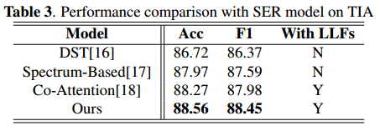
Background
Datasets
Methodology
Conclusion
Notes:
Here I will show the results of the TIAM model. To the best of our knowledge, there are no deep learning models for intonation assessment datasets in recent years, so we chose to use some speech emotion recognition models as the baseline. The experimental results show that the model with audio low-level features performed better than the evaluation results of the model without low-level features, indicating that audio low-level features play an essential role in intonation assessment tasks.

Slide 12
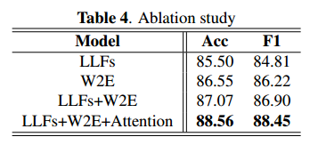
Background
Datasets
Methodology
Conclusion
Notes:
Furthermore, we also did a series of ablation experiments. The results show that fusing Wav2vec2 embedding and low-level features can significantly improve the performance of intonation assessment.

Slide 13
Background
This study first constructed a Teaching Intonation Assessment (TIA) dataset. This dataset is a high-quality and difficult benchmark dataset with the characteristics of rich disciplines, diverse data, and realistic classroom contexts. In order to test the validity of this dataset, we also proposed the Teaching Intonation Assessment Model (TIAM) based on low-level and deep-level features of speech.
Datasets
Methodology
Conclusion
Notes:
In conclusion, this study first constructed a Teaching Intonation Assessment (TIA) dataset. This dataset is a high-quality and difficult benchmark dataset with the characteristics of rich disciplines, diverse data, and realistic classroom contexts. In order to test the validity of this dataset, we also proposed the Teaching Intonation Assessment Model (TIAM) based on low-level and deep-level features of speech.

Slide 14
THANK YOU
Our code and TIA dataset are now available on GitHub(https://github.com/zhangcy407/TIA).
You can also contact us via this email: zhanghy680@nenu.edu.cn
2024 IEEE International Conference on Acoustics, Speech and Signal Processing
Notes:
That’s all of my presentation. If you have any questions, I’d be happy to answer them. Thank you for your attention.

