Slide 1
Video Compression via Inter-frame Chroma Prediction
Rulin Huang, Shaohui Li, Wenrui Dai, Jixiang Luo, Chenglin Li, Junni Zou, and Hongkai Xiong
lishaohui@sjtu.edu.cn
Department of Electrical Engineering
Shanghai Jiao Tong University
Mar. 4, 2022

Slide 2
Motivations
Original/YUV 444 (100%)
YUV 422
YUV 420
Samples (-33%)
samples (-50%)
recover
recover
Spatial Chroma Subsampling
Reduces the chroma samples for representing a colorful frame
Temporal Chroma Subsampling
Is that accessible?

Slide 3
Proposed Framework

Slide 4
Proposed Framework
Input
Uncompressed colorful (YUV420/YUV422/YUV444) frames.
Chroma Sampling
Discard chroma components of non-key frames.
Standard HEVC Encoders
Encode colorful frames and grayscale frames separately.
Modified HEVC Encoder
Support hybrid coding with colorful key frames and grayscale non-key frames.

Slide 5
Proposed Framework
Input
Uncompressed colorful (YUV420/YUV422/YUV444) frames.
Chroma Sampling
Discard chroma components of non-key frames.
Standard HEVC Encoders
Encode colorful frames and grayscale frames separately.
Modified HEVC Encoder
Support hybrid coding with colorful key frames and grayscale non-key frames.

Slide 6
Proposed Framework
Modified/Standard HEVC Decoder
Output frames with colorful key frames and grayscale non-key frames.
Inter-Frame Chroma Prediction
Propagate chroma components from the key frames to non-key frames.
Implemented by neural networks.
Output
Reconstructed colorful frame sequence.

Slide 7
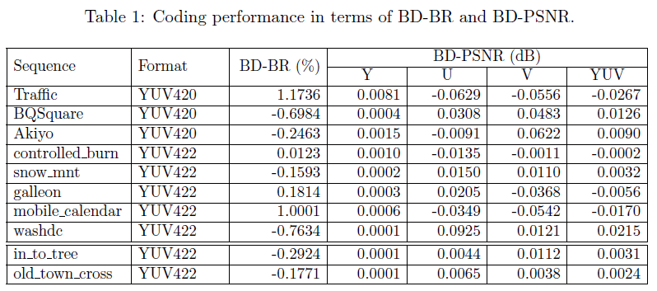
Experiments
The baseline is the standard HEVC codec;
Comparable to standard HEVC;
Better performance is achieved on sequences with smooth motions.

Slide 8
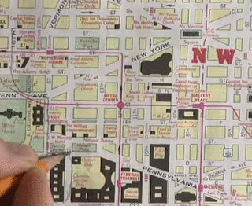
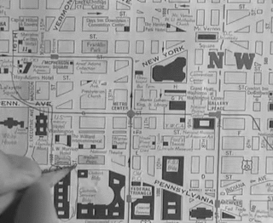
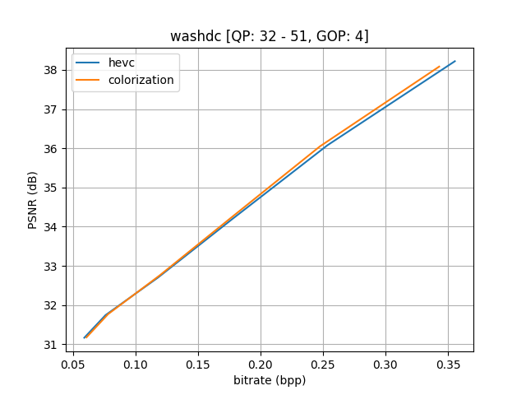
Experiments
key frames
colorful / 25 frames
non-key frames
grayscale / 75 frames
reconstructed frames
colorful / 100 frames
An example: washdc
Format: YUV422
Resolution: 352x288
GOP Size: 4
Comparable to HEVC

Slide 9
Discussions
In this work, we
proposed a video compression framework with chroma sampling and prediction (without theoretical analysis)
removed the chroma components of key frames (uniform sampling)
achieved chroma prediction using neural networks (time consuming)
validated the compression framework on some sequences (comparable rate-distortion performance)
In future works, we want to
offer a theoretical analysis on the potential of chroma prediction
explore non-uniform sampling
speed up the neural network-based chroma prediction
combine the temporal and spatial chroma sampling to improve rate-distortion performance

Slide 10
Many Thanks
Shaohui Li
lishaohui@sjtu.edu.cn

