Slide 1
2021DCC
Presentation
Deformable Convolution Network based Invertibility-driven Interpolation Filter for HEVC
Qiuyang Zhang∗ Xiaofeng Huang∗ Haibing Yin∗ Weihong Niu∗

Slide 2
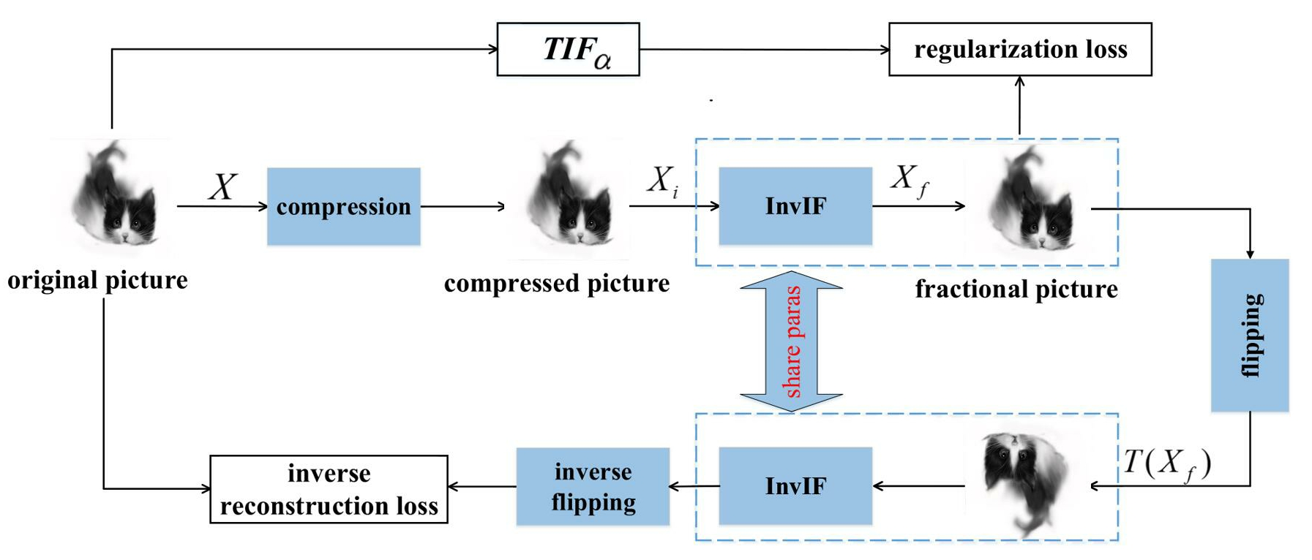
InvIF

Slide 3
Drawbacks:
(1) unefficient network structure
(2) unefficient loss term
(3) training samples generation method

Slide 4
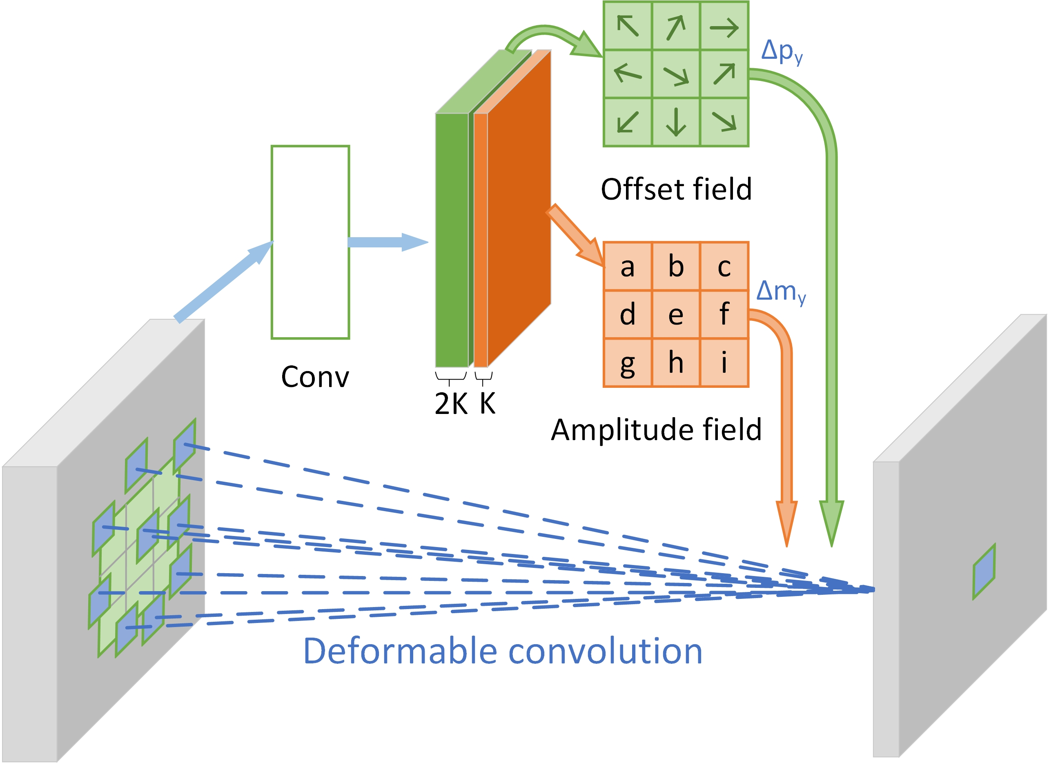
Deformable Convolution

Slide 5
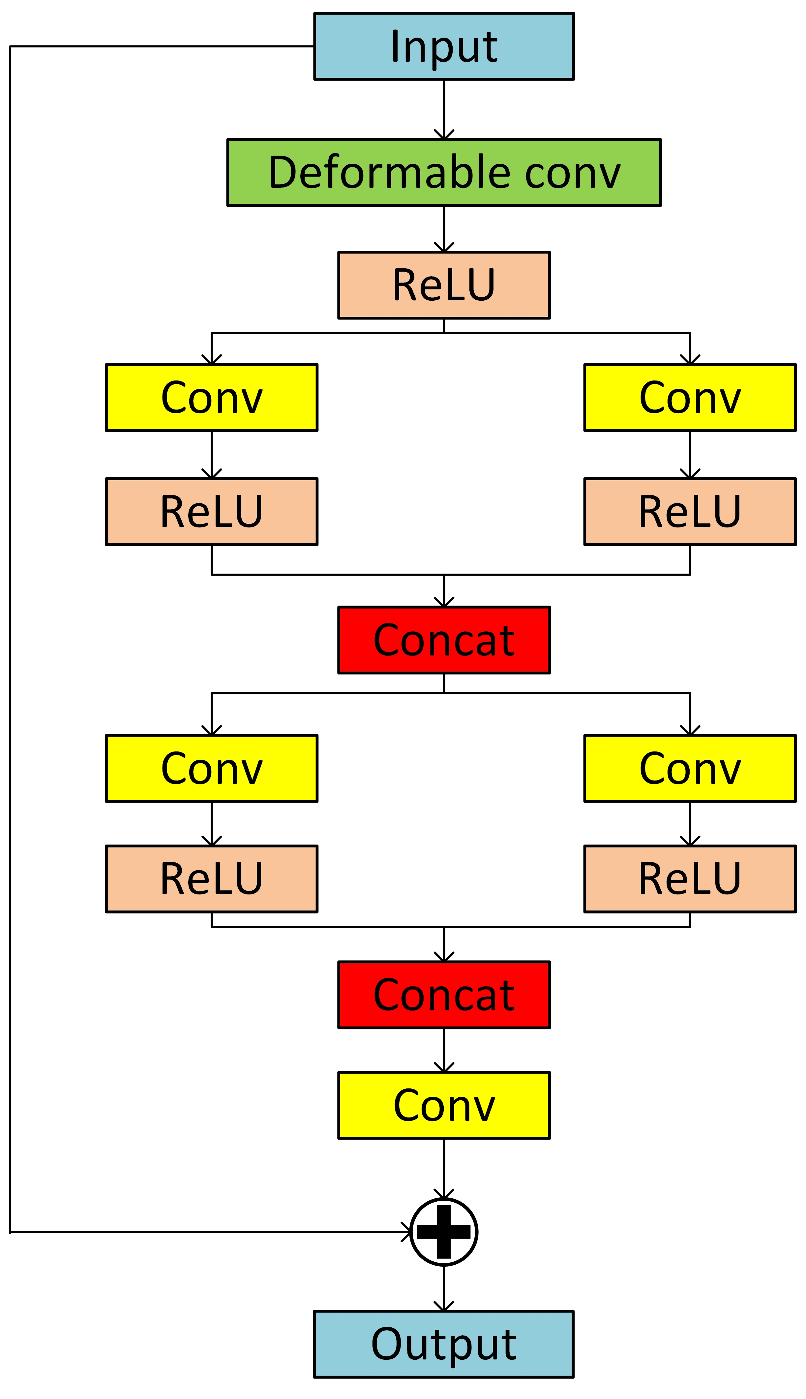
Network structure of DCN

Slide 6
GAN-based regularization term

Slide 7
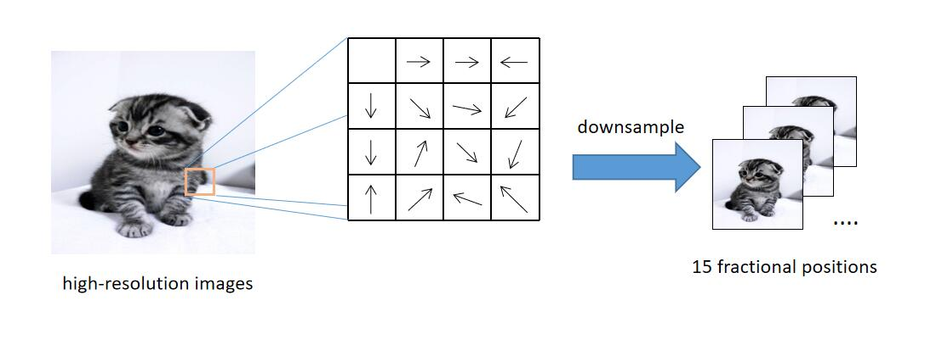
motion blur method

Slide 8
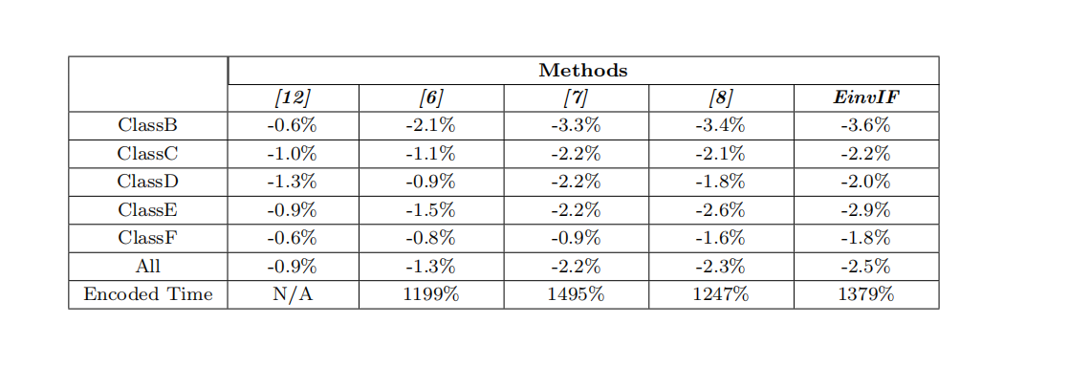
results

Slide 9
2021DCC
Presentation
Thank you for listening!

