Slide 1
Fusion of modulation spectral and spectral features with symptom metadata for improved speech-based COVID-19 detection
Presenter: Yi Zhu
Author: Yi Zhu, Tiago H. Falk
Multimodal/Multisensory Signal Processing&Enchancement lab, INRS
ICASSP 2022
Notes:
Alt+f5

Slide 2
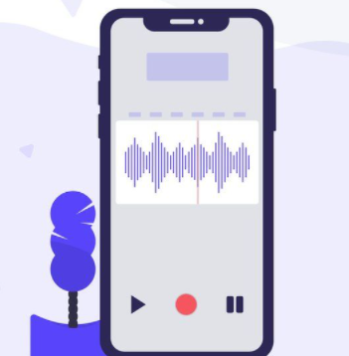
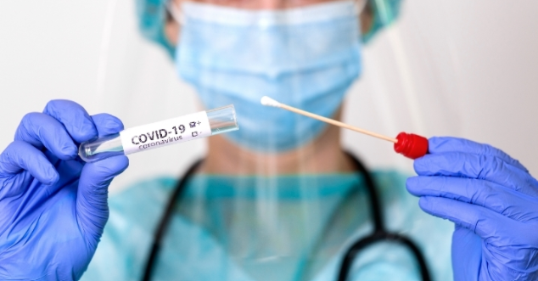
Background
6.2 million deaths as of April,2022
Conventional testing methods are expensive, time-consuming, and required help from medical professionals
Audio-based self-testing toolkit
Notes:
The COVID-19 pandemic, also known as the coronavirus pandemic, is an ongoing global pandemic of coronavirus disease 2019. [1]As of mid-April, it has led to 3.2million deaths. [3]Conventional testing approaches, which include saliva test, blood test, or CT-scan, have been shown to be accurate, but on the other side, these methods are expensive, time-consuming, and required to be performed under the guidance of medical professional. Nowadays, with the development of remote sensing and artifical intelligence, the idea of audio-based self-testing toolkits was proposed, with which people can get their covid test result in seconds without going to the hospital and without any help from the medical professionals.

Slide 3
Audio-based AI test
COVID-19 virus directly targets at lungs
Symptoms: shortness of breath and cough events
Hypothesis: symptoms can be measured by speech analysis
Advantages of AI-based test:
low-cost
real-time results
long-term monitoring of health status
Notes:
With the virus targeting directly at lungs, symptoms like shortness of breath and cough events are induced [1][2]. Furthermore, physiological changes have been reported in lung areas and articulators. This opens up the possibility of an AI-based test to diagnose COVID by analyzing speech[3]. [4]Compared to the conventional methods, the cost of an AI test is lower, instead of waiting for days it can provide real-time results, and with wearable devices/smartphones, it can help monitoring the disease state in the long-term. [5]In reality, a remote AI cough/speech test would work as follows. Firstly, it requires individuals to make forced coughs or to speak with a given utterance. These audio recordings were then processed and fed into models to make classifications.

Slide 4
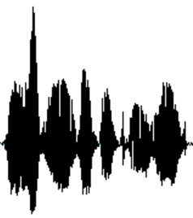
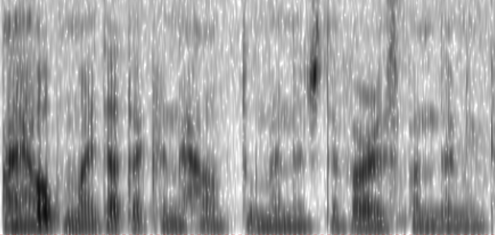
Existing audio-based COVID-19 detection models
Audio-based COVID-19 detection system
F
Time
COVID-19 detection challenges
ComParE 2021 baseline UAR ~0.6 achieved with linear SVM
Limitation of DL models
Robustness to unseen data
Interpretability
Notes:
A common speech-based classification/detection system relies on ‘spectrogram’, or the features extracted from the spectrogram, as inputs to classifiers to make predictions. However, these conventional features did not work well for a COVID test. [1] One example is the performance reported by the 2021 Interspeech COVID detection challenge, where a baseline UAR score of around 0.6 was achieved with SVM model. Although recent studies reported imrpovement can be achieved with more complex models, there exists two issues that significantly limited the use of existing models. The first issue is the robustness to unseen data. When reproducing several existing models, we noticed that even within the same dataset, there could be a high variation using different train/test data partitions. Such lack of robustness makes it even more challenging when the model is externally tested. And another major limitation of DNN-based models lies in the poor interpretability (i.e., black-box behaviour) they provide, hence resulting in limited clinical use.

Slide 5
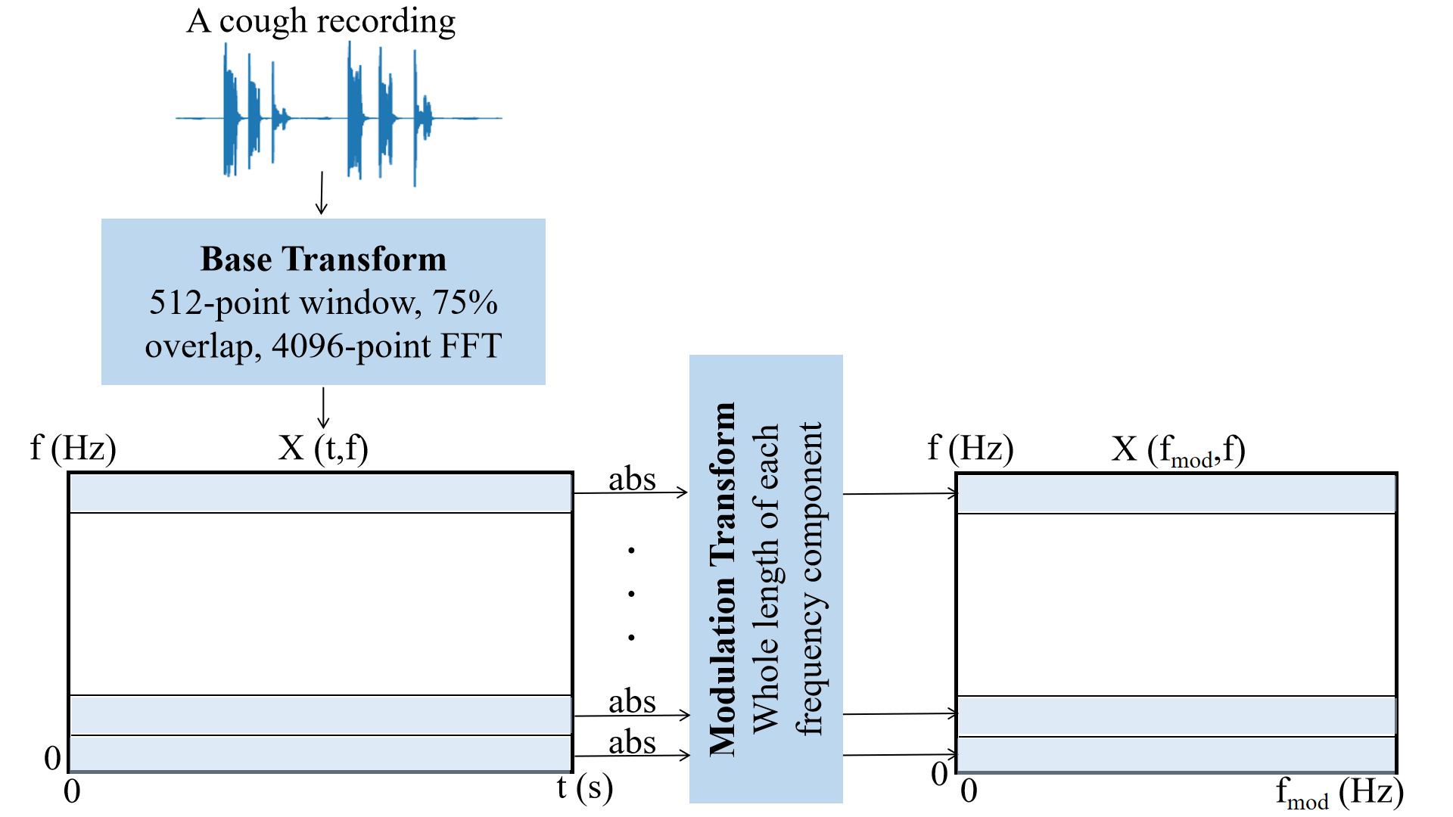
Modulation Spectrogram
A frequency-frequency representation
Dynamics of the frequency components
Speech emotion recognition, speech enhancement, speech intelligibility assessment
Notes:
To overcome such limitations, we here introduce using a new representation, termed ’modulation spectrogram’. [1]In general, it captures the dynamic of the frequency components, and has been applied before in speech enhancement and speech emotion recognition[2]. [3]The basic signal processing idea behind this representation is that on the basis of spectrogram, we then take a second FFT on each frequency components to achieve a frequency-frequency representation. Now, without getting into too much detail, I’ll show you guys a few visualizations.

Slide 6
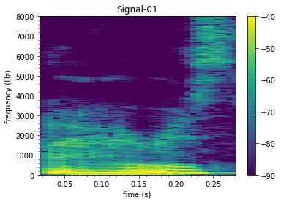
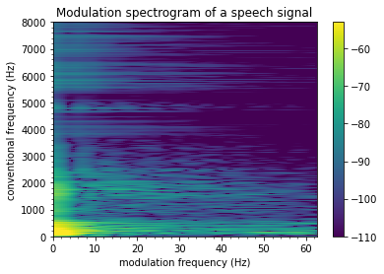
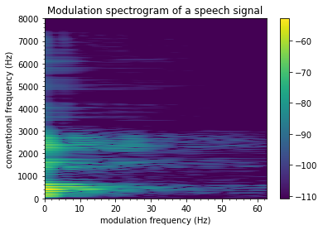
Spectrogram vs Modulation Spectrogram (during the utterance ‘virus’)
COVID
Non-COVID
Frequency (Hz)
Frequency (Hz)
Time (s)
Time (s)
Frequency (Hz)
Frequency (Hz)
Modulation frequency (Hz)
Modulation frequency (Hz)
Notes:
Here is a side-by-side comparison of spectrogram and modulation spectrogram during the utterance of the word ‘virus’. Without getting lost in the graph, I will point out the difference between COVID and healthy. [1]In spectrogram, if we estimate the track of formants and pitch, you would see a similar pattern between COVID and healthy. In contrast, if you look at modulation spectrogram, we start to see more discrimination. [2]1. Higher energy between 0-10 modulation frequency 2. Separated peaks at conventional frequency 2 and 3kHZ 3. Higher energy between 20-40 modulation frequency above 4kHz. Now let’s see some examples for cough.

Slide 7
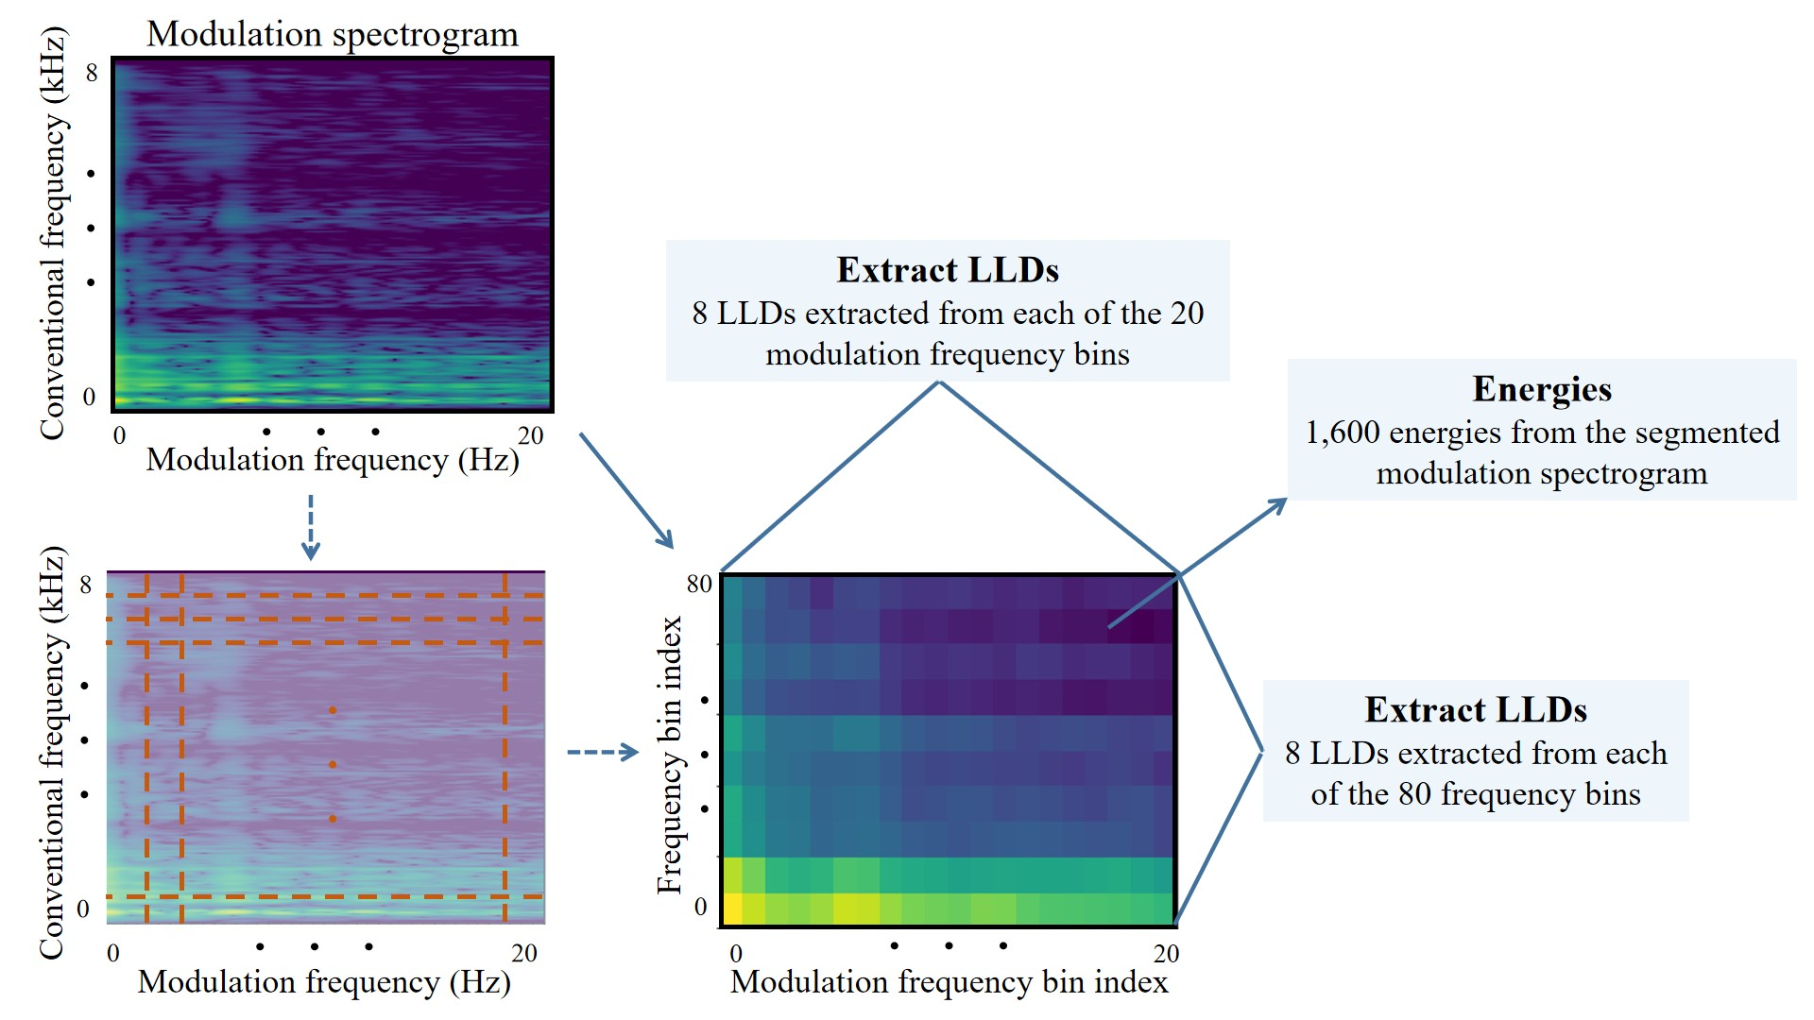
Modulation spectrogram features (MSF)
Energies
400 energies from the quantized modulation spectrogram
Classifier
Extract LLDs
8 LLDs extracted from each of the 20 frequency bins

Slide 8
Feature fusion
Spectral information
Patient information
openSMILE
MSF
Metadata
Joint feature set
Feature selection
Classifier

Slide 9
Experiments
Task 1
Task 2
Task 3
Individual feature set
All features
Fused feature sets
Feature selection
Feature selection
Feature selection
Training (Set-1)
Training (Set-1)
Training (shuffled)
Testing (Set-2&3)
Testing (Set-2&3)
Testing (shuffled)

Slide 10
Results
Best performer for test set 2: MSF
Best performer for test set 3: openSMILE
Metadata alone does not achieve good performance
Robust performance achieved with 35 features
UAR: unweighted average recall; TPR: true positive rate; FPR: false positive rate

Slide 11
Experiments
Task 1
Task 2
Task 3
Individual feature set
All features
Fused feature sets
Feature selection
Feature selection
Feature selection
Training (Set-1)
Training (Set-1)
Training (shuffled)
Testing (Set-2&3)
Testing (Set-2&3)
Testing (shuffled)

Slide 12
Results
Fused feature set has the most robust peformance across schemes
Metadata improves performance over using modulation/spectral features

Slide 13
Average modulation spectrogram for COVID and non-COVID speech
COVID
non-COVID

Slide 14
Top features
Find intersection among top-10 features across schemes
Modulation spectral descriptor at 1kHz -> vocal coarseness
Spectral entropy -> muffled speech
Loss of smell and taste

Slide 15
Future studies
A COVID detection system that is...
transferable across datasets
applicable in a real-world setting
sustainable and energy-efficient

