Slide 1
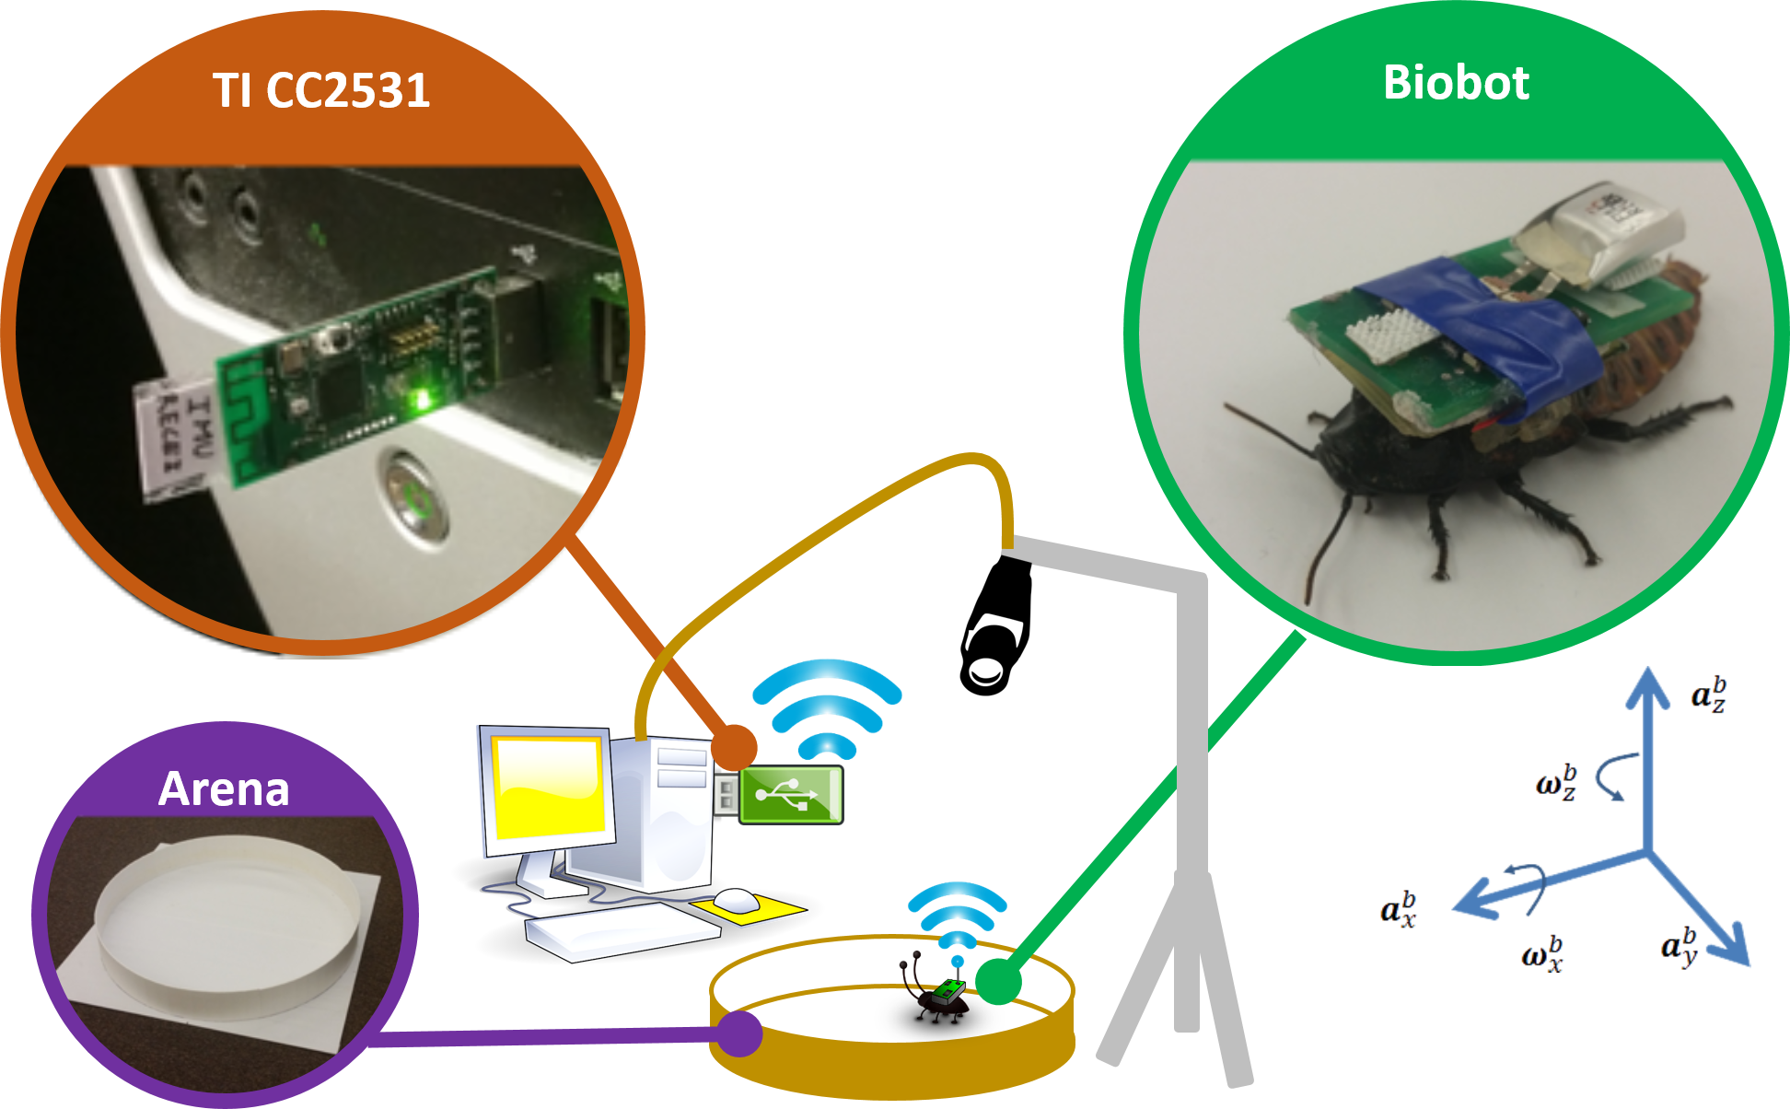
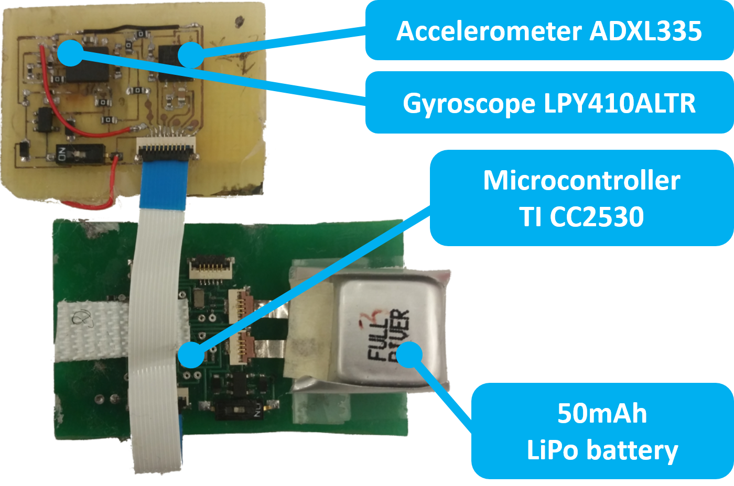
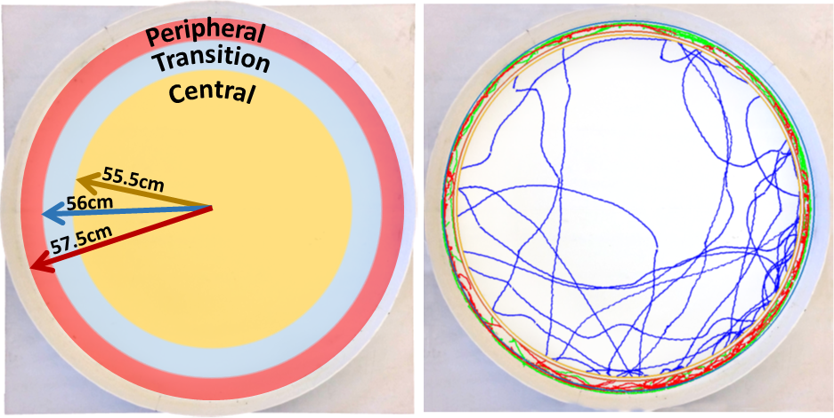
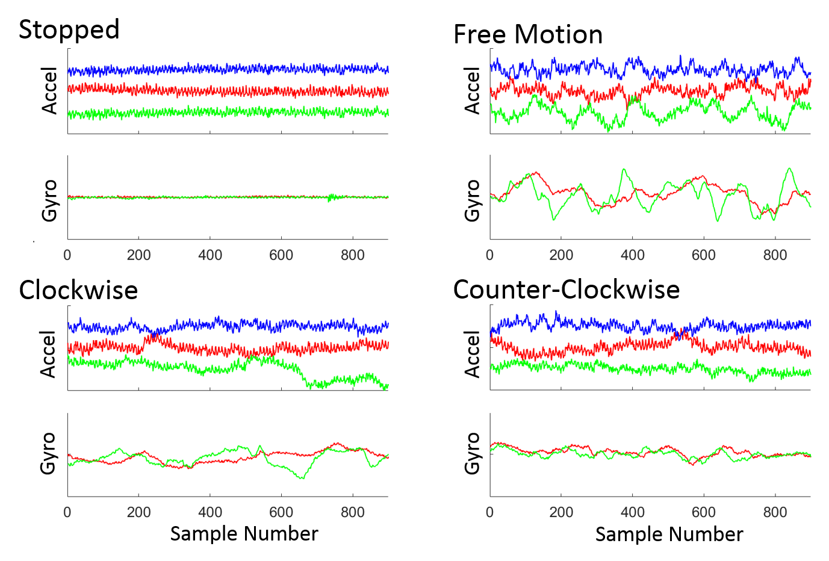
A STUDY ON MOTION MODE IDENTIFICATION FOR CYBORG ROACHES
Jeremy Cole, Farrokh Mohammadzadeh, Christopher Bollinger, Tahmid Latif, Alper Bozkurt, Edgar Lobaton
North Carolina State University
Active
Robotic
Sensing Laboratory
Abstract
This work demonstrates the ability to accurately detect the movement state of Madagascar hissing cockroaches equipped with a custom board containing a five degree of freedom inertial measurement unit. The cockroach moves freely through an unobstructed arena while wirelessly transmitting its accelerometer and gyroscope data. Multiple window sizes, features, and classifiers are assessed. An in-depth analysis of the classification results is performed to better understand the strengths and weaknesses of the classifier and feature set. The conclusions of this study show promise for future work on cockroach motion mode identification and localization.
Experimental Setup
Analysis
Analysis of feature set, segmentation, and classifier using four metrics (accuracy, precision, recall, and F₁ score.
Highlighted blue columns show the best configurations.
Precision matrix calculated using 1.5 second window size, all features, and SVM.
Performance under varying window size
Window Size | 0.5s | 1.0s | 1.5s | 2.0s
Avg. Accuracy | 0.9123 | 0.9290 | 0.9302 | 0.9336
Precision | 0.8168 | 0.8450 | 0.8666 | 0.8531
Recall | 0.8118 | 0.8535 | 0.8603 | 0.8476
F₁ Score | 0.8143 | 0.8492 | 0.8634 | 0.8503
Five Degree of Freedom IMU Backpack with components labeled.
Performance under varying feature set
Feature Set | FT | FS | FW | FTS | FTW | FSW | FTSW
Avg. Accuracy | 0.9185 | 0.9125 | 0.8371 | 0.9262 | 0.9222 | 0.9157 | 0.9302
Precision | 0.8305 | 0.8313 | 0.7074 | 0.8581 | 0.8450 | 0.8355 | 0.8666
Recall | 0.8354 | 0.8281 | 0.7031 | 0.8502 | 0.8422 | 0.8350 | 0.8603
F₁ Score | 0.8329 | 0.8297 | 0.7052 | 0.8542 | 0.8473 | 0.8352 | 0.8634
Problem Statement
The goal is to classify four types of roach movements: Stationary, Freely Moving, Clockwise Wall-Following, Counter Clockwise Wall-Following.
Sensor Backpack is attached to the roach, who is then allowed to move in a circular arena for one hour.
Movement in the peripheral zone is defined to be wall-following.
Movement in the central zone is defined to be freely moving.
Movement in the transition zone is neither wall-following nor freely moving.
Absence of movement is defined to be stationary, regardless of the zone.
Performance under varying classifier
Classifiers | SVM | RF | LDA | kNN
Avg. Accuracy | 0.9302 | 0.9238 | 0.9226 | 0.9081
Precision | 0.8666 | 0.8470 | 0.8530 | 0.8255
Recall | 0.8603 | 0.8437 | 0.8405 | 0.8292
F₁ Score | 0.8634 | 0.8454 | 0.8467 | 0.8274
Sample Signals and Feature Vector
System setup with zones labeled. The roach’s trajectory is also shown, where black = stationary, blue = freely moving, green = clockwise wall-following, red = counter clockwise wall-following. The coordinate frame of the IMU is shown relative to the roach.
Precision Matrix
 | S | FM | CW | CCW
S | 0.9315 | 0 | 0.0093 | 0.0055
FM | 0.0548 | 0.7669 | 0.0926 | 0.0609
CW | 0.0137 | 0.1805 | 0.8759 | 0.0416
CCW | 0 | 0.0526 | 0.0222 | 0.8920
Proposed System Diagram
This Paper focuses here
Activity Recognition
Acronyms: S (Stationary), FM (Freely Moving), CW (Clockwise wall-following), CCW (counter clockwise wall-following). FT (Temporal Features), FS (Spectral Features), FTS (Temporal & Spectral Features), FTW (Temporal & Wavelet Features), FSW (Spectral & Wavelet Features), FTSW (All Features), AHRS (Attitude Heading Reference System), SVM (Support Vector Machine), RF (Random Forest), LDA (Linear Discriminant Analysis), kNN (k-Nearest Neighbors).
Sample IMU Signals shown for different motion modes. Accelerometer measurements show the x (red), y (green), and z (blue) axes. Gyroscope measurements show the x (green) and z (red) axes. Signals are vertically shifted to improve visibility.
Group (# Features) | Name (# Features)
Temporal (47) | Mean (5), Variance (5), Skewness (5), Kurtosis (5), Range (5), Gyro Energy (2), Correlation between Axes (10), Mean Absolute Deviation (5), Interquartile Range (5)
Spectral (40) | Average Power Spectral Density (5) Magnitude of Fourier Coefficients (30) , Spectral Entropy (5)
Wavelet (30) | Wavelet Coefficient Energy (25) Wavelet Fractal Dimension (5)
IMU
Signals
Gait
Detection
Roach Displacement
Roach
Pose
Conclusions
Current approach can differentiate between two types of wall-following as well as moving and non-moving.
There is a non-trivial misclassification rate when distinguishing between freely moving and wall-following. This will be addressed in future work.
AHRS
Acknowledgement
This work was fully funded by the National Science Foundation under the cyber-physical Systems Program (Award Number 123943).
117 Features total.
Features are those that are commonly used for human activity recognition using inertial sensors.
Notes:
FINAL

