Slide 1
THE USTC SYSTEM FOR CADENZA 2024 CHALLENGE
Hongbo Lan, Tianyou Cheng, Maokui He, Hang Chen, Jun Du
University of Science and Technology of China, Hefei, China
IEEE ICASSP 2024

Slide 2
Contents
1 Introduction
2 Methods
3 Experiments and Results
4 Conclusion

Slide 3
Contents
1 Introduction
2 Methods
3 Experiments and Results
4 Conclusion

Slide 4
Introduction
The WHO reports that over 1.5 billion people world wide suffer from hearing loss﻿.
Hearing loss makes it harder to discern lyrics.
Hearing loss causing music to sound duller as high-frequency disappear.
By 2050, at least 700 million people will require hearing rehabilitation.
The Cadenza 2024 Challenge :
Develop systems to rebalance music and improve the listening experience.
Use the HAAQI (Hearing Aid Audio Quality Index) score to evaluate processed signals.

Slide 5
Introduction
We propose a signal processing system that can personalize the mixing of music for the Cadenza 2024 Challenge.
Fine-tune the HDemucs model on the given dataset.
Explore the effect of training set size on the model.
Explore different training goals for different stages of output.
Add the original audio in downmixing stage to make up for some lost information.

Slide 6
Contents
1 Introduction
2 Methods
3 Experiments and Results
4 Conclusion

Slide 7
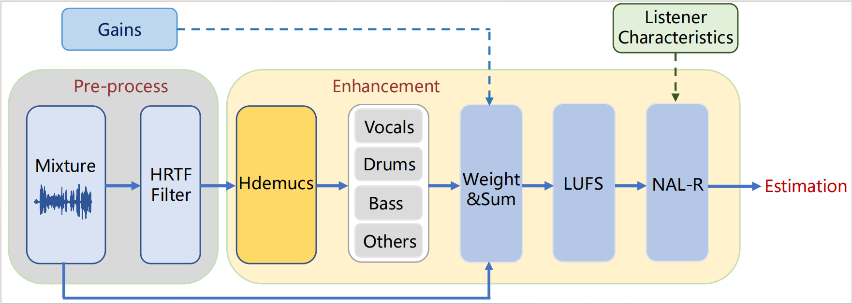
Methods
System architecture

Slide 8
Methods
Hybrid Demucs model can split mixtures into four stems: vocals, drums, bass, and others (VDBO).
A hybrid dual U-Net encoder-decoder model.
Time branch, frequency branch and shared layers.
Local attention instead of regular attention.
Group normalization and low rank SVD method for stable training

Slide 9
Methods
Fine-tune models with a multi-target strategy.
Using a combination of outputs from different stages as a training target for separating models
Training with mean absolute error loss function.
Applying an average weighting to the four VDBO sources.

Slide 10
Methods
Post-processing for demixing stage.
Fusing signals from models that emphasizing different objectives.
Adding a percentage (e.g.0.15) of the original audio to the mixing signal.

Slide 11
Contents
1 Introduction
2 Methods
3 Experiments and Results
4 Conclusion

Slide 12
Experiments and Results
Experiments setup.
Train set : songs simulated by MUSDB-18HQ train set.
Validation set: songs simulated by MoisesDB data set .
Test set: songs simulated by MUSDB-18HQ eval set.
Training on 3 NVIDIA GTX-3090 GPUs with 24GB of RAM, using a batch size of 24 and an 8-second segments.

Slide 13
Experiments and Results
Explore the effect of training set size on the model.
The size of the training data does not have a significant effect on performance
Considering the training efficiency, we choose to use 200 scenes to fine-tune model.

Slide 14
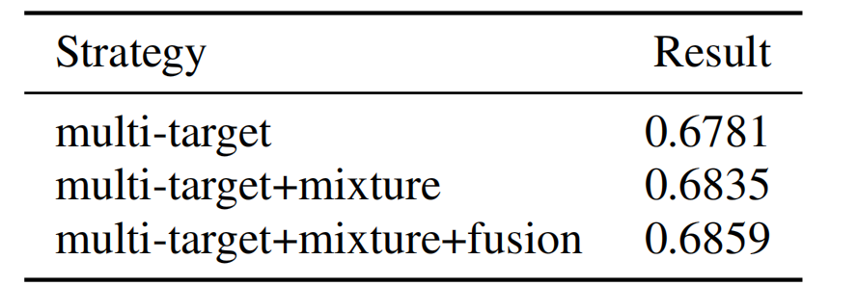
Experiments and Results
Results obtained using different strategies.
All results are based on fine-tuning
Mixing original mixture information with multiple-targets is effective
Model fusion achieve better scores

Slide 15
Experiments and Results
Best HAAQI score of our system.
Note that the validation dataset is based on the MoisesDB dataset while the test dataset is based on the MUSDB-18HQ dataset and the real audiograms.

Slide 16
Contents
1 Introduction
2 Methods
3 Experiments and Results
4 Conclusion

Slide 17
Conclusion
We propose a system based on HDemucs model for music rebalancing for the hearing impaired.
The system includes the use of HRTF simulation, multi-target training , fusion, and post-processing of original information.
The model has limitations in effectively handling cases of severe hearing loss, indicating an area for future improvement and research focus

Slide 18
Conclusion
Future Prospects
Utilization of auditory characteristics
Optimization of multi-target training
Approaches in sequence modeling
…

Slide 19
Q&A
Thanks for listening!
If you have any questions about this paper, welcome to leave a comment and I will answer them.

