Slide 1
Logobereich
Jointly Learning Selection Matrices for Transmitters, Receivers, and Fourier Coefficients
Han Wang *, †, Yiming Zhou*, ‡, Eduardo Pérez*, †, Florian Römer*, †
* Applied AI Signal Processing and Data Analysis, Fraunhofer Institute for Nondestructive Testing, Germany
† Technische Universität Ilmenau, Germany
‡ Hochschule für Technik and Wirtschaft des Saarlandes, Germany

Slide 2
Overview
Problem Formulation and Motivation
Uniform Linear Array
Samples
Target/Scatterer/Reflector
Transmitters
Receivers
$$y=Ax+n$$

Slide 3
Overview
Structured Compressed Sensing / Subsampling
How can we subsample the data?
Reducing transmitters, receivers, and Fourier coefficients.
How to optimize the subsampling pattern?
Joint Deep Probabilistic Subsampling.
Samples
Which optimization target can we consider?
Transmitters
Signal/Image reconstruction error. (task-based learning)
Receivers

Slide 4
Structured Subsampling
Kronecker product connects selection matrices
$$M_{T}$$
from
$$N_{T}$$
transmitters
$$S_{T}∈ℝ^{M_{T}×N_{T}}$$
Select
$$M_{R}$$
from
$$N_{R}$$
receivers
$$S_{R}∈ℝ^{M_{R}×N_{R}}$$
$$M_{F}$$
from
$$N_{F}$$
coefficients
$$S_{F}∈ℝ^{M_{F}×N_{F}}$$
Row-wise one-hot matrix
Subsampling Process:
$$0$$
$$1$$
$$0$$
$$0$$
$$0$$
$$0$$
$$0$$
$$y_{s}=\left(S_{T}⨂S_{R}⨂S_{F}\right)y=Sy$$
$$0$$
$$0$$
$$0$$
$$0$$
$$0$$
$$1$$
$$0$$
$$1$$
$$0$$
$$0$$
$$0$$
$$0$$
$$0$$
$$0$$
Unified Subsampling Matrix:
$$S∈ℝ^{M_{T}M_{R}M_{F}×N_{T}N_{R}N_{F}}$$
$$0$$
$$0$$
$$0$$
$$1$$
$$0$$
$$0$$
$$0$$

Slide 5
Deep Probabilistic Subsampling (SOTA)
Gumbel-Softmax reparameterization trick
Logits
Gumbel Noise
Logits Matrix
$$θ_{1}$$
$$θ_{2}$$
$$θ_{3}$$
$$θ_{4}$$
$$θ_{5}$$
$$θ_{6}$$
$$θ_{7}$$
$$g_{1}$$
$$g_{2}$$
$$g_{3}$$
$$g_{4}$$
$$g_{5}$$
$$g_{6}$$
$$g_{7}$$
$$θ_{1,1}$$
$$θ_{1,2}$$
$$θ_{1,3}$$
$$θ_{1,4}$$
$$θ_{1,5}$$
$$θ_{1,6}$$
$$θ_{1,7}$$
$$θ_{2,1}$$
$$θ_{2,2}$$
$$θ_{2,3}$$
$$θ_{2,4}$$
$$θ_{2,5}$$
$$θ_{2,6}$$
$$θ_{2,7}$$
$$θ_{3,1}$$
$$θ_{3,2}$$
$$θ_{3,3}$$
$$θ_{3,4}$$
$$θ_{3,5}$$
$$θ_{3,6}$$
$$θ_{3,7}$$
$$θ_{4,1}$$
$$θ_{4,2}$$
$$θ_{4,3}$$
$$θ_{4,4}$$
$$θ_{4,5}$$
$$θ_{4,6}$$
$$θ_{4,7}$$
$$Softmax$$
Mask Matrix
$$Argmax$$
$$\sim$$
$$θ_{1,2}$$
$$\sim$$
$$\sim$$
$$\sim$$
$$\sim$$
$$\sim$$
Trainable Parameters of $S$:
$$\sim$$
$$−inf$$
$$\sim$$
$$\sim$$
$$\sim$$
$$\sim$$
$$\sim$$
$$M_{T}M_{R}M_{F}×N_{T}N_{R}N_{F}$$
$$0$$
$$1$$
$$0$$
$$0$$
$$0$$
$$0$$
$$0$$

Slide 6
Joint Deep Probabilistic Subsampling
Network Architecture: From Logits to Selection Vectors
$$0$$
$$1$$
$$0$$
$$0$$
$$0$$
$$0$$
$$0$$
$$Softmax$$
$$TopK$$
$${\tilde{s}}_{T}$$
Selection
Matrix
$$0$$
$$0$$
$$0$$
$$0$$
$$0$$
$$1$$
$$0$$
$$1$$
$$0$$
$$0$$
$$0$$
$$0$$
$$0$$
$$0$$
DPS
$${\tilde{s}}_{R}$$
$$0$$
$$0$$
$$0$$
$$1$$
$$0$$
$$0$$
$$0$$
DPS
$$TopK$$
$${\tilde{s}}_{F}$$
Selection
Vector
Subsampling:
$$y_{s}=\left({\tilde{s}}_{T}⨂{\tilde{s}}_{R}⨂{\tilde{s}}_{F}\right)⨀y$$
$$1$$
$$1$$
$$0$$
$$1$$
$$0$$
$$1$$
$$0$$
Parameters: $N_{T}N_{R}N_{F}$
Parameters: $N_{T}{+N}_{R}+N_{F}$

Slide 7
Learned Sparse Signal Recovery
Complex Learned Fast Iterative Shrinkage-Thresholding Algorithm
$$ISTA: x_{k+1}=S_{λ/L}\left\{\left(I−\frac{1}{L}A^{H}A\right)x_{k}+\frac{1}{L}A^{H}y\right\}$$
$$LASSO: \min_{x}{{\left\|Ax−y\right\|}_{2}^{2}+λ{\left\|x\right\|}_{1}}$$
$$W_{r}$$
$$x_{r}$$
$${W_{r}x}_{r}−W_{i}x_{i}$$
$$y$$
Complex Linear
$$x$$
$$x_{i}$$
$${W_{r}x}_{i}−W_{i}x_{r}$$
$$S_{λ/L}$$
Complex Linear
$$W_{i}$$
Complex-Valued Linear Layer
Phase remains same

Slide 8
Global Network Architecture
Task-based supervised learning
Global Structure:
$$\hat{x}$$
DPS
Selection Vector
CL-FISTA
Output
Input
$$y$$
1. L1 Norm
2. L2 Norm
3. Huber Loss
Ground Truth
$$x$$
$$𝓛={\left\|x−\hat{x}\right\|}_{p}$$

Slide 9
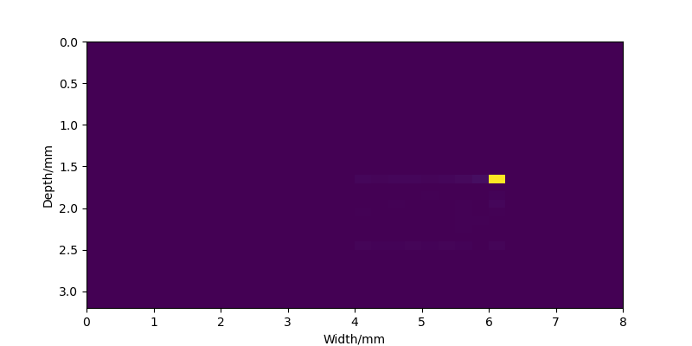
Summary
Evaluation and Conclusion
Evaluation Metrics:
Summary:
1. Contrast-to-Noise Ratio
1. Gumbel-Softmax is applied to form one-hot row.
2. Reconstruction Error
2. TopK trick converts matrix to vector.
3. Parallel structure enables joint learning.
4. Customized complex-valued layers are used for complex-valued signal recovery.
Fig. Reconstructed Image at Compression Ratio = 2.5%

