Slide 1
Improving Prosody with Linguistic and BERT Derived Features in Multi-speaker Based Mandarin Chinese Neural TTS
Yujia Xiao Lei He Huaiping Ming Frank K. Soong
Microsoft China
4/17/2020

Slide 2
Overview
Motivation
Tacotron2
Limited training data - Multi-speaker Tacotron2
Insufficient input information - Involving external information
Proposed Models with External Information
LinFeat: Linguistic Feature based Tacotron Model
BertBr: Break Predicted by Refined Bert-CRF model
BertEmb: character embedding from Bert model
Experiments
Conclusion

Slide 3
Motivation

Slide 4
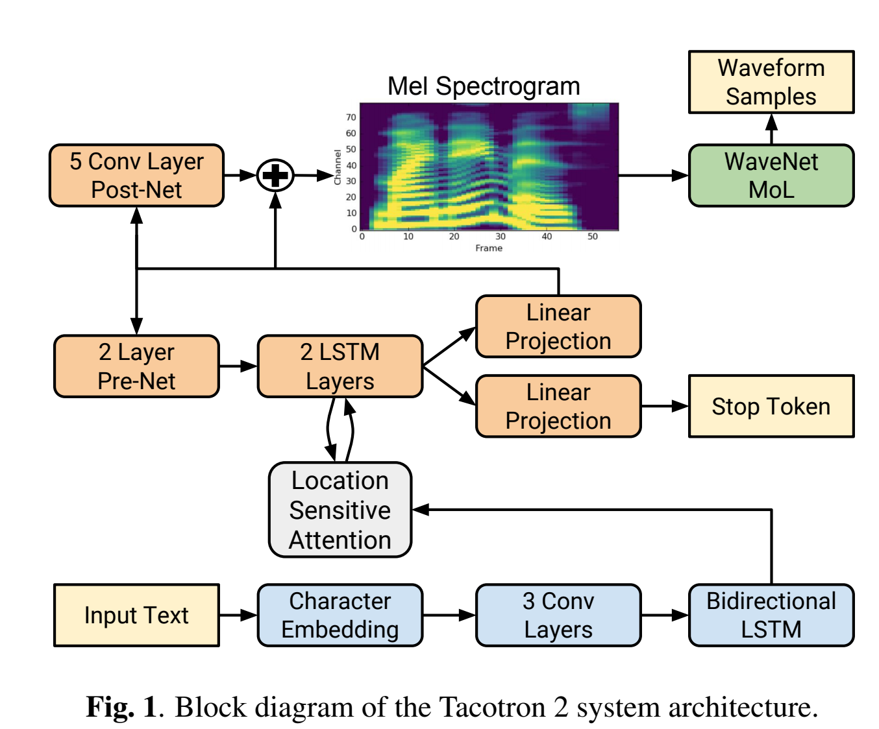
Motivation
Tacotron2
Natural, high quality TTS
Occasional instability
limited training data from target speaker
out of domain input, insufficient info to be inferred from the training data
*Diagram refers to https://arxiv.org/pdf/1712.05884.pdf.

Slide 5
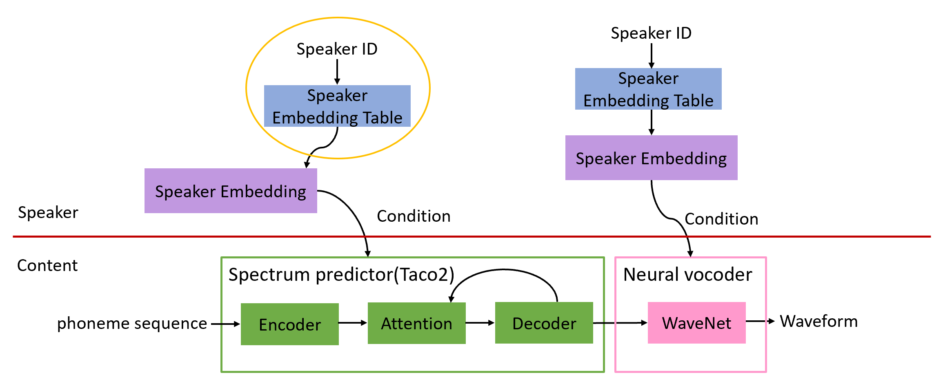
Motivation
Limited training data
Multi-speaker Tacotron2 (Baseline)
- leverage data from other speakers
*Refer to Yan’s work: https://arxiv.org/pdf/1812.05253.pdf

Slide 6
Motivation
Insufficient input information
For Chinese, wrong breaks leads to bad prosody.
“How are you feeling today? “
“你今天感觉怎么样？”
Input Chinese Characters: thousands or more, too heavy for real services.
Input Phoneme-like sequence as in English: succinct to represent, but the underlying semantic information become more complicate to model due to homonyms.
In this work, improve our Chinese TTS quality by employing external semantic and prosodic information.

Slide 7
Proposed Models
with External Information

Slide 8
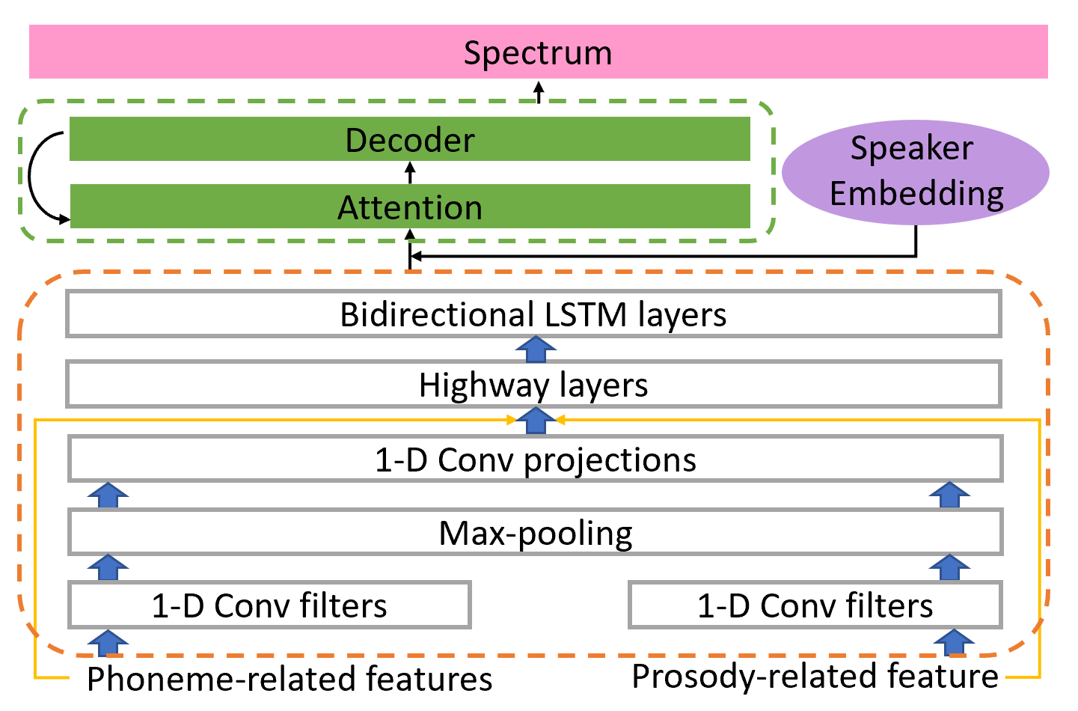
LinFeat: Linguistic Feature based Tacotron Model
Replace phone input with Linguistic feature
Using both phoneme- and prosody-related features as input
ID of the current phoneme; two preceding and succeeding phonemes
Break tag (Br0 - 4) predicted by CRF model integrated in the font-end; Chinese tones;
sentence type

Slide 9
BertBr: Break Predicted by Refined Bert-CRF model
Integrate break tags into phone input sequence
Input Example:
s . a_h . nn_h / br0 / d . a_h . a_l / br1 / yv . el_h . nn_l / br0 / yi . el_l . ng_h / br0 / sh . aa_h . ng_h / br2 ……
Bert: for modeling natural language, found effective in many NLP task
Bert-CRF: pre-trained, Chinese Bert model refined with CRF layer(s) for conditioning its output with sentence level information
*Break prediction refers to Dongxu’s work.

Slide 10
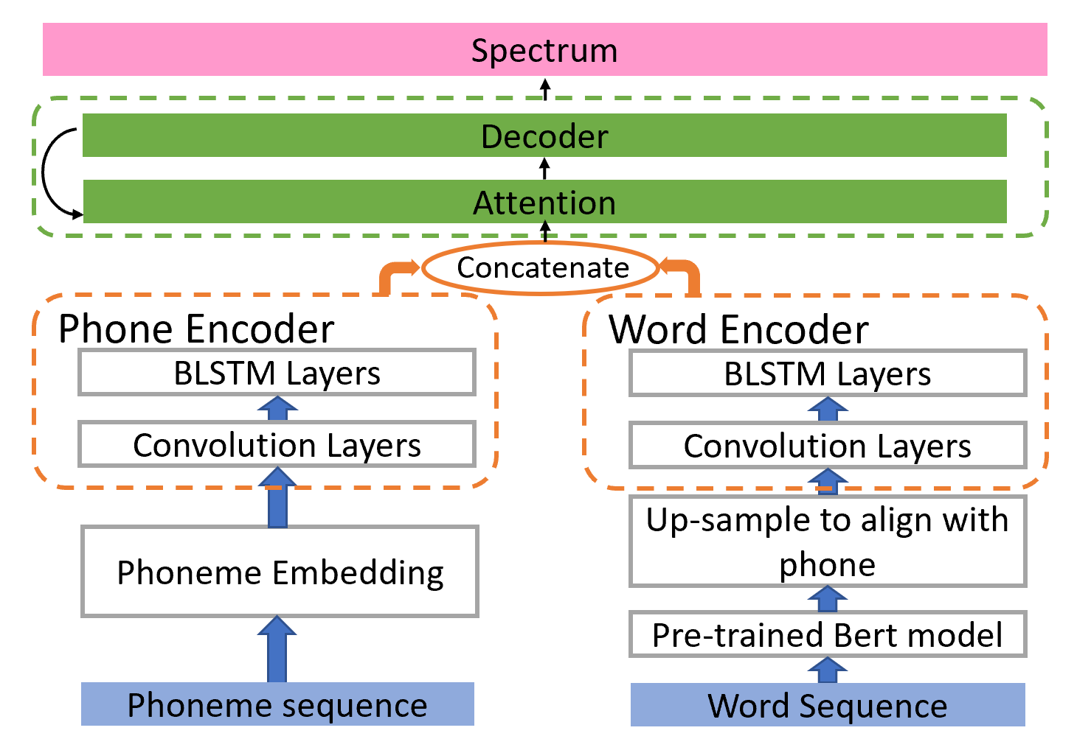
BertEmb: character embedding from Bert model
Character embeddings in pre-trained Chinese Bert model
Good performance in a single speaker neural TTS model (+ 0.182 CMOS gain)

Slide 11
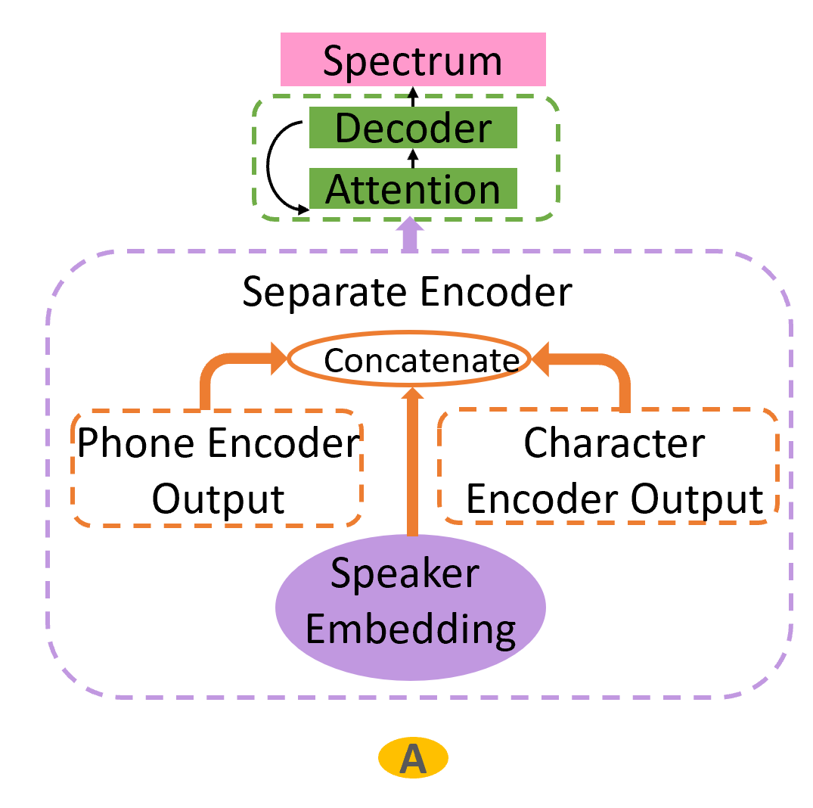
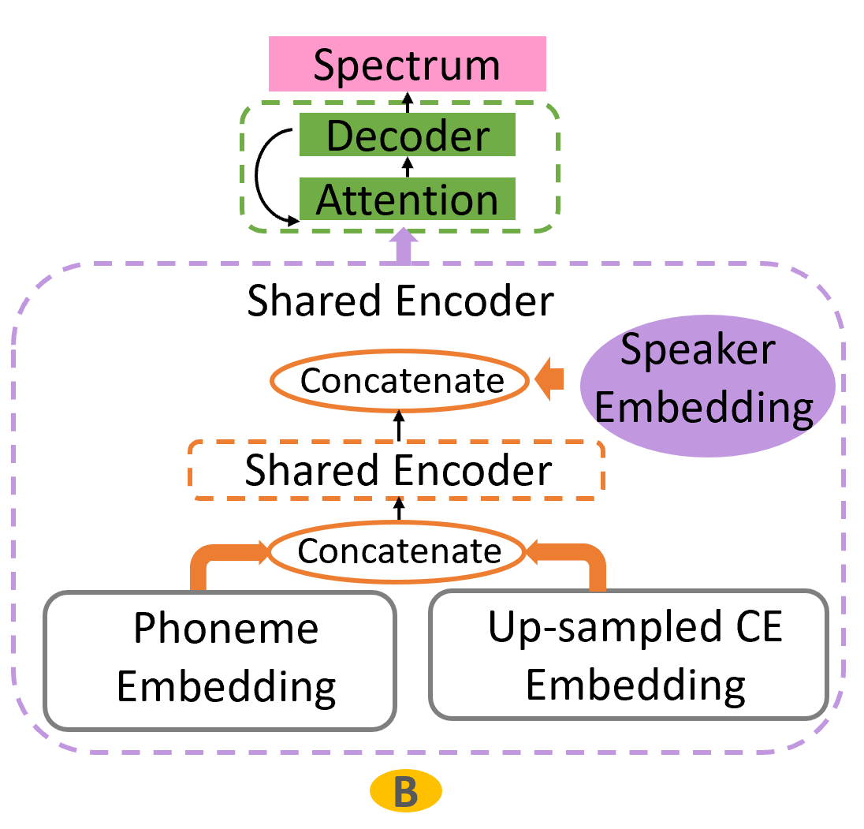
BertEmb: character embedding from Bert model
Character embeddings in pre-trained Chinese Bert model
For multi-speaker neural TTS model, Phone and character embeddings are concatenated first and sent to a shared encoder, whose output is then concatenated with speaker embedding.
0.144 CMOS gain

Slide 12
Experiments

Slide 13
Experiments
Training and Testing
Training
Source model: trained on 110 hrs speech of 13 different speakers
Target speaker model: 8 hrs of speech of target speaker to adapt the source model to the target speaker
Domain: News
Test
In-domain test: news title and content
Out-of-domain test: chat
Extra test: audio-book

Slide 14
Experiments
Domain Description
News Title & News Content
News Content is relatively close to our training data
News Title is more challenging for its abbreviations and incomplete expression
Chat
Sentence structures and words using in Chat is much simpler than that in News
Contains many modal particles, which is different from the training data.
Audiobook
Covering and beyond challenges of both News and Chat.
Sentences are usually long and in a more distinctive style.
Its story telling tends to be more expressive than News.

Slide 15
Experiments
Subjective listening tests
CMOS test
10 native speakers listen, compare and score the samples generated by two different models; 7 integer scores from -3 to +3
MOS test
25 native speakers listen and give scores in a scale of 5 points; 1:Bad, 2:Poor, 3:Fair, 4:Good, 5:Excellent, including recordings for benchmark calibration

Slide 16
Experiments
Baseline vs Proposed Models
In-domain (News Title & News Content)
All proposed models perform better than the baseline
Gain in News Title consistently higher than News Content

Slide 17
Experiments
Baseline vs Proposed Models
Out-of-domain (Chat)
LinFeat: worst; cannot handle mismatched context well
BertBr: on-par with the baseline, focusing on the break improvement
BertEmb: best, semantic and contextual info encoded in the pretrained Bert model helps

Slide 18
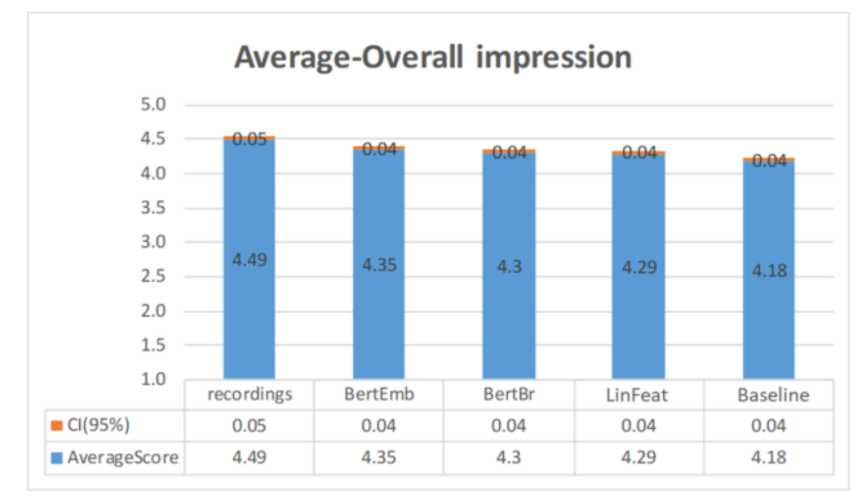
Experiments
Overall performance (MOS Test)
Test scripts (News and Chat)
All proposed models perform better than the baseline (+0.11, +0.12, +0.17).
BertEmb: best, only 0.14 lower than recordings.

Slide 19
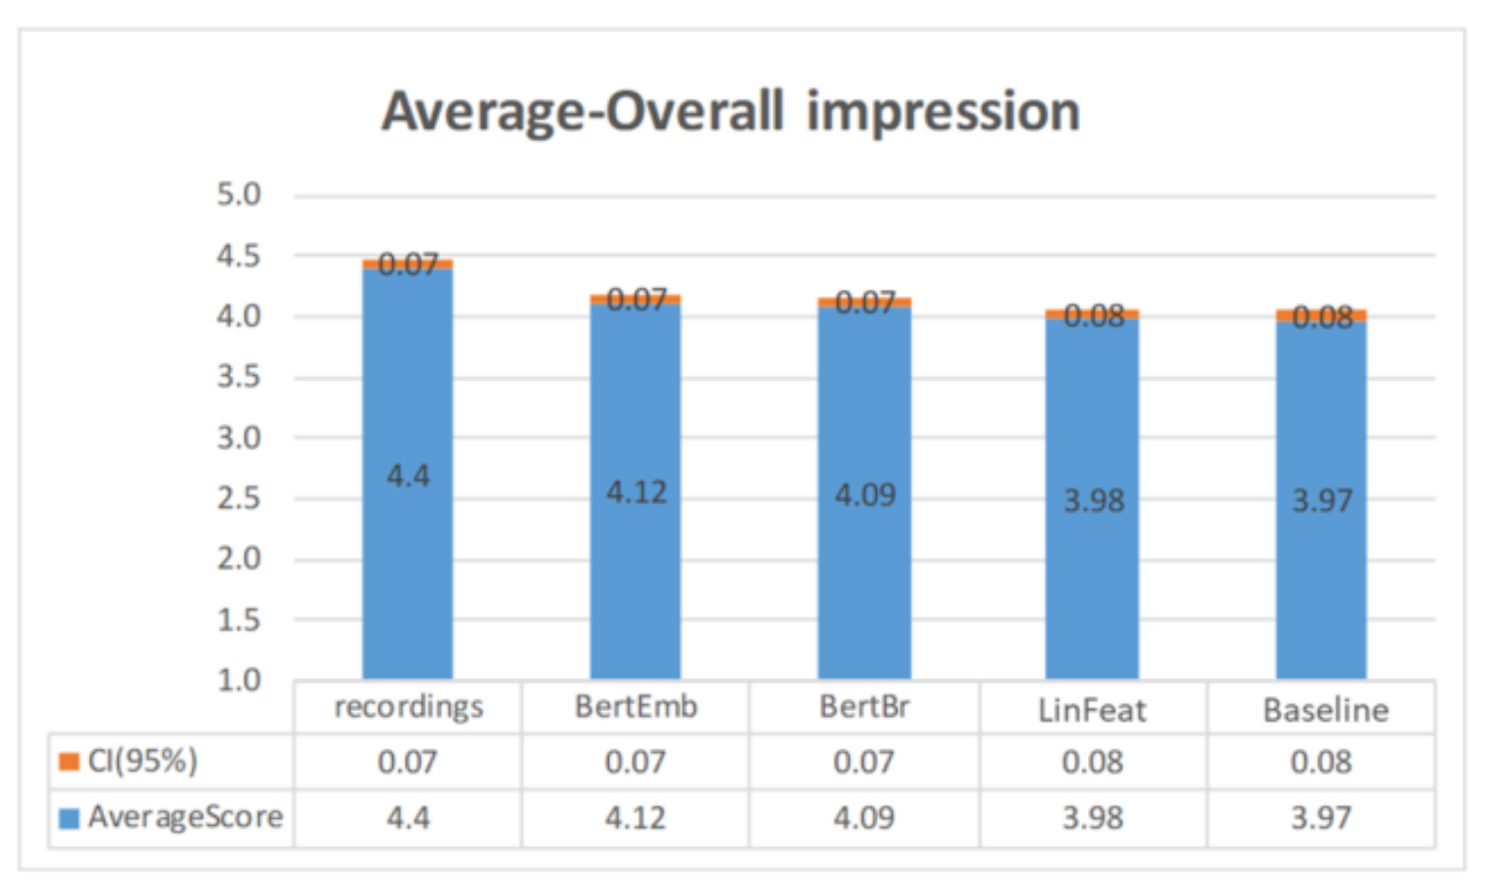
Experiments
Audiobook domain (MOS Test)
All MOS scores lower than those in previous MOS tests
The rank ordering among all models are the same as in previous MOS test

Slide 20
Summary
By exploiting external semantic and prosodic information, all models (LinFeat, BertBr, BertEmb) can improve TTS quality.
BertEmb model is most effective; outperforms the baseline for both in- and out-domain tests.
Semantic information (phoneme/character embeddings) should be integrated before incorporating speaker information.
Audiobook domain is more challenging than News/Chat domain and can be investigated further.

Slide 21
Thanks!

Slide 22
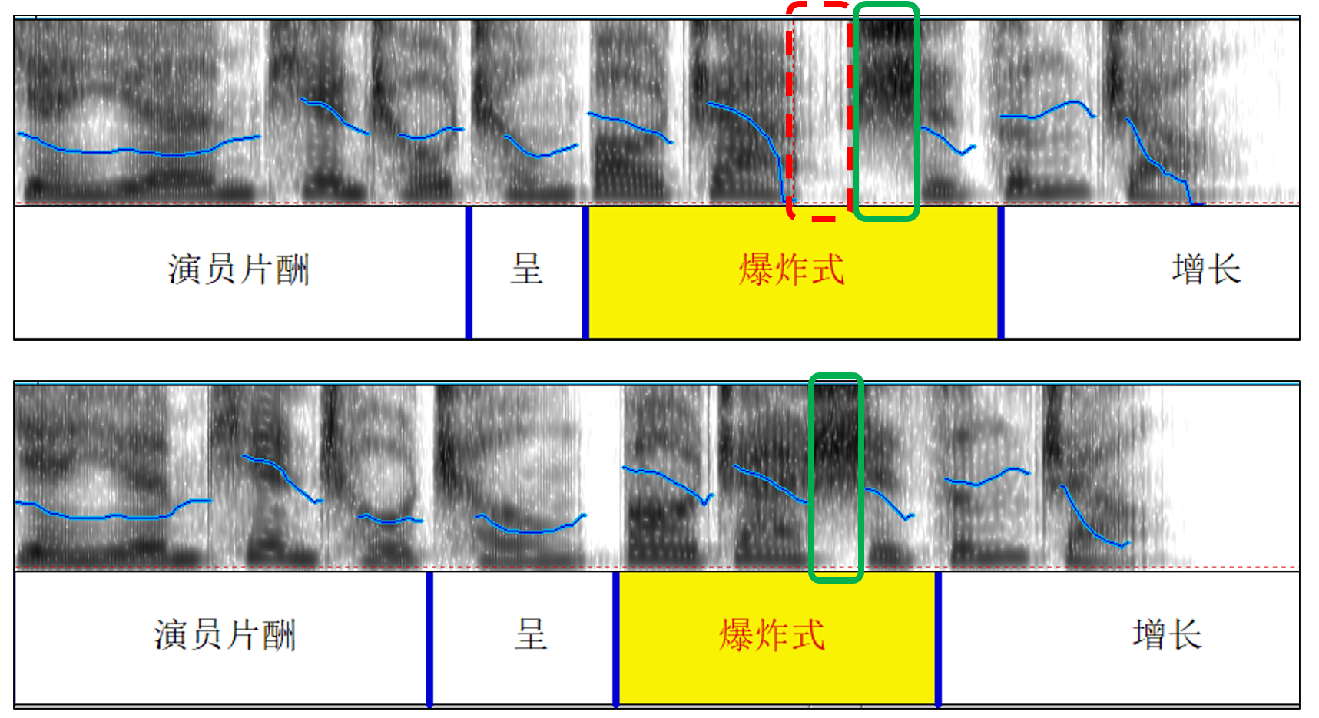
Appendix – Break Issue
Break issue fix – before and after
An example from baseline model with improper break in highlight phrase (the red rectangle with dashed line).
The same example produced by BertEmb model with a more appropriate break pattern.

Slide 23
Appendix - Samples
Baseline VS LinFeat
Text | Baseline | LinFeat
俄外长谈中东问题: 不容许“操纵安理会决议”。
韩国电视圈罢工潮愈演愈烈。
演员片酬呈爆炸式增长。

Slide 24
Appendix - Samples
Baseline VS BertBr
Text | Baseline | BertBr
意大利政府网站因官员晒收入访问过量被挤爆。
茅台成龙酒珍藏版售16800元。
北京队酒店安保升级便衣盘查。

Slide 25
Appendix - Samples
Baseline VS BertEmb
Text | Baseline | BertEmb
霸王龙咬合力高达3.5万牛顿为鳄鱼10倍。
最新教育部认可美国大学名单。
女子坐过山车遇加速致颈椎脱落。
数千台农抗议进口瘦肉精牛肉。

