Slide 1
Boosting Noise Robustness of Acoustic
Model via Deep Adversarial Training
Bin Liu
Institute of Automation,
Chinese Academy of Sciences
April 20, 2018
bin.liu2015@nlpr.ia.ac.cn

Slide 2
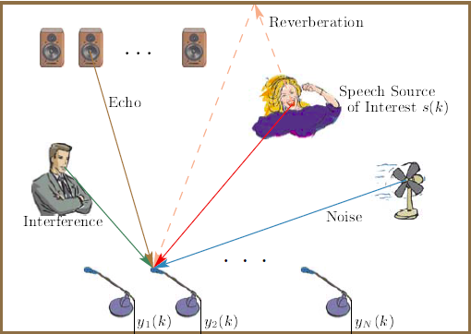
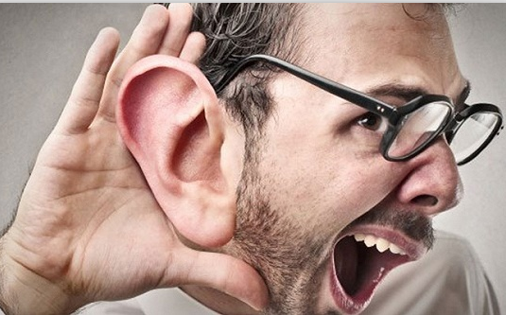
1. Introduction
The real-world auditory environments
Noise &
Interference
Echo
Reverberation
Interfering speech and reducing the performance of speech interaction

Slide 3
1. Introduction
The real-world auditory environments
clean speech
noisy speech
Speech Enhancement

Slide 4
1. Introduction
Speech enhancement
Signal Processing-based Speech Enhancement
f
Filter Design
Learning-based Speech Enhancement
Feature Extraction
Supervised Learning
Separation Targets
Synthetize

Slide 5
1. Introduction
Speech enhancement
More complex pipelines, more computations, higher hardware costs.
Use a particular form of loss functions. The speech distortions and mismatches to training sometimes degrade the ASR performance.
clean
noisy
enhanced

Slide 6
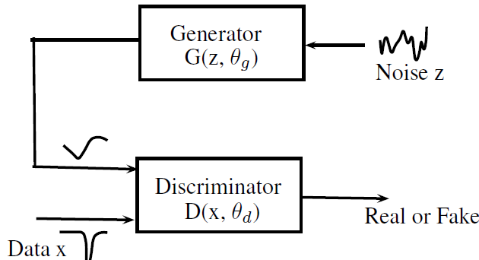
2. Generative Adversarial Nets
Generative Adversarial Nets
Discriminator D: as well as possible at detecting the generator’s “fakes”.
Generator G: produce outputs that cannot be distinguished from “real” samples by D.
[1]Ian J. Goodfellow, Jean Pouget-Abadie, Mehdi Mirza, Bing Xu, David Warde-Farley, Sherjil Ozair, Aaron Courville, and Yoshua Bengio, “Generative adversarial nets,” in International Conference on Neural Information Processing Systems, 2014, pp. 2672–2680.
[2]Bajibabu Bollepalli, Lauri Juvela, and Paavo Alku, “Generative adversarial network-based glottal waveform model for statistical parametric speech synthesis,” in INTERSPEECH, 2017.

Slide 7
2. Generative Adversarial Nets
GAN Formulation
LS-GAN
GAN Applications
Speech conversion, synthesis, enhancement
Spoken language identification
[1] Xudong Mao, Qing Li, Haoran Xie, Raymond Y. K Lau, Zhen Wang, and Stephen Paul Smolley, “Least squares generative adversarial networks,” 2016.

Slide 8
3. Deep Adversarial Training For Robust ASR
Architecture

Slide 9
3. Deep Adversarial Training For Robust ASR
Architecture
Classifier
recognize the senones
Minimizng the category loss
Formulation
$$\min_{C}{V\left(C\right)=}𝔼_{h\sim p_{h}(h)}\left[−\log\left(C\left(k | h\right)\right)\right]$$

Slide 10
3. Deep Adversarial Training For Robust ASR
Architecture
Discriminator
tries to classify a signal as the clean or enhanced
Formulation
$$\min_{D}{V\left(D\right)=\frac{1}{2}}𝔼_{x\sim p_{data}(x)}\left[{\left(D\left(x\right)−1\right)}^{2}\right]$$
+ ${\frac{1}{2}𝔼}_{\tilde{x}\sim p_{data}(\tilde{x})}\left[{\left(D\left(G\left(\tilde{x}\right)\right)\right)}^{2}\right]$

Slide 11
3. Deep Adversarial Training For Robust ASR
Architecture
Generator
trained to produce outputs that cannot be classified from “real” samples by D.
Formulation
$\min_{G}{V_{GAN}\left(G\right)}{=}$ ${\frac{1}{2}𝔼}_{\tilde{x}\sim p(\tilde{x})}\left[{\left(D\left(G\left(\tilde{x}\right)−1\right)\right)}^{2}\right]$
$$\min_{G}{V\left(G\right)=}αV_{GAN}\left(G\right)+V\left(C\right)$$

Slide 12
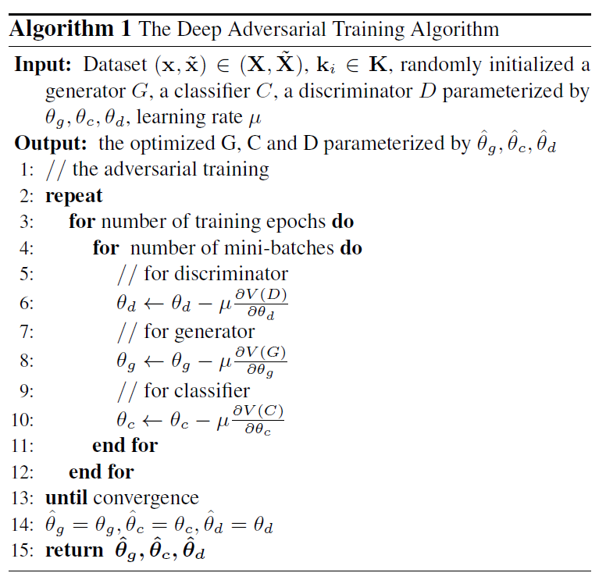
3. Deep Adversarial Training For Robust ASR
Training
Algorithm 1 The Deep Adversarial Training Algorithm
We alternatively train the parameters
of D, G and C to fine-tune the model.
Three components are implemented with neural networks and the parameters are updated by stochastic gradient descent.

Slide 13
4. Experiments
Dataset
CHiME-4 corpus | Real | Simulated
Training set | 1,600 | 7,138
Development set | 1,640 | 1,640
Test set | 1,320 | 1,320
Setup
80-dimensional filter-banks as the input features.
The frame-level targets required in training come from a well trained Gaussian Mixture Model (GMMHMM) system.

Slide 14
4. Experiments
Setup
component | Architecture
Generator | 8 2-D strided convolutional layers, 3 *3 filters and 2 *1 strides
Discriminator | MLP with two hidden layers of 1024 neurons, Relu, dropout with 0.3
Classifier | MLP with only one hidden layer of 1024 neurons
The baseline system is built following the Kaldi chime4/s5 1ch recipe.
‘CE-train’ : optimized by minimizing the cross-entropy loss.

Slide 15
4. Experiments
Results
We evaluate how the hyper-parameter α affects the performance of ASR. α specifies the tradeoff between the adversarial loss and the category loss for the optimization objective of G.
$$\min_{G}{V\left(G\right)=}αV_{GAN}\left(G\right)+V\left(C\right)$$

Slide 16
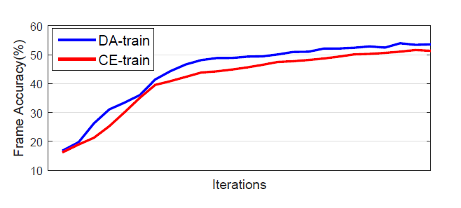
4. Experiments
Results
WERs (%) on the CHIME-4 corpus.
Data |  | Baseline | CE-Train | DA-Train | RERR
Dev | simu | 20.46 | 18.27 | 15.34 | 25.02
 | real | 22.13 | 19.65 | 17.30 | 21.83
 | avg. | 21.30 | 18.96 | 16.32 | 23.38
Test | simu | 29.94 | 27.66 | 24.75 | 17.33
 | real | 36.27 | 34.15 | 33.83 | 6.73
 | avg. | 33.11 | 30.91 | 29.29 | 11.54
The frame accuracy during training

Slide 17
5. Conclusions and Future Works
We propose an adversarial training method to directly boost noise robustness of acoustic model.
The joint optimization of generator, discriminator and AM concentrates the strengths of both GAN and AM for speech recognition.
We will perform deep adversarial training for acoustic modeling at the full-sequence level.

Slide 18
Thanks！

