Slide 1
Learning From Taxonomy: Multi-Label Few-Shot Classification for Everyday Sound Recognition
Jinhua Liang Huy Phan Emmanouil Benetos
By Jinhua Liang
April 17, 2024

Slide 2
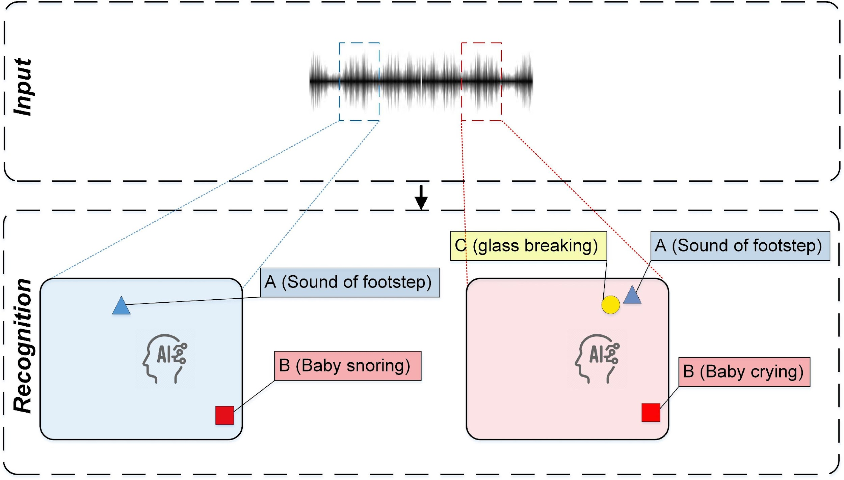
Introduction
Everyday sound recognition - to identify types of sound events in recordings or audio stream.
Few-shot learning - to rapidly adapt to a new task-specific dataset by the provided examples
It is labor-intensive to annotate recordings for each category of sound events

Slide 3
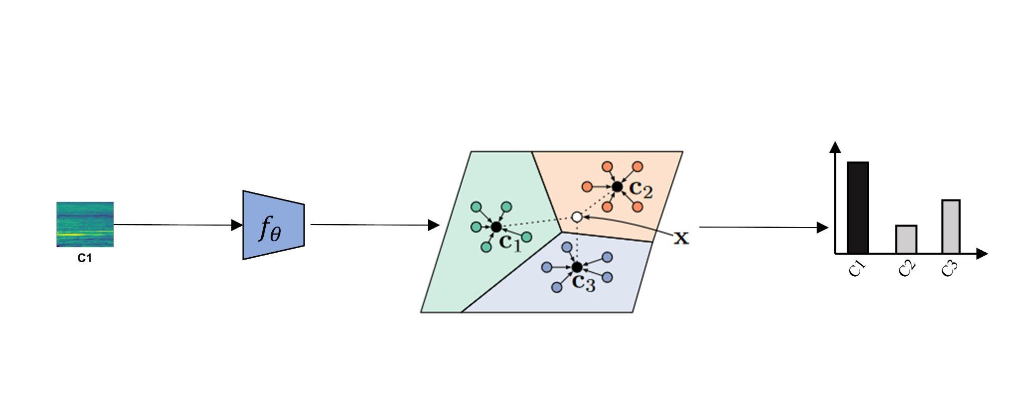
Bibliography study: Prototypical Networks
[1] Snell et al. Prototypical Networks for Few-shot Learning
Prototypical networks^{[1]} calculate the prototypes by clustering the audio samples by their categories in the latent space
, where

Slide 4
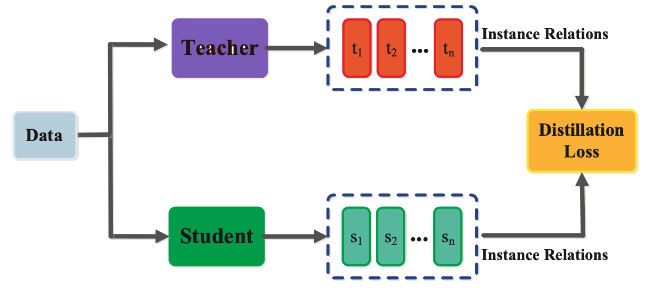
Bibliography study: Knowledge distillation
[1] Hinton et al. Distilling the Knowledge in a Neural Network
[2] Szegedy et al. Rethinking the inception architecture for computer vision
Label smoothing originates from the idea of knowledge distillation^{[1]} where soft labels are derived from one-hot ground-truth by an ensemble system. It helps models avoid over-confidence in the training process.
Szegedy simplified this technique by replacing pre-trained models with a uniform distribution^{[2]}

Slide 5
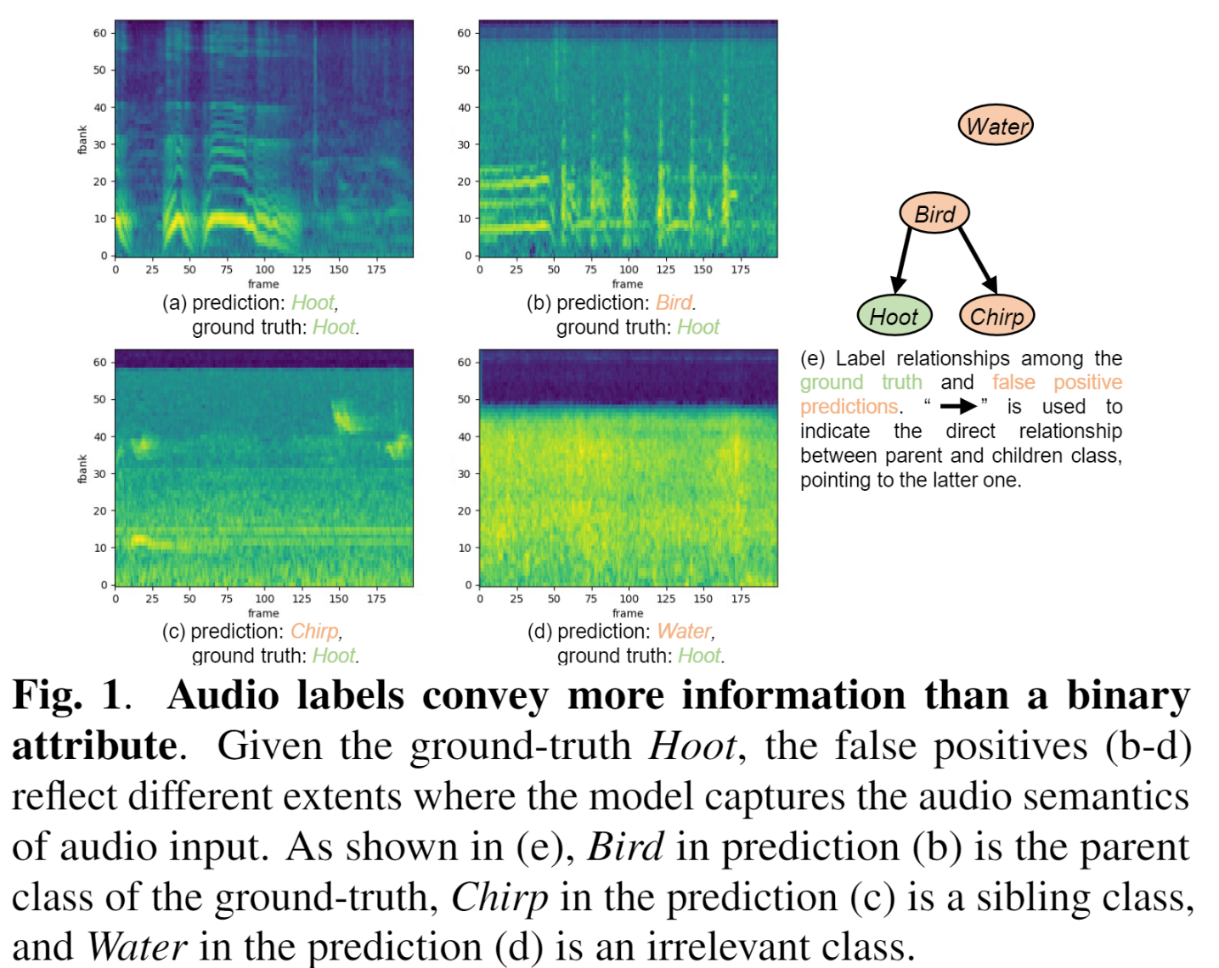
Motivation
False positives are not equally “wrong”
Bird and Chirp are more close to Hoot
Water does NOT look like Hoot at all
Can we leverage the relationship between labels to improve audio encoders in data-scarce scenarios?

Slide 6
Method: Dataset curation
[1] https://zenodo.org/records/7557107
Data Curation
Filter classes in the taxonomy
Split the remaining labelset
Fix label smearing in the splits
Divide database into different split
Features
Class diversity: 143 classes
Polyphonic dataset: > 1 labels per sample
Fully open resource^{[1]}

Slide 7
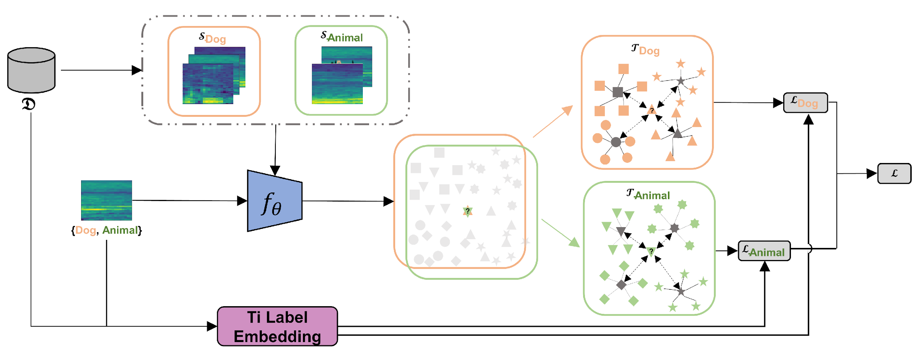
Methods: Exploiting absolute toxonomy
We introduce an ontology-aware framework, namely Lad-ProtoNet, to leverage the knowledge built in taxonomy by using both absolute and relative taxonomy.
Notes:
and the one of test sample get larger, the performance of few-shot learning decrease.

Slide 8
Methods: Exploiting relative toxonomy
For relative correspondence, we divide a multi-label classification into multiple single-label classification:
Notes:
and the one of test sample get larger, the performance of few-shot learning decrease.

Slide 9
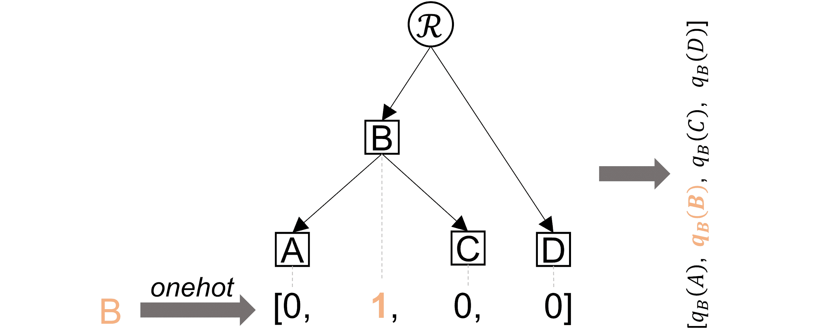
Methods
We incorporate the absolute knowledge in taxonomy to the model by softening labels:
Notes:
and the one of test sample get larger, the performance of few-shot learning decrease.

Slide 10
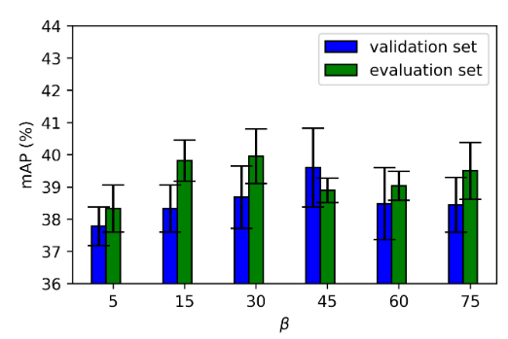
Evaluation
Table 1. Comparison of different with 0.95 confidence.
We split the FSD-FS into train (98), validation (30), and evaluation (15) sets.
Table 2. Ablation study on FSD-FS evaluation split.
Comparing the models coupled with the Ti-embedded label w.r.t various β values. (Ti-embedding approximates onehot vector when β get higher)
Notes:
and the one of test sample get larger, the performance of few-shot learning decrease.

Slide 11
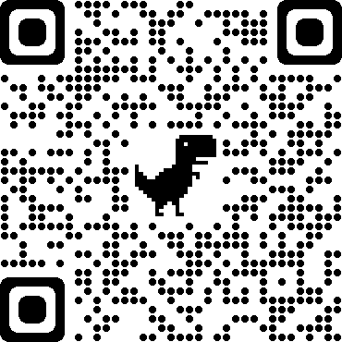
Takeaways…
LaD-ProtoNet is introduced to exploit the relative label relationship by handling the classification task associated with more abstract label with a higher priority than that associated with a more fine-grained labe outlines two research objectives: audio feature learning and fast adaptation
Ti label embedding is proposed to encode label distance in the ontology, improving the model’s performance with negligible computational cost
A new dataset was proposed to foster the domain of multi-label few-shot audio tagging
Knowledge in taxonomy does help the model learn in few-shot setting
E-mail: jinhua.liang@qmul.ac.uk
ORCID: https://orcid.org/0000-0002-4570-0735
Homepage: https://jinhualiang.github.io/, or:
By Jinhua Liang
April 17, 2024

