Slide 1
Online Auditing of Information Flow
Mor Oren-Loberman
Joint work with Vered Azar and Wasim Huleihel
Tel-Aviv University

Slide 2
Content
Introduction
Problem Formulation
Main Results
Experiments

Slide 3
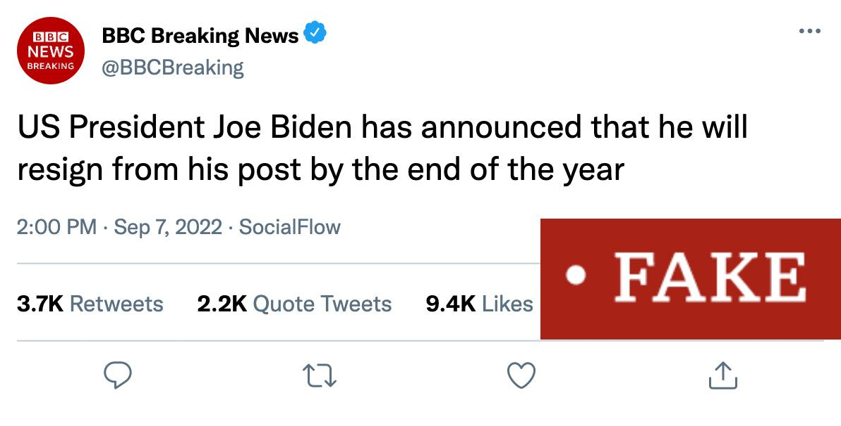
INTRODUCTION
Detecting MISINFORMATION

Slide 4
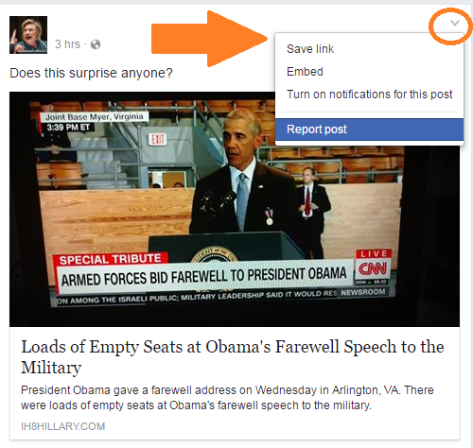
INTRODUCTION
Detecting MISINFORMATION
“Human-based” methods Crowdsourcing, user feedbacks, and third-party fact-checking
Unscalable
Significantly slow

Slide 5
INTRODUCTION
Detecting MISINFORMATION
ML methods Utilizing users and post content features
Require pre-determined number of observations.
Require large amount of data

Slide 6
INTRODUCTION
Is it possible to infer whether pieces of information propagated over time in a social network are falsehood or truth based only on the way they diffuse over the network?

Slide 7
QuickStop
INTRODUCTION
Real-time quickest misinformation detection based on an edge-based probabilistic model
Hypothesis testing formulated as a Markov optimal stopping problem
$$\left(V_{1},U_{1}\right)$$
$$\left(V_{2},U_{2}\right)$$
$$\left(V_{3},U_{3}\right)$$
$$⋯$$
A Markov chain model for sequential observations
[1] H. Wei, X. Kang, W. Wang, and L. Ying, “Quickstop: A markov optimal stopping approach for quickest misinformation detection,” Proceedings of the ACM on Measurement and Analysis of Computing Systems, vol. 3, no. 2, pp. 1–25, 2019

Slide 8
OUR Model
INTRODUCTION
Real-time quickest misinformation detection algorithm based on a general and realistic probabilistic information spreading model
Takes into account practical aspects
Social network graph structure
Possibility of missing data
All possible diffusion paths
$$𝓖=\left(𝓥,𝓔\right)$$
$$1$$
$$2$$
$$3$$
$$4$$
$$5$$
$$6$$
$$7$$
$$8$$
$$9$$
$$10$$
$$11$$
$$12$$
$$13$$
$$14$$
$$15$$
$$16$$
$$17$$
$$18$$
$$19$$
$$20$$
$$21$$
$$22$$
$$23$$
$$24$$
$$25$$
A social media graph with a single information source at $S=1.$

Slide 9
EDGE BASED MODEL
PROBLEM FORMULATION
followee
$$x_{u}$$
$$W_{u,v_{3}}=f\left(x_{u},x_{v_{3}}\right)∈\text{Z}≜\left\{0,1,…, Z−1\right\}$$
followers
$$x_{v_{1}}$$
$$x_{v_{2}}$$
$$x_{v_{3}}$$

Slide 10
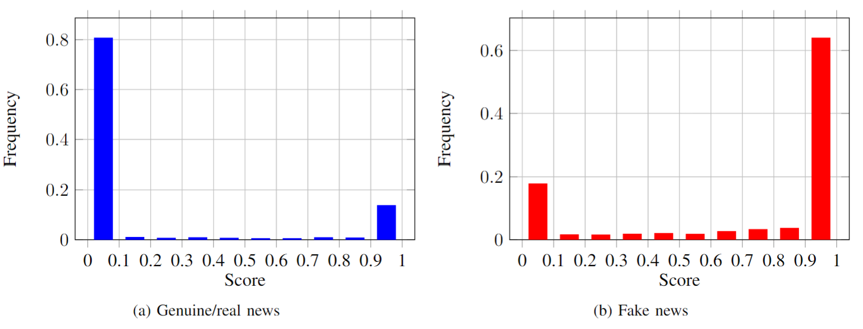
EDGE BASED MODEL
PROBLEM FORMULATION
followee
$$x_{u}$$
$$W_{u,v_{3}}=f\left(x_{u},x_{v_{3}}\right)∈\text{Z}≜\left\{0,1,…, Z−1\right\}$$
followers
$$x_{v_{1}}$$
$$x_{v_{2}}$$
$$x_{v_{3}}$$
$$0$$
$$1$$
$$2$$
$$3$$
$$0$$
$$1$$
$$2$$
$$3$$
Real News
$$𝓘=0$$
Fake News $𝓘=0$
Distributions of SVM classification scores of the edge-based model on the Weibo dataset, for $Z$=4

Slide 11
EDGE BASED MODEL
PROBLEM FORMULATION
followee
$$x_{u}$$
: $\left(u,v_{3}\right) → W_{u,v_{3}}=f\left(x_{u},x_{v_{3}}\right)$
$$Event Z_{ℓ}$$
followers
$$x_{v_{1}}$$
$$x_{v_{2}}$$
$$x_{v_{3}}$$

Slide 12
information flow
PROBLEM FORMULATION
1
$$W_{1,2}^{{\text{P}}_{1}}$$
$$W_{1,4}^{{\text{P}}_{4}}$$
$$W_{1,3}^{{\text{P}}_{2}}$$
$$2$$
$$3$$
$$4$$
Each weighted path correspond to a different Markov chain
$$W_{2,6}^{{\text{P}}_{1}}$$
$$W_{3,7}^{{\text{P}}_{2}}$$
$$W_{1,20}^{{\text{P}}_{3}}$$
$$W_{4,23}^{{\text{P}}_{4}}$$
$$5$$
$$6$$
$$7$$
$$8$$
$$9$$
$$10$$
$$11$$
$$W_{6,14}^{{\text{P}}_{1}}$$
$$W_{7,18}^{{\text{P}}_{2}}$$
$$12$$
$$13$$
$$14$$
$$15$$
$$16$$
$$17$$
$$18$$
$$19$$
$$20$$
$$21$$
$$22$$
$$23$$
$$24$$
$$25$$
$𝓟=$ Set of all possible directed paths in $𝓖$ stating at the source
Consecutive retweets (edges) are modeled as a first-order Markov chain with $Z$ states
Initial Probabilities: $η_{ℐ }\left(z\right)=ℙ\left(W_{1,v}=z ∣ ℋ_{ℐ}\right)$
Transition probabilities: $α_{ℐ}\left(z ∣ z′\right)=ℙ\left(W_{u,v}=z ∣ W_{v,y}=z′,ℋ_{ℐ}\right)$

Slide 13
Observations
PROBLEM FORMULATION
1
$$Z_{1}=$$
$$W_{1,2}^{{\text{P}}_{1}}$$
$$2$$
$$3$$
$$4$$
The observations are subsamples of the complete paths
$$W_{3,7}^{{\text{P}}_{2}}$$
$$W_{1,20}^{{\text{P}}_{3}}$$
$$Z_{3}=$$
$$Z_{2}=$$
$$Z_{5}=$$
$$W_{4,23}^{{\text{P}}_{4}}$$
$$5$$
$$6$$
$$7$$
$$8$$
$$9$$
$$10$$
$$11$$
$$Z_{6}=$$
$$W_{6,14}^{{\text{P}}_{1}}$$
$$W_{7,18}^{{\text{P}}_{2}}$$
$$Z_{4}=$$
$$12$$
$$13$$
$$14$$
$$15$$
$$16$$
$$17$$
$$18$$
$$19$$
$$20$$
$$21$$
$$22$$
$$23$$
$$24$$
$$25$$
Observing only arbitrary parts of the information spreading trace ${\left\{Z_{ℓ}\right\}}_{ℓ≥1}$ sequentially,
where $Z_{ℓ}=W_{u,v}^{\text{P}}$ for some $\text{P}∈𝒫$ and edge $\left(u,v\right)∈$ $ℰ$
Gathering the natural filtration ${\left\{ℱ_{ℓ}\right\}}_{ℓ≥1}$, with $ℱ_{ℓ}=\left\{Z_{1},Z_{2}, …,Z_{ℓ}\right\}$

Slide 14
Learning Problem
PROBLEM FORMULATION
1
$$Z_{1}$$
$$2$$
$$3$$
$$4$$
$$Z_{3}$$
$$Z_{2}$$
$$Z_{5}$$
Stop sampling and decide$?$ $ℋ_{0}$ vs. $ℋ_{1}$
$$5$$
$$6$$
$$7$$
$$8$$
$$9$$
$$10$$
$$11$$
$$Z_{6}$$
$$Z_{4}$$
$$12$$
$$13$$
$$14$$
$$15$$
$$16$$
$$17$$
$$18$$
$$19$$
$$20$$
$$21$$
$$22$$
$$23$$
$$24$$
$$25$$
Find the stopping time $T$ and decision rule $δ_{T}$ that minimize
Average cost of errors due to misdetection
Propagation cost due to spreading misinformation
+
$c_{e}\left(T,δ_{T}\right)=c_{ Ⅰ}ℙ_{ℋ_{0}}\left(δ_{T}=1\right)+$ $c_{Ⅱ}ℙ_{ℋ_{1}}\left(δ_{T}=0\right)$
$c𝔼\left[T𝟙_{ℋ_{1}}\right]$
($c$ propagation cost per time slot)

Slide 15
Learning Problem
PROBLEM FORMULATION
Objective
$$\inf_{T,δ_{T}}{c_{e}\left(T,δ_{T}\right)+}c𝔼\left[T𝟙_{ℋ_{1}}\right]$$
Find the stopping time $T$ and decision rule $δ_{T}$ that minimize
Average cost of errors due to misdetection
Propagation cost due to spreading misinformation
+
$c_{e}\left(T,δ_{T}\right)=c_{ Ⅰ}ℙ_{ℋ_{0}}\left(δ_{T}=1\right)+$ $c_{Ⅱ}ℙ_{ℋ_{1}}\left(δ_{T}=0\right)$
$c𝔼\left[T𝟙_{ℋ_{1}}\right]$
($c$ propagation cost per time slot)

Slide 16
Posterior probability recursion
MAIN RESULTS
The last observation in $\left(Z_{1},…,Z_{ℓ−1}\right)$ in the path $P∈𝓟_{ℓ}$
Posterior probability of misinformation: $Π_{ℓ}≜ℙ\left(ℋ_{1} ∣ ℱ_{ℓ}\right)$
Conditional probability of $Z_{ℓ}$: $A_{ℐ}\left(Z_{ℓ} ∣ ℱ_{ℓ−1}\right)≜ℙ\left(ℋ_{1} ∣ ℱ_{ℓ−1},ℋ_{ℐ}\right)$
Path score probability measure: $μ_{A}\left(\text{P}\right)≜ℙ\left(\text{P} ∣ ℱ_{ℓ−1},ℋ_{ℐ}\right)$
$v_{I_{ℓ}\left(P\right)}^{P}$
$$Z_{I_{ℓ}\left(P\right)}^{P}=W_{v_{I_{ℓ}\left(P\right)}^{P},u_{I_{ℓ}\left(P\right)}^{P}}$$
$u_{I_{ℓ}\left(P\right)}^{P}$
The following recursive relation holds
$$Π_{ℓ+1}=\frac{Π_{ℓ}A_{1}\left(Z_{ℓ+1} ∣ ℱ_{ℓ}\right)}{Π_{ℓ}A_{1}\left(Z_{ℓ+1} ∣ ℱ_{ℓ}\right)+(1−Π_{ℓ})A_{0}\left(Z_{ℓ+1} ∣ ℱ_{ℓ}\right)},$$
where $A_{ℐ}\left(Z_{ℓ} ∣ ℱ_{ℓ−1}\right)=η_{ℐ}\left(Z_{ℓ}\right)$ if $Z_{ℓ}$ connected directly to the source. Otherwise, $$A_{ℐ}\left(Z_{ℓ} ∣ ℱ_{ℓ−1}\right)=𝔼_{μ_{A}}\left[\sum_{z_{I_{ℓ}\left(P\right)+1}^{ℓ−1}∈{\text{Z}}^{ℓ−I\left(P\right)−1}}{\prod_{j=I_{ℓ}\left(P\right)+1}^{ℓ}{α_{ℐ}\left(z_{j} ∣ z_{j−1}\right)}}\right]$$ with $z_{k}^{ℓ}≜\left(z_{k},…,z_{ℓ}\right)$
$$W_{v_{I_{ℓ}\left(P\right)+1}^{P},u_{I_{ℓ}\left(P\right)+1}^{P}}$$
$$W_{v_{I_{ℓ}\left(P\right)+2}^{P},u_{I_{ℓ}\left(P\right)+2}^{P}}$$
Theorem 1
$$W_{v_{I_{ℓ}\left(P\right)+3}^{P},u_{I_{ℓ}\left(P\right)+3}^{P}}$$
$$v_{ℓ}$$
$$Z_{ℓ}=W_{v_{ℓ},u_{ℓ}}^{P}$$
$$u_{ℓ}$$

Slide 17
Optimal sequential test
MAIN RESULTS
Objective
$$\inf_{T,δ_{T}}{c_{e}\left(T,δ_{T}\right)+}c𝔼\left[T𝟙_{ℋ_{1}}\right]$$
$$\inf_{T,δ_{T}}{c_{e}\left(T,δ_{T}\right)+}c𝔼\left[T𝟙_{ℋ_{1}}\right]$$
$$\inf_{T}{𝔼\left[g\left(Π_{T}\right)+cTΠ_{T}\right]}$$
$$g\left(π\right)≜\min_{}\left\{c_{Ⅱ}π,c_{ Ⅰ}\left(1−π\right)\right\}$$
$$\inf_{T}{𝔼\left[g\left(Π_{T}\right)+cTΠ_{T}\right]}$$
Theorem 2
The equivalence to the well-known optimal stopping problem allows us to achieve an optimal quickest solution

Slide 18
Optimal Stopping Time
MAIN RESULTS
NEW Objective
$$\inf_{T}{𝔼\left[g\left(Π_{T}\right)+cTΠ_{T}\right]} \left(1\right)$$
Sequence of value functions $s_{ℓ}\left(π,z_{1}^{ℓ}\right)=\inf_{T}{𝔼\left[g\left(Π_{T}\right)+CTΠ_{T} ∣ Π_{ℓ}=π,ℱ_{ℓ}=z_{1}^{ℓ}\right]}, s_{0}\left(π,∅\right)≜g\left(π\right)$ $s_{ℓ}\left(π,z_{1}^{ℓ}\right)$ is the minimum expected total cost if the algorithm is obligated to stop at $T ≥ℓ$ conditioned on the information up to $ℓ.$
Define ${\overline{s}}_{ℓ}\left(π,z_{1}^{ℓ}\right)=s_{ℓ}\left(π,z_{1}^{ℓ}\right)−cℓπ, ℓ≥1$

Slide 19
Optimal Stopping Time
MAIN RESULTS
NEW Objective
$$\inf_{T}{𝔼\left[g\left(Π_{T}\right)+cTΠ_{T}\right]} \left(1\right)$$
$z_{1}^{ℓ}≜\left(z_{1},…,z_{ℓ}\right),$ then
1. Find the stopping time $T$ by solving (1)
$T^{∗}=$ $\inf_{}{ \left\{ℓ∈ℕ: Π_{ℓ}∉\left(π_{low}\left(z_{1}^{ℓ}\right),π_{up}\left(z_{1}^{ℓ}\right)\right)\right\}}$
2. Find the optimal decision rule $δ_{T^{∗}}$
$$δ_{T^{∗}}\left(z_{1}^{T^{∗}}\right)=\left\{\begin{aligned}0, Π_{T^{∗}}≤π_{low}\left(z_{1}^{T^{∗}}\right) \\ 1, Π_{T^{∗}}≥π_{up}\left(z_{1}^{T^{∗}}\right)\end{aligned}\right.$$
Theorem 3
Solution

Slide 20
Optimal Stopping Time
MAIN RESULTS
$T^{∗}=$ $\inf_{}{ \left\{ℓ∈ℕ: Π_{ℓ}∉\left(π_{low}\left(z_{1}^{ℓ}\right),π_{up}\left(z_{1}^{ℓ}\right)\right)\right\}}$
$$δ_{T^{∗}}\left(z_{1}^{T^{∗}}\right)=\left\{\begin{aligned}0, Π_{T^{∗}}≤π_{low}\left(z_{1}^{T^{∗}}\right) \\ 1, Π_{T^{∗}}≥π_{up}\left(z_{1}^{T^{∗}}\right)\end{aligned}\right.$$
Solution
Where
$$π_{low}\left(z_{1}^{ℓ}\right)=\sup{ \left\{0≤π≤\frac{c_{ Ⅰ}}{c_{ Ⅰ}+c_{Ⅱ}}: {\overline{s}}_{ℓ}\left(π,z_{1}^{ℓ}\right)=c_{Ⅱ}π\right\}}$$
$$π_{up}\left(z_{1}^{ℓ}\right)=\inf{ \left\{\frac{c_{ Ⅰ}}{c_{ Ⅰ}+c_{Ⅱ}}≤π≤1: {\overline{s}}_{ℓ}\left(π,z_{1}^{ℓ}\right)=c_{ Ⅰ}\left(1−π\right)\right\}},$$
and
$${\overline{s}}_{ℓ}\left(π,z_{1}^{ℓ}\right)=\inf_{}\left\{g\left(π\right), 𝔼\left[{\overline{s}}_{ℓ+1}\left(Π_{ℓ+1},ℱ_{ℓ+1}\right) ∣ Π_{ℓ}=π,ℱ_{ℓ}=z_{1}^{ℓ}\right]+cπ\right\}$$

Slide 21
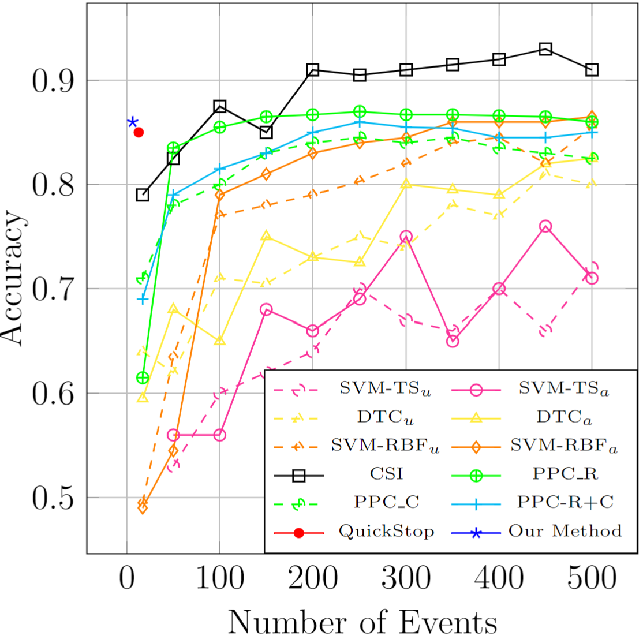
Experiments
Weibo dataset
80% training, 20% test
$c_{ Ⅰ}=c_{Ⅱ}=10$
$c=0.05$
$Z=4$
Same accuracy
in half the time

Slide 22
Questions?

Slide 23
Additional results, proofs and discussions can be found in the full version of this paper [2]
[2] Mor Oren-Loberman, Vered Azar, and Wasim Huleihel, “Online auditing of information flow,” arXiv:2310.14595, 2023.

Slide 24
THANK YOU
Mor Oren-Loberman​
+972-502515131
orenmor@mail.tau.ac.il
linkedin.com/in/mor-oren-loberman-1002777b

Slide 25
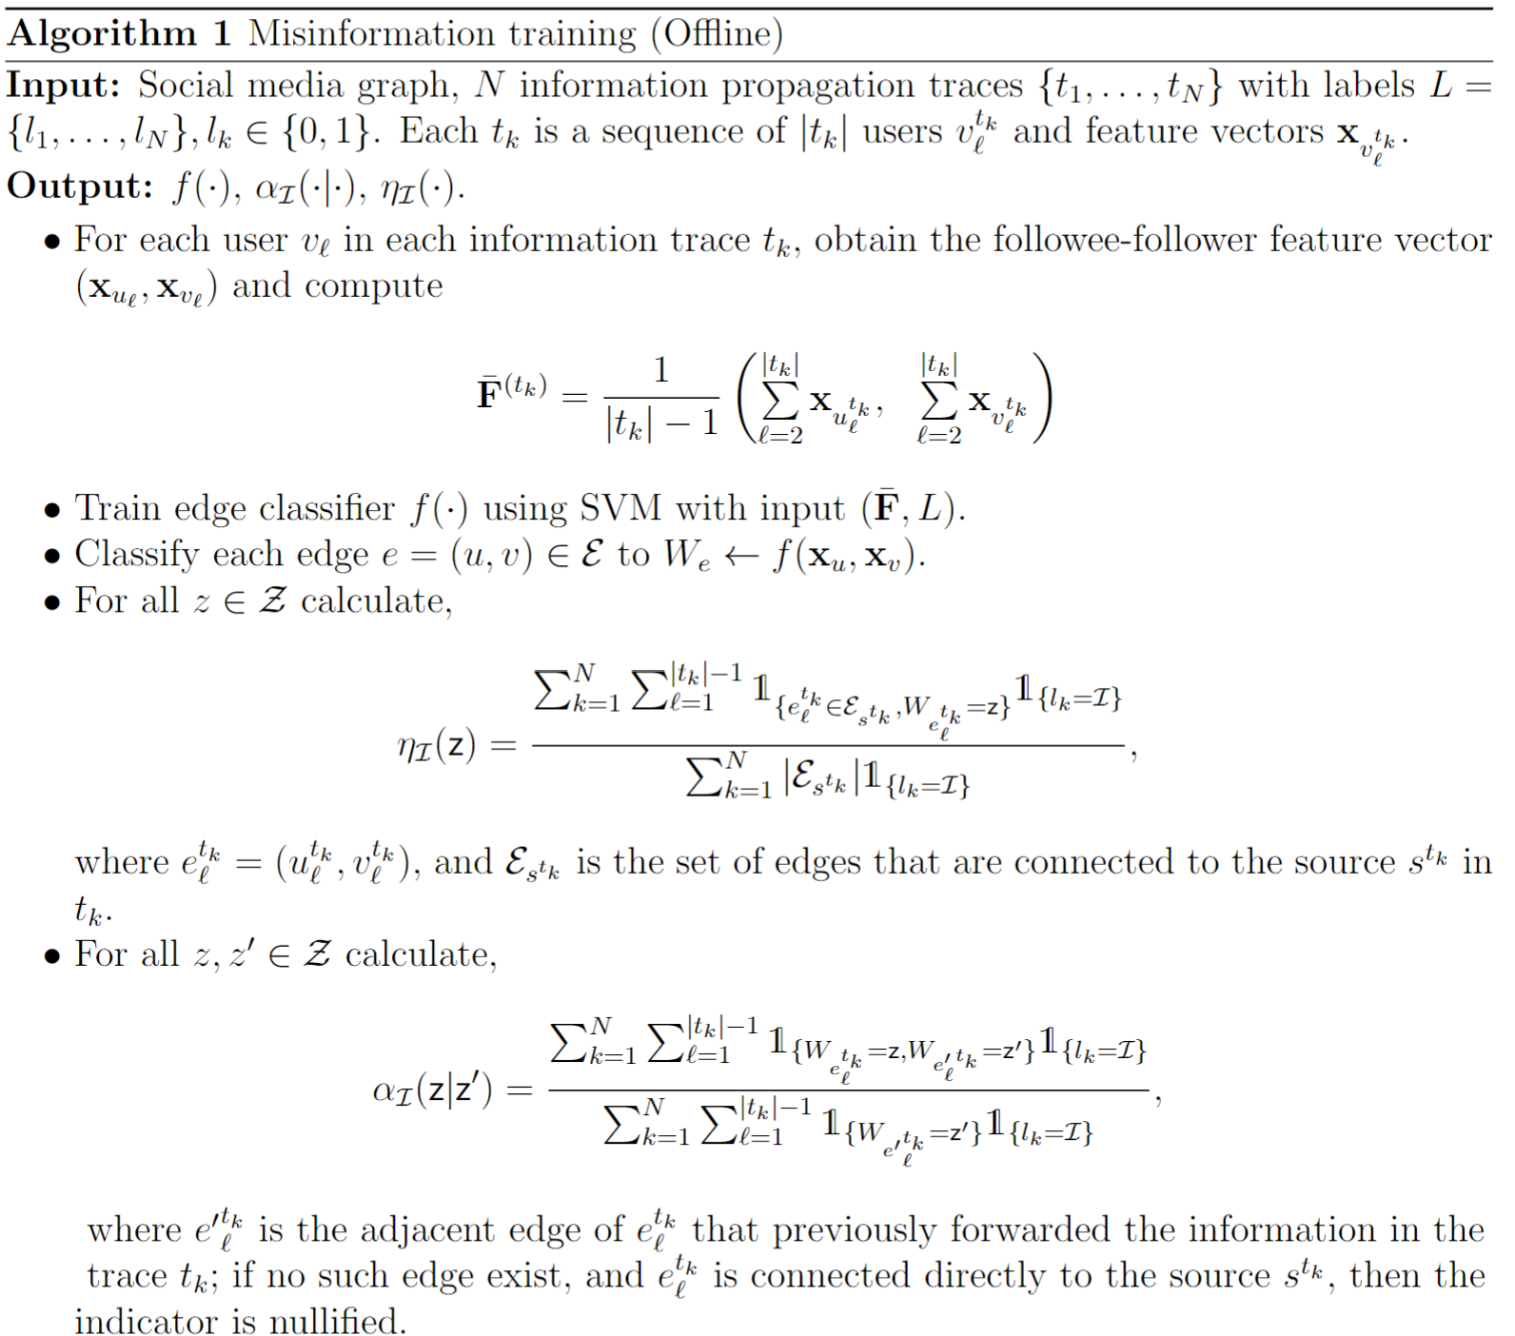
Algorithm
APPENDIX A
Average feature vector
Initial probabilities
$$η_{ℐ }\left(z\right)=ℙ\left(W_{1,v}=z ∣ ℐ\right)$$
Transition probabilities $$α_{ℐ}=ℙ\left(W_{u,v}=z ∣ W_{v,y}=z^{′},ℐ\right)$$

Slide 26
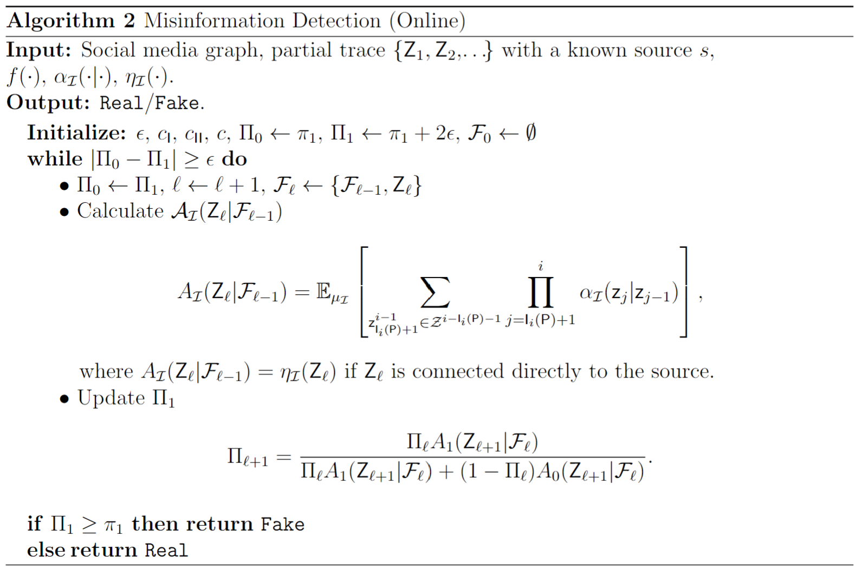
APPENDIX A
Algorithm
Conditional probability of an observation $Z_{ℓ}$ $$A_{ℐ}\left(Z_{ℓ} ∣ ℱ_{ℓ−1}\right)≜ℙ\left(ℋ_{1} ∣ ℱ_{ℓ−1},ℐ\right)$$
Posterior probability of misinformation $$Π_{ℓ}≜ℙ\left(ℋ_{1} ∣ ℱ_{ℓ}\right)$$

Slide 27
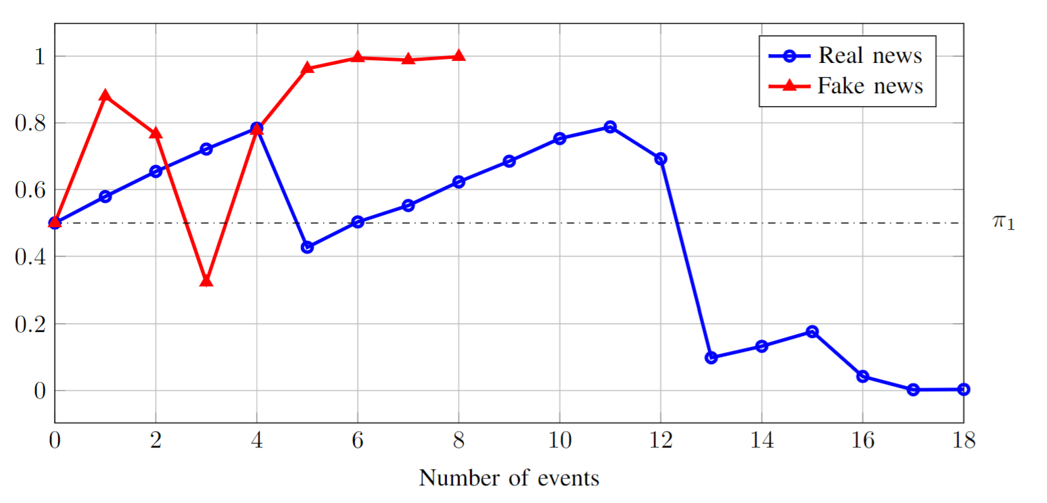
APPENDIX B
evolution of $Π_{ℓ}$
Examples of $Π_{ℓ}$ and $T$ on real/fake news under our method

Slide 28
APPENDIX B
evolution of $Π_{ℓ}$
Real news
Fake news
Examples of $Π_{ℓ}$ and $T$ on real/fake news under our method and QuickStop

Slide 29
APPENDIX C
Probabilities
Edge transition probability matrices $α_{ℐ}\left(⋅|⋅\right)$ from the Weibo dataset, for $Z=4$
Edge initial probabilities $η_{ℐ}\left(⋅\right)$ from the Weibo dataset, for $Z=4$

Slide 30
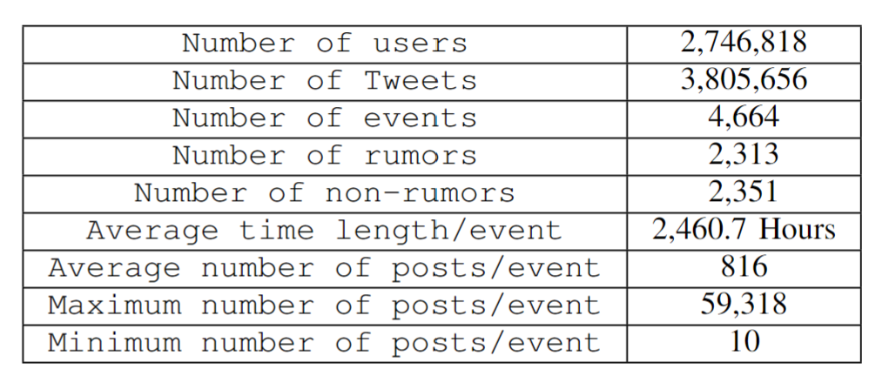
APPENDIX D
Dataset
Details of the Weibo dataset
${\text{Sina} \text{Weibo}}^{1}$ is China’s leading micro-blogging service provider with eight times more users than Twitter
User features such as the number of followees, the number of followers, the registration days, etc., were originally extracted from Sina Weibo API.
The social media graph structure G is reconstructed by a union of all the information traces.
We have uniformly drawn 50% of the observations.
${}^{1}$https://service.account.Weibo.com
${}^{2}$http://open.weibo.com/wiki/API

