Slide 1
Enhanced Channel Estimation in mm-Wave MIMO Systems Leveraging Integrated Communication and Sensing
Silvia Mura
Marouan Mizmizi
Umberto Spagnolini
Athina Petropulu

Slide 2
Introduction
Problem Statement
The acquisition of precise Channel State Information (CSI) assumes critical significance for 6G wireless networks
Trade-off between CSI accuracy and overhead
Goal: Reducing channel estimation overhead through the utilization of ISAC systems

Slide 3
System Model
Rx Signal by the AP
Tx signal by the Access Point (AP)
Precoder
Sensing Channel
Within each channel coherence interval, the AP communicates with a single antenna UE in downlink mode, while concurrently sensing Q extended targets, including the UE. Subsequently, the UE transmits its data to the AP in uplink mode.
Communication Rx Signal by the AP
Uplink Channel
Communication Rx Signal by the UE
Downlink Channel

Slide 4
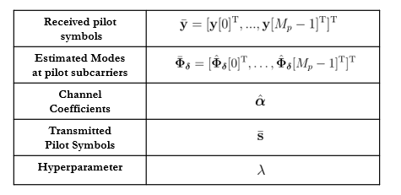
Sensing-aided Channel Estimation
Proposed Solution
Initial Space-Time Modes Matrix
Sensing-aided Communication Channel Estimation
1) Sensing Parameters Estimation and Initial Communication Parameters Definition
2) Mismatch Definition:
Channel Coefficient Estimation
Mode Mismatch Compensation
Grid-based Mode Augmentation

Slide 5
Initial Space-Time Modes Matrix
Sensing Channel
Initial Space-Time Modes Matrix
Mapping to the Spac- time modes of the Communication Channel
Sensing modes estimation through range-angle compression
Discriminate LoS/NLoS given the syncronization
/
For each qth Target
Communication Channel Modes
Sensing-aided Initial Estimates
LoS
NLoS

Slide 6
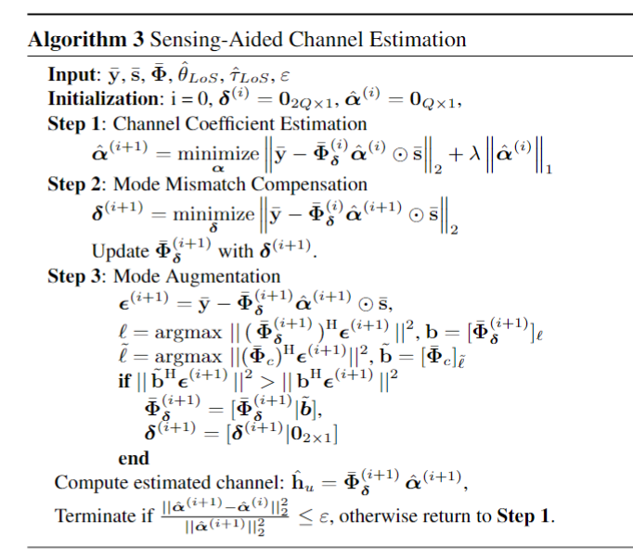
Sensing-aided Channel Estimation
Channel Parameters Estimation
Mode Mismatch Compensation
Grid-based Mode Augmentation
Mode Mismatch Compensation
Mode Augmentation
Mismatch vector introduction to counting for potential mismatches between communication and sensing modes
Scenario dependent Space-Time Modes Grid
AP
Find the most correlated atom of
with the residual
The new atom is added to if it shows the highest correlation with the residual

Slide 7
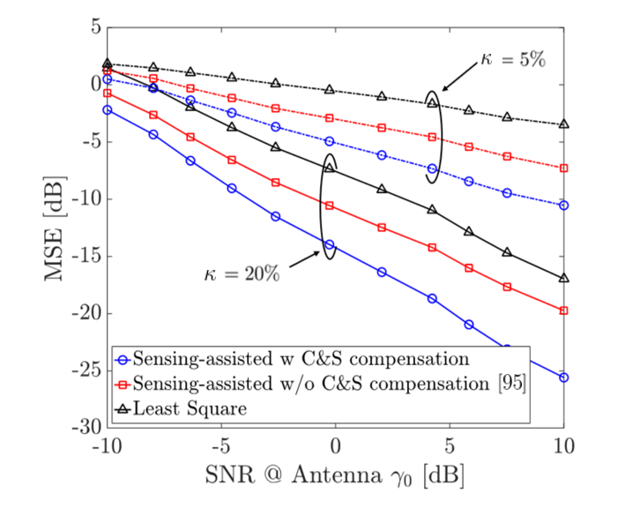
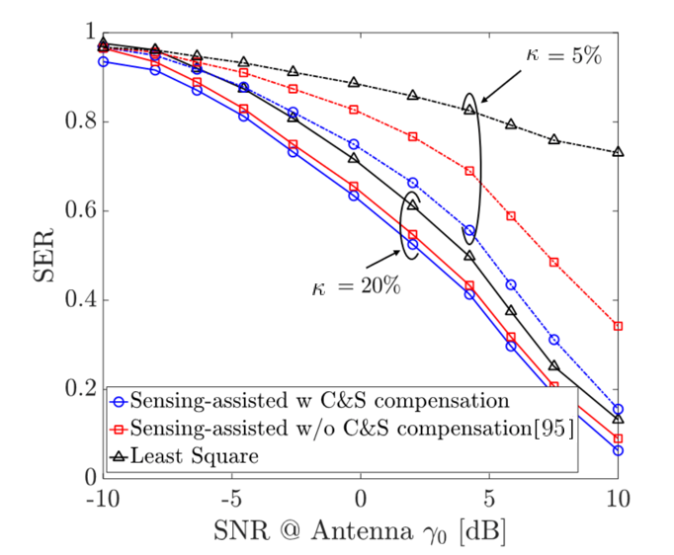
Numerical Results
Mean Square Error
Symbol Error Rate
$$f_{0}$$ | 60 Ghz
Ricean Factor | 4 dB
N | 8
Combiner | MMSE
: percentage of pilots
The effectiveness of integrating sensing information is highlighted by the improved performance of the proposed method and [1] with limited pilot density.
The proposed algorithm ability to address communication and sensing mismatch contributed to a substantial improvement in MSE
LS methodology limitations under scarce pilot resources are revealed
1] Huang, Zhe, et al. "Joint pilot optimization, target detection and channel estimation for integrated sensing and communication systems." IEEE Transactions on Wireless Communications 21.12 (2022): 10351-10365.

Slide 8
Conclusions
Introducing a novel sensing-assisted channel estimation scheme exploiting the similarities of the time-space modes between communication and sensing channel modes
The method seeks to address communication and sensing mismatches due to the presence of extended targets
The proposed method decreases the overhead and number of needed pilots, while improving the MSE
References
[1] Z. Huang, K. Wang, A. Liu, Y. Cai, R. Du, and T. X. Han, “Joint pilot optimization, target detection and channel estimation for integrated sensing and communication systems,” IEEE Transactions on Wireless Communications, vol. 21, no. 12, pp. 10 351–10 365, 2022

Slide 9
Thanks
Silvia Mura
silvia.mura@polimi.it
www.deib.polimi.it

