Slide 1
Applying Connectionist Temporal Classification Objective Function to Chinese Mandarin Speech Recognition
Pengrui Wang, Jie Li, Bo Xu
Interactive Digital Media Technology Research Center
Institute of Automation, Chinese Academy of Sciences, Beijing, China
wangpengrui2015@ia.ac.cn

Slide 2
Outline
Intention and work
Brief review of CTC function and search graphs
Experiments
Summary

Slide 3
Intention and Work
Intention
To improve the CTC-based end-to-end ASR system on Chinese Mandarin
Whether CTC-trained CD-Phn model match the hybrid CD states model on Chinese Mandarin?
Our Work
Three different level output units characters (Chars), context independent phonemes (CI-Phns), context dependent phonemes (CD-Phns)
Training strategy and posterior normalization
Implement of UniLSTM with row convolution

Slide 4
Review of CTC
In ASR, CTC has the ability to learn the alignments between speech frames and their transcript label sequences
Observation sequence X = (x₁，…, x₂, …, x_{T})
Symbol sequence z = (z_{1,} …, z₂, …, z_{U} ) (U≤T)
HMM-like model in CTC function ( z = (A,B,B) )
Pr(z|X) is quickly calculated by forward-backward algorithm

Slide 5
WFST in CTC
Three types of the search graphs
S_{chars} = T ◦ min( det (Ls ◦ G))
S_{CI-Phns} = T ◦ min( det (Lp ◦ G))
S_{CD-Phns} = T ◦ min( det (C ◦ (Lp ◦ G)))
G: grammar WFST, Ls: spelling WFST, Lp: phoneme-lexicon WFST,
C: CD-Phn to CI-Phn WFST
Spelling WFST

Slide 6
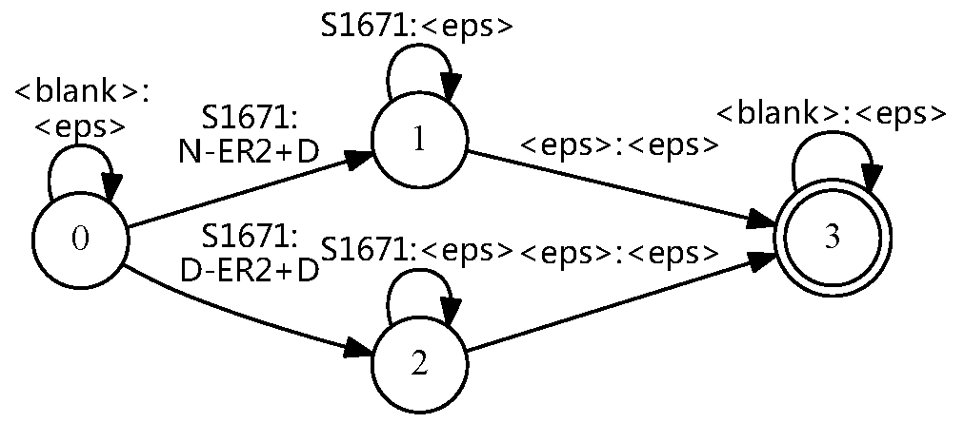
WFST in CTC
Character token WFST
CD-phn token WFST
Consume blank labels
map tied CD-Phns to untied CD-Phns

Slide 7
Experiments
Setup
Feature：40-dimensional (LFB)
LSTM： 3 hidden layers， 800 memory cells
Max-Norm Regularization（1.0）,
limit the gradient （-50， 50）
Corpus: HKUST
Set | training | development | testing
calls | 851 | 22 | 24

Slide 8
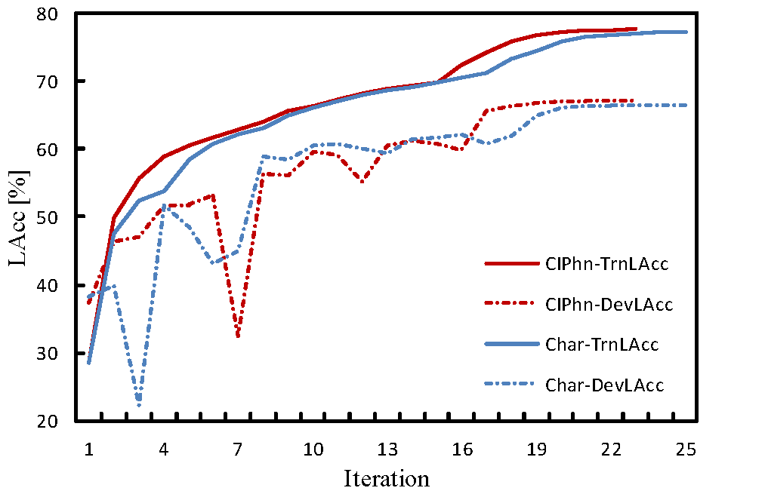
Experiments
Learning Rate Adjustment Strategy
Newbob:
Learning rate is halved whenever label accuracy drops. LAcc=1-LER （label error rate）
Possible reason:
development set has little ability to represent training set using CTC
Solution
Using “Newbob-Trn”, so that model can be trained more sufficiently

Slide 9
Experiments
Blank Label Prior Cost
A decoder is better to satisfy del ≈ 2 * ins
Blank label prior is large
 | WER（%） | ins | del | sub
BlankPrior*1 | 36.96 | 3456 | 1638 | 15658
BlankPrior*0.2 | 33.48 | 1852 | 2748 | 14200
BlankPrior*0.1 | 33.10 | 1462 | 3497 | 13626
BlankPrior*0.05 | 33.32 | 988 | 4909 | 12811

Slide 10
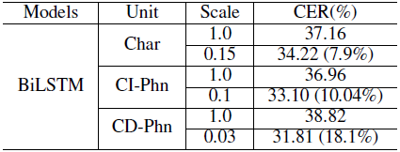
Experiments
Baseline (Hybrid model)
This work
Char model (end-to-end) performs well
CD-Phns model outperforms hybrid CD states model

Slide 11
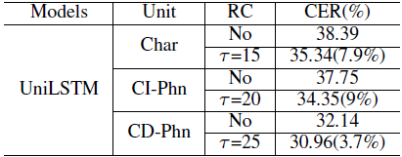
Experiments
UniLSTM with row convolution
Three output units all have performance gain
UniLSTM-RC model even match BiLSTM model
It is useful for online recognition system

Slide 12
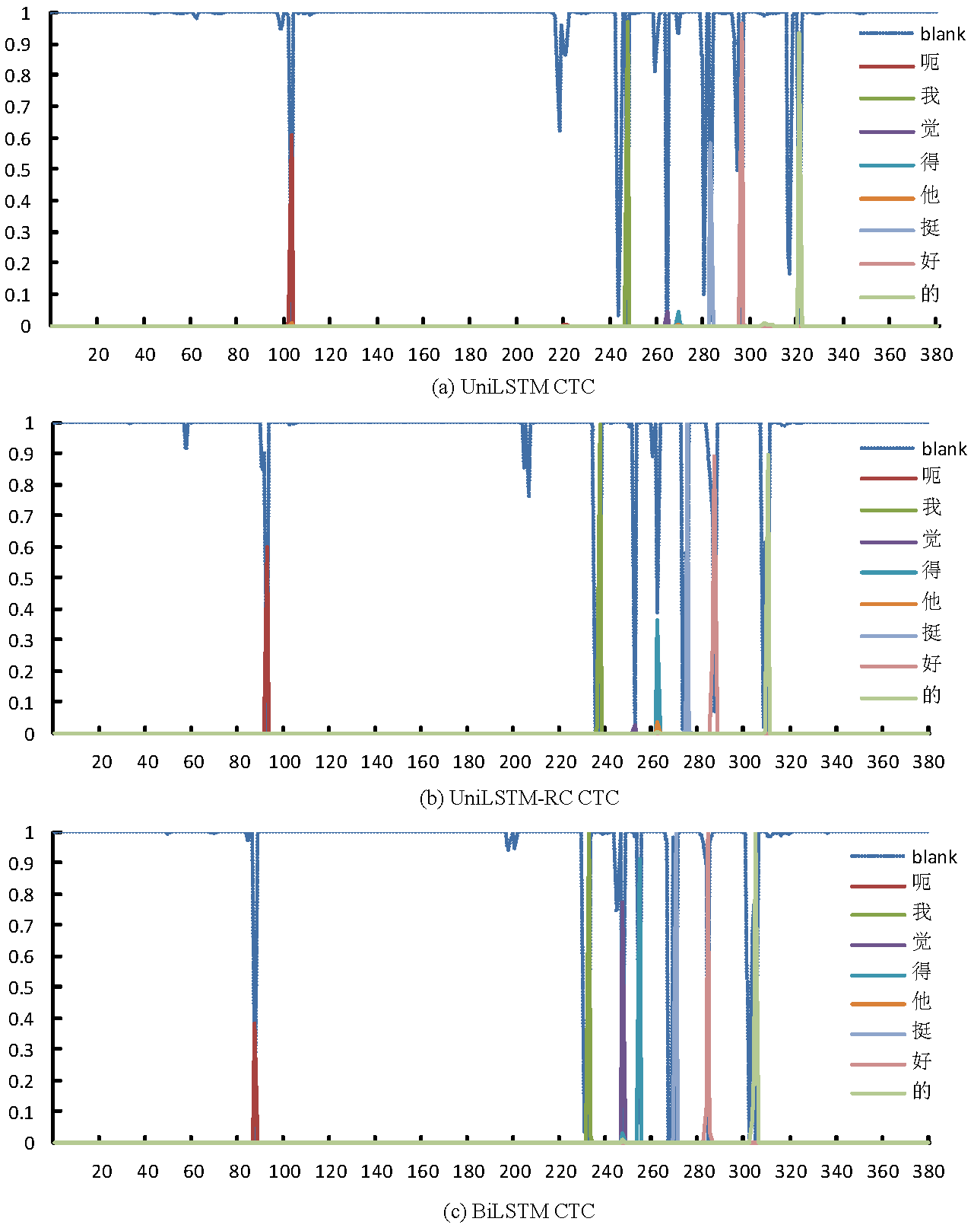
frame | 1-85 | 86-107 | 108-219 | 220-243 | 244-253 | 254-261 | 262-267 | 268-284 | 285-301 | 302-329 | 330-380
char | SIL | 呃 | SIL | 我 | 觉 | 得 | 他 | 挺 | 好 | 的 | SIL

Slide 13
Summary
Three different level output units are explored: Chars, CI-Phns and CD-Phns
Improve the training strategy and posterior normalization
Propose Newbob-Trn strategy to make training stable and adequate
Add extra cost on blank label prior when decoding
Establish the CTC-trained UniLSTM-RC model which ensures the real-time requirement of a online system, meanwhile, brings performance gain compared with UniLSTM model

