Slide 1
SELECTIVE MUTUAL LEARNING: AN EFFICIENT APPROACH FOR SINGLE CHANNEL SPEECH SEPARATION
Ha Minh Tan^{1,}*, Duc-Quang Vu^{1,}*, Chung-Ting Lee², Yung-Hui Li², Jia-Ching Wang¹
¹ Dept. of Computer Science and Information Engineering, National Central University, Taiwan
² AI Research Center, Hon Hai Research Institute, Taiwan

Slide 2
Outline
1
Overview
2
Backbone Network
3
Selective Mutual Learning
4
Experiments
5
Conclusion

Slide 3
Overview: T-F and Time domain methods
The speech separation methods include two main categories:
Time-frequency (T-F) domain-based methods (a)
Time-domain-based methods (b)

Slide 4
Overview: T-F domain method
Time-frequency (T-F) domain-based methods (a)
The T-F method uses to approximate the estimated spectrum with the clean spectrum of the speakers.
The T-F method uses the T-F mask as a training target.
Several limitations arise in the TF domain-based methods.
The T-F representation in a complex domain contains both the magnitude and phase of the signal.
Most of the proposed T-F methods only solve the magnitude of the mixture and have an upper bound on separation performance.
Several methods use the phase-sensitive mask and complex ratio mask, the separation performance still exists in the upper bound.
The T-F domain method for effective performance requires high-frequency resolution e.g., the window length of 32ms for speech separation and 90ms for music separation.

Slide 5
Overview: T domain method
The time-domain-based methods directly separate the mixed waveform, and have achieved new state-of-the-art performance, e.g., TasNet, Conv-TasNet, TCN.
A novel interleaving architecture of DPRNN is capable of modeling extremely long-time sequences and novel state-of-the-art performance.
Recent advanced models used the intra-segment and inter-segment in DPRNN’s architecture: DPTNet, SepFormer, and various lightweight methods, e.g., GroupComm-DPRNN [20], GC3-DPRNN [21], Sandglasset [22], etc

Slide 6
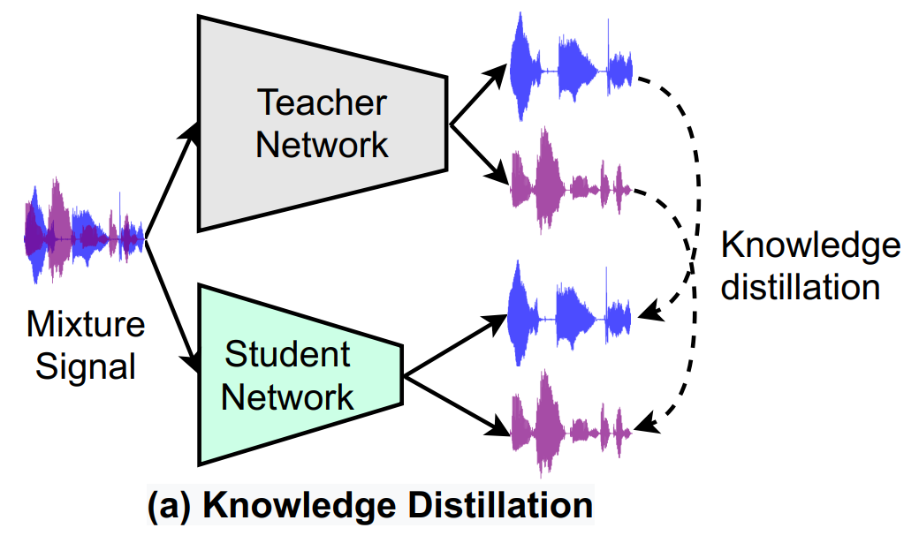
Overview: Knowledge distillation
To improve the performance for lightweight models knowledge distillation (KD) is one of the common approaches.
Use a big pre-trained network to transfer knowledge to other smaller networks in order to improve the performance of smaller networks.
However, the KD approach requires a powerful large teacher network to guide the student network. The distillation process usually is performed one way, i.e., from teacher to student.
The black line is the forward path; the black dashed line indicates the feature distillation from the pre-trained teacher to the student.

Slide 7
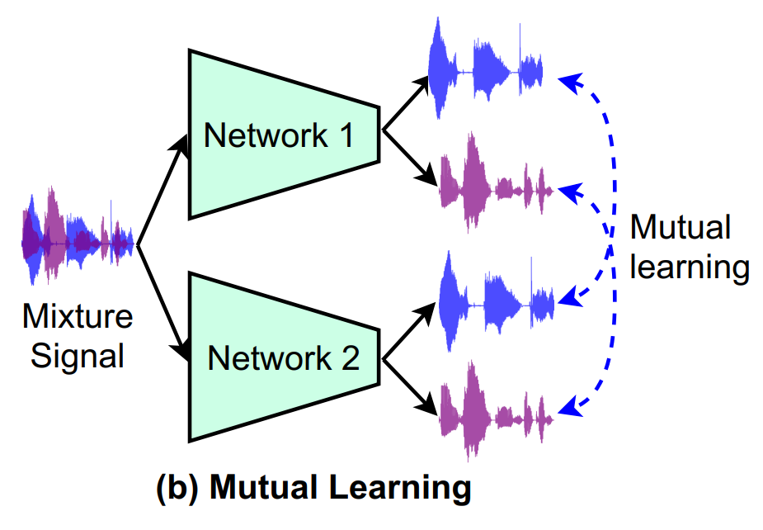
Overview: Mutual Learning
The mutual learning process usually is performed in two ways. Mutual learning (ML) approaches use a group of students to learn and share knowledge simultaneously with each other during the training phase.
Mutual learning has become a promising approach to increase performance on many different tasks such as image classification, audio tagging, speech recognition, etc.
The black line is the forward path; the blue dashed line illustrates the knowledge sharing between two networks in the Mutual Learning approach.

Slide 8
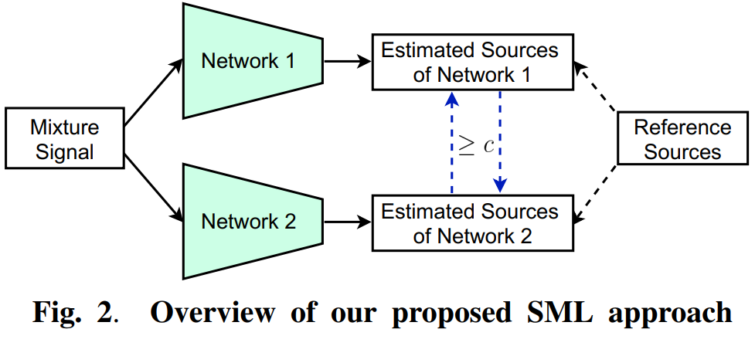
Propose: Selective Mutual Learning
In the selective mutual learning (SML) method, two networks are trained simultaneously to solve the task together.
Moreover, they are to be like a pair of friends, learning and sharing knowledge with each others.
In our SML approach, only high-confidence predictions are utilized to guide the remaining network while the low-confidence predictions are ignored.

Slide 9
Contribution: Selective Mutual Learning
(1) A new approach based on ML for single channel speech separation. To our best knowledge, this is the first ML method that is built for speech separation.
(2) We propose a novel SML strategy. It allows removing poor predictions between two networks during the sharing knowledge process.
(3) Experimental results show that our proposed SML approach outperforms other training mechanisms such as independently training, KD, and ML with the same network architecture. The details are discussed in Section 3.

Slide 10
Method: Selective Mutual Learning
In time domain speech separation frameworks, SI-SNR is used as the training target to compare the similarity between a reference clean source s and an estimated source ŝ.
The SI-SNR is defined as follows:
Input mixture feature:
Output estimated sources:
Reference sources:

Slide 11
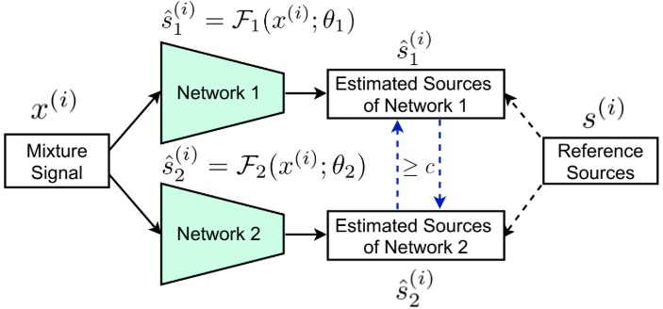
Method: Selective Mutual Learning
In Eq. (2) and (3), Ը₁ and Ը₂ correspond to the overall loss functions of the network 1 and network 2. λ is a hyper-parameter representing the weight of Ը_{sml} and Ը_{sup.}
Ը₁ (2) and Ը₂ (3) depend on λ, Ը_{sml} and Ը_{sup} .
Ը_{sup} is the supervised loss between the reference clean source and the estimated source.
Ը_{sml} is the selective mutual learning loss function between two networks.

Slide 12
Method: Selective Mutual Learning
Eq. (4) and (5) correspond to the supervised losses of the network 1 and network 2. Eq. (6) and (7) correspond to the selective mutual learning losses of the network 1 and network 2.
The estimated source of network 1 as a reference pseudo source to guide the training of network 2 and likewise for the training of network 1.
An important contribution, we only retain the high-quality estimated sources and ignore the low-quality estimated sources during the selective mutual learning phase. A hyper-parameter of the confidence factor c is used to evaluate the quality of the estimated sources.

Slide 13
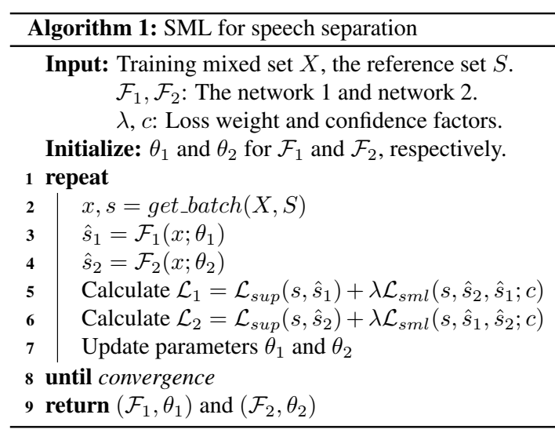
Method: Selective Mutual Learning
In selective mutual learning algorithm, network with input X, output Ŝ, and reference S, we use Ը₁ and Ը₂ for convergence. Specifically, Ը_{sml} is used for training phase when , opposite, Ը_{sml} isn’t used for training phase when

Slide 14
Experiments
Dataset:
Use the WSJ0-2mix dataset with a 30-hour training dataset, a 10-hour validation dataset, and a 5-hour evaluation dataset.
The mixed waveforms are sampled 8kHz.
Training and validation datasets in si_tr_s folder, and the evaluation dataset in the si_dt_05 and si_et_05 folders.
Metrics:
Use scale-invariant signal-to-noise ratio improvement (SI-SNRi), source-to-distortion ratio improvement (SDRi), short-time objective intelligibility (STOI), and perceptual evaluation of speech quality (PESQ).
In recent years, SI-SNRi and SDRi are widely used for time domain speech separation.
All the larger values of the metrics lead to a better separation system.

Slide 15
Experiments
Implementation Details:
The SML approach includes a pair of networks.
We use the DPRNN backbone with 3-blocks (instead of 6-blocks as in the official version) for both networks.
The confidence factor c is initialized to 15 and increases by +1 after 10 epochs. The maximum value of c is set to 20.
The λ is set to 0.001.
We use the Adam optimizer, the initial learning rate of 1e−4, and a decaying rate of 0.98 for every two epochs.
All the networks are trained with uPIT to maximize SI-SNR and 4-second long segments.
A gradient clipping method with a maximum L2-norm of 5 is used during training and the batch size of 4.

Slide 16
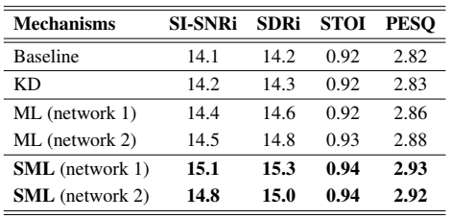
Experiments: Performance Comparison
Comparison of the separation performance of the Selective Mutual Learning approach with other mechanisms on the WSJ0-2mix dataset
Comparison with other mechanisms:
In this example, we use the online training in the KD method.
The ML method uses all predictions of the two networks for sharing knowledge.
SML only retains high-quality predictions for sharing knowledge.

Slide 17
Experiments: Performance Comparison
All methods are trained with the same network architecture i.e., DPRNN 3-blocks. The teacher network of the KD approach is the DPRNN 6-blocks.
Comparison results:
The performance of the KD approach insignificantly improves compared to the baseline method (14.2 dB vs 14.1 dB SI-SNRi)
The capacity gap between the large teacher and the small student is one of the notable limitations of the KD approach.
The student cannot effectively exploit the knowledge transferred from the teacher.
ML improves compared to the baseline method. However, ML learns all predictions ( low SI-SNRi and high SI-SNRi of the other student)
SML only retains high-quality SI-SNRi for sharing knowledge and get the best separation performance.

Slide 18
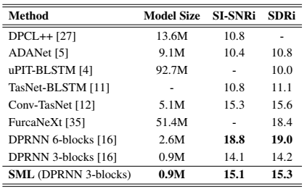
Experiments: Performance Comparison
Comparison of the SML approach to state-of-the-art methods on the WSJ0-2mix dataset. In which, the model size is the total of parameters used in each model.
Comparison with the state-of-the-art methods:
The SML method has obtained high SI-SNRi and SDRi while using a small model size.
The proposed method outperforms the DPRNN when using the same model size as that of the proposed SML.
The proposed method outperforms the Conv-TasNet, but at much lower model size.

Slide 19
Conclusion
We have proposed a novel SML approach for speech separation, to improve the performance of each peer network in a cohort.
Each network is trained with supervised learning and knowledge distillation selectively from the other network.
The exchange and sharing of knowledge between two networks help to enhance the generalization performance.
The experimental results have shown that the SML approach outperforms other training mechanisms such as independently training, KD, and ML.
In addition, only with 0.9M params, the SML approach achieves competitive performance compared to state-of-the-art heavy networks.

Slide 20
Thank You !

