Slide 1
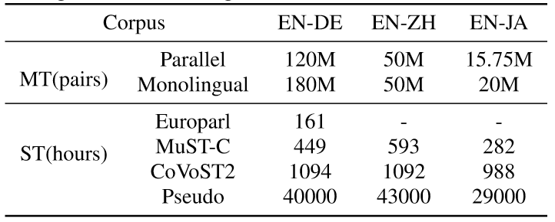
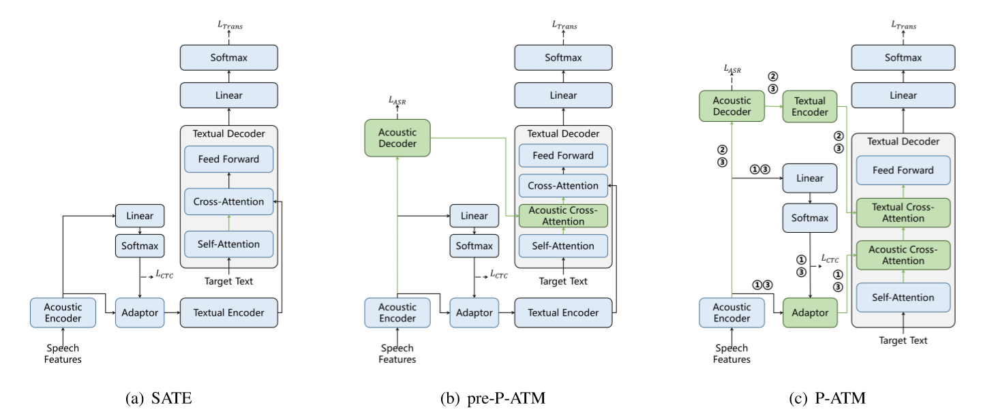
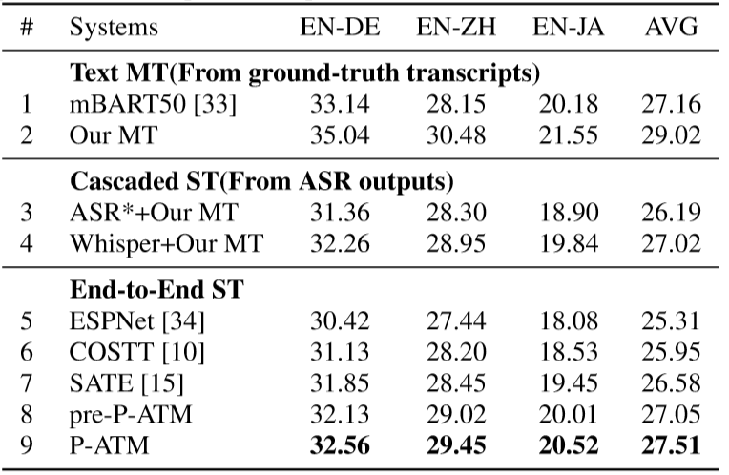
Pre-Trained Acoustic-And-Textual Modeling For End-To-End Spech-To-Text Translation
Weitai Zhang^{1,2}, Hanyi Zhange², Chenxuan Liu^{1,2}, Zhongyi Ye^{1,2} ,Xinyuan Zhou², Chao Lin², Lirong Dai¹
¹University of Science and Technology of China, China, ²iFLYTEK Research, China
Background
Experiments
Existing end-to-end models mainly attributes and attempts to address the problem of modeling burden and data scarcity, while always fail to maintain both cross-modal and cross-lingual mapping well at the same time
We propose a novel model architecture Pre-trained Acoustic and Textual Modeling (P-ATM). utilize pre-trained ASR and MT models together to improve E2E ST
We use two additional cross-attention modules to alleviate the cross-modal and cross-lingual representation inconsistency, additionally, we develop an adaptation fine-tuning method to preserve the pre-training knowledge and keep fine-tuning stably
Experimental results on the IWSLT2023 offline ST task from English to German, Japanese and Chinese show that our method achieves state-of-the-art BLEU scores and surpasses the strong cascaded ST counterparts in unrestricted setting.
Experimental setups
Datasets: offline ST task in the IWSLT2023
ASR model: Whisper-large-v2 (1550M)
MT model: transformer architecture consists of an encoder with 18 layers and a decoder with 6 layers
Results
Our pre-P-ATM achieves a significant improvement of 0.47 BLEU compared with SATE, achieve state-of-the-art results on the IWSLT2023 offline ST task
Our final version of P-ATM surpasses our best cascaded system by 0.49 BLEU, with better fusion of acoustic and textual features
Approach
Analysis
Effects of Pre-training :Compared with randomly initialized acoustic and textual modules, pre-trained ASR and MT models bring significant gain of ∼2 BLEU scores
Effects of Adaptation Fine-tuning :Adaptation fine-tuning slightly updates the model parameters to preserve the pre-trained knowledge from the ASR and MT models, enabling the model to achieve a 0.35 BLEU improvement over the vanilla P-ATM.
The P-ATM Architecture:
It initializes with pre-trained ASR and MT models, enabling it to fully utilize these pre-trained datasets.
It incorporates Textual Cross-Attention to better leverage the high-level information from the acoustic model, and Acoustic Cross-Attention to alleviate the propagation of errors in acoustic representations.
Adaptation fine-tuning:
Acoustic Adaptation: fine-tuning the text decoder with acoustic representations (CTC decoding).
Text Adaptation: fine-tuning the text decoder and text encoder with ASR outputs(text decoding).
Joint Adaptation: update all parameters of the entire model with all training data.

