Slide 1
Unlocking deep learning: A BP-free approach for parallel block-wise training of neural networks
Anzhe Cheng*, Zhenkun Wang* , Chenzhong Yin*, Mingxi Cheng*, Heng Ping*, Xiongye Xiao, Shahin Nazarain, Paul Bogdan
University of Southern California, Los Angeles, CA, USA
Notes:
1

Slide 2
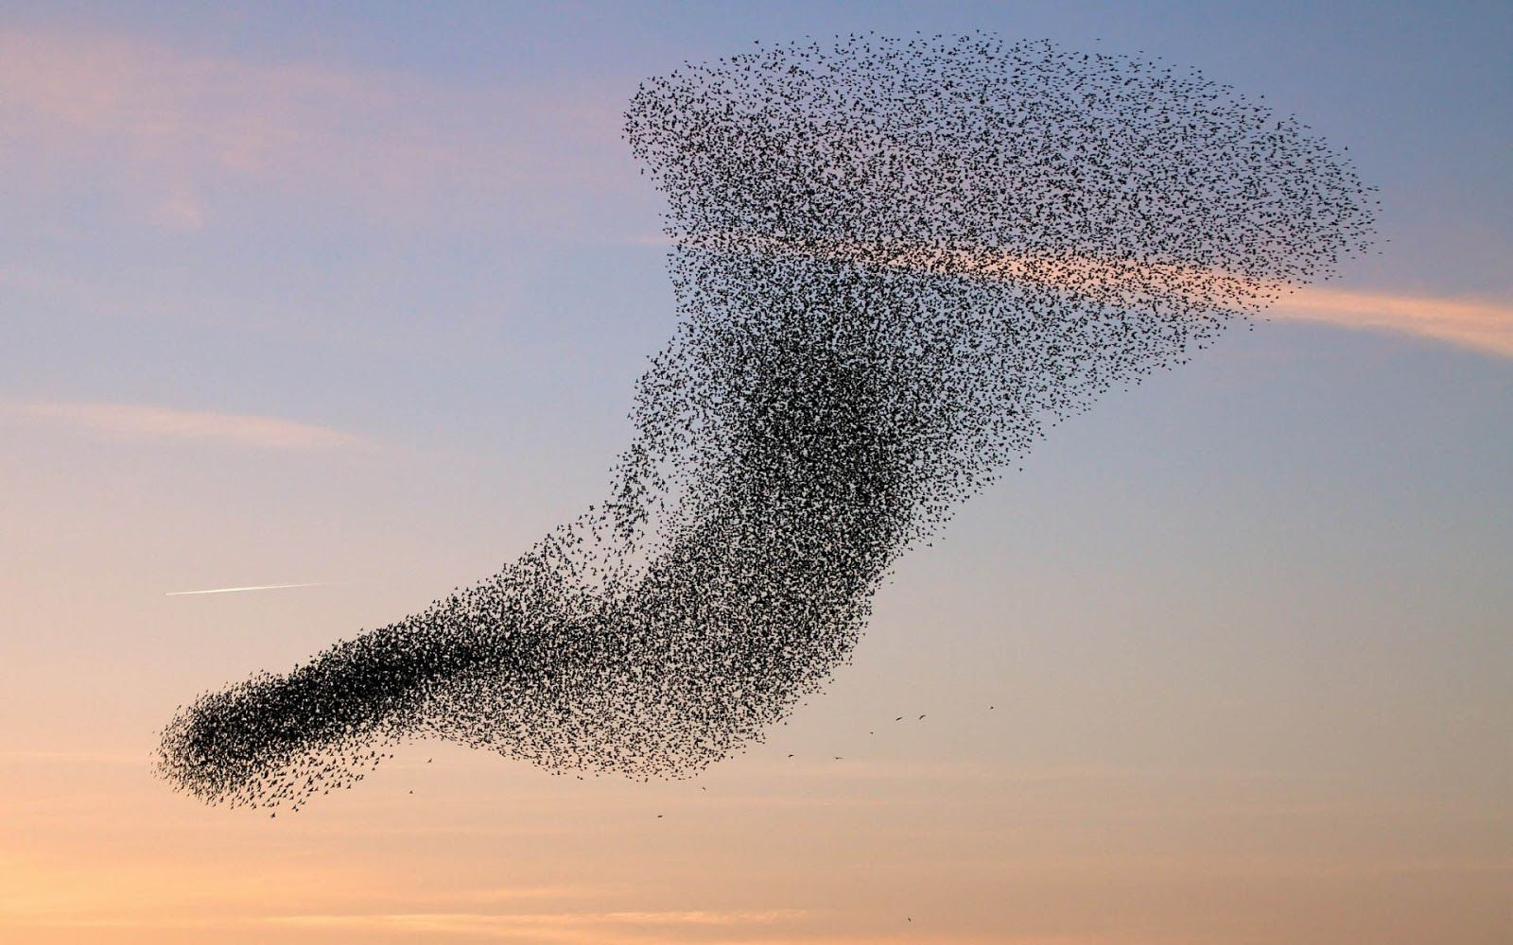
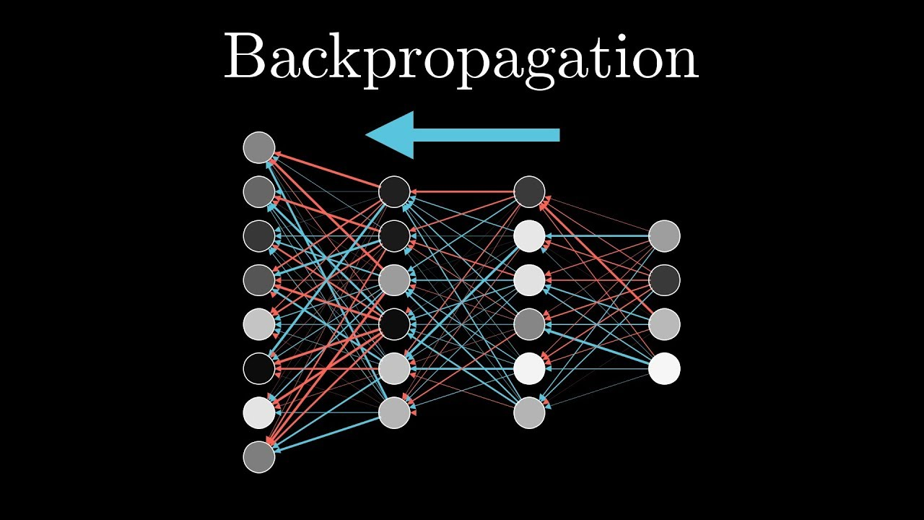
Intuition of BWBPF
Limitation of traditional BP
Chain rule cannot be computed parallel
Distributed NN
Inspired from collective motion rules
Block-wise Learning
Notes:
The table is the result of error rate performed on different networks. No matter the small datasets(e.g. cifar10) or the large ones(tiny-imagenet), our method(BWBPF) has outperformed traditional BP and other block-wise learning methods. We have also tested our method with different numbers of blocks. Though with more blocks, the error rate increases, we still have the significant advantage over other methods. Our paper has been accepted by ICASSP2024, and the bottom link is the arXiv link for our paper.

Slide 3
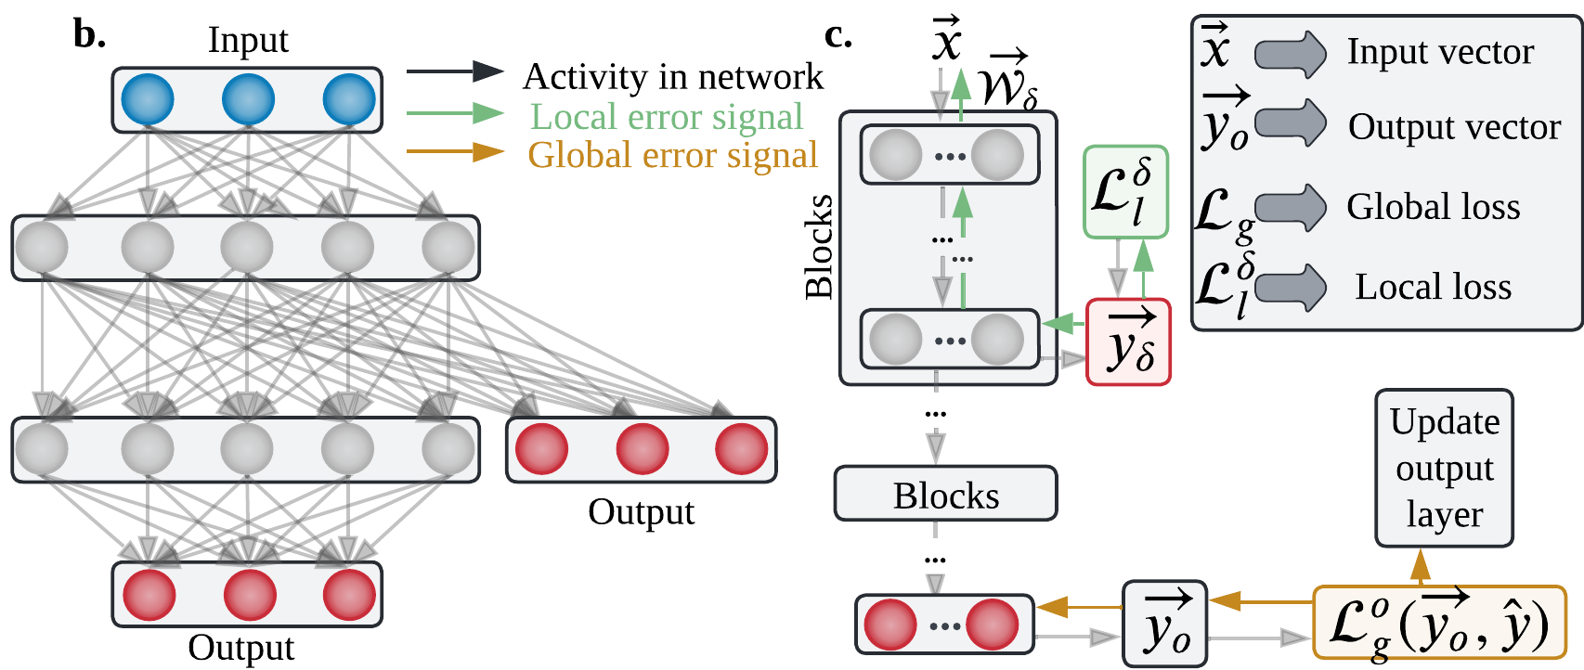
Block-wise BP-Free Network
Blocks: organize and group one or more layers together
Auxiliary components: update weights within each block
Advantage over BP: using local loss instead of global loss
Loss: $L=λ_{1}L_{g}^{O}+$ ${λ_{2}}_{ }^{ }$ $\sum_{l=1}^{K}{𝓛_{l}^{δ}}$
Notes:
We divided the neural network into two or more groups which is called blocks. As shown in c., each block contains one or more convolutional layers together. At the end of each blocks, we added auxiliary components which is used for weight updating within each blocks. As shown in this figure b. we added an output layer at the end of blocks, so that we could calculate the local loss instead of global loss in BP. By using local loss, we could prevent update locking and backward locking which are significant downsides in traditional BP. The loss function we used is the addition of all blocks’ local loss with a weight of lambda2 plus the global loss with the weight of lambda1.

Slide 4
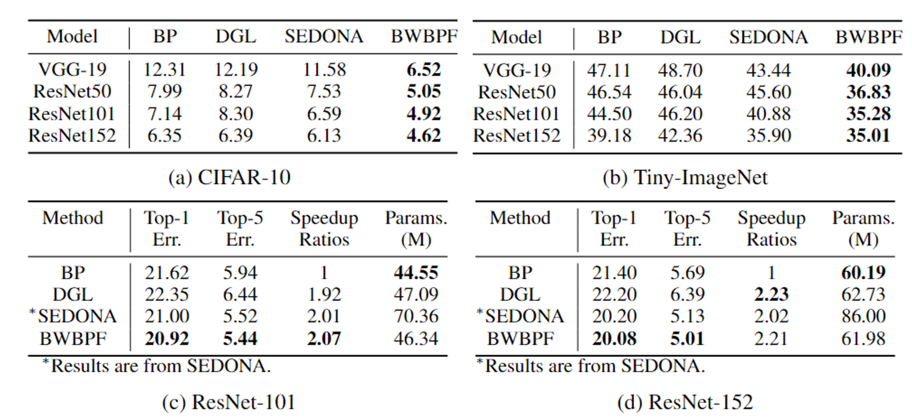
Results on Cifar-10 and Tiny-ImageNet
Error rate of multiple networks
Networks’ results on Cifar-10
Networks’ results on Tiny-ImageNet
arXiv link: https://arxiv.org/abs/2312.13311
Notes:
The table is the result of error rate performed on different networks. No matter the small datasets(e.g. cifar10) or the large ones(tiny-imagenet), our method(BWBPF) has outperformed traditional BP and other block-wise learning methods. We have also tested our method with different numbers of blocks. Though with more blocks, the error rate increases, we still have the significant advantage over other methods. Our paper has been accepted by ICASSP2024, and the bottom link is the arXiv link for our paper.

Slide 5
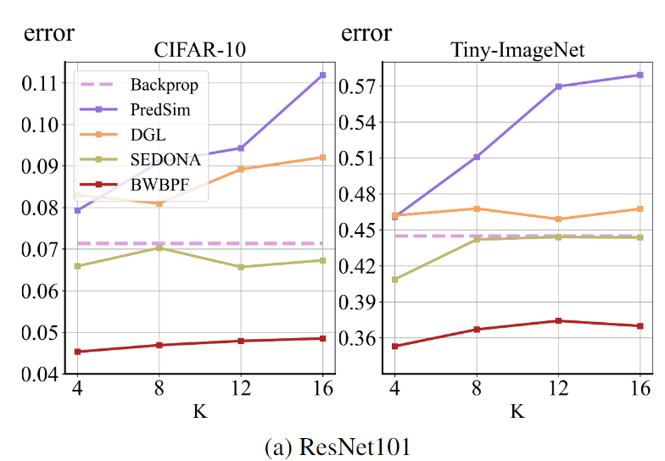
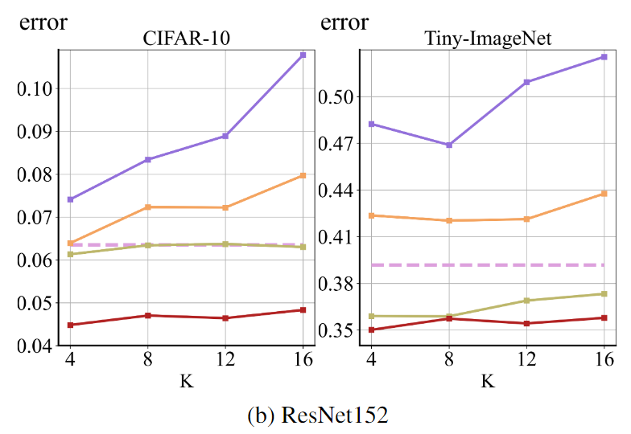
Results on Cifar-10 and Tiny-ImageNet
BWBPF with multiple blocks
With K blocks on ResNet101
With K blocks on ResNet152
arXiv link: https://arxiv.org/abs/2312.13311
Notes:
The table is the result of error rate performed on different networks. No matter the small datasets(e.g. cifar10) or the large ones(tiny-imagenet), our method(BWBPF) has outperformed traditional BP and other block-wise learning methods. We have also tested our method with different numbers of blocks. Though with more blocks, the error rate increases, we still have the significant advantage over other methods. Our paper has been accepted by ICASSP2024, and the bottom link is the arXiv link for our paper.

Slide 6
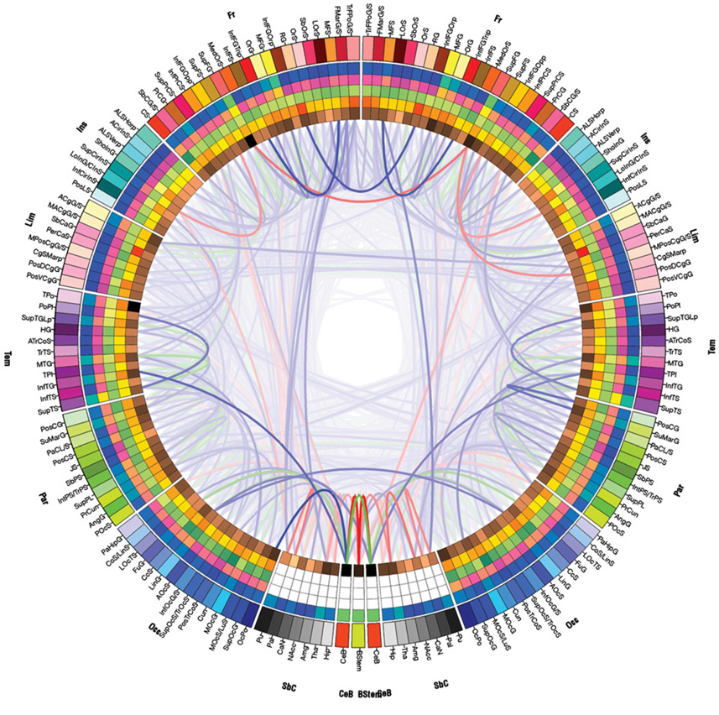
Future Work
Current Work
Proposed novel block-wise learning method(BWBPF)
Computes local losses for individual blocks
Divides the network into subnetworks
Improves generalization
Future Work
Extending application domains of BWBPF algorithm
Exploring alternative learning mechanisms inspired by biology
Irimia A, Chambers MC, Torgerson CM, Van Horn JD. Circular representation of human cortical networks for subject and population-level connectomic visualization. Neuroimage. 2012 Apr 2;60(2):1340-51. doi: 10.1016/j.neuroimage.2012.01.107. Epub 2012 Jan 28. PMID: 22305988; PMCID: PMC3594415.
Notes:
The table is the result of error rate performed on different networks. No matter the small datasets(e.g. cifar10) or the large ones(tiny-imagenet), our method(BWBPF) has outperformed traditional BP and other block-wise learning methods. We have also tested our method with different numbers of blocks. Though with more blocks, the error rate increases, we still have the significant advantage over other methods. Our paper has been accepted by ICASSP2024, and the bottom link is the arXiv link for our paper.

Slide 7
Thank You!

