Slide 1
Voice Activity Detection Based on Sequential Gaussian Mixture Model
Tianjin Key Laboratory of cognitive Computing and Intelligent System
Zhan Shen, Jianguo Wei, Wenhuan Lu, Jianwu Dang
Tianjin Key Laboratory of Cognitive Computation & its Applications
Tianjin University, China

Slide 2
Tianjin Key Laboratory of cognitive Computing and Intelligent System
Introduction
Voice activity detector (VAD) plays an important role in many speech signal processing systems, wherein each utterance are partitioned into speech/nonspeech segments.
Research branch of VAD
Acoustic features
Energy, pitch, zero-crossing rate, higher-order statistics, …
Each acoustic feature reflects only some characteristics of human voice;
Not very effective in extremely difficult scenarios.
Statistical models
Make model assumptions on distributions of speech and nonspeech respectively, and then design statistical algorithms to dynamically estimate the model parameters;
Gaussian model, Laplacian model, Gamma model, GARCH model …
Difficult to derive a closed-form parameter estimation algorithm.
Deep Neural Network
Train acoustic models from given noisy corpora;
Superior performance only if the training scenario is matched with the test scenario;
Heavy computational load;
Use some succeeding and preceding frames as the input, which leads to the latency for several frames.
Notes:
2

Slide 3
Tianjin Key Laboratory of cognitive Computing and Intelligent System
Introduction
Voice activity detector (VAD) plays an important role in many speech signal processing systems, wherein each utterance are partitioned into speech/nonspeech segments.
Research branch of VAD
Acoustic features
Energy, pitch, zero-crossing rate, higher-order statistics, …
Each acoustic feature reflects only some characteristics of human voice;
Not very effective in extremely difficult scenarios.
Statistical models
Make model assumptions on distributions of speech and nonspeech respectively, and then design statistical algorithms to dynamically estimate the model parameters;
Gaussian model, Laplacian model, Gamma model, GARCH model …
Difficult to derive a closed-form parameter estimation algorithm.
Deep Neural Network
Train acoustic models from given noisy corpora;
Superior performance only if the training scenario is matched with the test scenario;
Heavy computational load;
Use some succeeding and preceding frames as the input, which leads to the latency for several frames.
Notes:
3

Slide 4
Tianjin Key Laboratory of cognitive Computing and Intelligent System
Unsupervised Learning Framework
Acoustic feature: smoothed subband logarithmic energy
The input signal is grouped into several Mel subbands in the frequency domain;
The logarithmic energy is calculated by using the logarithmic value of the absolute magnitude sum of each subband, then smoothed to form an envelope for classification;
(1)
Notes:
4

Slide 5
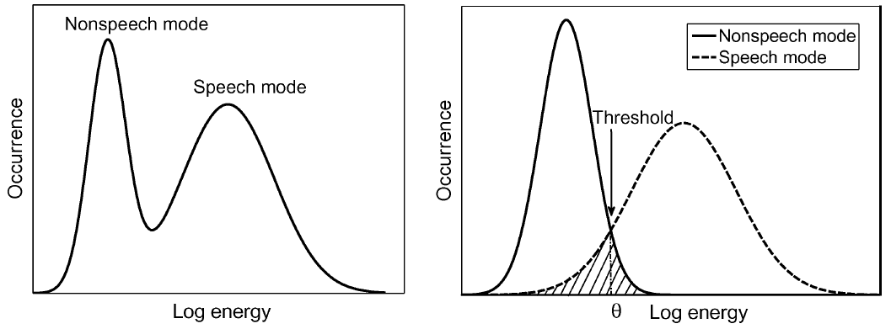
Tianjin Key Laboratory of cognitive Computing and Intelligent System
Unsupervised Learning Framework
Two Gaussian models are employed as the classifier to describe the logarithmic energy distributions of speech and nonspeech.
These two models are incorporated into a two-component GMM. The mean and variance of nonspeech logarithmic energy are smaller than those of speech logarithmic energy.
Notes:
5

Slide 6
Tianjin Key Laboratory of cognitive Computing and Intelligent System
Unsupervised Learning Framework
is an optimal threshold to minimize the classification error;
The samples with logarithmic energy less than the threshold is classified as nonspeech, and otherwise as speech.
(2)
(3)
(4)
Notes:
6

Slide 7
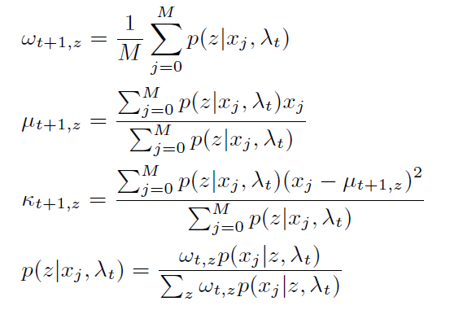
Tianjin Key Laboratory of cognitive Computing and Intelligent System
Estimation of GMM Parameters
The parameter set was updated based on maximum likelihood frame by frame.
The sequential scheme is a first-order process.
The GMM is initialized with the first M frames through the typical EM algorithm
(5)
(6)
(7)
(8)
Notes:
7

Slide 8
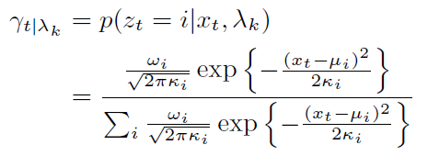
Tianjin Key Laboratory of cognitive Computing and Intelligent System
Estimation of GMM Parameters
The GMM is sequentially updated based on maximum likelihood criterion after initialization.
The parameter set for the (k+1)-th frame is estimated by
(9)
(10)
(11)
Notes:
8

Slide 9
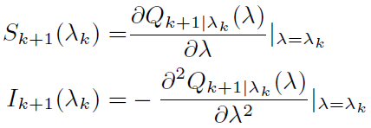
Tianjin Key Laboratory of cognitive Computing and Intelligent System
Estimation of GMM Parameters
Iterative Newton-Raphson algorithm is utilized to maximized the Q-function.
(12)
(13)
(14)
Notes:
9

Slide 10
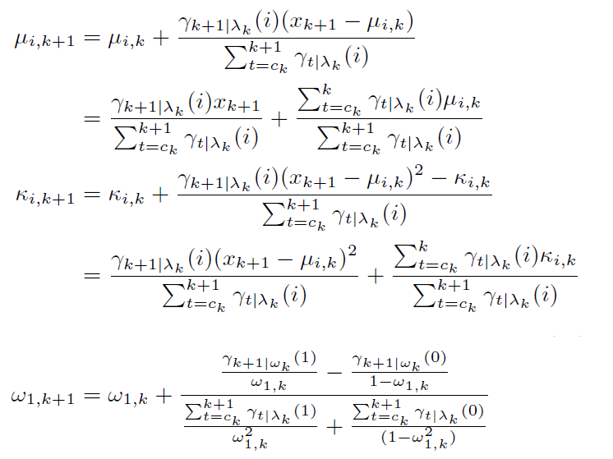
Tianjin Key Laboratory of cognitive Computing and Intelligent System
Estimation of GMM Parameters
Substituting the parameters set into (12) yields the following recursive formulas.
(15)
(16)
(17)
Notes:
10

Slide 11
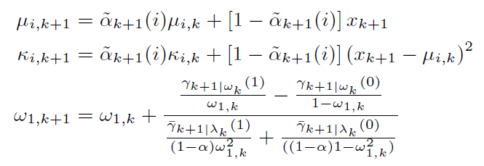
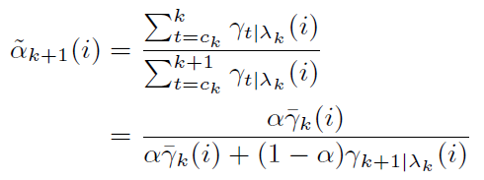
Tianjin Key Laboratory of cognitive Computing and Intelligent System
Estimation of GMM Parameters
The average of the speech presence/absence probability can be defined as a sequential variable.
Each parameter in a new parameter set can be represented as a function of new observation, previous parameter set and speech presence probability.
(18)
(19)
(20)
(21)
(22)
Notes:
11

Slide 12
Tianjin Key Laboratory of cognitive Computing and Intelligent System
Constraints on GMM
A number of constraints are introduced to make sure that the proposed GMM fits with the situation of speech absence as well as speech presence.
In the situation of speech absence, a virtual speech component is constructed to fit the two-component GMM.
All these constraints are embedded into both the initialization and updating processes of sequential GMM.
Constraint to means
Constraint to variances
Constraint to weight coefficients
Notes:
12

Slide 13
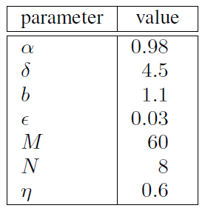
Tianjin Key Laboratory of cognitive Computing and Intelligent System
Experimental Conditions
Data set: TIMIT TEST corpus;
Clean speech signal: 16 male speakers, 16 female speakers, 320 utterances in total;
Noises: Babble noise at SNRs of 0, 10 and 20 dB;
F16 cockpit at SNRs of 0, 10 and 20 dB;
White gaussian at SNRs of 0, 10 and 20 dB;
Sampling rate: 8000 Hz;
Referenced VADs: ITU G.729 Annex B VAD (G729B);
ESTI AMR VAD options 1 (AMR1);
ESTI AMR VAD options 2 (AMR2);
SGMM VAD by Ying (SGMM);
Parameters:
Notes:
13

Slide 14
Tianjin Key Laboratory of cognitive Computing and Intelligent System
Experimental Results
Babble noise at SNR of 0dB, 10dB, and 20dB
Notes:
14

Slide 15
Tianjin Key Laboratory of cognitive Computing and Intelligent System
Experimental Results
F16 cockpit at SNR of 0dB, 10dB, and 20dB
Notes:
15

Slide 16
Tianjin Key Laboratory of cognitive Computing and Intelligent System
Experimental Results
White gaussian at SNR of 0dB, 10dB, and 20dB
Notes:
16

Slide 17
Tianjin Key Laboratory of cognitive Computing and Intelligent System
Experimental Results
Table: F-measure for 0dB SNR.
 | Babble | F16 | White
G729B | 0.7250 | 0.7046 | 0.6194
AMR1 | 0.7680 | 0.5594 | 0.7744
AMR2 | 0.6412 | 0.5440 | 0.5947
SGMM | 0.7746 | 0.8153 | 0.8312
ML | 0.7941 | 0.8693 | 0.8993
TP: True Positive
FP: False Positive
TN: True Negative
FN: False Negative
Notes:
17

Slide 18
Tianjin Key Laboratory of cognitive Computing and Intelligent System
Process of VAD Decision
Updating
1: FOR each new coming frame at time k+1
2: Do FFT and calculate at each Mel subband
3: FOR at each subband
4: Maximized the Q-function with Newton’s method.
5: Update the means.
6: Constrain the means.
7: Update the variances.
8: Constrain the variances.
9: Update the weight coefficients.
10: Constrain the weight coefficients.
11: Determine the threshold from GMM.
12: Tune the threshold.
13: Determine as speech/nonspeech.
14: END
15: Summarize all subbands’ classification by voting.
17: Discriminate the k+1 frame.
17: END
Initialization
1: FOR the first M frames
2: FOR each Mel subband
3: Extract a logarithmic energy envelope.
4: Establish a GMM by EM with constraints.
5: Determine the threshold from GMM.
6: Tune the threshold.
7: Classify of M samples as speech/nonspeech.
8: END
9: Summarize all subbands’ classification by voting.
10: Discriminate speech/nonspeech.
11: END
Notes:
。
18

Slide 19
Tianjin Key Laboratory of cognitive Computing and Intelligent System
Discussion
Conclusion
This work presents a novel voice activity detector based on Gaussian mixture model;
The logarithmic power is utilized as the acoustic feature;
The sequential likelihood function is presented to estimate the parameter set of this GMM frame by frame;
The likelihood function is sequentially maximized based on the Newton-Raphson method;
The major contribution of this paper is the optimal estimation of the GMM parameter set.
Future Work
Compare the experimental results with other statistical model based VADs.
Notes:
19

Slide 20
Thank you !
This work was supported by National Natural Science Foundation of China (No.61233009).

