Slide 1
KaraSinger: Score-Free Singing Voice Synthesis with VQ-VAE using Mel-spectrograms
Chien-Feng Liao*, Jen-Yu Liu*, Yi-Hsuan Yang
Taiwan AI Labs, Taiwan

Slide 2
Introduction
Vocoder
Acoustic model
Lyrics
Note
Duration
Common singing voice synthesis (SVS) system

Slide 3
Introduction
Vocoder
Acoustic model
Lyrics
Note
Duration
Common singing voice synthesis (SVS) system
Music score

Slide 4
Introduction
Vocoder
Vocoder
Acoustic model
Acoustic model
Lyrics
Note
Duration
Lyrics
Accompaniment
(optional)
Common singing voice synthesis (SVS) system
KaraSinger
Score-free SVS

Slide 5
Why score-free SVS?
For ordinary users, composing a reasonable melody is much harder than writing lyrics.
Collecting singing voices with annotated music score requires significant efforts, while KaraSinger only needs sentence-level alignment during training.
A new direction for SVS, where common users and music creators can both experience the creativity of AI.

Slide 6
Why score-free SVS?

Slide 7
Related work
Proposed method
Experimental results

Slide 8
Related work
Proposed method
Experimental results

Slide 9
Related work
Jukebox from OpenAI [1]
A generative model that generates music, including vocals and instruments
In a variety of genres and artist styles

Slide 10
Related work
Stage1
Waveform
Jukebox from OpenAI [1]
Stage1 – VQ-VAE
VQ Encoder
Discrete latent codes
VQ Decoder
Reconstructed
waveform

Slide 11
Related work
Stage1
Stage2
Waveform
Conditions
Jukebox from OpenAI [1]
Stage1 – VQ-VAE
Stage2 – language model
VQ Encoder
Language model
(Prior)
Discrete latent codes
Predicted
Discrete latent codes
VQ Decoder
VQ Decoder
Reconstructed
waveform

Slide 12
Related work
Stage1
Stage2
Waveform
Conditions
Our contribution
Focus on singing voices
Lightweight model for single GPU
Real-time inference
VQ Encoder
Language model
(Prior)
Discrete latent codes
Predicted
Discrete latent codes
VQ Decoder
VQ Decoder
Reconstructed
waveform

Slide 13
Related work
Proposed method
Experimental results

Slide 14
Related work
Proposed method
Experimental results

Slide 15
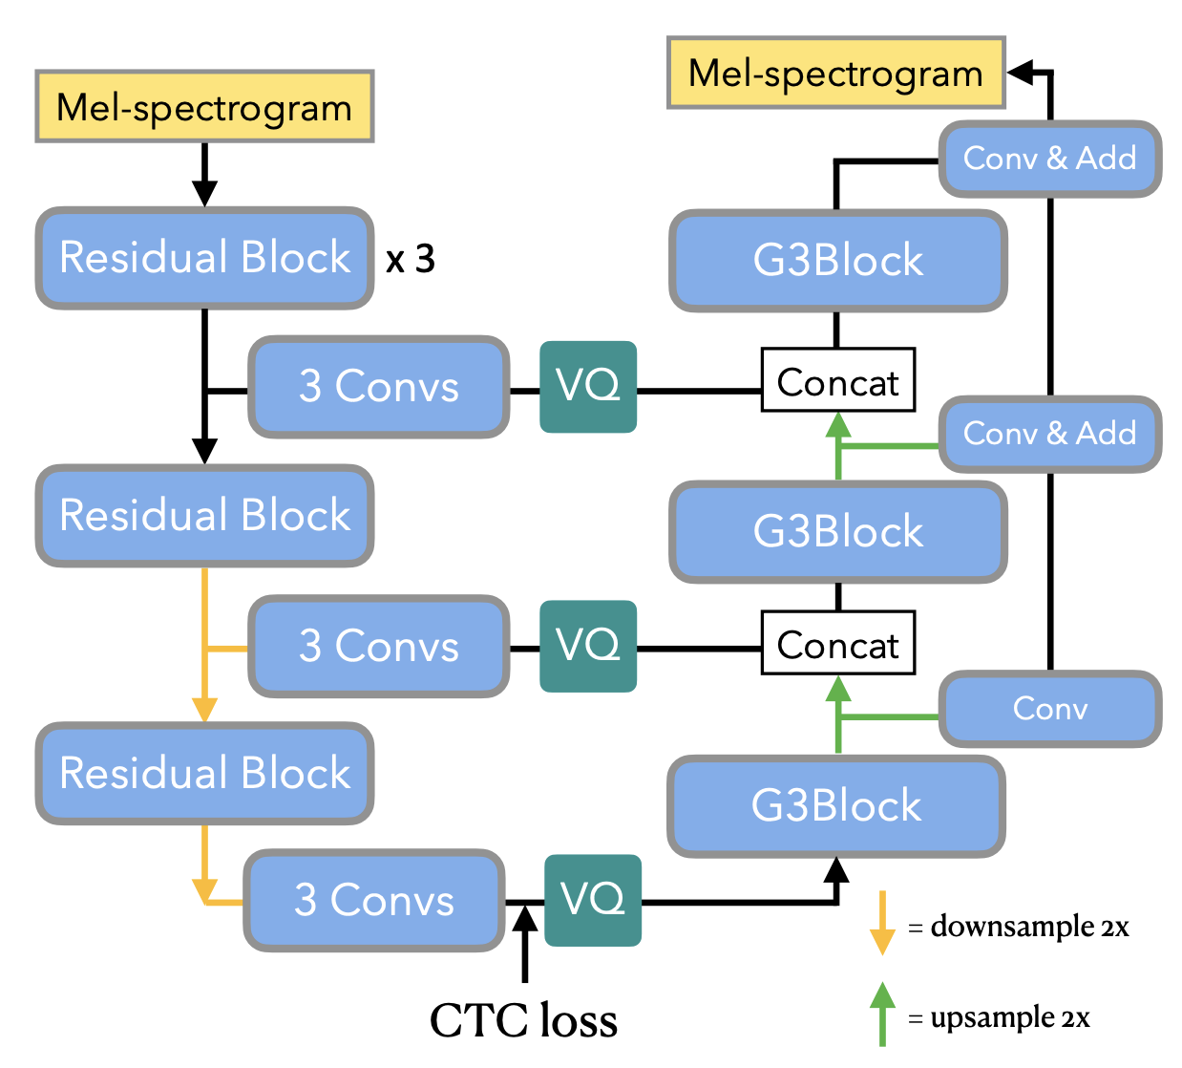
VQ-VAE
Hierarchical VQ-VAE [2]
Works on Mel-spectrograms
All levels are jointly trained
CTC loss [3] on top-level codes
Bot-level
Mid-level
Top-level

Slide 16
Language model

Slide 17
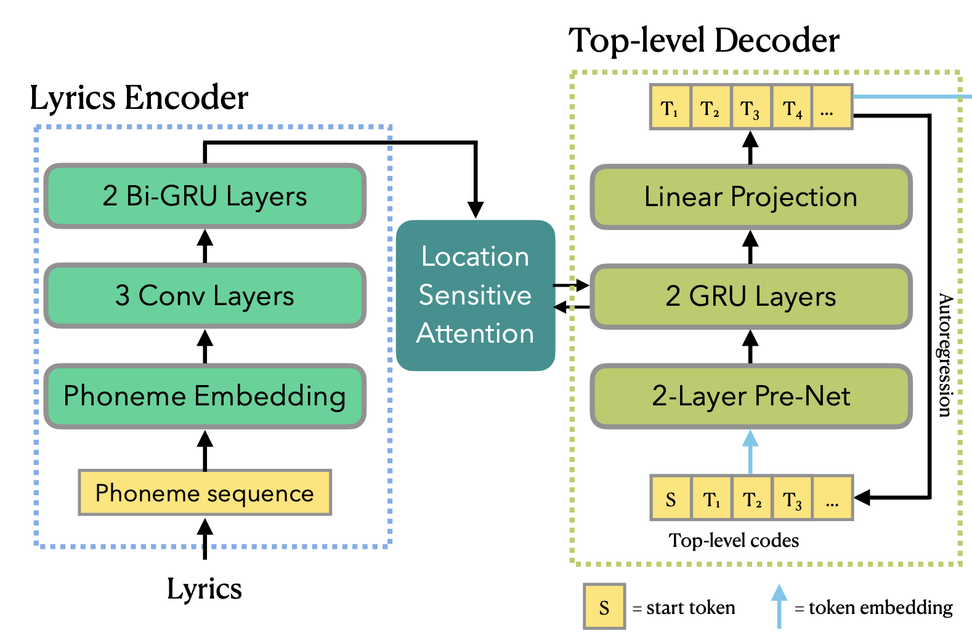
Language model
Tacotron2-like model [4]
Location sensitive attention [5]

Slide 18
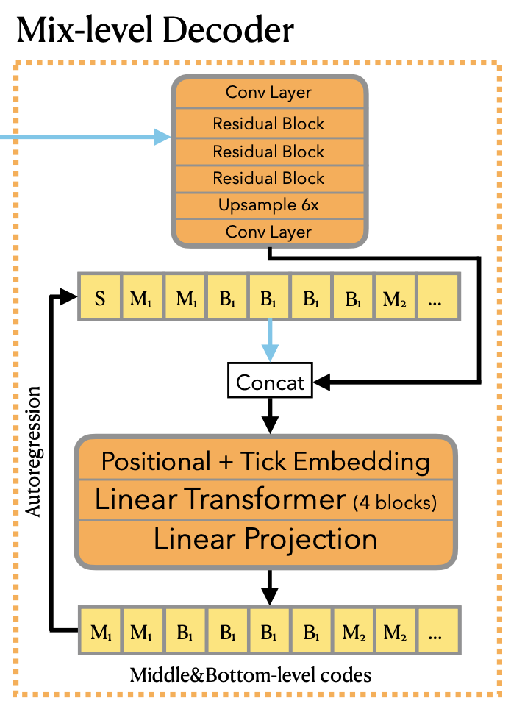
Language model
Top-level codes
Middle- and bottom-level codes are jointly predicted by combine them into a single sequence
Linear Transformer [6]
Tick embedding (T1, T2, T3, T4, T5, T6, T1, …)
Use an upsampler block to condition on top-level codes

Slide 19
Related work
Proposed method
Experimental results

Slide 20
Related work
Proposed method
Experimental results

Slide 21
Dataset
550 songs purchased from an English karaoke website
All female singer, pop genre, no singer information
Run NUS AutoLyricsAlign [7] on the vocals to obtain sentence-level alignments of the lyrics
Songs are split into segments between 5 to 15 seconds.
The final dataset ~20 hours
Sampled at 44.1 kHz

Slide 22
Experiment
Compare 3 models

Slide 23
Experiment
Compare 3 models
noCTC

Slide 24
Experiment
Compare 3 models
noCTC
3-level
Top-level
Middle-level
Bottom-level

Slide 25
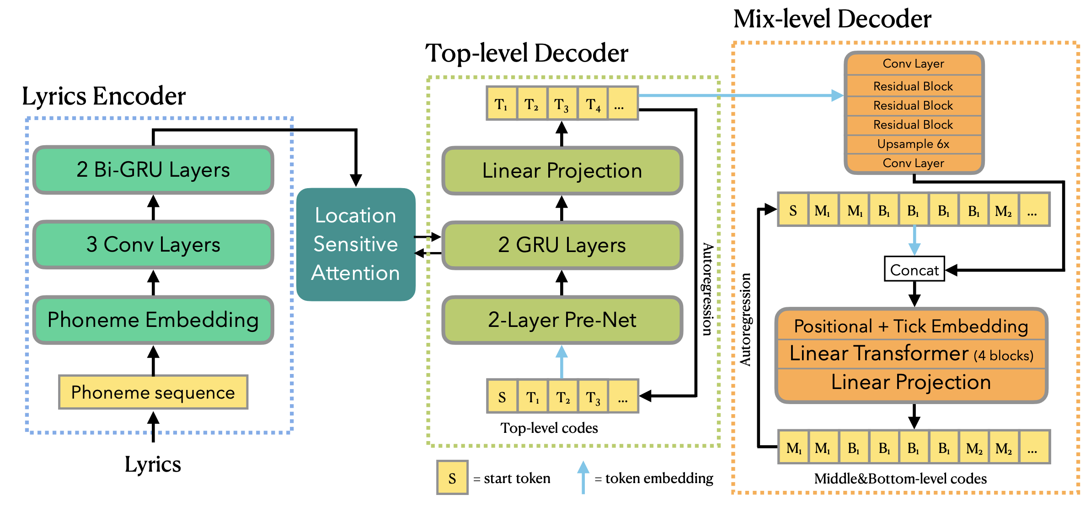
Experiment
Compare 3 models
noCTC
3-level
proposed

Slide 26
Subjective evaluation
Listening test
28 participants
Each participant is asked to rate 15 samples (5 sentences, each generated by 3 models)
rate the samples considering the following three aspects:
Intelligibility
Musicality
Overall quality

Slide 27
Results
CTC loss is crucial for the system to work

Slide 28
Results
CTC loss is crucial for the system to work
Jointly predict middle- and bottom-level codes provides overall improvement

Slide 29
Results
CTC loss is crucial for the system to work
Jointly predict middle- and bottom-level codes provides overall improvement
https://jerrygood0703.github.io/KaraSinger/

Slide 30
Conclusion
We introduced score-free SVS, a new direction for SVS task
KaraSinger, based on a hierarchical VQ-VAE over Mel-spectrograms and a lyrics conditioned LM to achieve score-free SVS.
Lightweight system that can run in real-time

Slide 31
For more questions please visit our poster session
Session: AUD-32: Audio Music Synthesis https://2022.ieeeicassp.org/view_session.php?SessionID=1033 Session Time: Friday, 13 May, 20:00 - 20:45 (Singapore Time, UTC +8)

Slide 32
References
[1] Dhariwal, P., Jun, H., Payne, C., Kim, J. W., Radford, A., & Sutskever, I. (2020). Jukebox: A generative model for music. arXiv preprint arXiv:2005.00341.
[2] Razavi, A., Van den Oord, A., & Vinyals, O. (2019). Generating diverse high-fidelity images with vq-vae-2. Advances in neural information processing systems, 32.
[3] Graves, A., Fernández, S., Gomez, F., & Schmidhuber, J. (2006, June). Connectionist temporal classification: labelling unsegmented sequence data with recurrent neural networks. In Proceedings of the 23rd international conference on Machine learning (pp. 369-376).
[4] Shen, J., Pang, R., Weiss, R. J., Schuster, M., Jaitly, N., Yang, Z., ... & Wu, Y. (2018, April). Natural tts synthesis by conditioning wavenet on mel spectrogram predictions. In 2018 IEEE international conference on acoustics, speech and signal processing (ICASSP) (pp. 4779-4783). IEEE.
[5] Chorowski, J. K., Bahdanau, D., Serdyuk, D., Cho, K., & Bengio, Y. (2015). Attention-based models for speech recognition. Advances in neural information processing systems, 28.
[6] Katharopoulos, A., Vyas, A., Pappas, N., & Fleuret, F. (2020, November). Transformers are rnns: Fast autoregressive transformers with linear attention. In International Conference on Machine Learning (pp. 5156-5165). PMLR.
[7] Gupta, C., Yılmaz, E., & Li, H. (2020, May). Automatic lyrics alignment and transcription in polyphonic music: Does background music help?. In ICASSP 2020-2020 IEEE International Conference on Acoustics, Speech and Signal Processing (ICASSP) (pp. 496-500). IEEE.

