Slide 1
Multi-Source Dynamic Interactive Network Collaborative Reasoning Image Captioning
reporter：Qiang Su
adviser：Zhixin Li
2024.04.16

Slide 2
Stage Sumary
1.1 Introductions of Multi-Source Dynamic Interactive Network Collaborative Reasoning Image Captioning(MSDIN)
1.2 Methods of Multi-Source Dynamic Interactive Network Collaborative Reasoning Image Captioning(MSDIN)

Slide 3
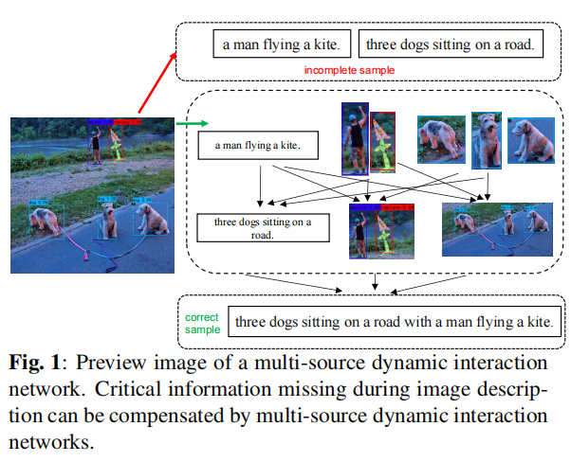
Introductions of MSDIN
Introductions of previews
According to many mainstream image captioning models, like DLCT, M2 and BPOD models, they are proved that multi-source feature inputs are possible to compensate for incomplete image description information in traditional models. For this reason, our work proposes a model for the dynamic interaction of multiple sources. The main contribution points of our work are as follows:

Slide 4
Introductions of MSDIN
Introductions of contributions
We propose a Multi-Source Dynamic Interaction Network(MSDIN) in the image captioning task. The network contains three feature enhancement channels, and the MSDIN dynamically selects among the three channels the features that are more compatible with the generated statements of the image description.
We propose a global scene enhancement channel(GSEC) in the image captioning task. It can complement the missing scene information of regional image features.
We propose a Regional Feature Enhancement Channel(RFEC) in the image captioning. It enables the regional features to further notice the associated objects.
We propose a multimodal semantic enhancement channel (MMSEC). Enhancing the semantic representation of the model by fusing text embedding vectors.

Slide 5
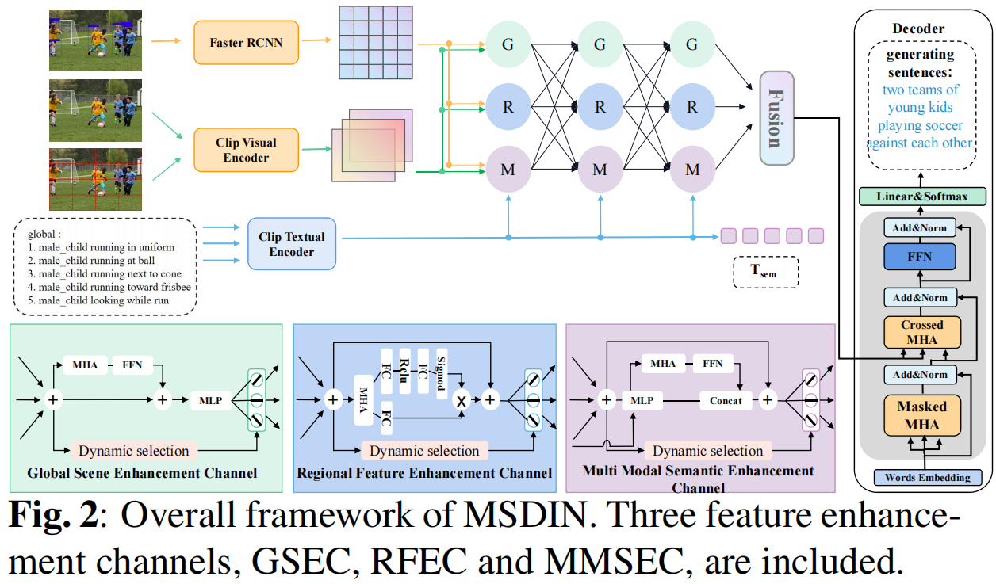
Methods of MSDIN
our work focuses on the important implementation parts of MSDIN. The overall structure of MSDIN is shown in Fig.2, and the whole architecture is based on the mainstream Transformer for transformation. The architecture is also divided into Encoder and Decoder architectures. The main work of MSDIN lies in the enhancement and filtering of input image and text features.

Slide 6
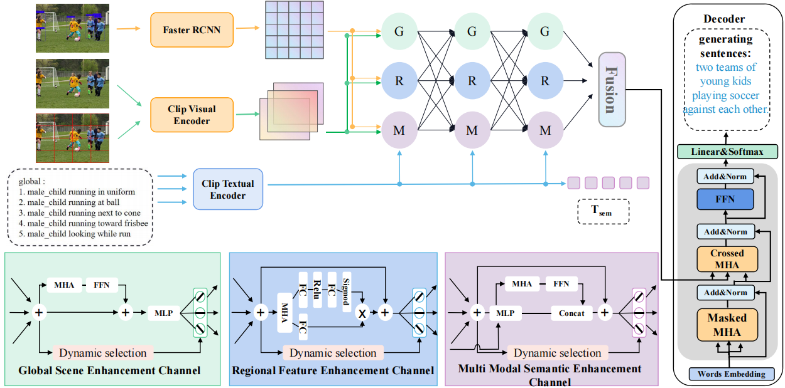
Methods of MSDIN
Dynamic channel selection mechanism
Dynamic selection range
our model treats multiple types of feature enhancement channels as a path selection problem. We treat the proposed 3 channels as one layer. The 3 channels are parallel within each layer. In total, the interaction range is divided into 3 layers. The interaction between each layer is selected using a dynamic selection mechanism.

Slide 7
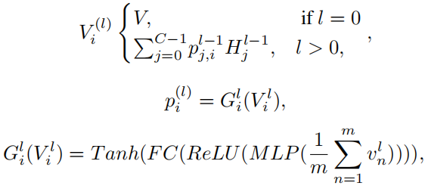
Methods of MSDIN
Dynamic Selection Mechanism
our model mainly designs three kinds of feature enhancement channels. Each feature enhancement channel has a dynamic path calculation module. The dynamic path calculation module is responsible for calculating the output probability of the features after channel enhancement. The dynamic selection mechanism selects a channel with the highest probability for output. Essentially, this is a soft selection approach. The specific formula is as follows:
where l denotes the number of layers, and p_{j,i}^{l-1} is the transfer probability of the j channel of the l-1 layer to the next layer. H_{j}^{l-1} is the output of the attention weight of the j channel of the l-1 layer. The probability of p_{j,i}^{l-1} is computed by the ReLU and Tanh functions. When l>0, the probability p_{j,i}^{l-1} is the weighted value of the current channel's output to each channel in the next layer. FC denotes fully connected function.

Slide 8
Methods of MSDIN
Global Scene Enhancement Channel(GSEC)
The GSEC is designed to extract global mesh image features through the "Visual Encoder" of CLIP~\cite{ref_clip} and use the mesh image features as the "query" for the cross-modal multi-head attention mechanism. The attention of the mesh image features is enhanced by regional features. In this way, the global scene information can be filtered and purified. The formulas involved are as follows:
where F denotes the feedforward layer, V_{G}^{(i)} denotes the mesh feature vector input to the current layer, and V_{r}^{(i)} denotes the area feature vector input to the current layer.

Slide 9
Methods of MSDIN
Global Scene Enhancement Channel(GSEC)
The RFEC is proposed to enhance the attention of a region feature by grid image features using the region feature as a "query." In this way, the region features can be compensated for the environment and scene information. The formulas involved are as follows:
where V_{R}^{(i)} denotes the region image feature vector of the current layer, and V_{g}^{(i)} denotes the grid image feature vector of the current layer. SM denotes the Sigmoid function. An attention purification operation is performed on the region feature attention by ReLU and Sigmoid function. V_{R}' denotes the enhanced region feature vector.

Slide 10
Methods of MSDIN
Global Scene Enhancement Channel(GSEC)
The MMSEC is proposed to extract textual features by means of CLIP's "Textual Encoder." It is injected into the model and trained together with the image features so that the model can acquire some knowledge of textual features. This operation can make the model purify some key information of the image and filter out some unwanted interference information. The formulas involved are as follows:
where V_{M}^{(i)} denotes the text feature vector and V_{g}^{(i)} denotes the grid image feature vector of the current layer.

Slide 11
Methods of MSDIN
Objective
In terms of the choice of training strategy, our work uses the mainstream two-stage training strategy. The first stage trains the model through the cross-entropy loss function. The specific formula is as follows:
where p_{θ} is probability and y_{t}* is the phrase of the output word.
The second stage is mainly rewarded with the CIDER score, a metric for mainstream image description, for reinforcement learning, which is formulated as follows:
where k is the beam size, r is the CIDEr-D score function, and is the baseline.

Slide 12
Methods of MSDIN
Objective
Samples with similar semantics should learn similar selection paths. In other words, their path distribution is consistent with the semantic distribution. Path regularization is designed to make the model better at learning paths. The specific formula is as follows:
where Lp denotes the channel loss function, V_{p}^{i} denotes the semantic embedding vector output by the model after the dynamic selection mechanism, and V_{s}^{i} denotes the semantic embedding vector pre-processed by the "Textual Encoder" in CLIP. For the same sample, the semantic embedding features between them should be as similar as possible.
The total loss function formula is as follows:
where L_{xe/rl} is the loss function for two-stage training, and α is the hyperparameter that regulates L_{p}. Based on debugging experience, we set α to 1.5.

Slide 13
2.1 Experiments of MSDIN
2.2 Conclusion of MSDIN

Slide 14
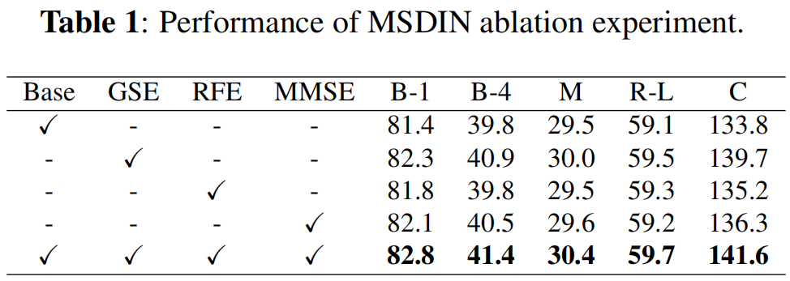
Experiments of MSDIN
Ablation Studies
In order to have a clearer understanding of the effectiveness of our proposed methods, in this section, we will show the ablation experiments. The data is shown in table 1.

Slide 15
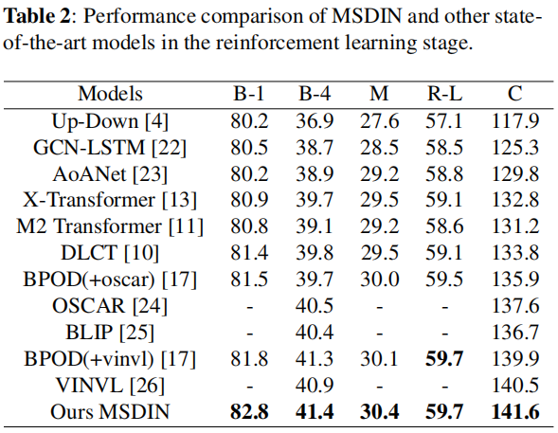
Experiments of MSDIN
To demonstrate the state-of-the-art of our work, in this section we compare it with many mainstream models. We visualize the effectiveness of the classification task by means of the COCO Offline Test Table 2, the COCO ensemble Test Table 3, and the COCO Online Test Table 4.
From Table 2, it is simple to see that our method has a large improvement in performance compared to the baseline model DLCT, and such data can fully prove the effectiveness of our method.

Slide 16
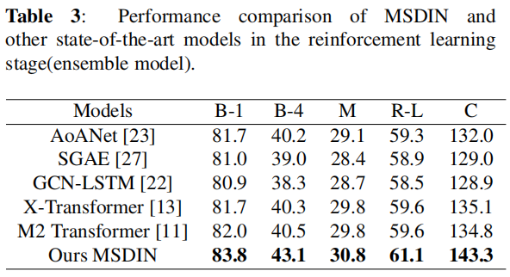
Experiments of MSDIN
Referring to a few models, like AOA and M2 models, the ensemble model is used to show the performance of the model. From Table 3, it can be seen that a significant improvement in performance was achieved compared to the models that also used the ensemble model.

Slide 17
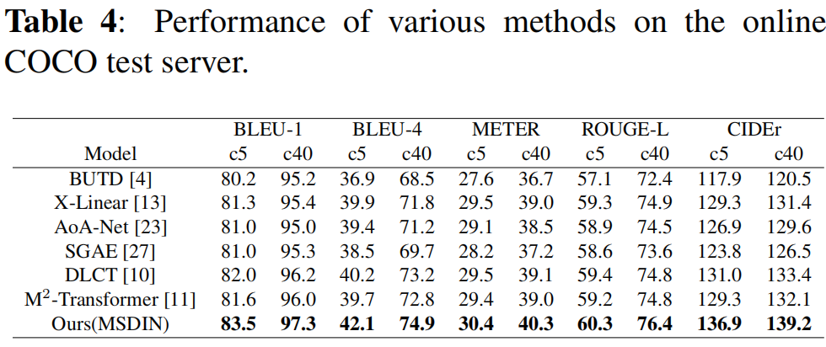
Experiments of MSDIN
From Table 4, we can see that the performance of our model is significantly improved compared to the previous models.

Slide 18
2.1 Experiments of MSDIN
2.2 Conclusion of MSDIN

Slide 19
Conclusion of MSDIN
Conclusion
Our model focuses on utilizing the input image features and text features more efficiently than previous mainstream image captioning tasks. Filtering operations are performed on grid image features, region image features and text features. Therefore, this paper proposes an MSDIN architecture to achieve diversified dynamic inputs.MSDIN contains three feature enhancement channels, GSEC, RFEC and MMSEC. The results show that MSDIN can effectively utilize the input image features and text features to improve the accuracy of the image captioning task.

Slide 20
THANKS
Reporter：Qiang Su 2024.04.16

