Slide 1
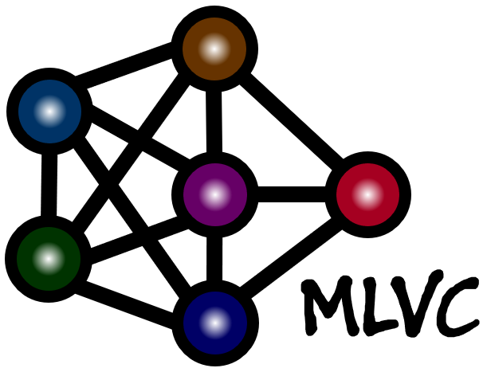
G-SharP: Globally Shared Kernel with Pruning for Efficient CNN
2024. 04. 16.
Eunseop Shin*, Incheon Cho*,
Awais Muhammad, A F M Shahab Uddin, YounHo Jang, Sung-Ho Bae
Machine Learning and Visual Computing Lab.
Kyung Hee University
Notes:
Hello Everyone. My name is Eunseop Shin.
Today I’ll introduce a new novel model compression method G-SharP: Globally shared Kernel with pruning for efficient CNN.

Slide 2
Contents
Introduction
Motivation
Proposed Method
Experimental Results
Conclusion
Notes:
Contents
First, before explaining the method proposed in this paper, we will find out what model compression is, why it is needed, and what methods are mainly used.
Second, I’ll describe the problem of the existing paper and the experimental results that motivated this paper.
Third, I will explain in detail the GsharP method step by step.
Next, we will look at the various experiments performed to verify GsharP method,
And finally conclude this presentation.

Slide 3
Introduction

Slide 4
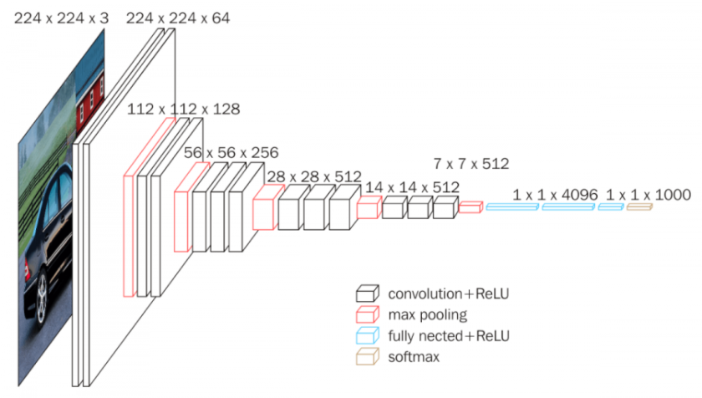
Introduction
Model Compression for Efficient CNN
Aiming to compress models without performance degradation.
Current DNN models are too large to inference Edge device.
Params: 138M
Size: 528MB
[1] Large CNN model Example: VGG
[1] Simonyan, Karen, and Andrew Zisserman. "Very deep convolutional networks for large-scale image recognition." arXiv preprint arXiv:1409.1556 (2014).
[Image Reference] https://neurohive.io/en/popular-networks/vgg16/
Notes:
Introduction
Deep neural networks have achieved remarkable performance across a multitude of fields,
However, this outstanding performance comes at a significant cost
regarding computational complexity, memory bandwidth, storage requirements, and substantial CO2 emissions.
The field of model compression has been evolving to solve these problems.
The model compression field aims to compress very large deep learning models without performance degradation.
In particular, most existing deep learning models have the disadvantage of being difficult to use on edge devices
because they are too large in terms of number of parameters, computational complexity, and memory usage.

Slide 5
Introduction
Compression Methods: Weight Sharing, Low Rank Decomposition, Pruning, Quantization, etc.
before sharing
after sharing
w1
w2
w3
Weight Sharing
share similar or same weight
Notes:
Currently, various model compression methods such as weight sharing, low-rank decomposition, pruning, quantization, and distillation etc are being studied.
Among them, we will briefly look at several compression methods used in this paper.
First is the weight sharing method.
The weight sharing is a method of sharing weights of the same or similar value across multiple layers.
Here, Before weight sharing, we can see the edges of the model each have different weights.
Among these, edges with similar weights are clustered to select a representative value, and this representative value is shared and used as the weight of each edge.
Let's look at the picture.
Change the orange-likes edges to w1, the green edge to w2, and the black edges to w3. After this clustering step, weights with the same value can be shared.
In this way, we can reduce memory usage and number of parameters.
Although illustrated in terms of edge ranges in this example, weight sharing can be performed on broader units such as nodes, layers, blocks etc.

Slide 6
Introduction
Compression Methods: Weight Sharing, Low Rank Decomposition, Pruning, Quantization, etc.
Original Weight
Weight1
Weight2
=
X
M x N
M x R
R x N
10 x 5
10 x 2
2 x 5
Low Rank Decomposition
Notes:
Next is Low Rank Decomposition.
The main purpose of low-rank decomposition is to reduce the number of parameters.
Assume we have M x N original weight here. We can low-rank decompose this original weight into two smaller weights, M x R and R x N.
Tuning R can reduce the number of parameters.
For example, when the original weight size is 10 x 5, it can be approximated with a 10 x 2 weight and a 2 x 5 weight through low-rank decomposition.
In this case, similar information can be expressed with 30 parameters, which is 40% less than the original weight size of 50.

Slide 7
Introduction
Compression Methods: Weight Sharing, Low Rank Decomposition, Pruning, Quantization, etc.
before pruning
after pruning
Weight Pruning
prune less impactive weight
Notes:
Last one is Weight Pruning.
The pruning method reduces computational complexity and the number of parameters by removing weights that do not or less affect the results.
Each pruning method primarily calculates the impact factor of each weight to find the optimal weight to remove.
Compression is performed by removing weights with low calculated impact factors.
Additionally, all three methods described before can be executed once after model training, or can be performed gradually during the training process.

Slide 8
Motivation

Slide 9
Motivation
Problem of previous works: weights that are shared should be same sized.
To Solve this problem, we propose to make the weight into the same size via Matrix Decomposition.
Basis can be the same size within all 3x3 convolution layers.
Original Weight
Coefficient
Basis Kernel
=
X
(Cin x Cout) x 9
(Cin x Cout) x R
R x 9
Notes:
Motivation
I started my research with the weight sharing method.
The weight sharing method evolved from sharing all layer weights of the same size for efficiency.
However, this method had the disadvantage that weights could only be shared if they had the same size.
To solve this problem, I performed matrix decomposition of the original weights to include at least one weight of the same size.
In this study, we specifically focused on reducing the weight of the convolution layer.
The original weight of the convolution layer is C_in x C_out x 3 x 3. This was converted into a 2D matrix with one channel dimension and one kernel dimension.
Now, through low-rank decomposition, we can separate the coefficient with channel information and the basis with spatial information.
As a result, the basis has the same size in all convolution layers.

Slide 10
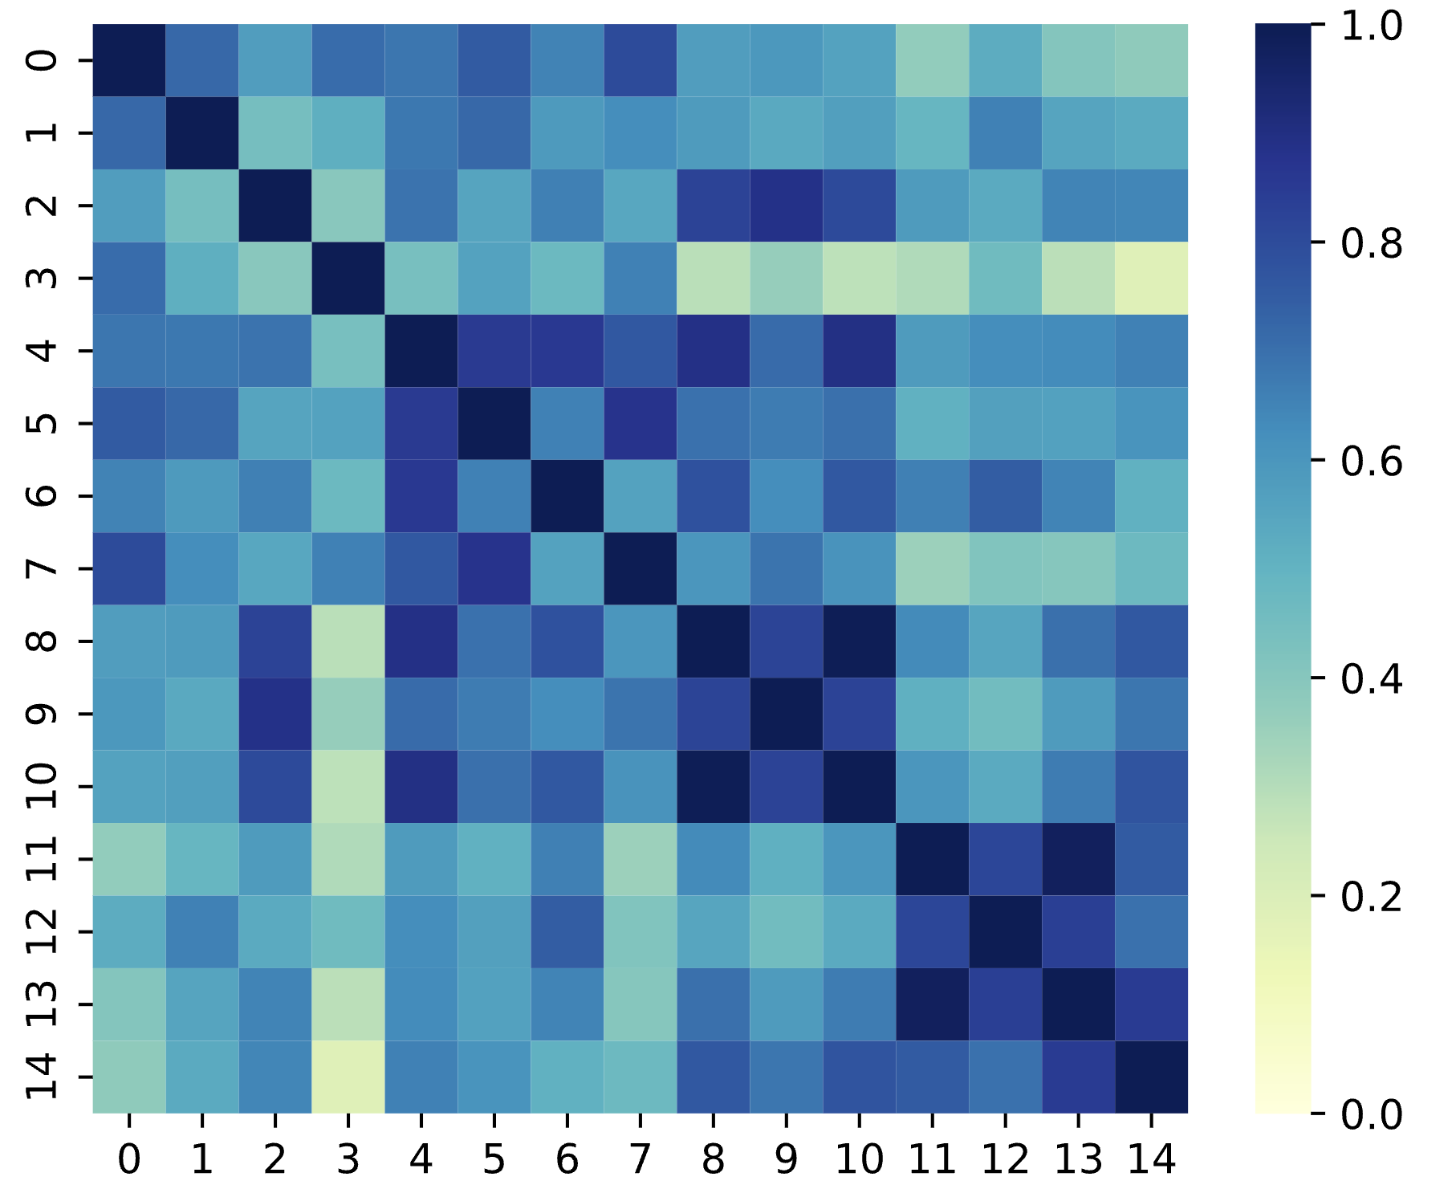
Motivation
Our key observation: similarity of weight is high: high redundancy
layer
layer
(1) Cosine Similarity between decomposed layer weight X and Y
(2) Cosine Similarity between Decomposed Basis
Notes:
However, this did not justify sharing the basis of all convolutional layers.
For this purpose, we performed additional experiments.
The basis was obtained by decomposing each convolutional layer.
Afterwards, we calculated the cosine similarity to find out how similar each basis was between layers.
As a result of performing the above experiment on several pretrained models such as ResNet and WRN, we were able to confirm that the average similarity was over 0.6.
Through this, we saw the possibility that the basis was quite similar and could be shared across all layers.

Slide 11
Proposed Method

Slide 12
Proposed Method - Filter Decomposition
First of all decompose Convolution Weights into Basis Kernels and Coefficients.
The number of parameters can be reduced by lowering the rank of decomposition.
Notes:
I’ll now explain the proposed method in detail.
As mentioned earlier in motivation, we start with low rank decomposition.
Decompose the weights of all convolutional layers into coefficient and basis kernels.
Through this process, the effect of initially reducing the number of parameters can be achieved.

Slide 13
Proposed Method - Globally shared basis kernel
Shearing One Global Kernels between all convolution layers.
Global Weights are transformed with Coefficient at each layer before convolution.
By referencing the shared kernels, the number of parameters is much reduced.
Notes:
Previously, through low-rank decomposition, all convolution layers have basis kernels of the same size.
We can now fall back on a single basis kernel that globally shared across the network.
To perform convolution, the original weights can be restored using the globally shared basis kernel and the coefficient present in each layer.
By referencing the shared kernels, the number of parameters is much reduced.

Slide 14
Proposed Method - Coefficient Pruning
It solve representational bottleneck caused by large dimension differences between Basis and Coefficient.
Perform pruning based on the scale factor of batch normalization and weights.
Additionally, the effect of reducing parameters and computational complexity can be obtained.
batch normalization
the importance of i-th filter in l-th layer
Notes:
As a side effect of low-rank decomposition, we discovered the phenomenon of representation bottlenecks.
This arises from the large dimension difference between the basis kernel and the coefficient.
This also makes the network inefficient, so additional ways to mitigate this were needed.
To solve this phenomenon, the dimension of the basis kernel had to be increased or the dimension of the coefficient had to be reduced.
However, the globally shared basis kernel had to be kept small to keep memory usage low.
So, we decided to reduce the size of the coefficient and used a pruning method utilizing the weight and scale factor of the batch norm.
Through this process, we were able to reduce the number of additional parameters and computational complexity.

Slide 15
Experimental Results

Slide 16
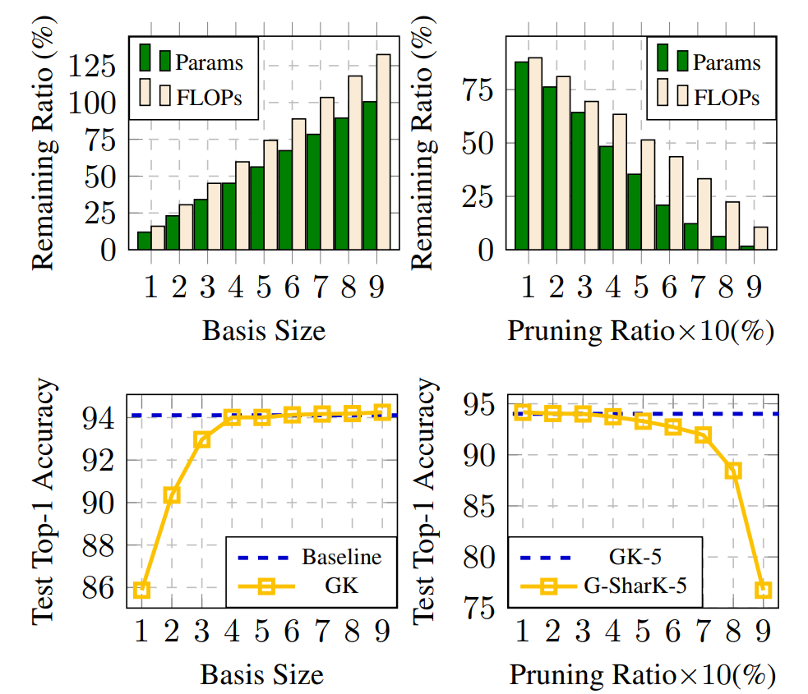
Experimental Results - Hyperparameters
Basis size 5 is provides an appropriate trade-off between accuracy and efficiency
Demonstrate that a pruning ratio of less than 60% can preserve accuracy.
Notes:
Before performing the main experiment, we conducted an experiment to find the optimal values ​​of two hyperparameters.
First is the basis size used in low-rank decomposition.
A basis size between 4 and 6 has been shown to be an appropriate trade-off between accuracy and efficiency.
Therefore, we set the intermediate value of 5 as the optimal value and performed the remaining experiments.
The second hyperparameter, Purning Ratio, can be flexibly adjusted depending on the number of targeting parameters and computational complexity.
Here, we checked the change in accuracy depending on the pruning ratio, and were able to see that accuracy was maintained when pruning was done below 60%.

Slide 17
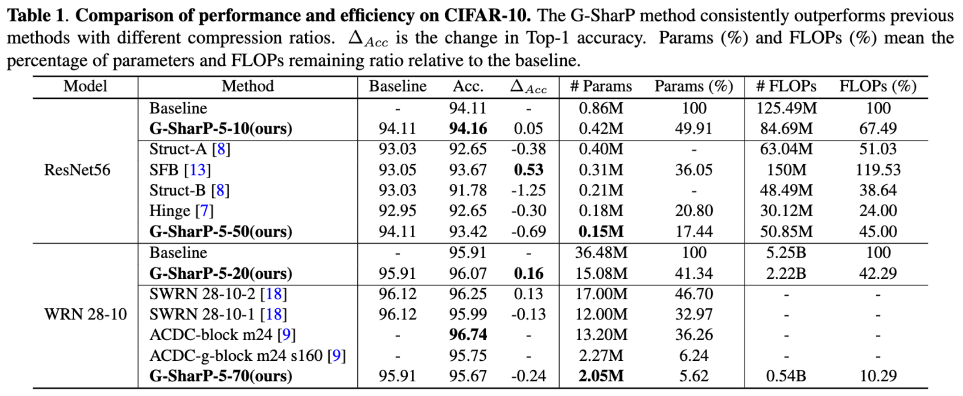
Experimental Results
Only a 0.24% decrease in accuracy despite using 5% of the number of parameters and 10% of the computational complexity of the WRN 28-10.
Notes:
First, we performed validation on CIFAR10 and ImageNet datasets to verify its effectiveness in the image classification task.
we experimented with compressing the ResNet56 and WRN28-10 models on the CIFAR10 dataset.
GsharP showed equal or better efficiency when compared to SOTA methods.
In particular, the WRN model compression showed an amazing compression rate
with only a 0.24% decrease in accuracy despite using 5% of the number of parameters and 10% of computational complexity of the original model.

Slide 18
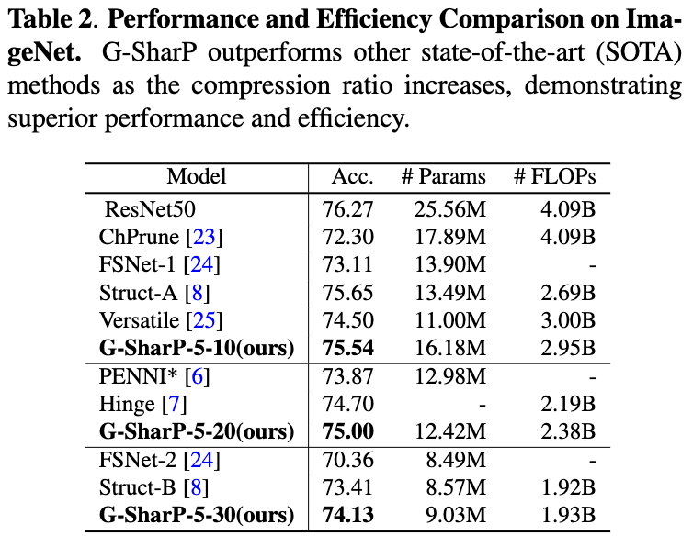
Experimental Results
It also showed better results on the real dataset ImageNet.
Notes:
We also saw good results on the ImageNet dataset.
The ResNet50 model was used here.
The purging ratio was changed and compared with the SOTA method.
As a result, we were able to obtain results with better accuracy while reducing the number of parameters and FLOPS.

Slide 19
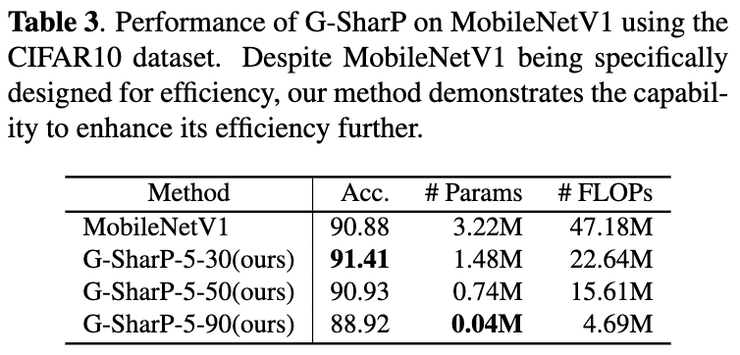
Experimental Results
Efficiency was further improved when G-SharP was applied to the efficiently designed MobilnetV1.
Notes:
We performed MobileNetv1 compression experiments to verify that GsharP works even on models that have already been designed efficiently.
Through this experiment, we were able to see GsharP working on MobileNetV1 model.
In particular, we were able to confirm that even though the number of parameters and FLOPS were compressed by 50%, the accuracy actually increased.

Slide 20
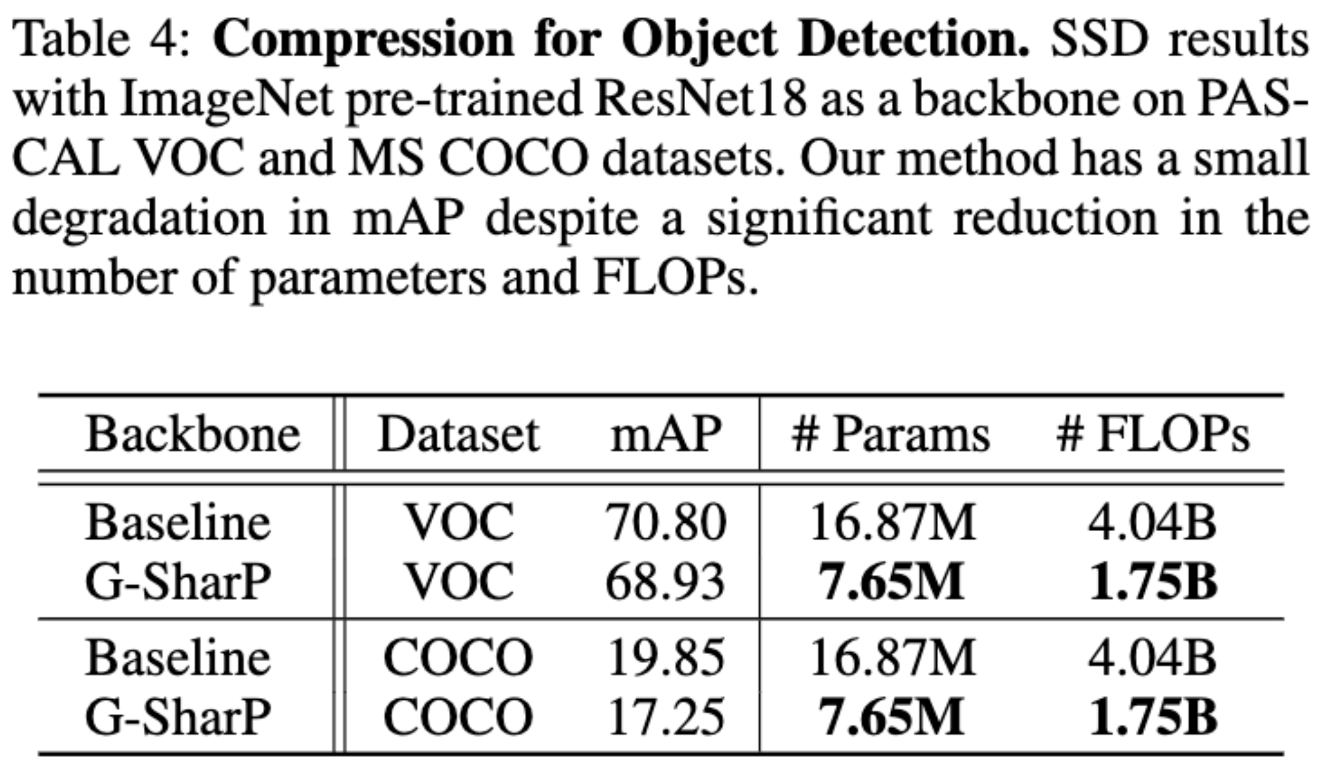
Experimental Results
Efficiency was further improved when G-SharP was applied to the efficiently designed MobilnetV1.
Notes:
We performed an Object Detection task experiment to confirm that GSharP operates robustly in other tasks.
We used the SSD model with the pretrained ResNet18 model as the backbone.
Also, We validated on both Pascal VOC and MS COCO datasets.
Despite reducing the number of parameters and FLOPS by more than 55%, we were able to obtain results that did not significantly reduce performance.

Slide 21
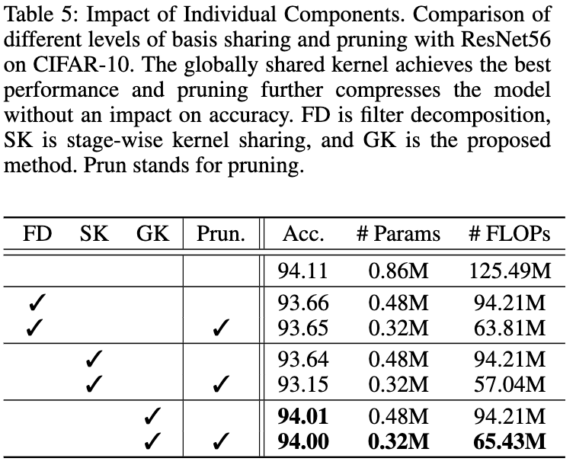
Experimental Results
GK shows better performance even though it has the same complexity as FD.
Pruning boosts compression efficiency.
Notes:
Lastly, we conducted an ablation study to see the impact of each component.
In this experiment, you can check the performance changes depending on the level of weight sharing and whether pruning is used.
Lastly, we conducted an ablation study to see the impact of each component.
In this experiment, you can check the performance changes depending on the level of weight sharing and whether pruning is used.
There are three levels of weight sharing. FD indicates that only Filter Decomposition is performed and weights are not shared.
The next step is SK, which is a stage-wise kernel sharing method that shares the basis kernel within stages that receive input of the same spatial size.
Lastly, the method of sharing the basis kernel globally is denoted as GK.
You can see that the GK shows
Additionally, using pruning helped with both efficiency and accuracy.
You can see that the number of parameters for FD, SK, and GK are the same. This is because the size of the shared Basis Kernel is very small and is displayed below the decimal point.
However, there is a big difference in performance. The GK method can be seen as increasing the Generalization of the network by acting as a kind of shortcut that integrates information flowing throughout the network.

Slide 22
Conclusion

Slide 23
Conclusion
We propose G-SharP, a filter decomposition method that exploits redundancies in the weights of CNNs by utilizing a globally shared basis kernel across the network.
We introduced a novel coefficient pruning method based on the batch normalization layer.
Comprehensive experiments demonstrate the effectiveness of our proposed method.

Slide 24
Thank you
Question:
kairos9603@khu.ac.kr

