Slide 1
Generalized End-to-End Loss For
Speaker Verification
Authors: Li Wan, Quan Wang, Alan Papir, Ignacio Lopez Moreno
Presented by: Quan Wang
2018-04-18
Notes:
Paper: https://arxiv.org/abs/1710.10467

Slide 2
Part 0:
Applications of Speaker Recognition

Slide 3
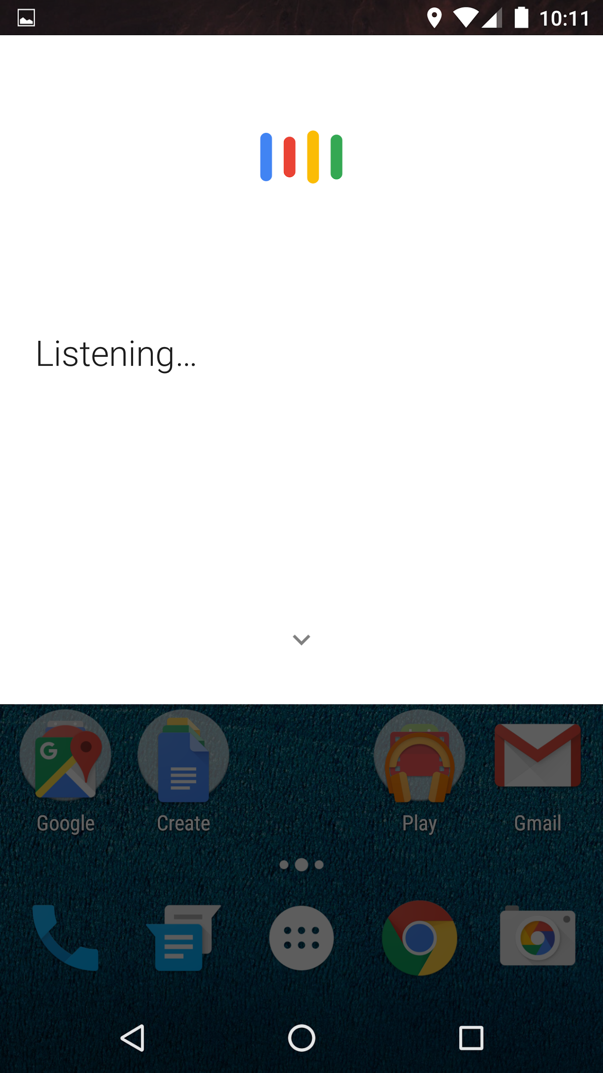
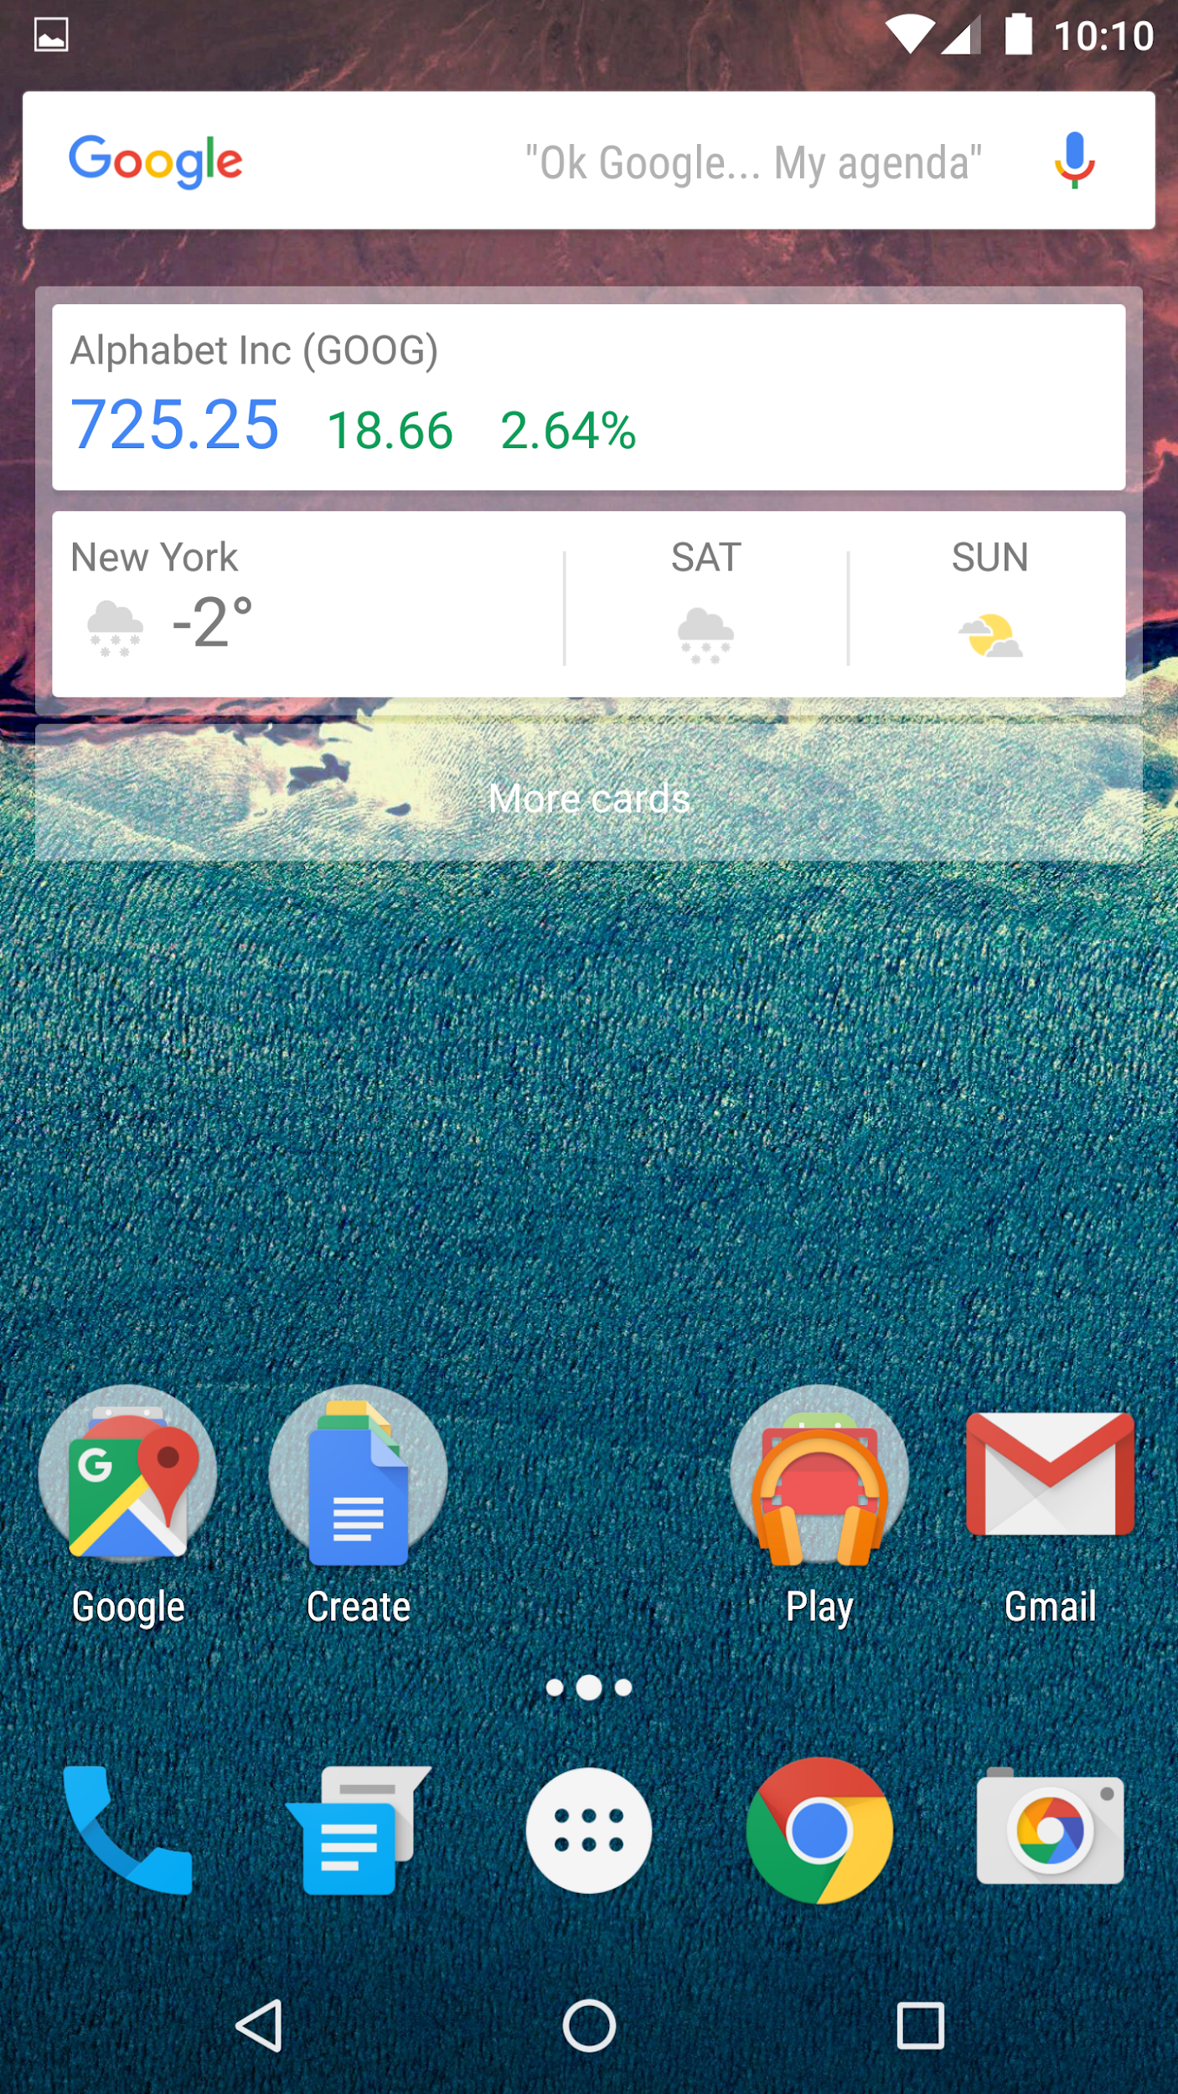
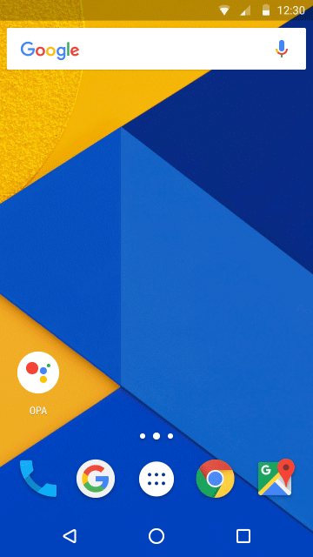
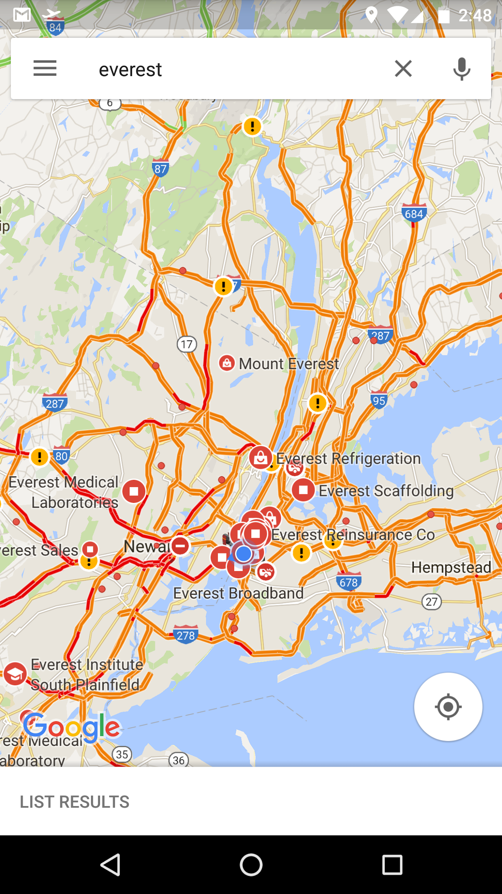
Speaker recognition at Google - Android
“OK Google”
“OK Google”
From Any Screen:
Waking Assistant
Voice Unlock:
Free your hands
Notes:
Applications in Google products:
Waking Assistant: from news, weather, maps
Free your hands from typing passwords

Slide 4
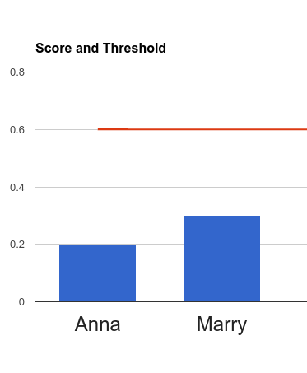
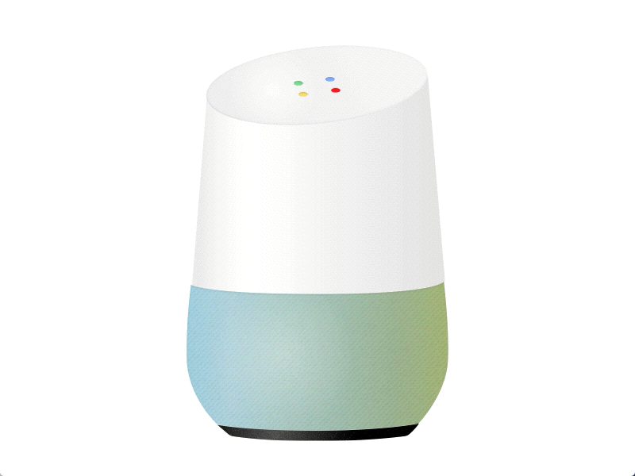
Speaker recognition at Google - Home
OK Google
Hi Andy!
OK Google
Hi Guest!
Notes:
Personalized results
Calendar
MultiUser

Slide 5
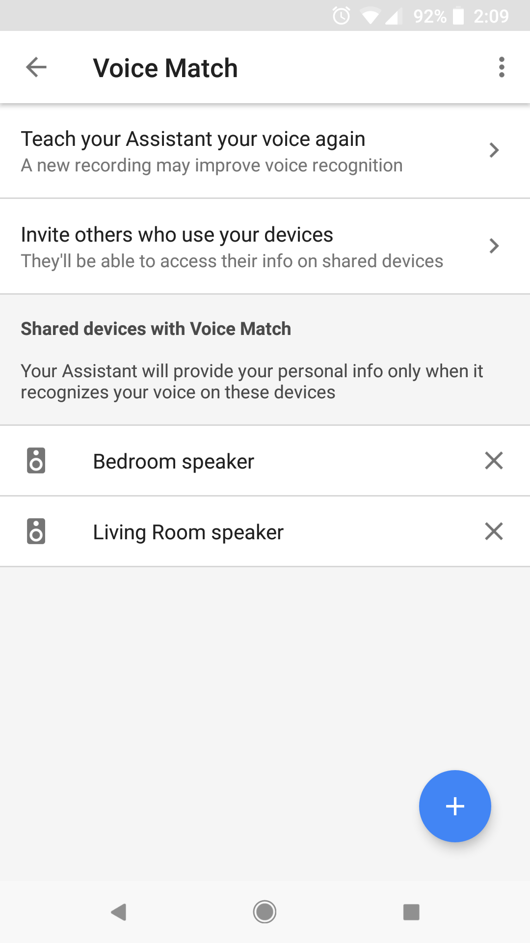
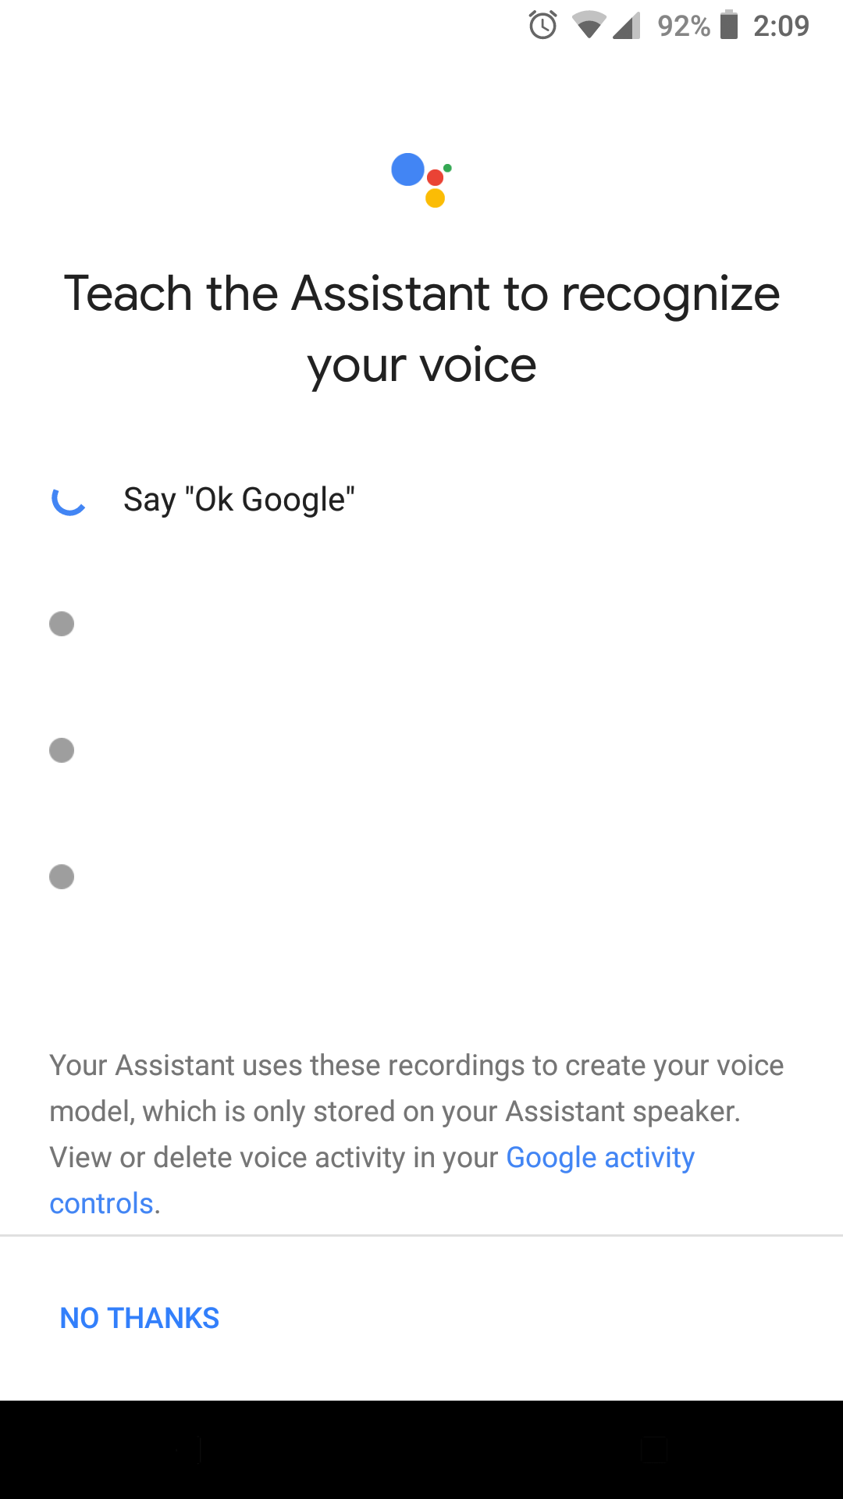
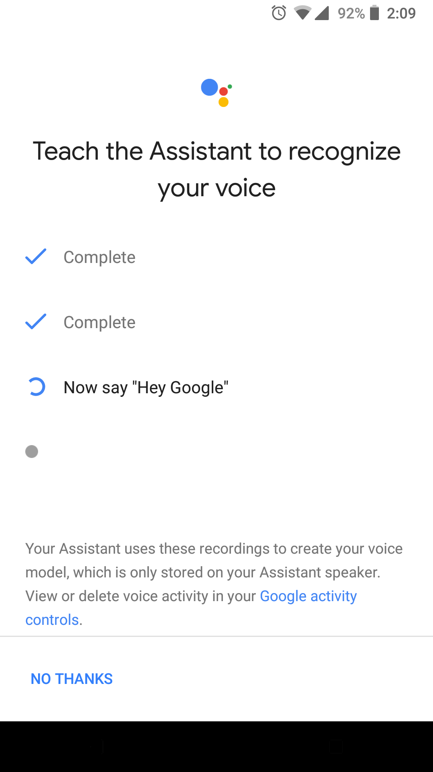
2-stage speaker recognition: Enroll and verify
Before we can verify a speaker, we need the user to enroll his voice:
Speak:
"OK Google" 2 times
"Hey Google" 2 times
Store the averaged embedding vector on device

Slide 6
Part 1:
Generalized End-to-End Loss

Slide 7
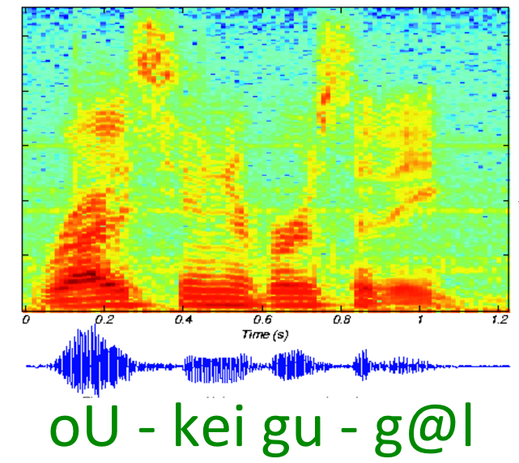
D-vector: Audio to embedding
64 dim
80 frames
LSTM
Cell
LSTM
Cell
LSTM
Cell
40 mel
LSTM
Cell
LSTM
Cell
LSTM
Cell
LSTM
Cell
LSTM
Cell
LSTM
Cell
oU k eI g u g @ l
Detected keyword
(fixed-length)
Multi-layer LSTM network
D-vector

Slide 8
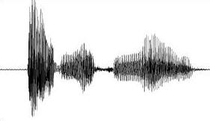
Verification decision: Thresholding cosine similarity
≥ T, same person:
< T ,different people:
Cosine Similarity

Slide 9
Loss function - Triplet loss
Triplet loss:
Pros: Simple, and correctly models the embedding space
Cons: Does NOT simulate runtime behavior
pair of same speaker (pos)
pair of diff speakers (neg)
Fig. Triplet loss. (image from FaceNet paper)
* Schroff, Florian, Dmitry Kalenichenko, and James Philbin. "Facenet: A unified embedding for face recognition and clustering." Proceedings of the IEEE conference on computer vision and pattern recognition. 2015.
Notes:
L=D(e_i,e_i^{(p)})-D(e_i,e_i^{(n)})

Slide 10
Loss function - Tuple end-to-end loss
Remember the verification runtime behavior
Collect enrollment utterances
Receive verification utterance
Cosine Similarity
Average
OFFLINE
Make verification decision
Notes:
L=D(e_i,e_i^{(p)})-D(e_i,e_i^{(n)})

Slide 11
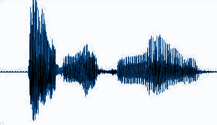
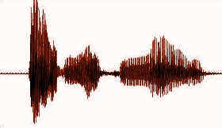
Loss function - Tuple end-to-end loss
Diff spk
Same spk
LSTM
LSTM
Average
...
Cosine Similarity
LSTM
End-to-end Loss
LSTM
* Heigold, Georg, et al. "End-to-end text-dependent speaker verification." Acoustics, Speech and Signal Processing (ICASSP), 2016 IEEE International Conference on. IEEE, 2016.

Slide 12
Loss function - Tuple end-to-end loss
accept / reject
Pros
Simulates runtime behavior in the loss function
Each (N+1)-tuple contains all utterances involved in a verification decision (unlike triplet)
Cons
Most tuples are easy - training is inefficient
logistic regression
Score Function
cosine similarity
Speaker Model
average
Speaker
Representation
...
LSTM
evaluation utterance
...
enrollment
utterance 1
enrollment
utterance N
* Heigold, Georg, et al. "End-to-end text-dependent speaker verification." Acoustics, Speech and Signal Processing (ICASSP), 2016 IEEE International Conference on. IEEE, 2016.

Slide 13
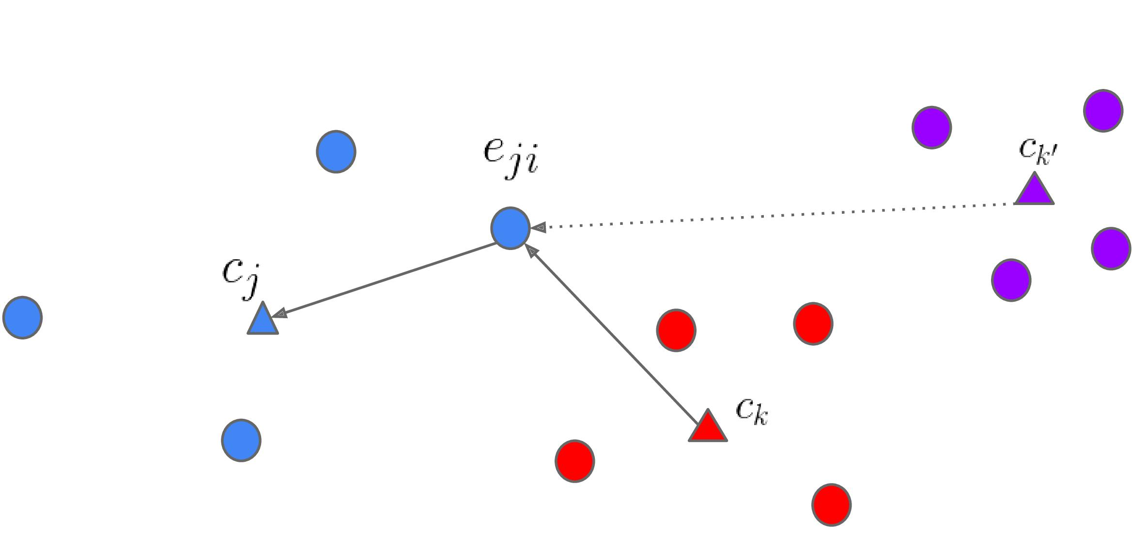
Loss function - Generalized end-to-end loss
One training batch
For each embedding , we only look at its distance to:
True speaker centroid
Closest false speaker centroid ⇒ max-margin principle, "support speaker"
Notes:
Close to true speaker centroid
Far away from closest false speaker centroid
Like support vector machine

Slide 14
Generalized end-to-end: Similarity matrix
We construct a similarity matrix for each batch:
Embeddings are L2-normalized:
Centroids:
Similarity:
Notes:
Sounds like complicated, but can be fast by constructing a similarity matrix

Slide 15
Generalized end-to-end: Softmax vs. contrast
One training batch
Each row of defines similarity between and every centroid
We want to be close to and far away from
Softmax:
Contrast:
Good for text-independent applications
Good for keyword-based applications

Slide 16
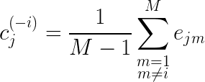
Generalized end-to-end: Trick about centroid
One training batch
For true speaker centroid, we should exclude the embedding itself
To avoid trivial solution: all utterances have same embedding
where

Slide 17
TE2E vs. GE2E: Efficiency estimate
For TE2E, assume a training batch has:
N speakers
Each speaker has M utterances
P enrollment utterances per speaker
Number of all possible tuples:
Theoretically, one GE2E step is equivalent to TE2E steps
Notes:
See proofs in paper
L=D(e_i,e_i^{(p)})-D(e_i,e_i^{(n)})

Slide 18
Part 2:
Multi-Reader

Slide 19
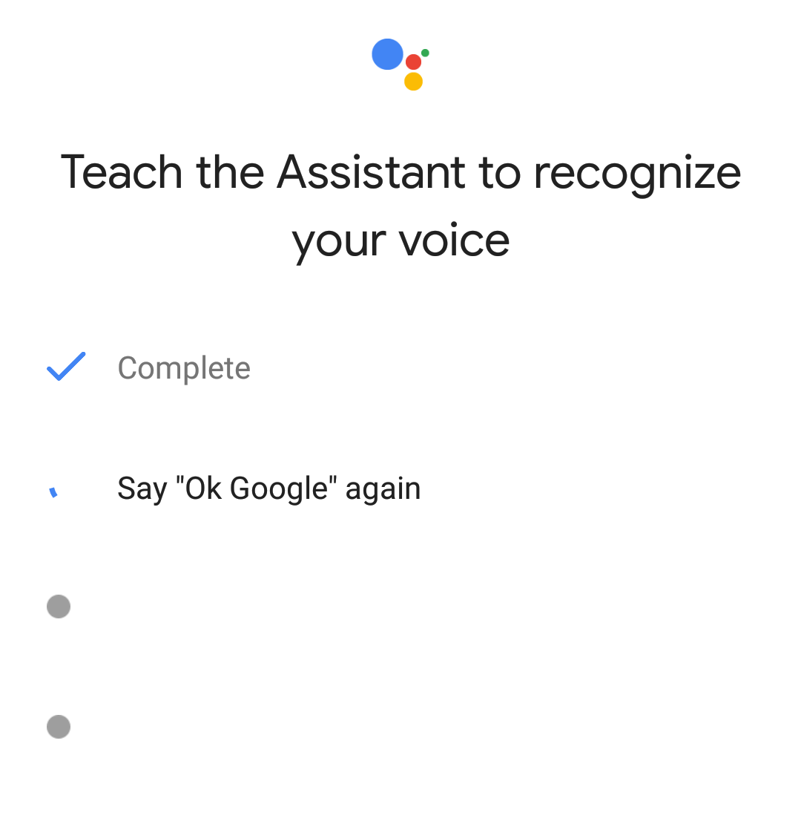
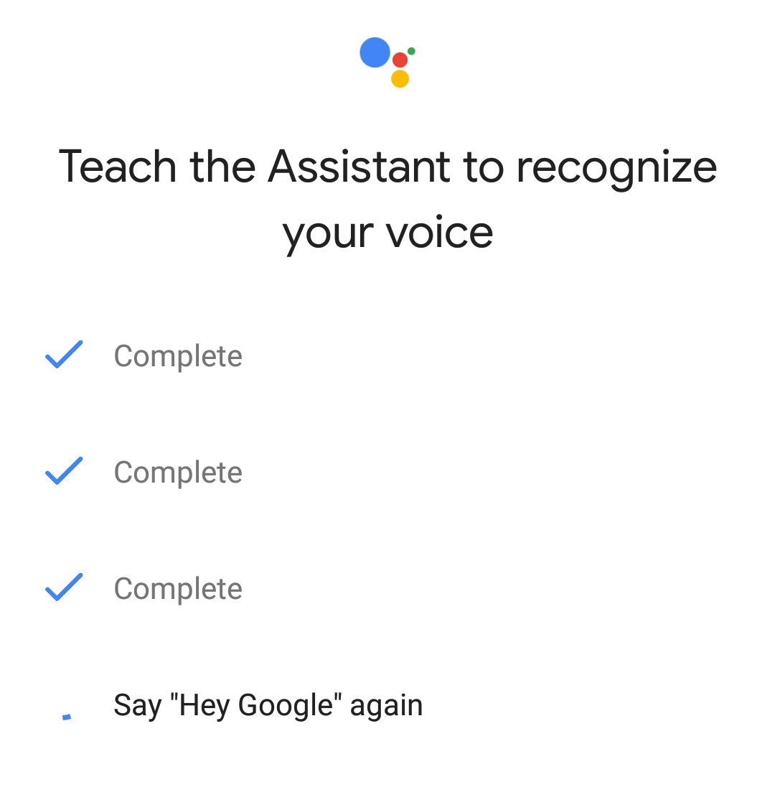
Single speaker recognition model for multi-keyword
Google supports two keywords at the same time
We need a single speaker recognition model to support both keywords
Challenge: Unbalanced training data
"OK Google": 150M utts from 630K spks
"Hey Google": 1.2M utts from 18K spks
Notes:
L=D(e_i,e_i^{(p)})-D(e_i,e_i^{(n)})

Slide 20
Single speaker recognition model for multi-keyword
If we directly mix the two datasets:
150M "OK Google" utts + 1.2M "Hey Google" utts
To actually optimize on a dataset, batch needs to have ≥2 speakers from it
For a training batch with N speakers, the probability P(≥2 speakers from the smaller dataset):
Notes:
L=D(e_i,e_i^{(p)})-D(e_i,e_i^{(n)})
2 speakers from dataset: otherwise no negative pairs from that set

Slide 21
Multi-Reader
Combine the loss from batches of different data sources
Each data source has a weight
Each gradient covers all data sources
Multi-Reader Loss:
Weight: ⍺
Weight: 1
Combined batch
Dynamic Batch Reader
Dynamic Batch Reader
Dataset D1
Dataset D2

Slide 22
Multi-Reader
Multi-Reader can be understood as a regularization technique
It's very useful in many scenarios:
Multiple keyword support
Multiple gender/age/race group support
Dialect and accented speech support
In-domain smaller set,
easy to overfit
Large set, for regularization

Slide 23
Part 3:
Text-Independent Speaker Verification

Slide 24
Text-Independent
We are interested in identifying speaker based on arbitrary speech
Challenge:
Length of utterance can vary
Unlike keyword-based, where we assume fixed-length (0.8s) for keyword segment
Naive solution: Full sequence training?
No batching - very very slow
Dynamic RNN unrolling - even slower...

Slide 25
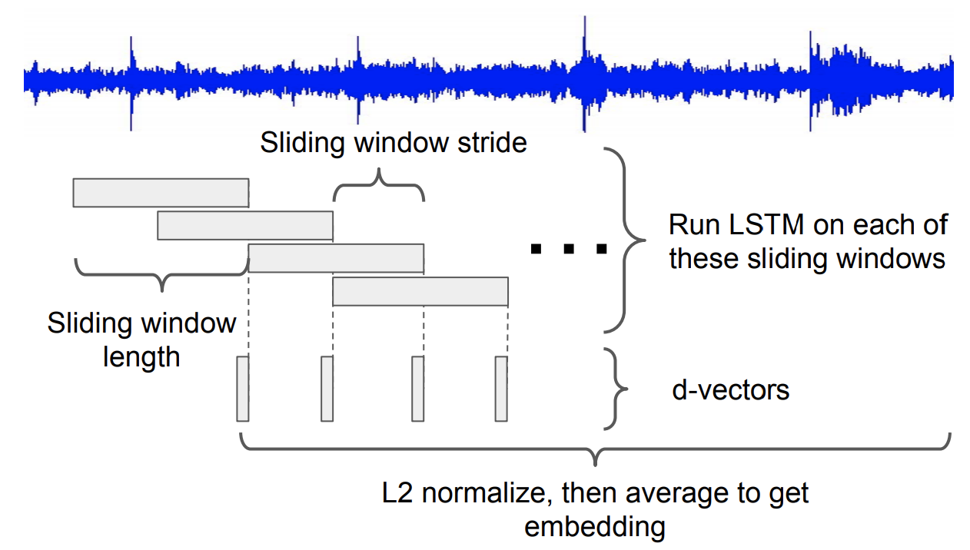
Text-Independent: Sliding window inference
In inference time, we extract sliding windows, and compute per-window d-vector
For experiments, we use 1.6s window size, with 50% overlap

Slide 26
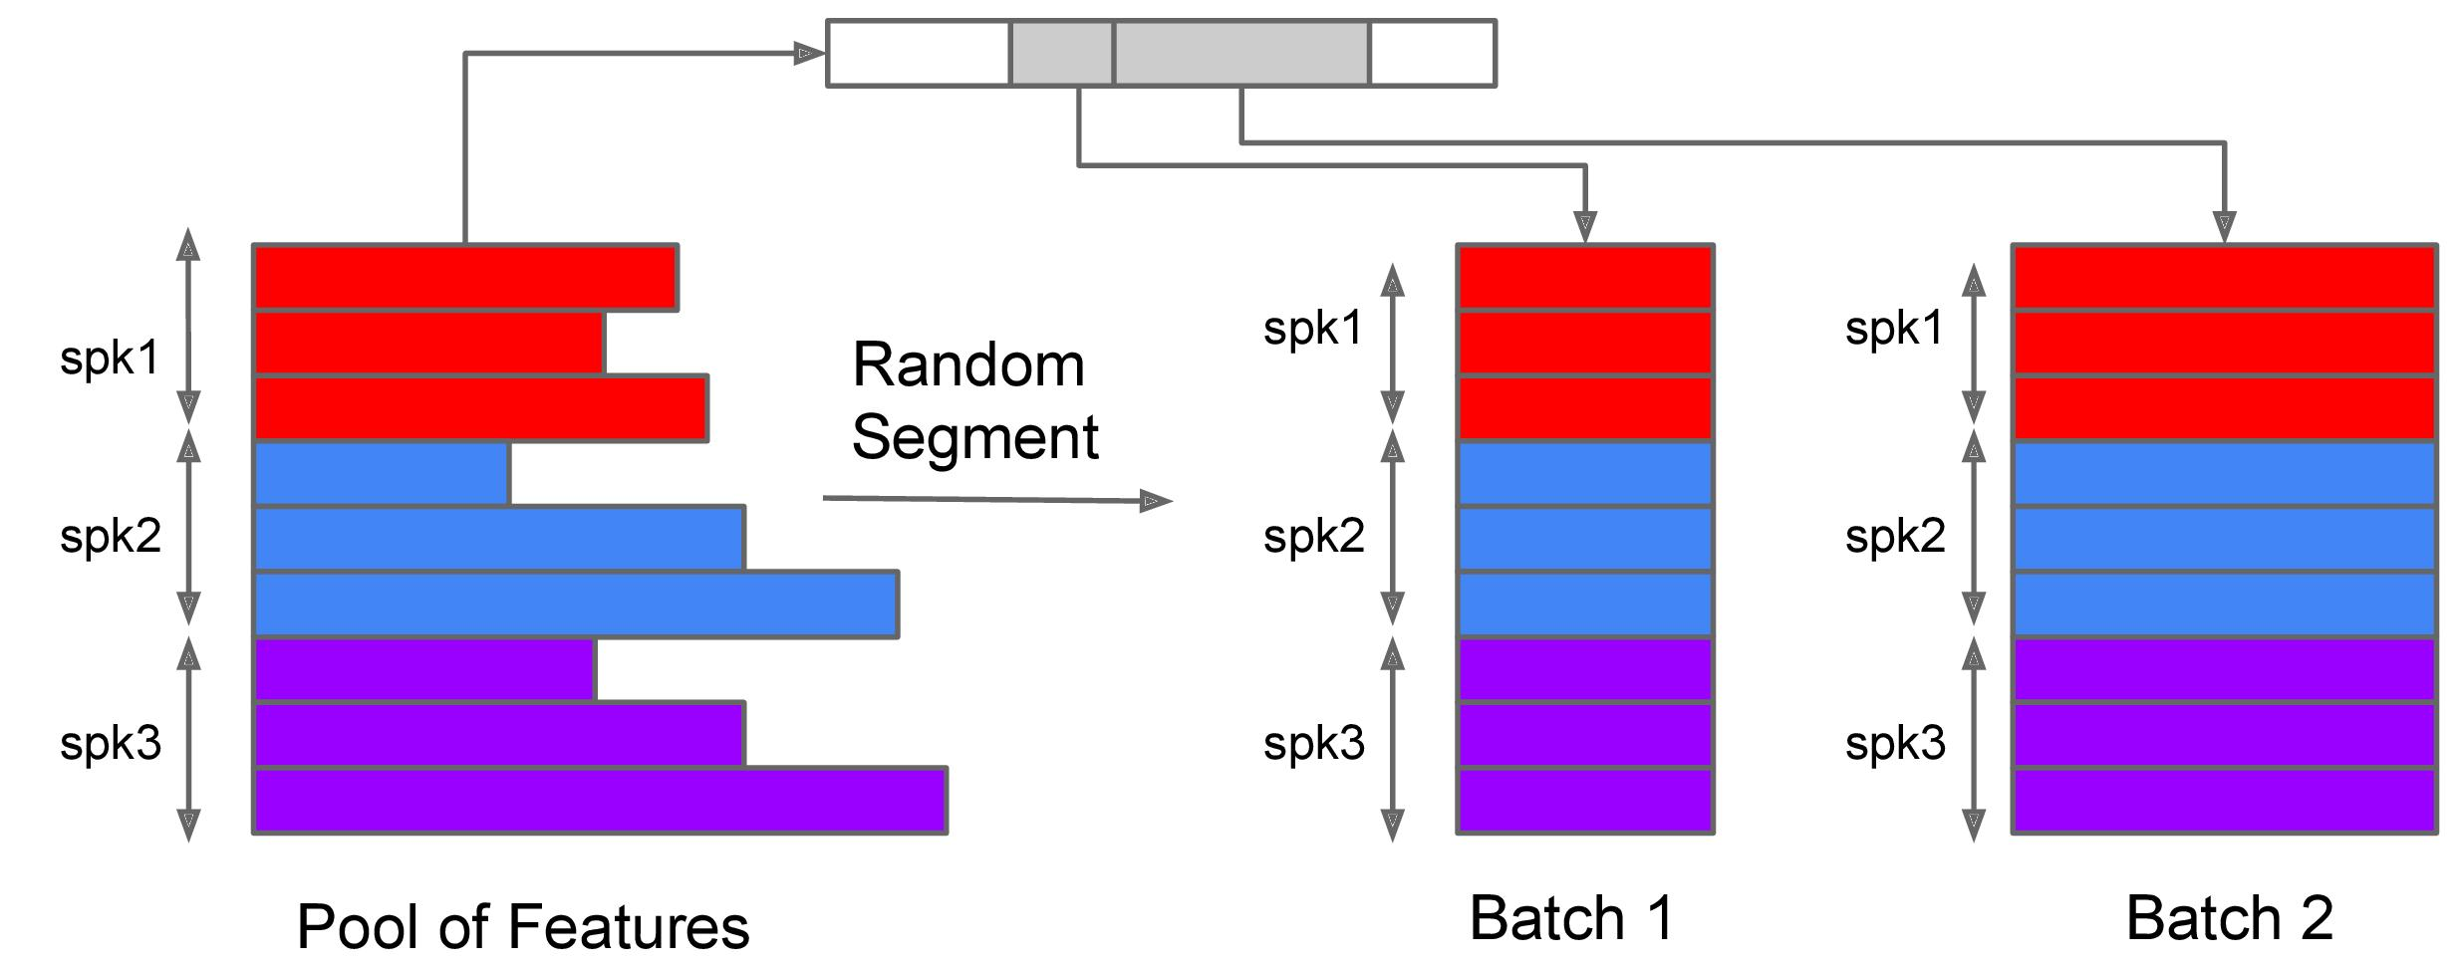
Text-Independent: Training
In training time, we need to group utterances by length
Extract segments by minimal truncation
Form batches of same-length segments
Notes:
Different batches have different length, but utterances from same batch have same length.

Slide 27
Part 4:
Experiment Results

Slide 28
Multi-Reader vs. Direct mixing
Text-dependent (keyword-based) experiments:
Testing data |  | Mixed data EER (%) | Multi-Reader EER (%)
Enrollment (~ 4.5 utts per spk) | Verification (~ 10 utts per spk)
OK Google | OK Google | 1.16 | 0.82
OK Google | Hey Google | 4.47 | 2.99
Hey Google | OK Google | 3.30 | 2.30
Hey Google | Hey Google | 1.69 | 1.15
cross-keyword verification

Slide 29
TE2E vs. GE2E
Text-dependent (keyword-based) experiments:
Model architecture |  | Loss | Multi Reader | Average EER (%) on all eval sets
LSTM (cell, proj) * layer | Linear embedding
(128, 64) * 3 | 64 | TE2E | No | 3.55
 |  |  | Yes | 2.67
(128, 64) * 3 | 64 | GE2E | No | 3.10
 |  |  | Yes | 2.38
3 times faster to converge

Slide 30
Text-Independent
Text-independent experiments:
3 times faster to converge
Inference | Loss | Other | EER (%)
Full sequence | Softmax | N/A | 4.06
Sliding window | TE2E | N/A | 4.13
Sliding window | GE2E | N/A | 3.55
Sliding window | GE2E | Larger training set Test normalization | 2.75
3 times faster to converge

Slide 31
Conclusions
Generalized end-to-end loss:
Faster, and better performance than TE2E loss
Potential applications: other verification systems, e.g. face recognition
Multi-Reader:
Powerful technique for supporting multiple keyword/accent/gender/age/...
Sliding window inference:
Enables TE2E and GE2E for text-independent

Slide 32
Related work
Speaker Diarization with LSTM
Authors: Quan Wang, Carlton Downey, Li Wan, Philip Andrew Mansfield, Ignacio Lopez Moreno
GE2E text-independent + spectral clustering ⇨ state-of-the-art diarization system
[SP-P5.4] Wed 13:30 - 15:30, Poster Area B
Attention-Based Models for Text-Dependent Speaker Verification
Authors: F A Rezaur Rahman Chowdhury, Quan Wang, Ignacio Lopez Moreno, Li Wan
GE2E text-dependent + attention ⇨ silence & noise robustness
[SP-P7.8] Wed 16:00 - 18:00, Poster Area A
Notes:
Another 2 papers from our team accepted by ICASSP

Slide 33
Questions?

Slide 34
Additional Slides

Slide 35
Application: Online diarization

