Slide 1
Quantum Federated Learning and Quantum Networks
Tyler Wang¹, Huan-Hsin Tseng², Shinjae Yoo²
¹ Department of Computer Science, Stony Brook University, Stony Brook, NY 11794
² Machine Learning Group, Computational Science initiative, Brookhaven National Laboratory, Upton, NY 11793
IEEE ICASSP, 17 April 2024

Slide 2
Introduction
Machine learning has had enormous success in fields such as computer vision and natural language processing
Problem: Models require large amounts of data to be effective
Confidential information – financial records, medical history, etc. – that should not be accessible by third parties
We integrate two novel methods to mitigate such concerns
Federated learning
Quantum data

Slide 3
Background
Federated learning, quantum circuits, quantum teleportation and error correction schemes

Slide 4
Federated Learning
Decentralized computer network architecture
Dataset is split among several client nodes
One set of weights is distributed among these clients
Separate update and training processes
Benefits?
Greater privacy and independence of client data
Improved accuracy of training

Slide 5
Federated Learning
Hub-Spoke Topology
Central server to oversee the training process
Performs weight initialization and distribution process among clients
Responsible for aggregating and updating weights after each round
Clients are randomly selected for each round
$$m(θ)$$
Distribute global model parameters $Θ$
$$m(θ)$$
$$M$$
$$m(θ)$$
Aggregation process
$$Σ(θ^{′})$$
Send parameter updates

Slide 6
Federated Learning
Ring Topology
Lack of a central server
Set number of clients are organized in a ring structure
One set of weights is created at the start and passed between clients
No aggregation process needed
$$m(θ)$$
$$m(θ)$$
Global set of weights
$$m(θ)$$
Communication of parameter updates $θ′$

Slide 7
Quantum Circuits and Data
Why do we use quantum?
No-cloning principle
Faster computational speed with real quantum computers
Greater efficacy in training, particularly of smaller datasets
Several issues to be addressed
Lack of pure quantum datasets
Error correction schemes
Quantum teleportation
$$x=5$$
$$x=3$$
$$x=3$$

Slide 8
Variational Quantum Circuits (VQC)
Encoder
Transform classical data into a quantum state
Variational encoding: Use input values as the values for quantum rotational gates (in our work, we use X-rotations)
$$\text{|0⟩}$$
$$R_{x}\left(x_{1}\right)$$
$$R\left(φ,θ,ω\right)$$
$$\text{|0⟩}$$
$$R_{x}\left(x_{2}\right)$$
$$R\left(φ,θ,ω\right)$$

Slide 9
Variational Quantum Circuits (VQC)
Variational layer
Contains single-qubit unitary gates parameterized by learnable parameters $φ, θ, ω$ and entangling CNOT gates
$$\text{|0⟩}$$
$$R_{x}\left(x_{1}\right)$$
$$R\left(φ,θ,ω\right)$$
$$\text{|0⟩}$$
$$R_{x}\left(x_{2}\right)$$
$$R\left(φ,θ,ω\right)$$

Slide 10
Variational Quantum Circuits (VQC)
Measurement
Output the Pauli-Z expectation value of the qubits
$$\text{|0⟩}$$
$$R_{x}\left(x_{1}\right)$$
$$R\left(φ,θ,ω\right)$$
$$\text{|0⟩}$$
$$R_{x}\left(x_{2}\right)$$
$$R\left(φ,θ,ω\right)$$

Slide 11
Quantum Error Correction (QEC)
Quantum nature of data is destroyed upon measurement
QEC provides methods to recover this “lost” state
Famous example: Shor Code (bit and phase flip corrections)
H
ψ
H
H
H
H
H

Slide 12
Quantum Teleportation
How do we communicate quantum data between clients?
Single-qubit teleportation
Shared Bell pair between two clients, sender (Alice) and receiver (Bob)
Alice measures her qubit and Bob performs a conditional correction
q_{a}
q_{tel}
Bell pair
q_{b}
BSM
A_{ec}

Slide 13
Quantum Teleportation
How do we communicate quantum data between clients?
Multipartite teleportation
Use of cluster states as transportation channels between Alice and Bob
Generated with a series of Hadamard and controlled-Z gates
Alice and Bob each own some of the qubits in the cluster state
Qubits are entangled with the cluster and then measured and corrected
BSM
BP₁
A_{ec}
BSM
BP₂
A_{ec}
r_{full}
r_{reduced}
channel
s_{reduced}
s_{full}

Slide 14
Quantum Federated Learning (QFL) Model
Training process, implementation of quantum weights

Slide 15
Federated Training Process
Use of decentralized ring topology with 3 clients
Dataset is split at the beginning of the training process
Note: Each client dataset is divided into training, validation, testing sets!
No need for central aggregation
S_{c1}
S_{train(cx)}
S_{i}
S_{c2}
S_{val(cx)}
S_{c3}
S_{test}

Slide 16
Federated Training Process
Each client network is defined by the VQC with data x_{i} , x_{i+1}
Encoding layer: One set of rotational-X gates (variational encoding)
Variational layer: Single parametrized unitary, two CNOT gates
Measurement layer: Output is Pauli-Z expectation values
$$\text{|0⟩}$$
$$R_{x}\left(x_{i}\right)$$
$$R\left(φ,θ,ω\right)$$
$$\text{|0⟩}$$
$$R_{x}\left(x_{i+1}\right)$$
$$R\left(φ,θ,ω\right)$$

Slide 17
Quantum Weights
First implementation of quantum weights in QFL
Use the variational encoding scheme to hold weights in the circuit
Weights are updated using the parameter-shift rule
But wait – how do we pass between clients now?
$$\text{|0⟩}$$
$$R_{x}\left(x_{1}\right)$$
$$\text{|0⟩}$$
$$R_{x}\left(x_{2}\right)$$
$$\text{|0⟩}$$
$$R_{x}\left(x_{3}\right)$$
VQC
$$\text{|0⟩}$$
$$R_{x}\left(x_{22}\right)$$
$$\text{|0⟩}$$
$$R_{x}\left(x_{23}\right)$$
$$\text{|0⟩}$$
$$R_{x}\left(x_{24}\right)$$

Slide 18
Quantum Weights
Quantum teleportation!
Each quantum layer in our model uses six weights → six qubits
A six-qubit state can be easily teleported with the following scheme
$$\text{|0⟩}$$
{U_{i}}
A_{ec(i)}
$$\text{|0⟩}$$
$$\text{|0⟩}$$
$$\text{|0⟩}$$
$$\text{|0⟩}$$
$$\text{|0⟩}$$

Slide 19
QFL Model
$$m(θ)$$
accuracy
{S}
quantum
teleportation
{S_{test}}
$$E(x)$$
$$m(θ)$$
$$m(θ)$$
{W_{global}}

Slide 20
Results
We compare our model against two other models:
Classical federated learning model
Federated structure
Quantum data/VQC
Quantum weights
Quantum federated learning model with classical weights
Federated structure
Quantum data/VQC
Quantum weights

Slide 21
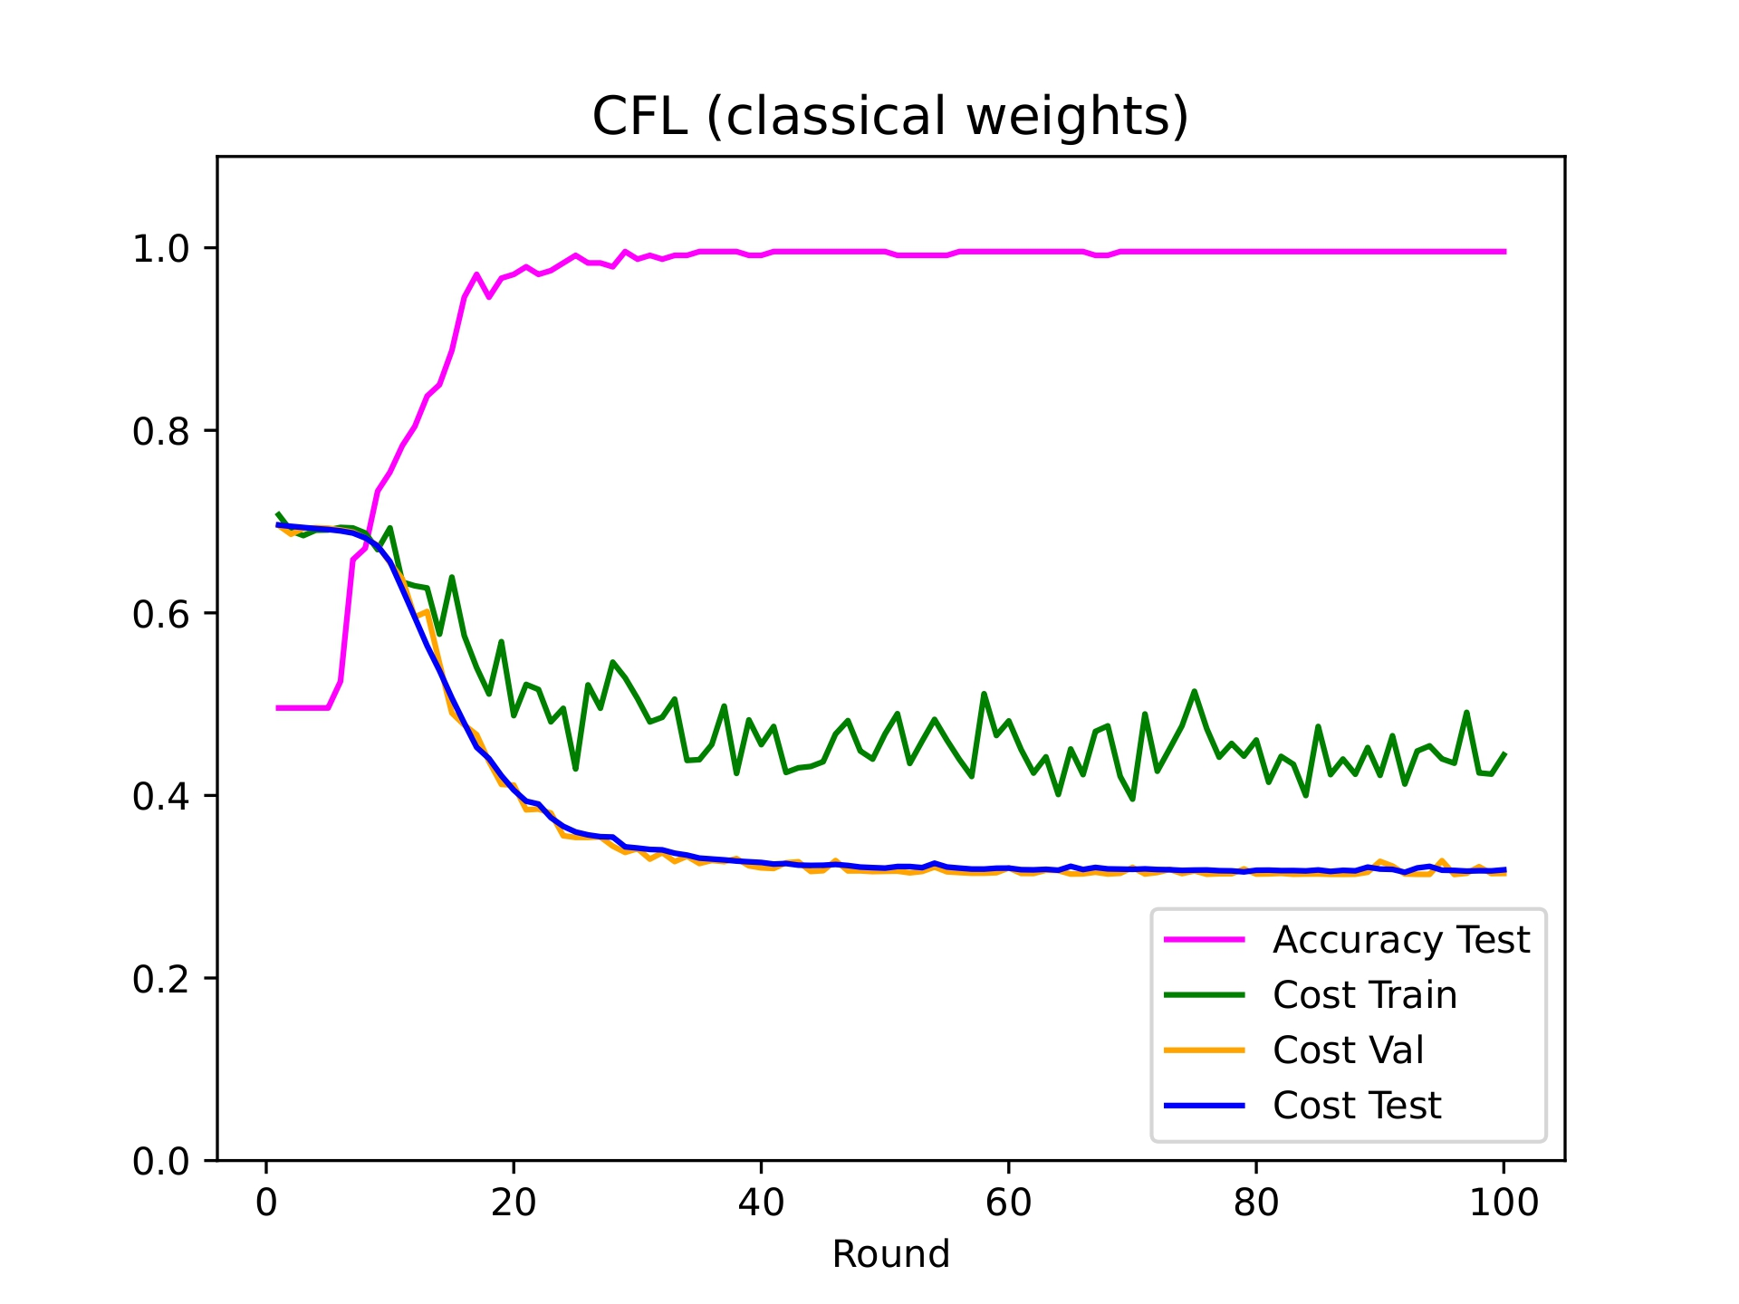
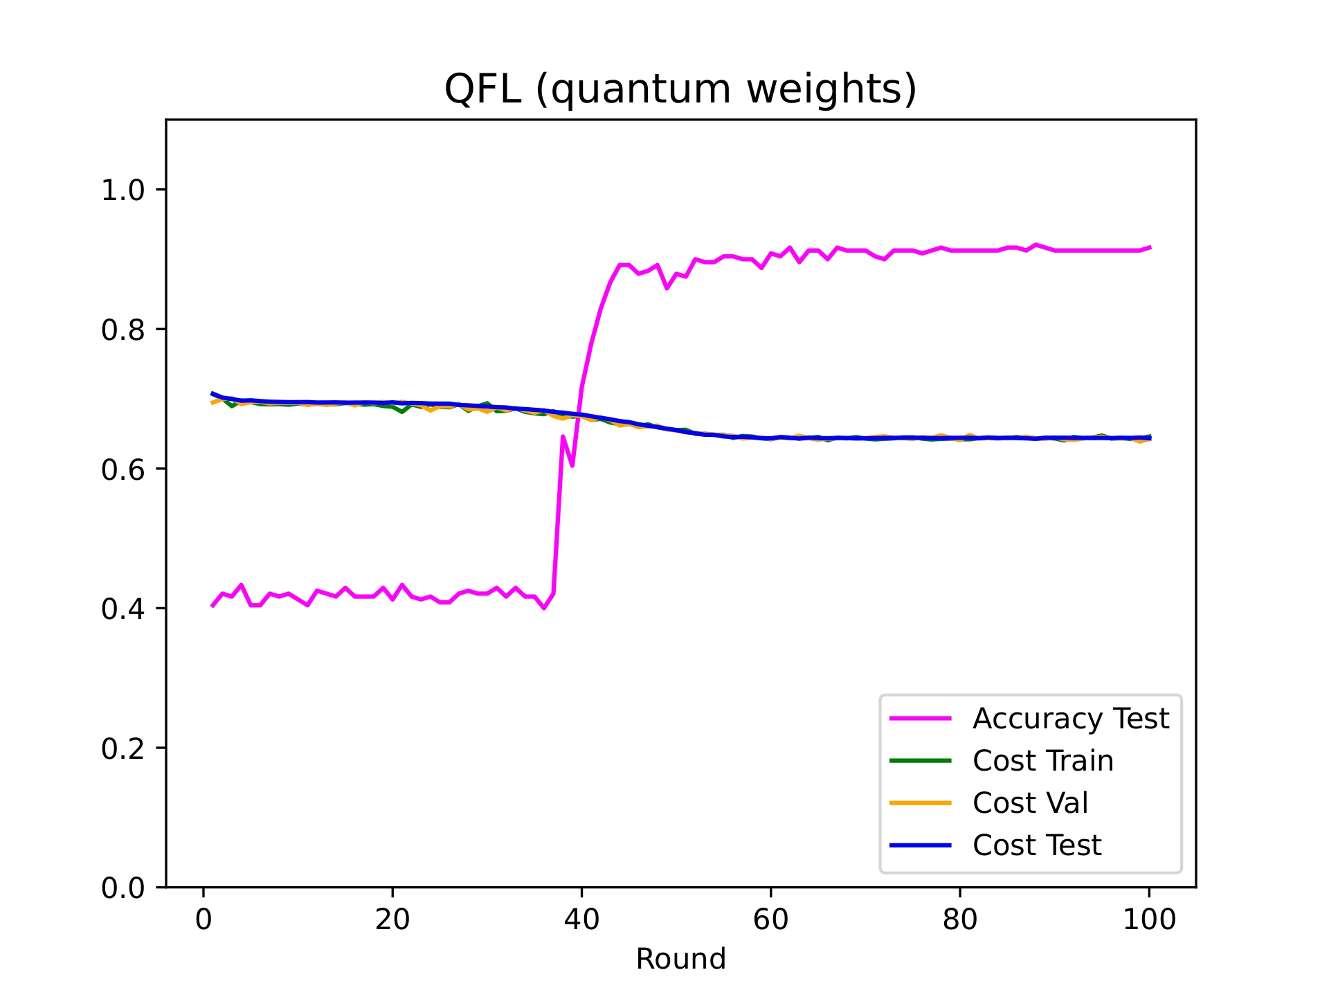
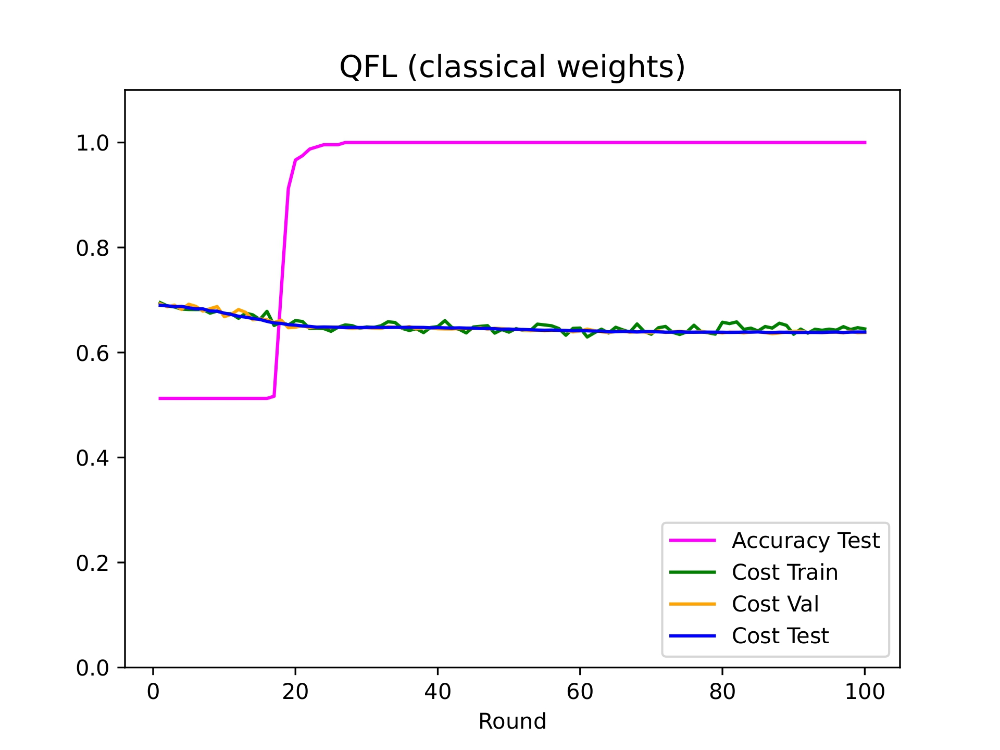
Results (graphs)

Slide 22
Results (table)
 | CFL | QFL (classical) | QFL (quantum)
Training Loss | 0.4445 | 0.6449 | 0.6459
Validation Loss | 0.3145 | 0.6382 | 0.6423
Testing Loss | 0.3185 | 0.6382 | 0.6435
Test Accuracy | 99.58% | 100.0% | 91.67%

Slide 23
Future Work
Quantum Internet Simulation Package (QuISP)
More powerful quantum capabilities
More accurate quantum teleportation processes
Better performance with large amounts of client nodes/qubits
Differential privacy
Lack of privacy-preserving features in QML/QFL models
We can incorporate differential privacy into our current QFL model

Slide 24
Conclusion
Privacy benefits of quantum computing and federated learning
Quantum: No-cloning theorem, faster training time
Training done entirely in quantum → reduces classical-quantum conversion overhead
Federated learning: Ring topology mitigates access to entire dataset
No central server → attackers can only penetrate part of the data
No need for quantum memory as well!

Slide 25
References (Thank You!)
Samuel Yen-Chi Chen and Shinjae Yoo, “Federated quantum machine learning,” Entropy, vol. 23, no. 4, pp. 460, 2021.
Mahdi Chehimi and Walid Saad, “Quantum federated learning with quantum data,” in ICASSP 2022-2022 IEEE International Conference on Acoustics, Speech and Signal Processing (ICASSP). IEEE, 2022, pp. 8617–8621.
Matthias C Caro, Hsin-Yuan Huang, Marco Cerezo, Kunal Sharma, Andrew Sornborger, Lukasz Cincio, and Patrick J Coles, “Generalization in quantum machine learning from few training data,” Nature communications, vol. 13, no. 1, pp. 1–11, 2022.
Mitali Sisodia and Anirban Pathak, “Comment on “quantum teleportation of eight-qubit state via six-qubit cluster state”,” International Journal of Theoretical Physics, vol. 57, no. 7, pp. 2213–2217, 2018.
Xiaoqing Tan Tan, Xiaoqian Zhang, and Tingting Song, “Deterministic quantum teleportation of a particular six-qubit state using six-qubit cluster state,” International Journal of Theoretical Physics, vol. 55, pp. 155–160, 2015.
Ryosuke Satoh, Michal Hajdusek, Naphan Benchasattabuse, Shota Nagayama, Kentaro Teramoto, Takaaki Matsuo, Sara Ayman Metwalli, Poramet Pathumsoot, Takahiko Satoh, Shigeya Suzuki, and Rodney Van Meter, “Quisp: a quantum internet simulation package,” in 2022 IEEE International Conference on Quantum Computing and Engineering (QCE). IEEE, 2022, pp. 353–364.
William M Watkins, Samuel Yen-Chi Chen, and Shinjae Yoo, “Quantum machine learning with differential privacy,” Scientific Reports, vol. 13, no. 1, pp. 2453, 2023.

