Slide 1
Rethinking Temporal Self-similarity for Repetitive Action Counting
Yanan Luo ^{*1}, Jinhui Yi ^{*1}, Yazan Abu Farha ², Moritz Wolter ¹, Juergen Gall ^{1,3}
¹ University of Bonn, ² Birzeit University,
³ Lammar Institute for Machine Learning and Artificial Intelligence
* Equal Contribution
Notes:
Good morning, everyone
I’m very glad to be here today to introduce my paper titled “Rethinking temporal self-similarity for repetitive action counting”.
This is joint works with my colleges from University of Bonn and Birzeit University, many thanks to them.

Slide 2
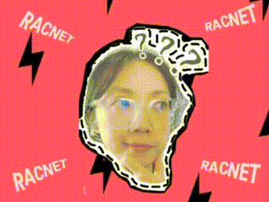
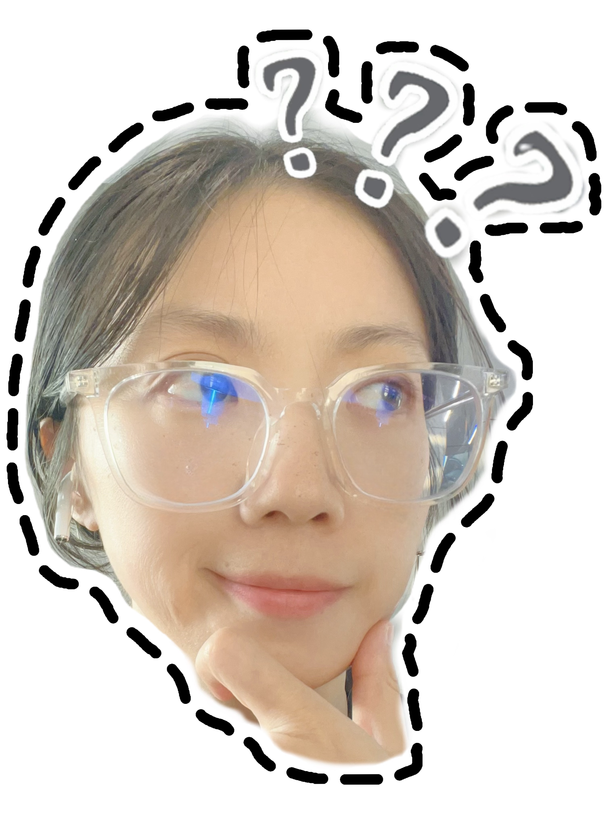
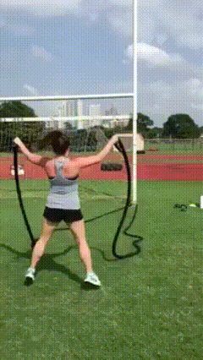
Introduction
What is class-agnostic repetitive action counting?
Repetitive action: periodic activities
Class-agnostic: ignore categories
Counting: number of the repetitions
Challenge: complex realistic scenarios
Data from RepCountA-test:
Hu et al., TransRAC: Encoding Multi-scale Temporal Correlation with Transformers for Repetitive Action Counting, CVPR 2022
Notes:
tapping feet to the music
This work aims to TODO.
But first of all, let me explain what is class-agnostic repetitive action counting.
Basically, in many scenarios like in the gyms, or in the playground while we are doing sports, we keep practicing the same action many times to build up our muscles. It’s therefore important to know how many actions we have done, e.g. with the help of video surveillance systems or simply cameras. Notice that in this work we focus on the class-agnostic setting, namely the model does not need to know what kind of the action is going to be performed, and the goal is to count how many times an actions has been observed from a given video.
This is a common and easy task for our humans, but it’s quite challenging for the models to learn from videos with, e.g. variant periodicity, action interruption and …..
As an example, please have a look on the following demo videos, here you can see that…

Slide 3
Previous Method
Key observation:
Temporal self-Similarity Matrix (TSM) -> solely intermediate layer
❗ Loss of information
Dwibedi et al., Counting Out Time: Class Agnostic Video Repetition Counting in the Wild, CVPR 2020
Hu et al., TransRAC: Encoding Multi-scale Temporal Correlation with Transformers for Repetitive Action Counting, CVPR 2022
Li et al.,Full Resolution Repetition Counting, ICIRA 2023
Notes:
Previous methods have been proposed for this problem. Recently, a line of recent works has been focusing on building a temporal self-similarity matrix from extracted vision features of a given video, and try to predict the repetitive count from the TSM matrix. However, considering TSM matrix as the only intermediate layer will result in loss of detail informations as it’s highly compressed.
Motivated by this insight, we therefore propose to (next slide)

Slide 4
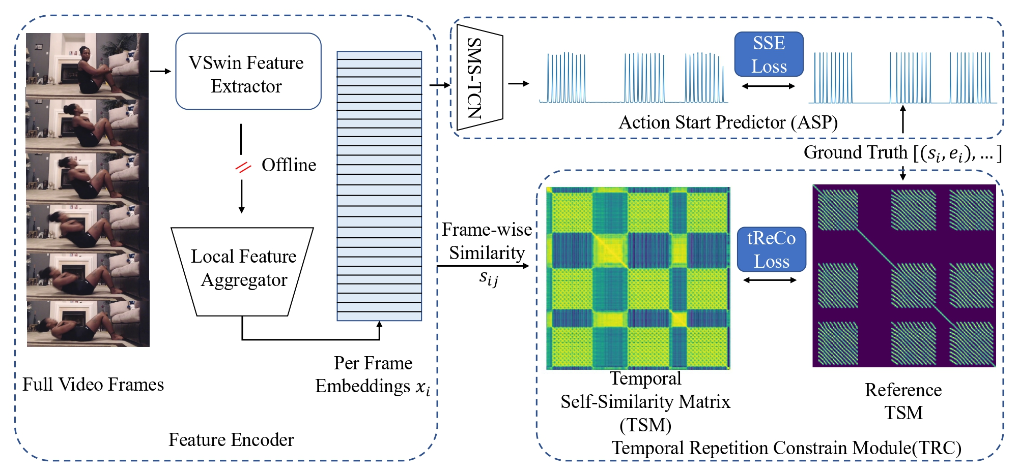
RACnet
Notes:
Motivated by this insight, we therefore propose to (next slide)
predict the repetitive counts directly from the extracted features with SMS-TCN model, and consider TSM matrix as an auxiliary (extra) task for providing complementary supervision signals.
As a result, we get the repetitive counts by counting the number of frames which represent an action start.

Slide 5
Action Start Predictor (ASP)
Counts: number of action starts
Notes:
TODO

Slide 6
Temporal Repetition Constrain (TRC)
Only for training phase
Notes:
Here is an example of how the consistency loss for TSM is computed.
I

Slide 7
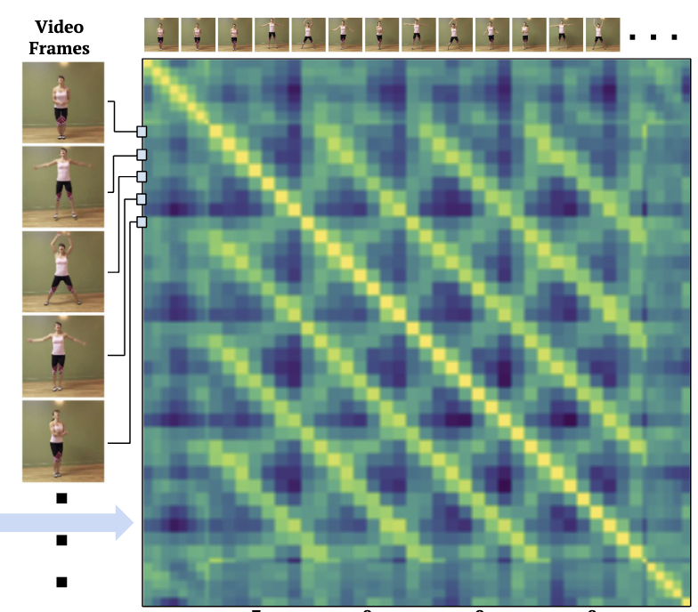
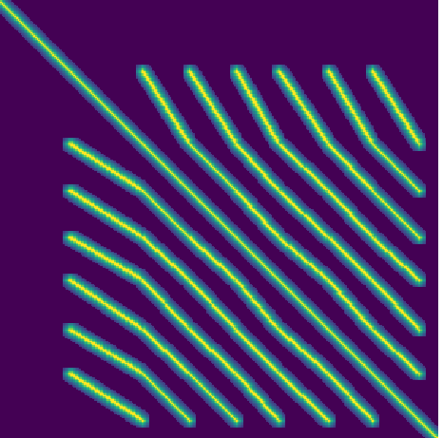
Reference TSM (refTSM)
Define a T X T matrix and initialize it .
Set both starts and ends to one.
Set all the elements that lie on the line connecting start, end pairs to one.
Smooth the matrix.

Slide 8
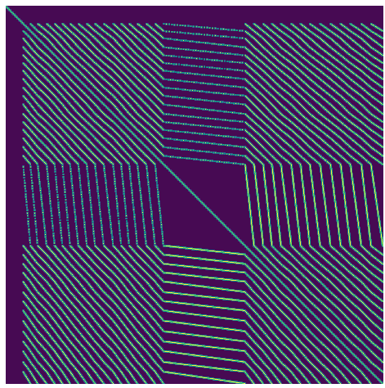
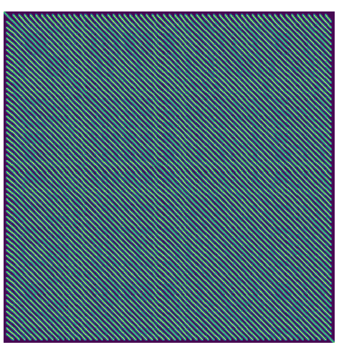
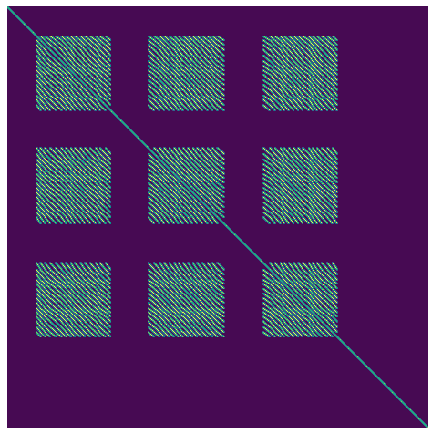
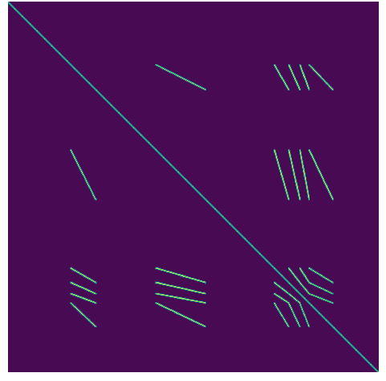
Visualization of refTSMs

Slide 9
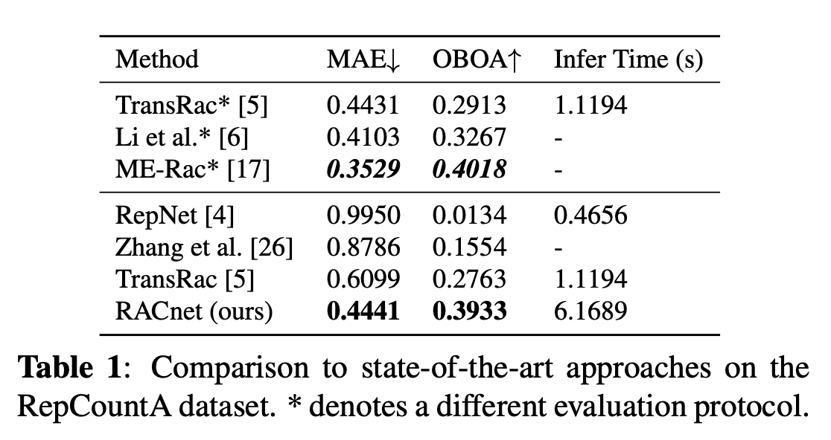
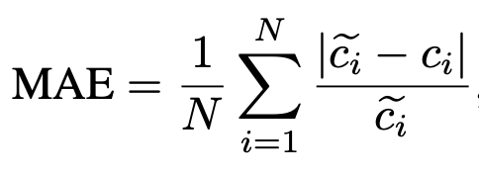
Quant. Results
Evaluation metrics

Slide 10
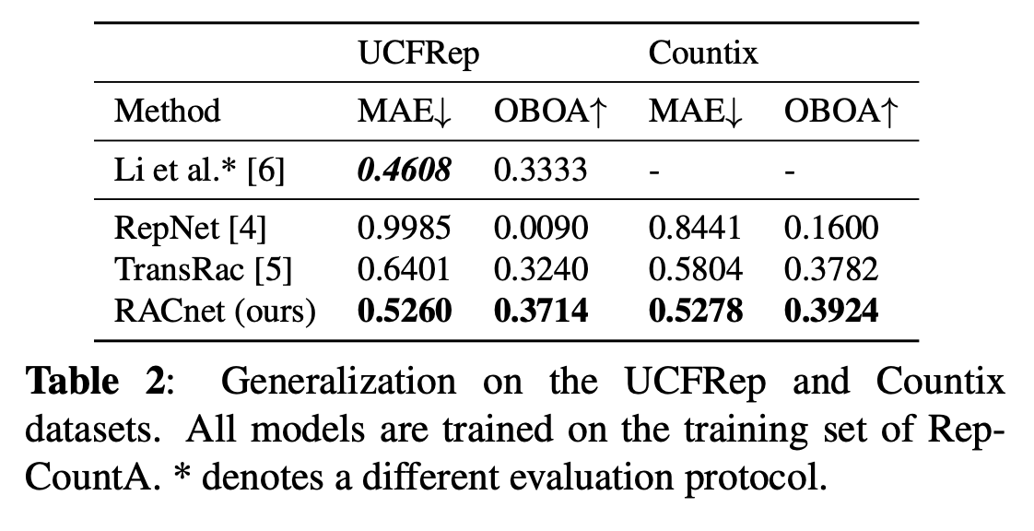
Quant. Results
Evaluation metrics

Slide 11
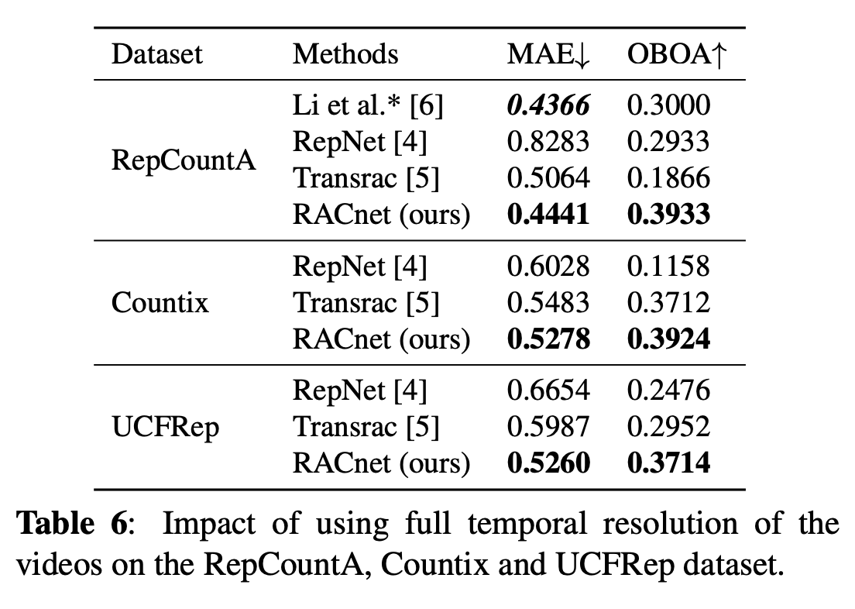
Ablation Study
Evaluation metrics

Slide 12
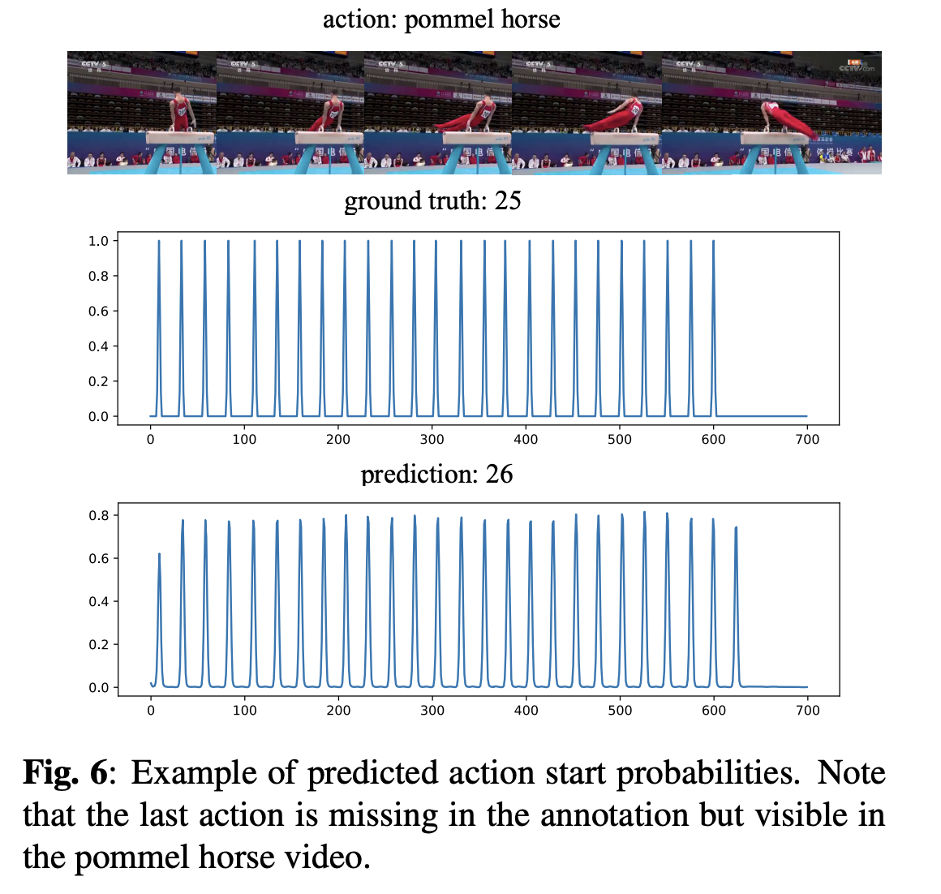
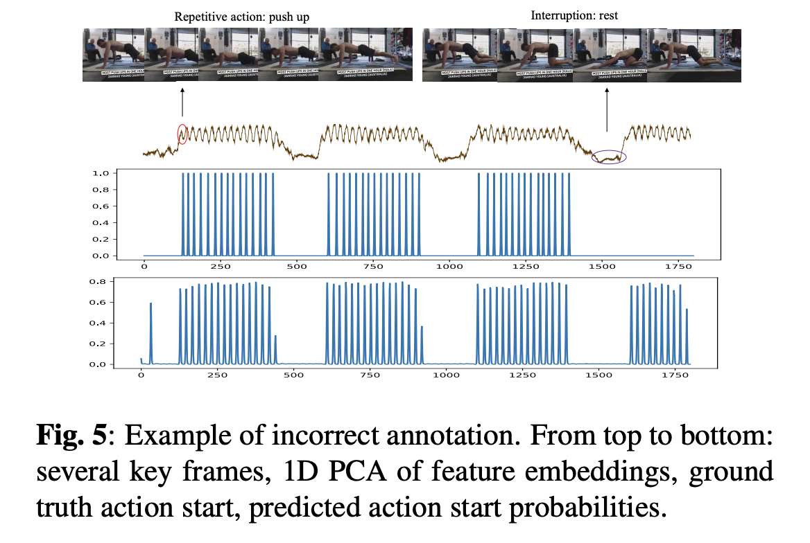
Qual. Results

Slide 13
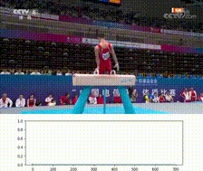
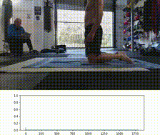
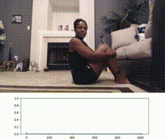
Demo
Video
Hommel horse
Groundtruth: 25 Prediction: 26
Push up
Groundtruth: 45 Prediction: 58
Sit up
Groundtruth: 30 Prediction: 30

Slide 14
Thanks for listening
Rethinking temporal self-similarity for repetitive action counting
Yanan Luo ^{*1}, Jinhui Yi ^{*1}, Yazan Abu Farha ², Moritz Wolter ¹, Juergen Gall ^{1,3}
¹ University of Bonn, ² Birzeit University,
³ Lammar Institute for Machine Learning and Artificial Intelligence
* Equal Contribution
Paper: https://arxiv.org/pdf/2407.09431 Code: https://github.com/Luoadore/RACnet

