Slide 1
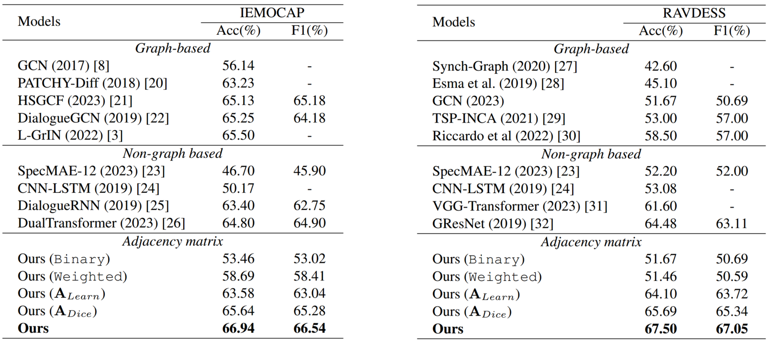
Adaptive Speech Emotion Representation Learning Based on Dynamic Graph
Yingxue Gao, Huan Zhao*, Zixing Zhang*
gaoxue@hnu.edu.cn
College of Computer Science and Electronic Engineering, Hunan University, China
1. Challenges & Goals
3. Method
Traditional methods focus solely on static graphs within a sequence. These methods update node representations by simply averaging neighbors’ features, neglecting the importance of different neighbors.
Hence, We introduce a novel weighted method for updating node representations. Instead of relying on traditional averaging techniques, our method calculates weights based on the degrees of neighboring nodes. Furthermore, We propose dynamic evolution graphs, which are constructed on subsequences segmented by a sliding window.
Traditional Dice similarity
Our Dice similarity
4. Model
GMQE= 0.97
201-Wt
GMQE= 0.98
201-YTE
GMQE= 0.97
201-C6A-66
GMQE= 0.95
201-C6A-60
GMQE= 0.96
201-T5A-74
GMQE= 0.98
201-C6A-78A
GMQE= 0.97
GMQE= 0.96
C
5. Results
Figure D1. Pre-Docking
Figure D2. Post-Docking
FcRn
Fc
2. Graph construction
FcRn
Fc
6. Conclusion & Future work
we combine the graph structure loss and classification loss to optimize during training. Experimental results demonstrate our model outperforms the latest (non-)graph-based models. In the future, we'll extend our work to handle multimodal data with graph structures.

