Slide 1
TOWARDS IMPROVED ROOM IMPULSE RESPONSE ESTIMATION FOR SPEECH RECOGNITION
Anton Ratnarajah, Ishwarya Ananthabhotla, Vamsi Krishna Ithapu, Pablo Hoffmann, Dinesh Manocha, Paul Calamia

Slide 2
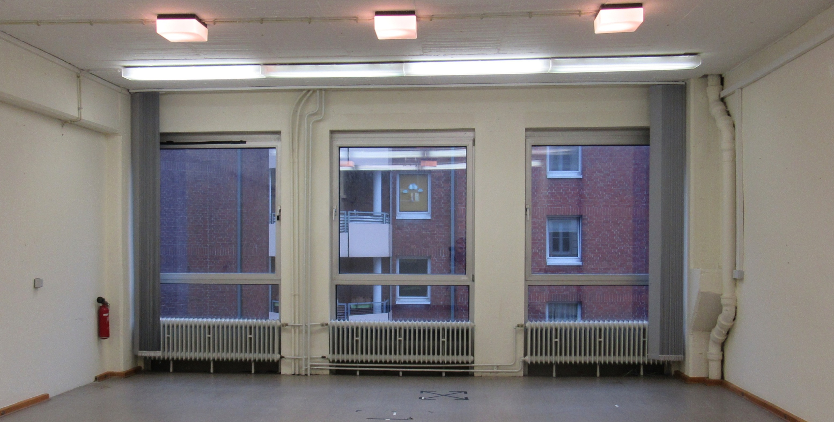
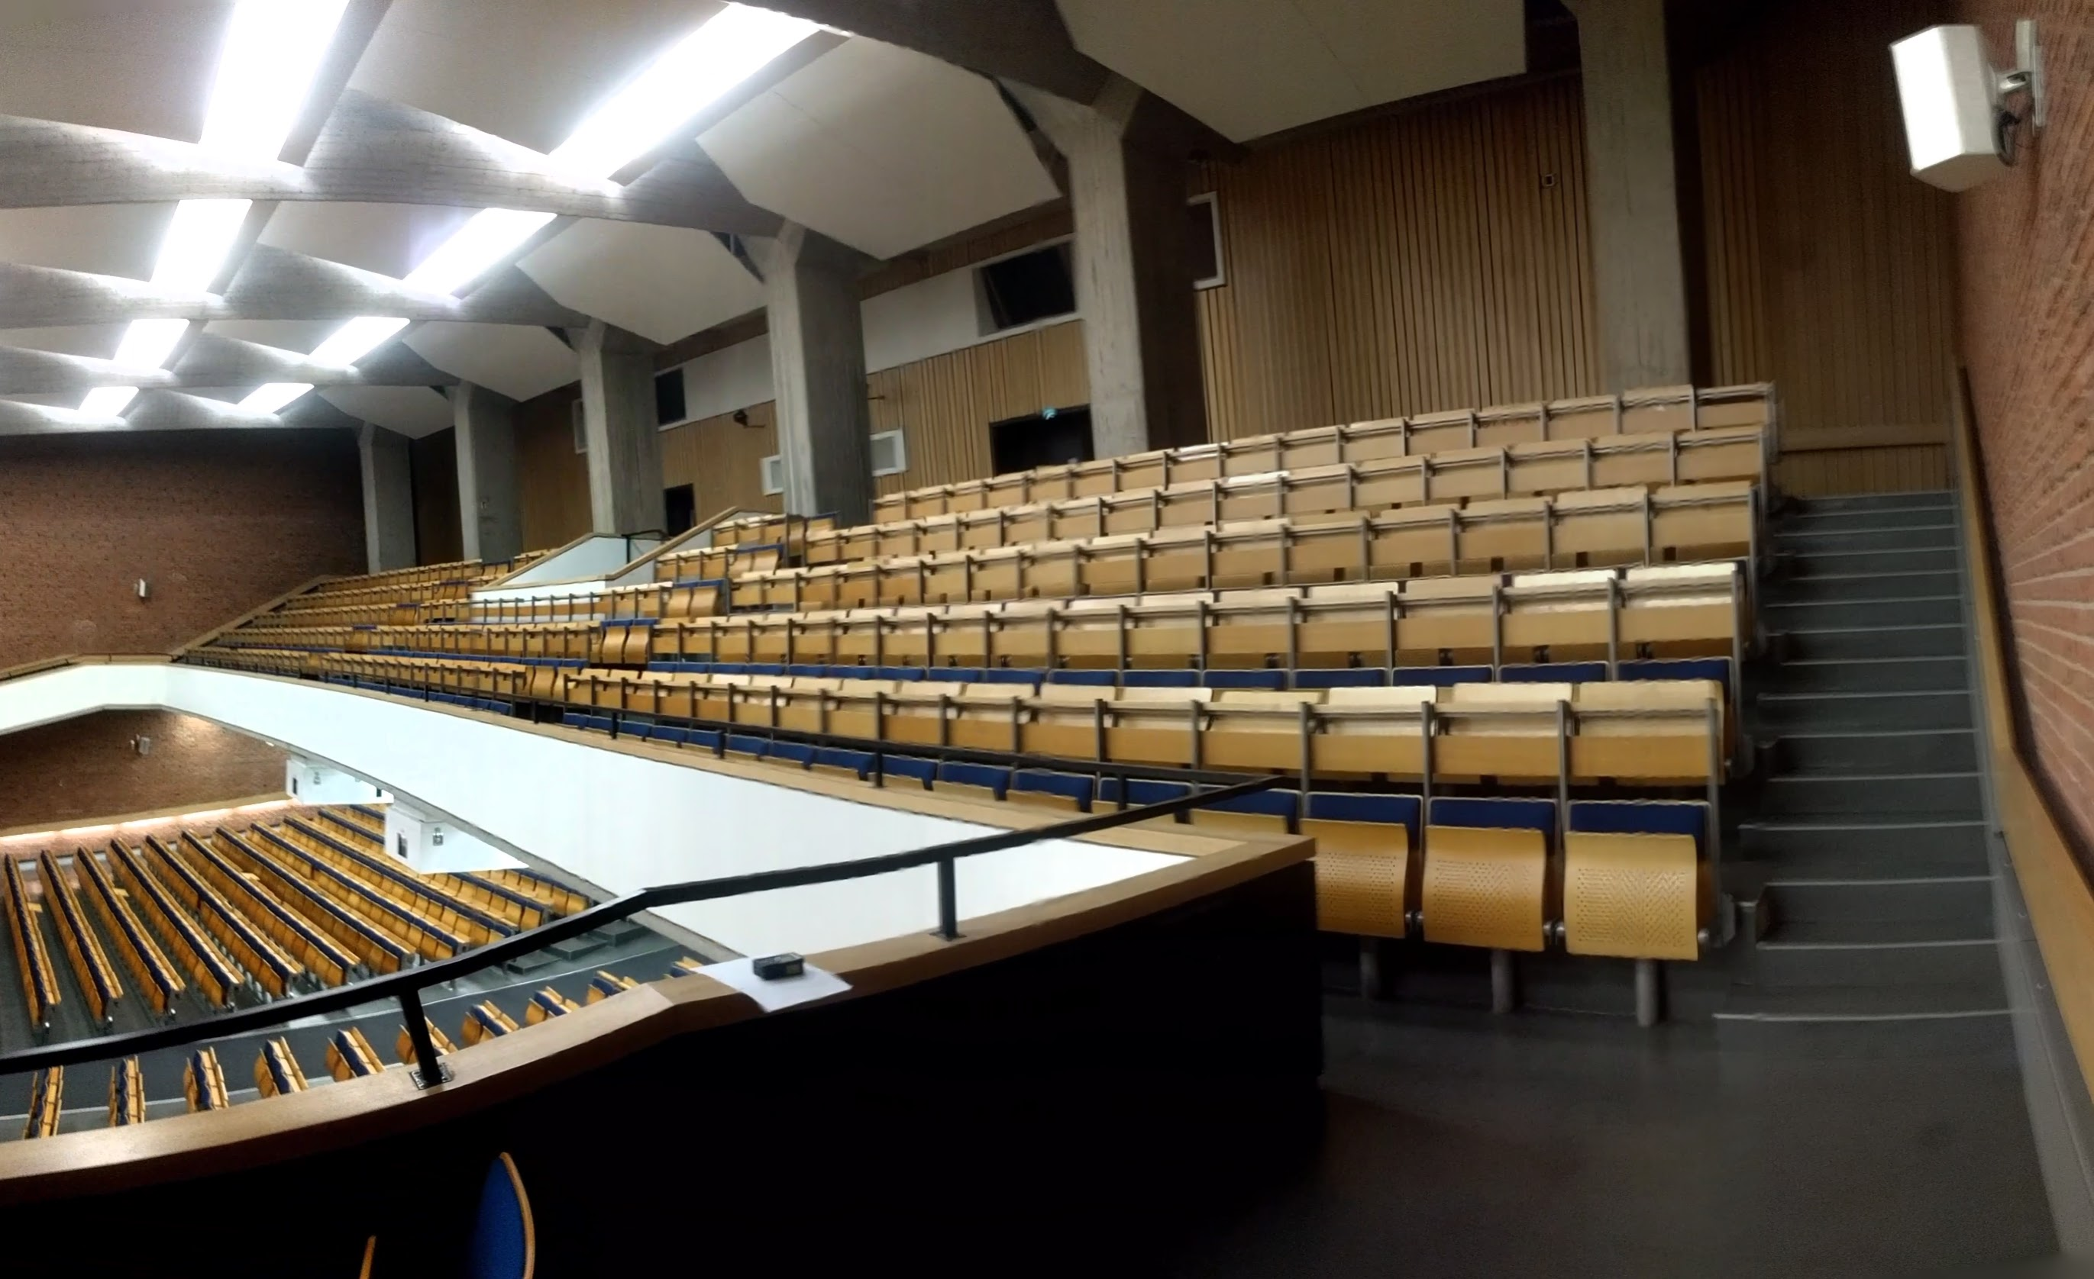
Introduction
Small Room
Auditorium
Notes:
The reverberation effects in audio recording depends on the acoustic environment in which the audio is recorded. For example, the way we hear a speech signal in a small room is signicantly different from the way we hear same speech signal in an auditorium. First, I will play the speech signal from the small room then the same speech signal from an auditorium.

Slide 3
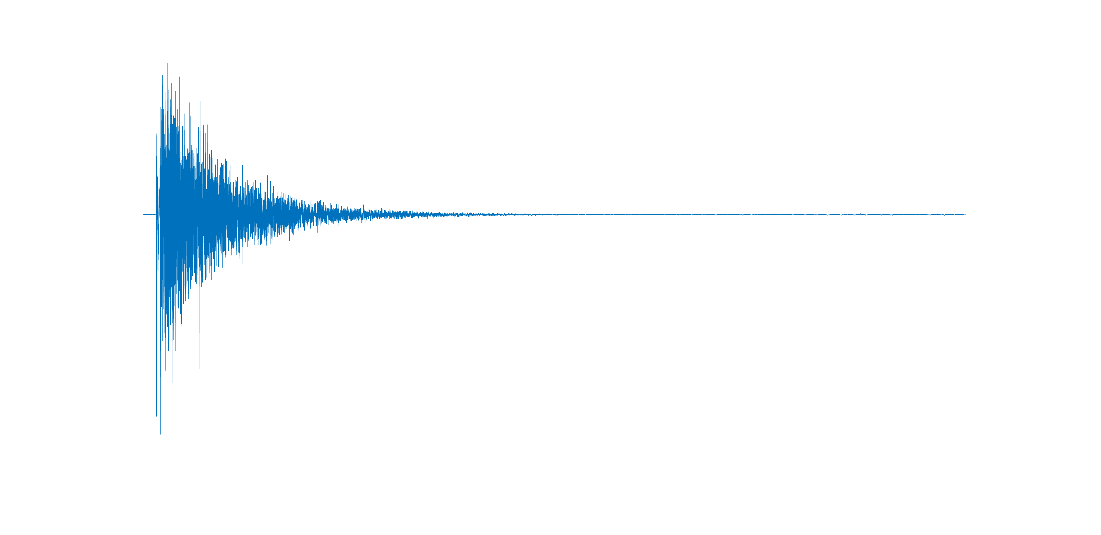
Introduction
Small Room
Auditorium
Room Impulse Response
Room Impulse Response
Notes:
The reverberation effects corresponding to the acoustic environment is characterized by transfer function known as room impulse response. We can see that the room impulse response function corresponding to a small room is significantly different from the room impulse response from an auditorium.

Slide 4
Introduction
Auditorium
Clean Speech
*
Room Impulse Response (RIR)
=
Synthetic Reverberant Speech
Notes:
If we know the room impulse response function for a given acoustic environment, we can augment reverberant speech corresponding to the acoustic environment by convolving any clean speech with the room impulse response.

Slide 5
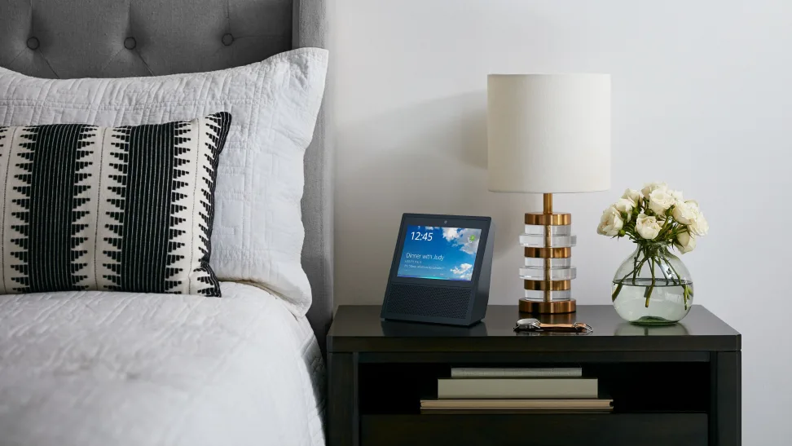
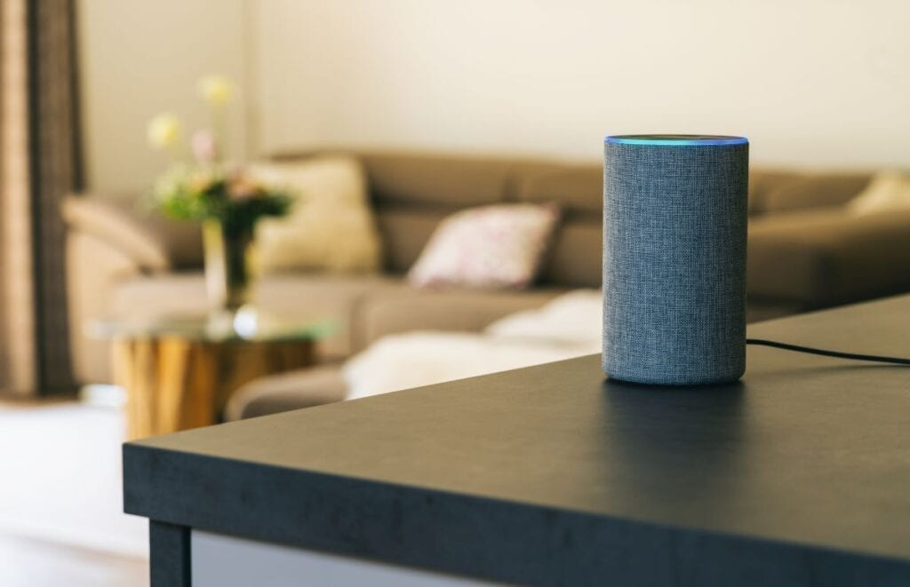
Introduction
Kitchen
Bedroom
Living Room
Notes:
In practical scenarios, voice assistant devices like Amazon echo and META portal are in a fixed indoor environment whose acoustic characteristics do not change frequently.

Slide 6
Our Approach
Test on real speech recordings
Automatic Speech Recognition System
Kitchen
Train
Clean Speech Dataset
Reverberant Speech Dataset
Reverberant Speech
Estimated RIR
*
Notes:
In our work, we focus on the room impulse response estimation framework, from the point of view of specific use case, automatic speech recognition system. We propose a learning-based approach of estimating room impulse responses from single-channel speech recordings from an indoor environment. Using the estimated room impulse responses, we augment reverberant speech training dataset by convolving clean speech dataset with estimated room impulse response. We train automatic speech recognition system using our synthetic reverberant speech data and test the system on real recordings.

Slide 7
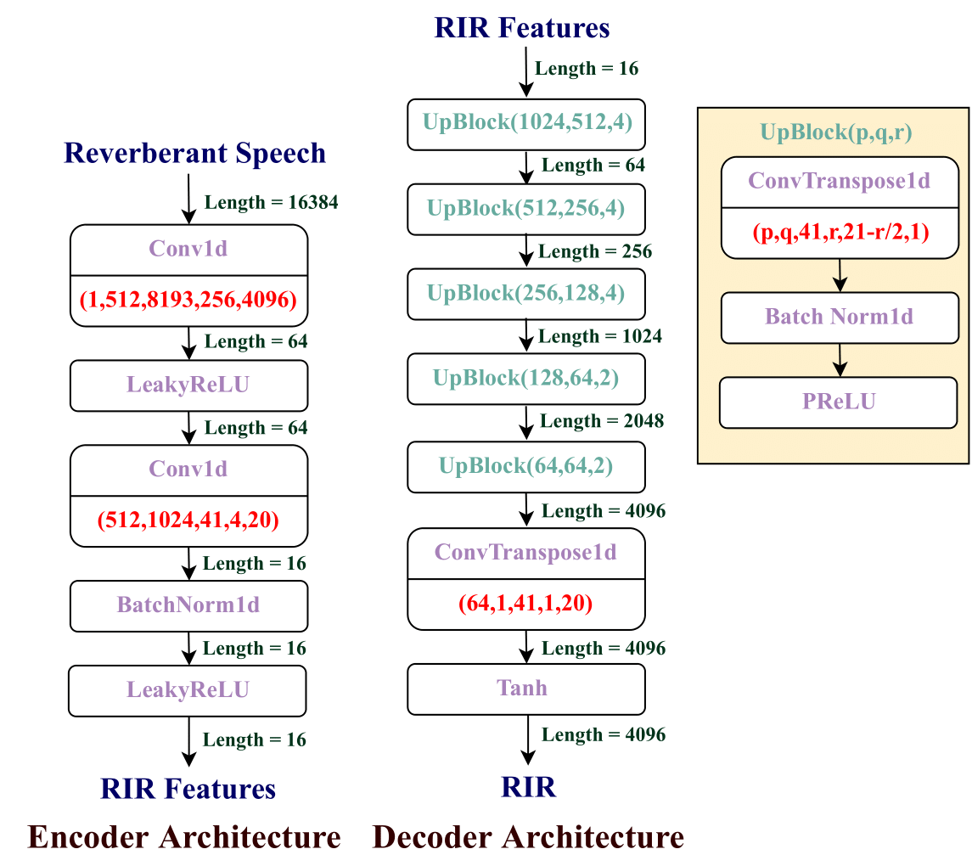
Our RIR Estimator
Notes:
We propose an encoder decoder architecture to estimate the room impulse response from the reverberant speech signal. Our encoder network RIR features from the reverberant speech and our decoder network contracts RIR from the extracted features.

Slide 8
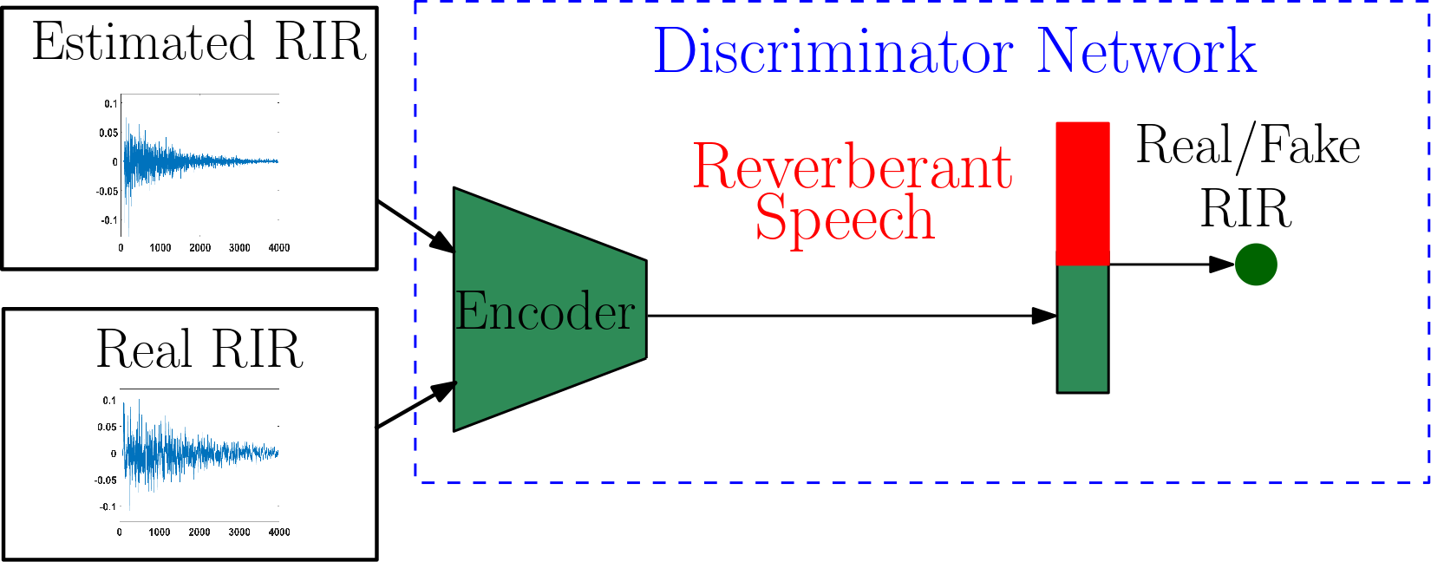
Discriminator Network
Notes:
Our discriminator network is optimized to discriminate between the estimated room impulse response and the ground truth room impulse response for a given reverberant speech data during training.

Slide 9
Objective Function
RIR Estimator : The objective function of RIR estimator network (L_{ENet}) consists of energy decay relief error (L_{EDR}), modified conditional GAN error (L_{CGAN}) and mean square error (L_{MSE}). We use the weight $λ$_{EDT} and $λ$_{MSE} to control the relative importance of L_{EDR} and L_{MSE} , respectively.
Notes:
Energy decay relief error is used to match the energy distribution of estimated RIR to the ground truth RIR over a set of octave frequency band.
The conditional GAN error is used to estimate RIR from the reverberant speech using our RIR estimator that is difficult to differentiate from the ground truth RIR by the discriminator network during training.
Mean square error is used to match the time domain representation of estimated RIR to the ground truth RIR.

Slide 10
Objective Function
Discriminator Network : The discriminator objective function (L_{DNet}) is maximized to differentiate ground truth room impulse response (RIR) from R_{G} of the reverberant speech S_{R} from the estimated RIR E_{Net}(S_{R}) during training the discriminator network.

Slide 11
Training Data
We generate 98,316 one-second duration synthetic training examples of reverberant speech by convolving a subset of 360 hours of clean speech from the LibriSpeech dataset with real RIRs collected by META.

Slide 12
Acoustic Evaluation
We created 5000 reverberant speech test examples by convolving clean speech from the LibriSpeech dataset with real RIRs from the MRIR dataset. We compared our performance against a baseline model and the state-of-the-art RIR estimator (FiNS).
We used following acoustic metrics to evaluate our approach
Log energy decay relief (EDR) Loss
Early reflection energy (ERE) loss
Mean square error (MSE)
Direct-to-reverberant ratio error (DRR)

Slide 13
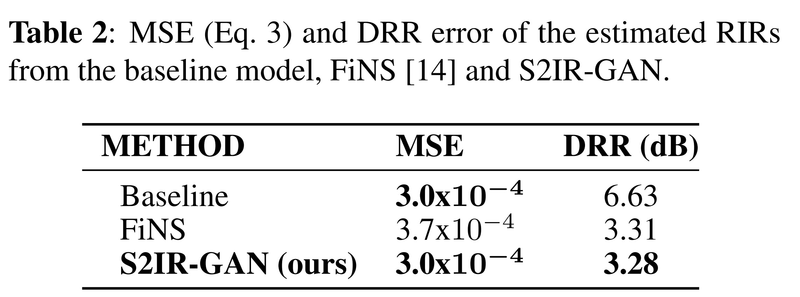
Acoustic Evaluation

Slide 14
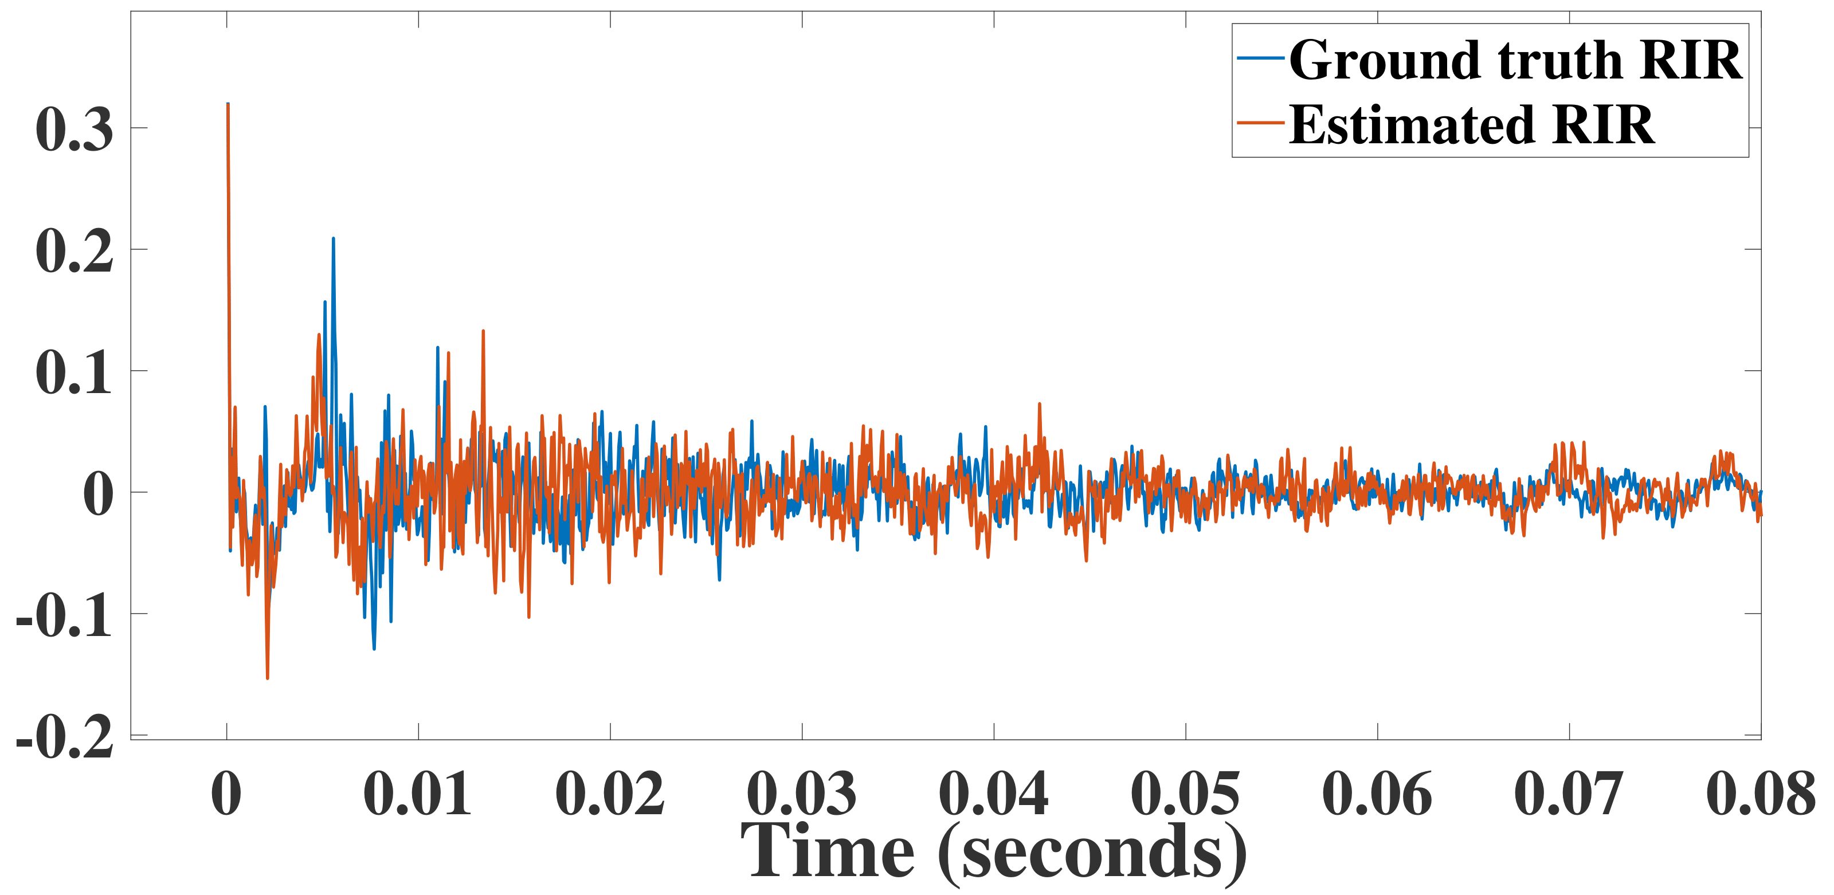
Acoustic Evaluation
Notes:
The following figure shows the time-domain plot of the ground truth room impulse response and the estimated room impulse response from our approach. We can see that the estimate room impulse response has similar macroscopic structure as the ground truth room impulse response while the fine structure differs from the ground truth room impulse response.

Slide 15
Automatic Speech Recognition
We use close-talk speech data (IHM) and far-field speech data (SDM) in the AMI corpus for our experiment.
From the SDM corpus, we sample 2000 reverberant speech examples of approximately one second duration. We input the sampled reverberant speech to the FiNS model and our proposed method S2IR-GAN and estimate the RIRs from the input speech. The close-talk IHM speech is convolved with the estimated RIRs to create synthetic reverberant speech training data.
We train the modified Kaldi ASR recipe with the synthetic training data and test the ASR model on the real-world reverberant SDM data. We also train the ASR model with unmodified IHM data as our baseline model.
We use word error rate (WER) to evaluate the performance of the ASR system.

Slide 16
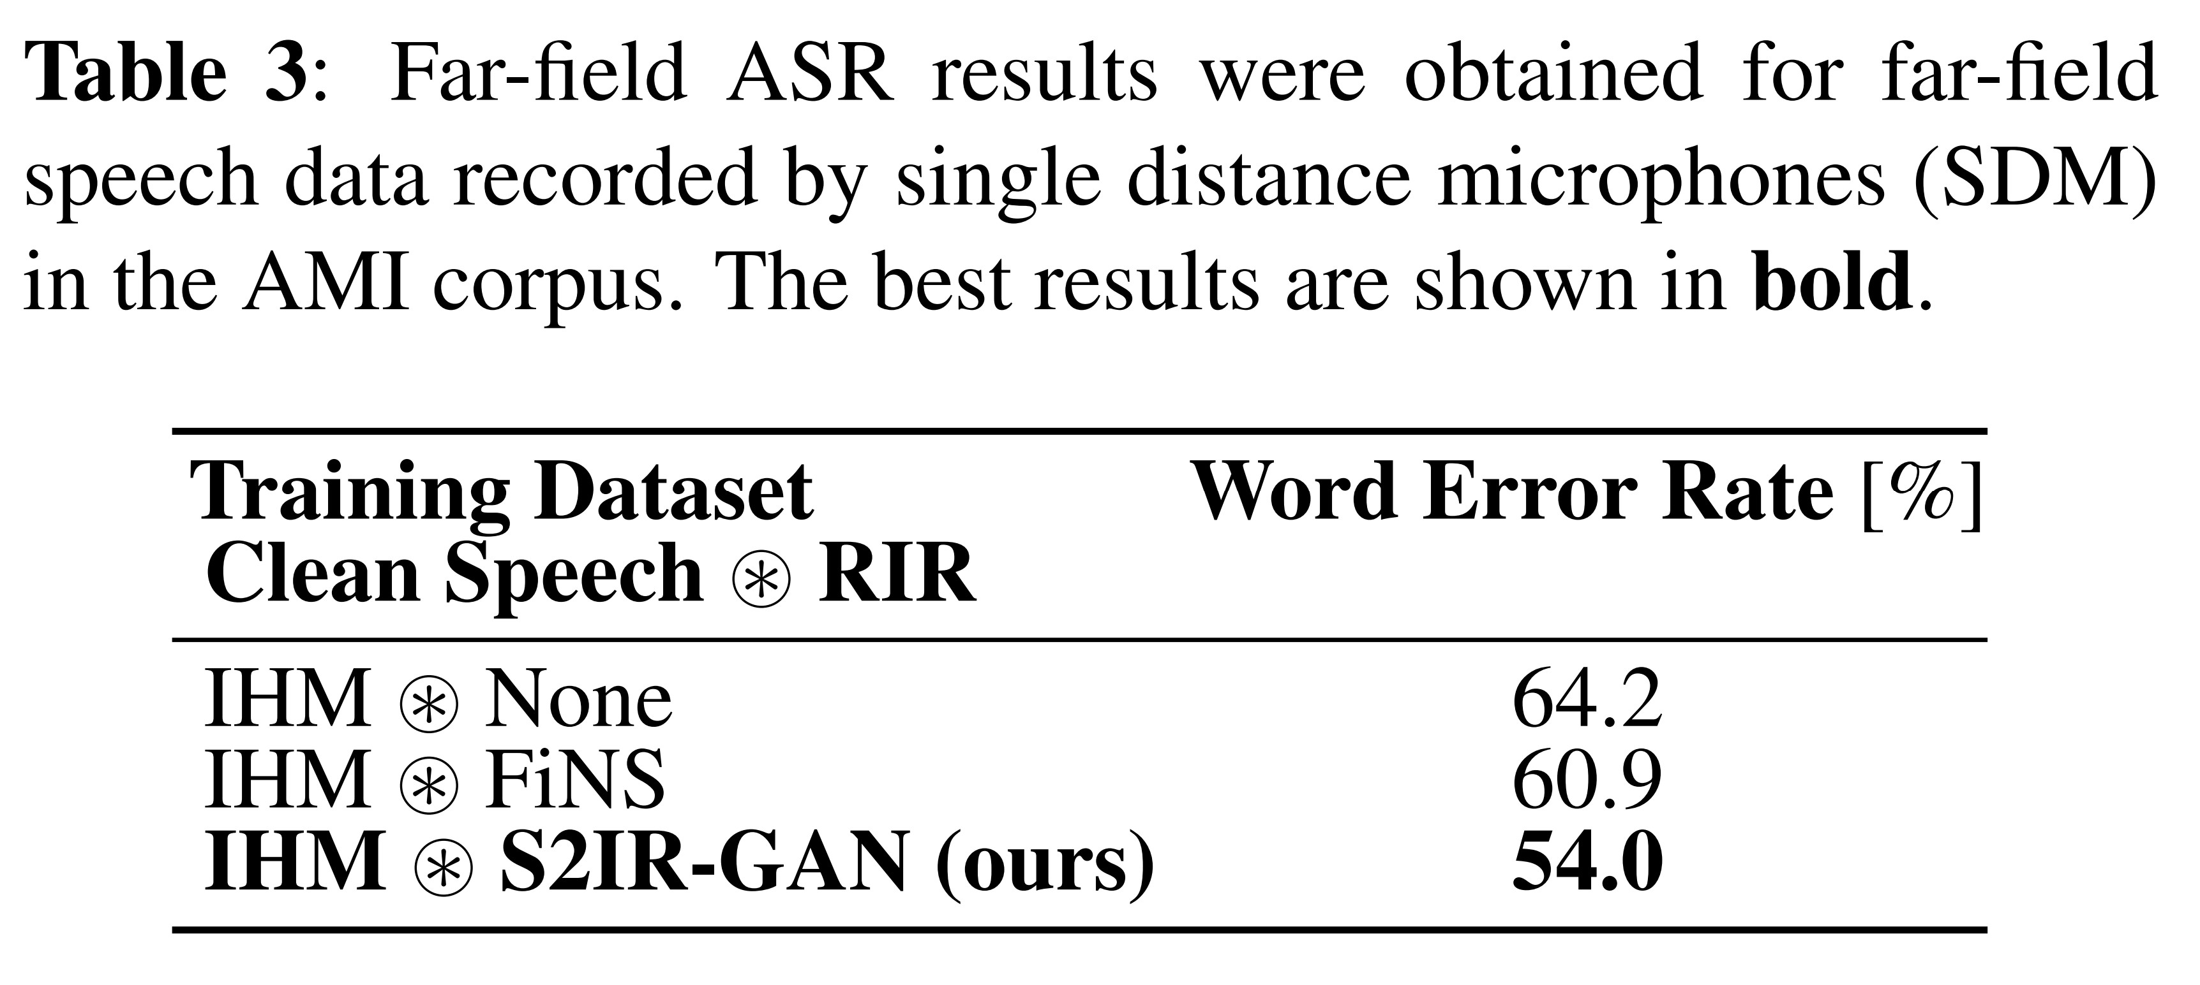
Automatic Speech Recognition

Slide 17
Conclusion
We present a method for the improved estimation of RIRs in the context of far-field speech recognition.
Our approach outperforms the state-of-the-art RIR estimator (FiNS) on acoustic metrics such as energy decay relief loss, early reflection energy loss, DRR error, and MSE. It is also shown to outperform FiNS in a downstream ASR task.
The main limitation of this work is that the network cannot capture the fine temporal structure of an RIR from reverberant speech.

