Slide 1
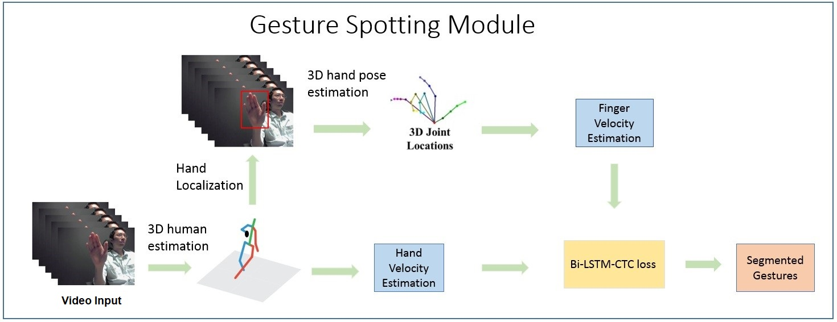
CONTINUOUS HAND GESTURE SPOTTING AND CLASSIFICATION USING 3D FINGER JOINTS INFORMATION
Nguyen Ngoc Hoang, Guee-Sang Lee, Soo-Hyung Kim, Hyung-Jeong Yang
Department of ECE, Chonnam National University, Korea
Problem Statement
Proposed Algorithm
Results
Table 1. The spotting- classification performance comparison on Chalearn LAP ConGD dataset [1].
Gesture spotting phase + Gestures classification phase
The continuous gestures are split into isolated gestures
In “zoom in”, “zoom out” gestures, there are movements of only fingers while the hand stands still – spotting is needed
Gestures spotting + gestures classification.
Speed of hand or finger is utilized to segment continuous gestures(Fig.1)
M-3DCNN-LSTM for classification with multimodalities : RGB, Optical flow and 3D key joints(Fig.2)
Method | Mean Jaccard Index [1]
2S-RNN [2] | 0.5162
Proposed in [3] (only RGB) | 0.5356
Proposed in [3] (RGB + Depth) | 0.5950
Our proposed | 0.5523
Introduction
Conclusion
A new approach for continuous dynamic hand gesture spotting- classification for RGB input
Used key 3D poses as the input of Bi_LSTM network.
Gesture classification module by multi-modal M-3DCNN-LSTM network.
Proved to be effective in the final performance
A continuous dynamic hand gestures spotting-classification with a RGB camera.
In the spotting module, the continuous gestures from the unsegmented and unbounded input stream are segmented into each isolated gestures based on 3D human pose and hand pose extraction.
The time series of 3D key pose movement are fed into Bidirectional Long Short-Term Memory (Bi_LSTM)
The isolated gestures are classified with multi-modal M-3DCNN-LSTM network.
Combining RGB, Optical Flow, and 3D pose
Two 3D_CNN stream networks of RGB and Optical Flow channel and one LSTM network of 3D pose features are fused
References
Fig.1. Gesture spotting module
[1] J. Wan, Y. Zhao, S. Zhou, I. Guyon, S. Escalera, and S. Z. Li, "ChaLearn Looking at People RGB-D Isolated and Continuous Datasets for Gesture Recognition," CVPR workshop, 2016.
[2] X. Chai, Z. Liu, F. Yin, Z. Liu and X. Chen, "Two Streams Recurrent Neural Networks for Large-Scale Continuous Gesture Recognition," the 23rd International Conference on Pattern Recognition (ICPR) , 2016.
[3] H. Wang, P. Wang, Z. Song and W. Li, "Large-scale Multimodal Gesture Recognition Using Heterogeneous Networks," IEEE International Conference on Computer Vision Workshops (ICCVW), 2017.
Fig.2. Gesture classification module

