Slide 1
Smart Fog: Fog Computing Framework for Telehealth Big Data Analytics in Wearable Internet of Things
Debanjan Borthakur

Slide 2
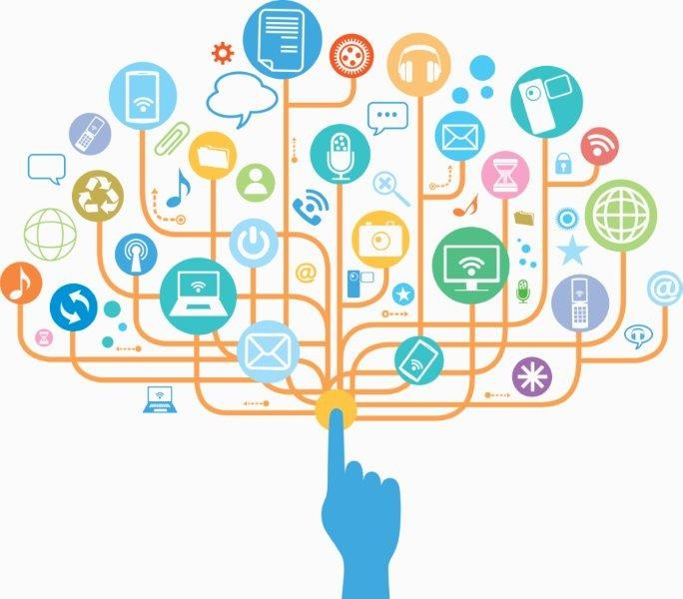
“Every two days now we create as much information as we did from the dawn of civilization up until 2003. That’s something like five exabytes of data”
-Eric Schmidt , former google CEO
10¹⁸bytes = 1000000000000000000B

Slide 3
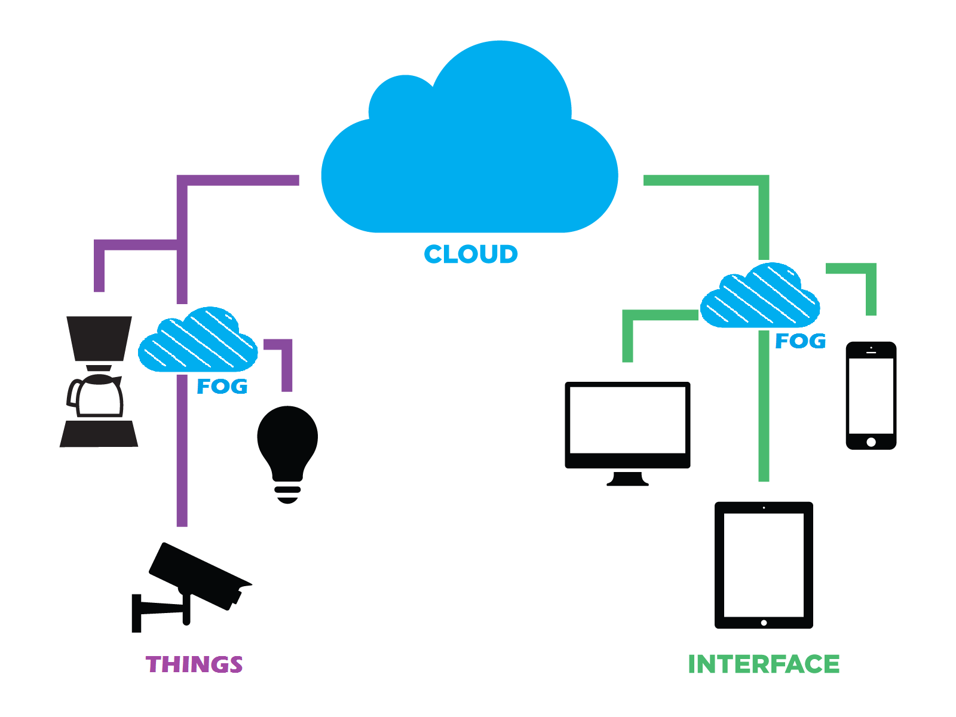
Costly
Higher Latency
Security
Reduced Congestion
Decentralised approach
More security
Notes:
Wearables in smart telehealth system led to the generation of large medical big data.
Cloud and fog services leverage these data for assisting clinical procedures
This paper suggests the use of low-resource machine learning on Fog devices kept close to wearables for smart telehealth
The proposed fog architecture uses Machine Learning and Signal processing of physiological data.
Fog is cloud in the ground

Slide 4
How can we use fog ?
Tele-Health monitoring of Parkinson Patients

Slide 5
Parkinson Speech
slurred speech, running out of breath, drooling
Notes:
Significance of This work :
Fog In simple words, is the decentralization of services at the edge of the network.
The computation and control closer to the sensors make the concept of Fog a better alternative to the cloud.
In our proposed architecture of smart Fog, we leveraged the idea of Fog for speech signal processing for telehealth monitoring.
Speech signal processing and Machine learning are fundamental blocks for detection and evaluation of speech disorders like dysarthria in patients with Parkinson's diseases.
Telehealth monitoring using smart devices is an effective remedy.

Slide 6
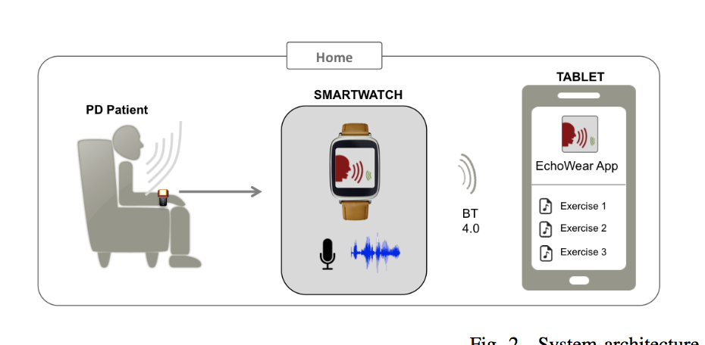
Data Collection :
Reference: Dubey, H., Goldberg, J. C., Abtahi, M., Mahler, L., & Mankodiya, K. (2015, October). EchoWear: smartwatch technology for voice and speech treatments of patients with Parkinson's disease. In Proceedings of the conference on Wireless Health (p. 15). ACM.
Notes:
Parkinson ECHOWEAR

Slide 7
Proposed Architecture
Cloud Backend
Front End for Wearable data
Fog architecture
Notes:
Use smartwatch data

Slide 8
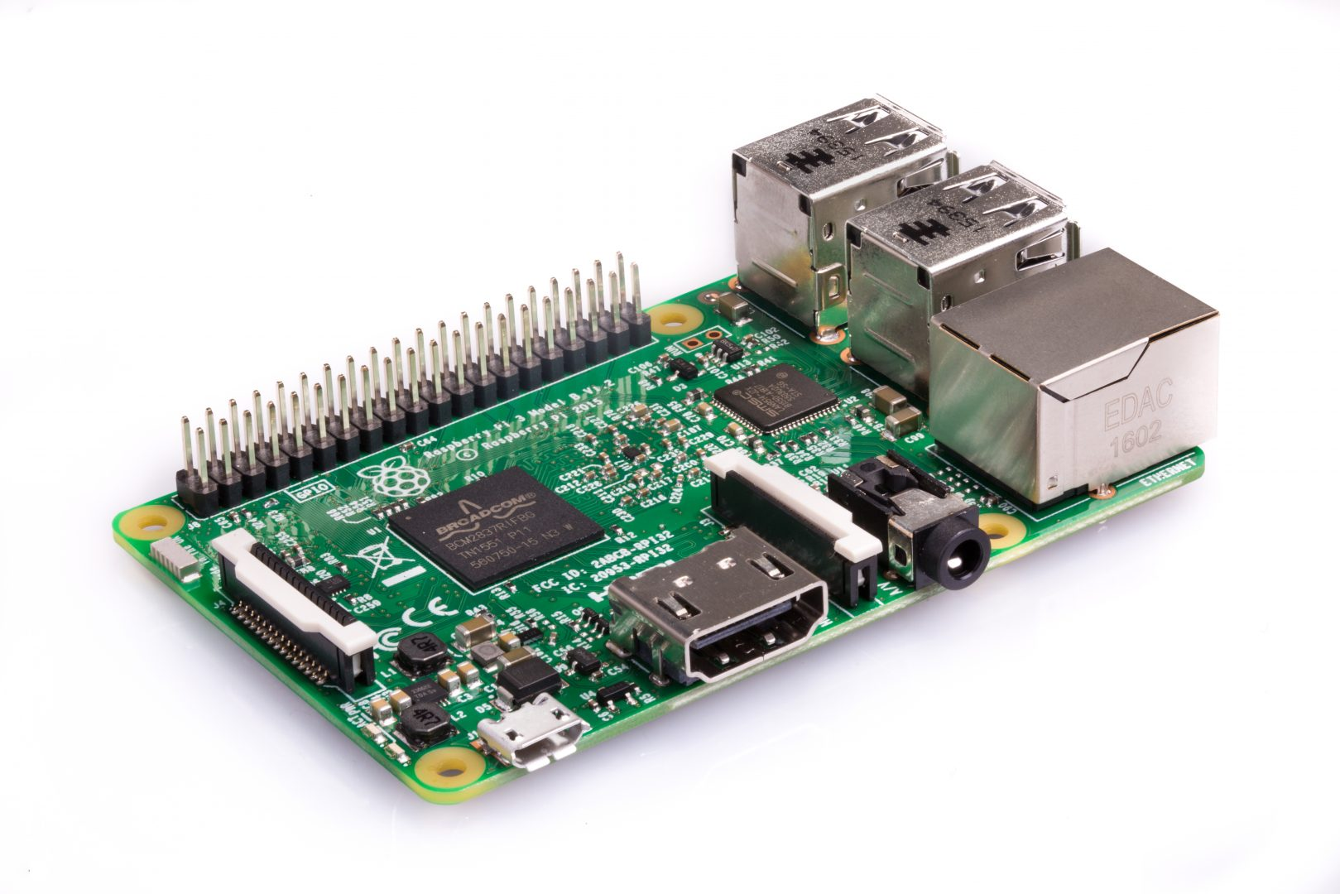
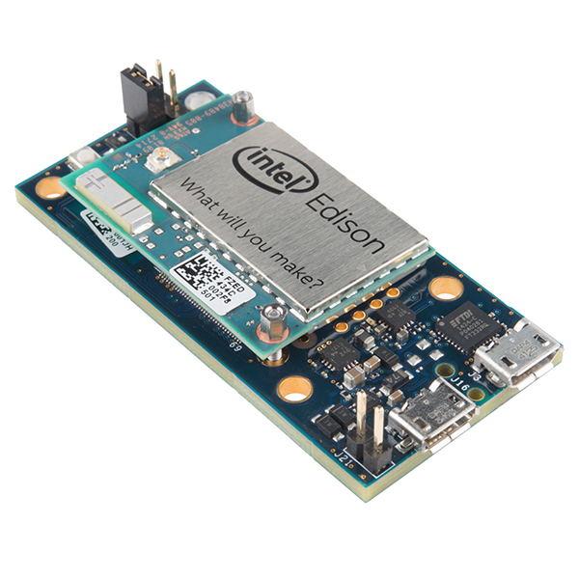
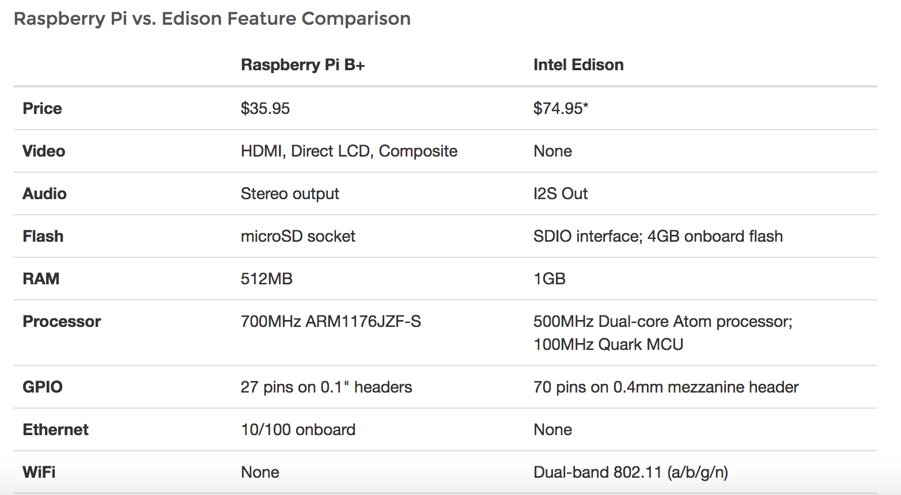
Fog Computing Hardware
Notes:
Comparison

Slide 9
Data : 164 Speech utterances from multiple subjects with utterances that are a short /a/, a long /a/, a normal then high pitched /a/,a normal then low pitched /a/ and phrases were chosen.
Features: The features were chosen are average fundamental frequency and intensity. Feature extraction is done using praat software.
Notes:
Add audio files

Slide 10
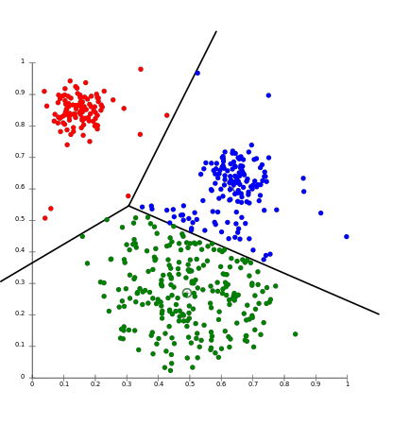
Fog Based low resourced machine learning
Feature extraction : average fundamental frequency (F0) and Average amplitude of the speech utterance.
K-means Clustering: K-means is a method of vector quantization and is quite extensively used in data mining.The goal of this algorithm is to find groups in the data, the number of groups represented by the variable K.

Slide 11
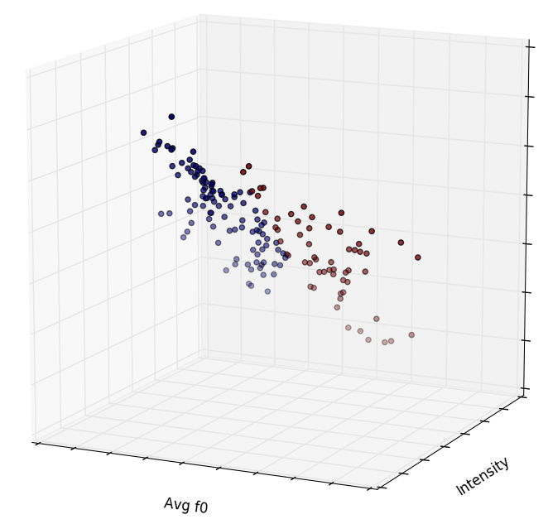
Results and Discussions :
K means plots:
Figure (a)shows the K-means clustering plot for 2 clusters shown with different colors.The python script ran on Raspberry Pi and Intel Edison to generate the results.

Slide 12
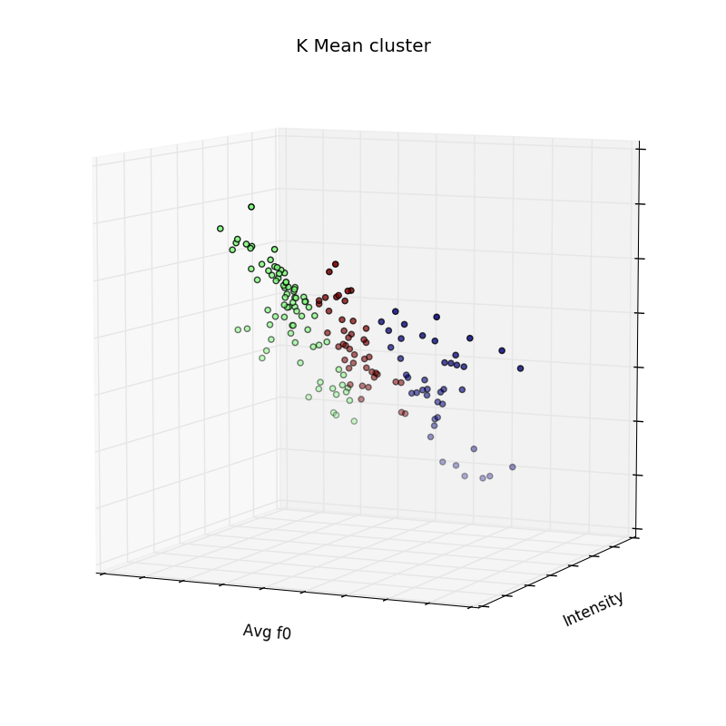
K means plots:
Figure (b)shows the K-means clustering plot for 3 clusters shown with different colors.The python script ran on Raspberry Pi and Intel Edison to generate the results.
Notes:
Pics of intel edison

Slide 13
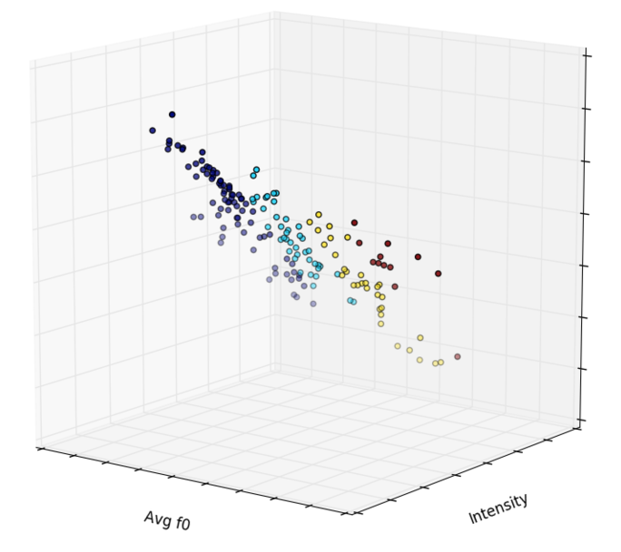
K means plots:
Figure (c)shows the K-means clustering plot for 3 clusters shown with different colors.The python script ran on Raspberry Pi and Intel Edison to generate the results.
Features
K means
Groups

Slide 14
Performance Comparison:
Results were compared in Raspberry pi and Intel Edison.
Figure shows the comparison of Intel Edison and Raspberry Pi fog devices.
The ideal system will minimize runtime,maximize CPU usage, and use a modest amount of memory.
The Raspberry Pi either outperformed or matched the Edison in each of this criterion.
Notes:
Explain individual

Slide 15
Conclusions:
We implemented low-resource machine learning on Fog devices kept close to wearables for smart telehealth.
A comparison between Raspberry Pi and Intel Edison showed , Raspberry Pi outperforms Edison in some aspects.
We believe this kind of fog architecture can help solve the Big Data problem one day.
Notes:
ML on Fog Node

Slide 16
Acknowledgement :
I would like to thank my co-authors, Interdisciplinary Neuroscience Programme members, University of Rhode Island,Patients of Parkinson Disease and audience for their help and support.

Slide 17
Thank You

