Slide 1
ICIP 2021
Anchorage, Alaska
Recover the Residual of Residual: Recurrent Residual Refinement Network for Image Super-Resolution
Tianxiao Gao¹, Ruiqin Xiong¹, Rui Zhao¹, Jian Zhang², Shuyuan Zhu³ and Tiejun Huang¹
¹ Peking University, Beijing, 100871, China
² Shenzhen Graduate School of Peking University, Shenzhen, 518055, China
³ University of Electronic Science and Technology of China, Chengdu, 611731, China
Speaker: Rui Zhao
IEEE ICIP 2021

Slide 2
Contents
Background ---------------------------------------------------------- pages 3-4
Proposed Method ---------------------------------------------------- page 6
Experiment Results -------------------------------------------------- page 8

Slide 3
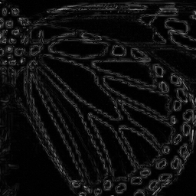
Background
Image Super-Resolution
Up-sample
Residual Learning
Low-Resolution Image
Residual Image
High-Resolution Image

Slide 4
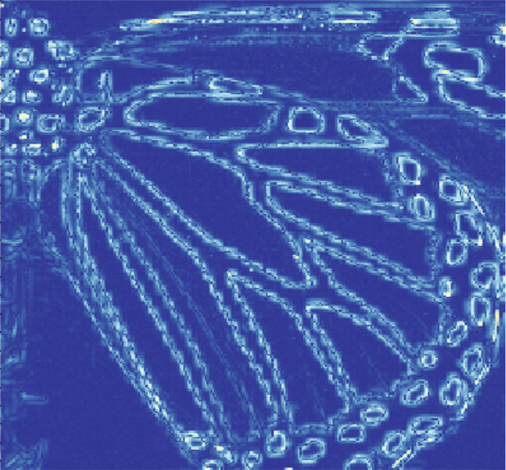
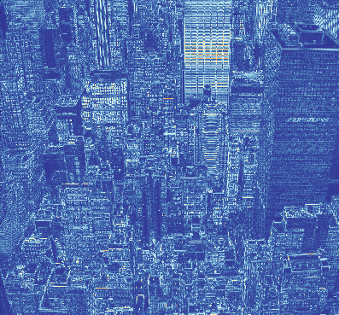
Background
Learning for Complex Residual
Large Variance
Large Scale
Difficult to Learn
HR Image
LR Image
Residual Image

Slide 5
Contents
Background ---------------------------------------------------------- pages 3-4
Proposed Method ---------------------------------------------------- page 6
Experiment Results -------------------------------------------------- page 8

Slide 6
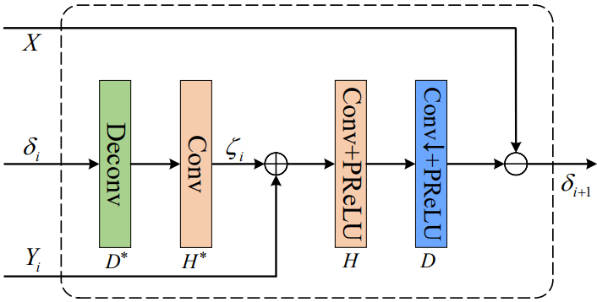
Background
Refinement for Residual
Conventional Methods
SR₀
SR₁
SR₂
Residual
Learning
Residual
Learning
Residual
Learning
LR
Local Residual Refinement
Global Residual Refinement

Slide 7
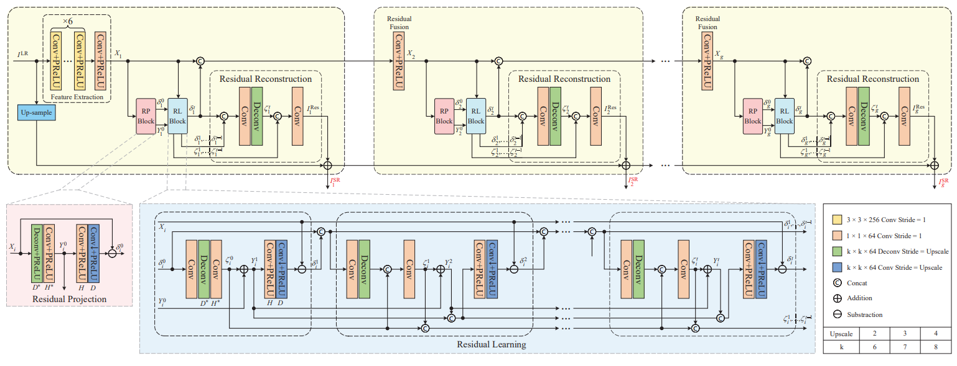
Background
Overall Network Structure

Slide 8
Contents
Background ---------------------------------------------------------- pages 3-4
Proposed Method ---------------------------------------------------- page 6
Experiment Results -------------------------------------------------- page8

Slide 9
Experiment Results
Average PSNR/SSIM with BI Degradation Model

Slide 10
Experiment Results
Average PSNR/SSIM with BD/DN Degradation Model

Slide 11
Experiment Results
‘img_014’ from Urban100
HR
Bicubic
SRFBN
Ours

Slide 12
Experiment Results
‘img_024’ from Urban100
HR
Bicubic
SRFBN
Ours

Slide 13
ICIP 2021
Anchorage, Alaska
The End
Recover the Residual of Residual: Recurrent Residual Refinement Network for Image Super-Resolution
Tianxiao Gao¹, Ruiqin Xiong¹, Rui Zhao¹, Jian Zhang², Shuyuan Zhu³ and Tiejun Huang¹
Speaker: Rui Zhao
IEEE ICIP 2021

