Slide 1
Fully Integerized End-to-End Learned Image Compression
Yimian Fang, Wen Fei, Shaohui Li, Wenrui Dai, Chenglin Li, Junni Zou, and Hongkai Xiong
Department of Electronic Engineering
Shanghai Jiao Tong University
21 February 2023

Slide 2
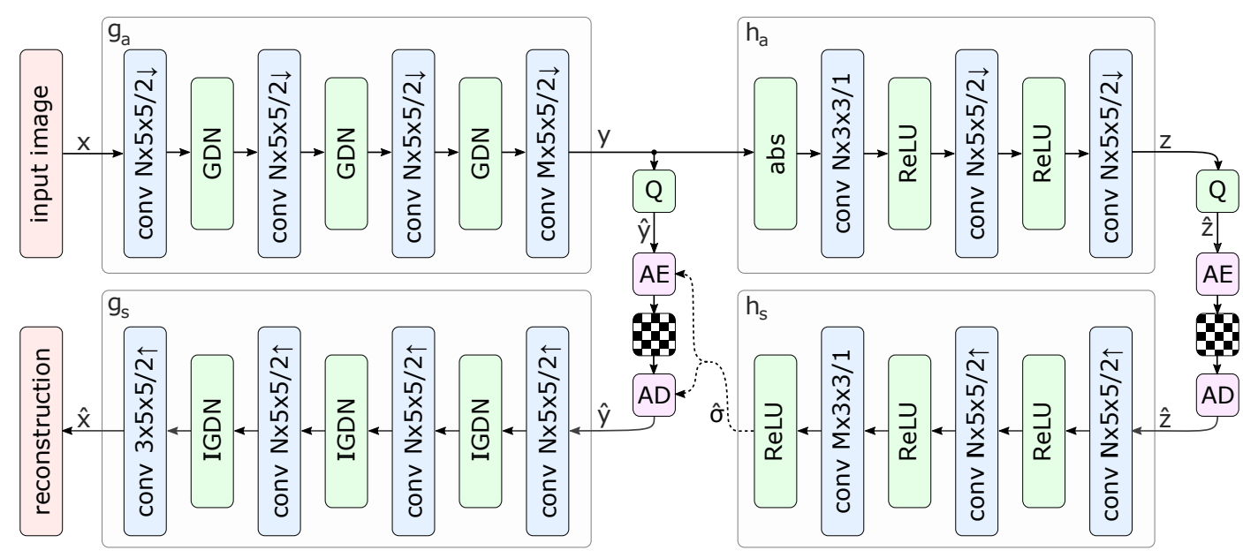
Learned Image Compression
The hyperprior model (ICLR 2018):
Figure 1. Network architecture of the hyperprior model.
Neural network based transform: $g_{a}$, $g_{s}$, $h_{a}$, $h_{s}$
Loss: $L=R+λD$
Underlying path (distortion) : $g_{a}$, $g_{s}$
Hyperprior path (bitrate) : $h_{a}$, $h_{s}$
J Ballé, Minnen D , Singh S , et al. Variational image compression with a scale hyperprior[J]. 2018.

Slide 3
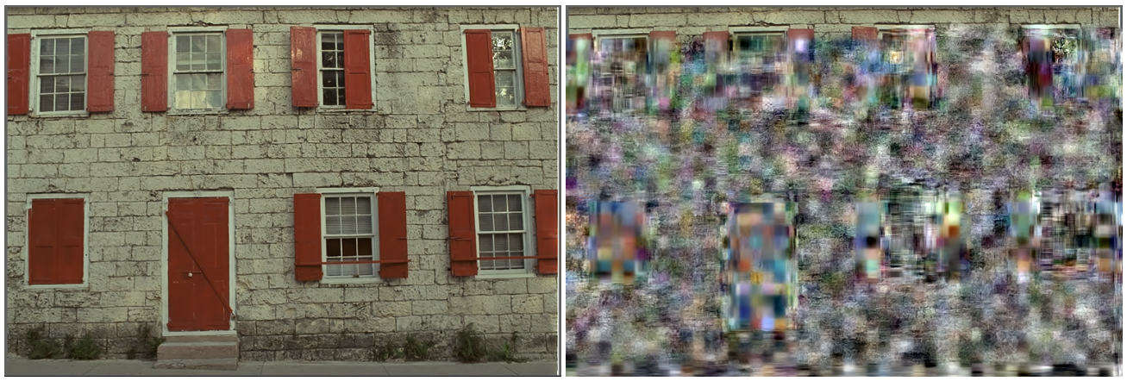
Problems
High computational complexity caused by over-parameterization and full-precison floating-point operations of neural networks still restrict the practical deployment, especially for real-time inference on resource-constrained embedded devices.
Floating-point operations could cause cross-platform instability.
Figure 2. Decoding failure caused by cross-platform instability.
Solution: Integer networks
Ballé J, Johnston N, Minnen D. Integer networks for data compression with latent-variable models[C]//International Conference on Learning Representations. 2019.

Slide 4
Network Quantization For Learned Image Compression
Piece-wise Quantization (ICIP 2020):
8-bit channel-wise weight quantization without activation quantization
Unable to implement integerized networks
Weight Clipping:
Simulated Quantization:
$${sf}^{i}=2^{−\left\lfloor \log_{2}{max⁡(\left|w^{i}\right|)}\right\rfloor }$$
${sw}^{i}=w^{i}×{sf}^{i},{sw}^{i}∈$(-2,2)
$w_{q}^{i}=\left\{\begin{aligned}&\frac{\left.Q({sw}^{i}×2^{FL−1}\right)}{2^{FL−1}×{sf}^{i}},\left|{sw}^{i}\right|∈\left[0.5,\left.2\right)\right. \\ &\frac{\left.Q({sw}^{i}×2^{FL}\right)}{2^{FL}×{sf}^{i}},\left|{sw}^{i}\right|∈\left[0.25,\left.0.5\right)\right. \\ &\frac{\left.Q({sw}^{i}×2^{FL+2}\right)}{2^{FL+2}×{sf}^{i}},else\end{aligned}\right.$, $FL=n−2, n=8$
Sun H, Cheng Z, Takeuchi M, et al. End-To-End Learned Image Compression With Fixed Point Weight Quantization[C]//2020 IEEE International Conference on Image Processing (ICIP). IEEE, 2020: 3359-3363.

Slide 5
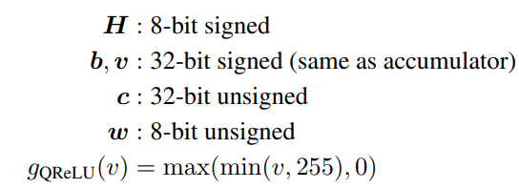
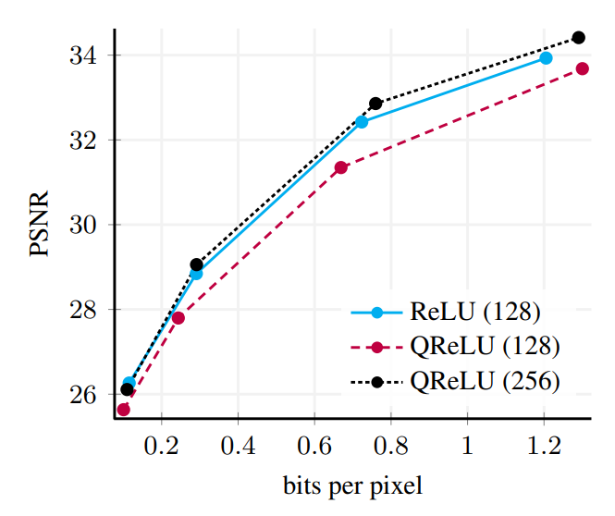
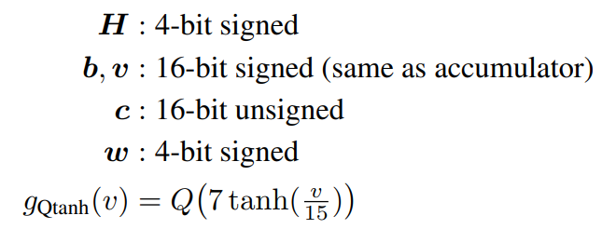
Network Quantization For Learned Image Compression
Integer Network for Latent-variable Models (ICLR 2019):
employ integer networks on entropy models by designing integer activation functions for ReLU and tangent.
When the whole LIC model is realized throughout with integer networks, rate-distortion performance is significantly degraded.
Figure 3. performance of Ballé (2018) ReLU and QReLU model with different numbers of filters.
Ballé J, Johnston N, Minnen D. Integer networks for data compression with latent-variable models[C]//International Conference on Learning Representations. 2019.

Slide 6
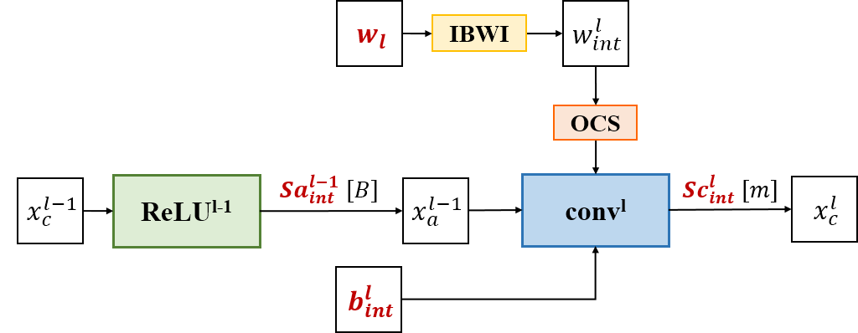
Overview
This paper is the first to realize a fully integerized model with negligible loss in R-D performance for LIC.
We employ channel-wise weight and activation quantization to realize the integer convolutions and activation functions in Figure 4.
To advance our method, we propose three approaches in consideration of weight bit-width and activation distribution.
Figure 4. Illustration of proposed integer convolution, and integer parameters that need to be stored are marked in red.

Slide 7
Linear Weight Quantization
Weight Quantization:
$n_{w}$-bit channel-wise linear quantization
Figure 4. Illustration of proposed integer convolution.
1. Integerization of Kernel Weight with Internal Bit Width Increment and Outlier Channel Splitting:
$$w_{int}^{l}=clamp(round\left(w^{l}∙s_{w}^{l}\right), −2^{n_{w}−1}, 2^{n_{w}−1}−1)$$
2. Integerization of Bias:
3. Integerization of Scale Factor:
$$b_{int}^{l}=round\left(b^{l}∙{\left(s_{w}^{l}∙s_{a}^{l−1}\right)}^{−1}\right)$$
$${Sc}_{int}^{l}=round\left(2^{m}∙s_{w}^{l}∙s_{a}^{l−1}\right)$$
Integer Convolution:
$$x_{c}^{l}=round((w_{int}^{l}∗x_{a}^{l−1}+b_{int}^{l})∙{Sc}_{int}^{l}∙2^{−m+k})$$

Slide 8
Internal Bit Width Increment
Internal Bit Width Increment (IBWI):
$n_{w}$-bit integer weight are stored with $n_{l}$-bit integer to save storage space
8 bit
$$w_{l}$$
10 bit $w_{int}^{l}$
Figure 5. Nonlinear mapping in logarithmic form.
Mapping $n_{l}$-bit to $n_{w}$-bit for inference:
$$w_{int}=\left\{\begin{aligned}round\left(2^{\frac{n_{w}−1}{n_{l}−1}\log_{2}\left(w_{l}+1\right)}\right)−1, w_{l}≥0 \\ &−round\left(2^{\frac{n_{w}−1}{n_{l}−1}\log_{2}\left({−w}_{l}\right)}\right), w_{l}<0\end{aligned}\right.$$
Notes:
位宽提升

Slide 9
Outlier Channel Splitting
Outlier Channel Splitting (OCS):
To obtain INT8 weights by duplicating channels.
Figure 6. Illustration of OCS.
$$\sum_{k=0}^{2^{n_{w}−8}−1}{\left\lfloor \frac{w_{int}+k}{2^{n_{w}−8}}\right\rfloor }=w_{int}$$
OCS for weight quantization:
R. Zhao, Y. Hu, J. Dotzel, C. De Sa, and Z. Zhang, “Improving neural network quantization without retraining using outlier channel splitting,” in Proc. 36th Int. Conf. Mach. Learn., 2019, pp. 7543–7552.
Notes:
OCS

Slide 10
Linear Activation Quantization
Activation Quantization:
8-bit linear quantization of ReLU
Figure 4. Illustration of proposed integer convolution.
1. Equalization
2. Integerization:
$${Sa}_{int}^{l−1} =round(\frac{2^{B}}{s_{a}^{l−1}})$$
$${val}_{int}^{l−1}=round\left(\frac{\left(2^{n}−1\right)×2^{B+k}}{Sa_{int}^{l−1}}\right)$$
$$x_{a}^{l−1} =round(clamp(x_{c}^{l−1},0,{val}_{int}^{l−1})∙{Sa}_{int}^{l−1}∙2^{−(B+k)})$$
3. Integer Convolution:
$$x_{c}^{l}=round((w_{int}^{l}∗x_{a}^{l−1}+b_{int}^{l})∙{Sc}_{int}^{l}∙2^{−m+k})$$

Slide 11
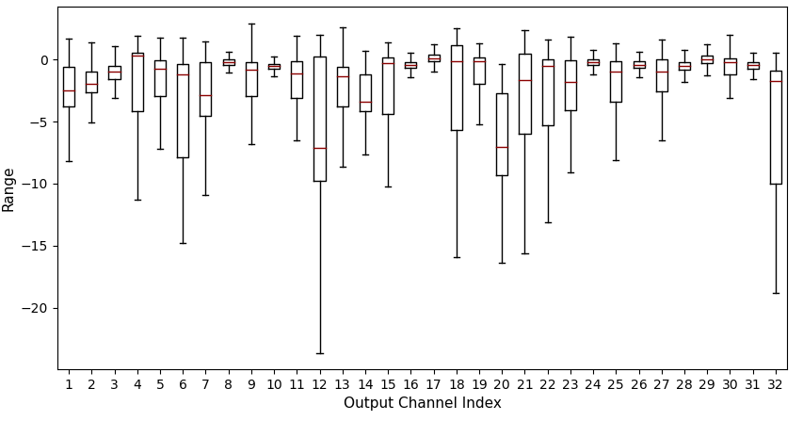
Activation Equalization
Activation Equalization:
To equalize the ranges of activation between different channels
$$x^{l−1}∙s^{l−1}$$
$$w^{l}{\left(s^{l−1}\right)}^{−1}$$
convolution output
Layer l-1
convolution kernel
Layer l
Figure 7. The first 32 channel output ranges of the second convolution layer in synthesis before equalization.
Figure 8. Illustration of equalization for a channel.
Equalization coefficient:
Incorporate scales into weight:
$$s^{l−1}=\frac{2^{n}}{r^{l−1}}$$
$${\hat{w}}^{l−1}=w^{l−1}∙s^{l−1}, {\hat{b}}^{l−1}=b^{l−1}∙s^{l−1}$$
Two- step activation equalization:
Scales are combined with weight,
so no additional storage space is required.
$${\hat{x}}^{l−1}=x^{l−1}∙s^{l−1}, {\hat{w}}^{l}=w^{l}{\left(s^{l−1}\right)}^{−1}$$

Slide 12
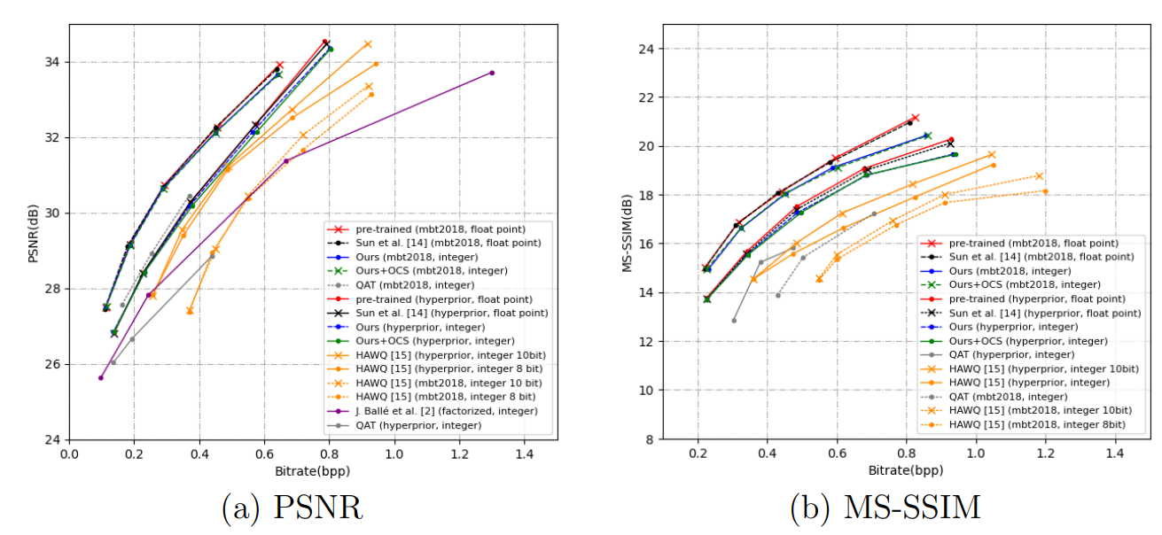
Experiment Results
Rate-distortion performance:
our performance is only lower than the floating-point model and better than other existing integer-only networks.
Figure 9. R-D performance comparison of different quantization methods.

Slide 13
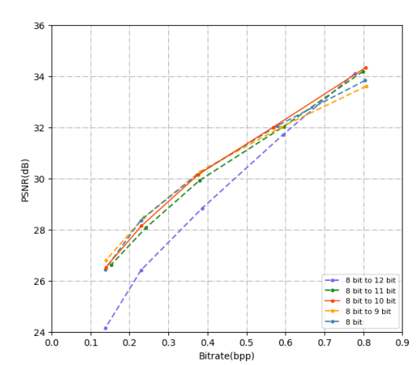
Ablation Studies For Internal Bit Width Increment
R-D performance at high bit-rates decreases under low precisions (e.g., 8-bit or 9-bit) in comparison to high precision.
Excessively high precision (e.g., 12-bit) could lead to zero $Sc_{int}$ and lose information.
Figure 10. Ablation study of internal bit-width increment on Kodak that raises the precision of weights from 8 bit to 9–12 bits.

Slide 14
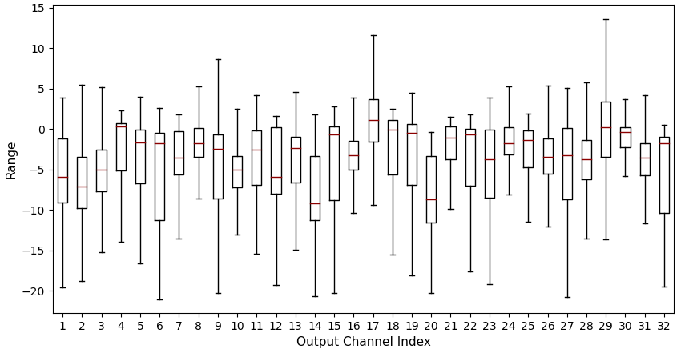
Ablation Studies For Activation Equalization
Equalization effectively compensates for the loss caused by quantization.
Figure 11. The first 32 channel output ranges of one convolution before (left) and after (right) equalization.
Table 1. Comparison of R-D performance of the full-precision model and the proposed fully-integerized models with (w/) and without (w/o) equalization under different λ.

Slide 15
Conclusion
we propose a novel fully-integerized model for learned image compression using per-channel weight quantization and activation quantization.
We develop internal bit width increment for integer convolution and equalize the channel distribution of activations to further improve R-D performance. We also apply OCS to realize INT8 models.
The proposed model achieves a reduction of 75% in storage cost with subtle loss in R-D performance compared with the full-precision pretrained model and outperforms existing integer networks.

Slide 16
Q & A
Many Thanks

