Slide 1
SPARSE DATA CORRECTION FOR PMU DATA UNDER GPS SPOOFING ATTACKS
Authors - Shashini De silva, Travis Hagan, Jinsub Kim and E.C.Sanchez

Slide 2
Acknowledgement
CREDC
This material is based upon work supported by the Department of Energy under Award Number DE-OE0000780.
Notes:
….
In order to get meaningful information out of measurements collected at different places, they need to be aligned in time

Slide 3
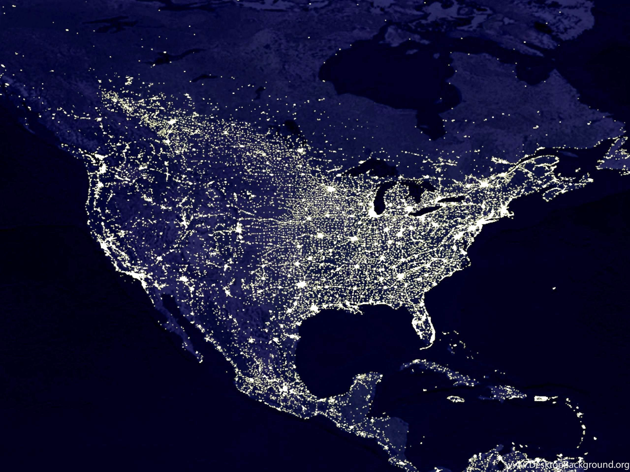
Introduction
Power network is a HUGE interconnected network!
Notes:
….
In order to get meaningful information out of measurements collected at different places, they need to be aligned in time

Slide 4
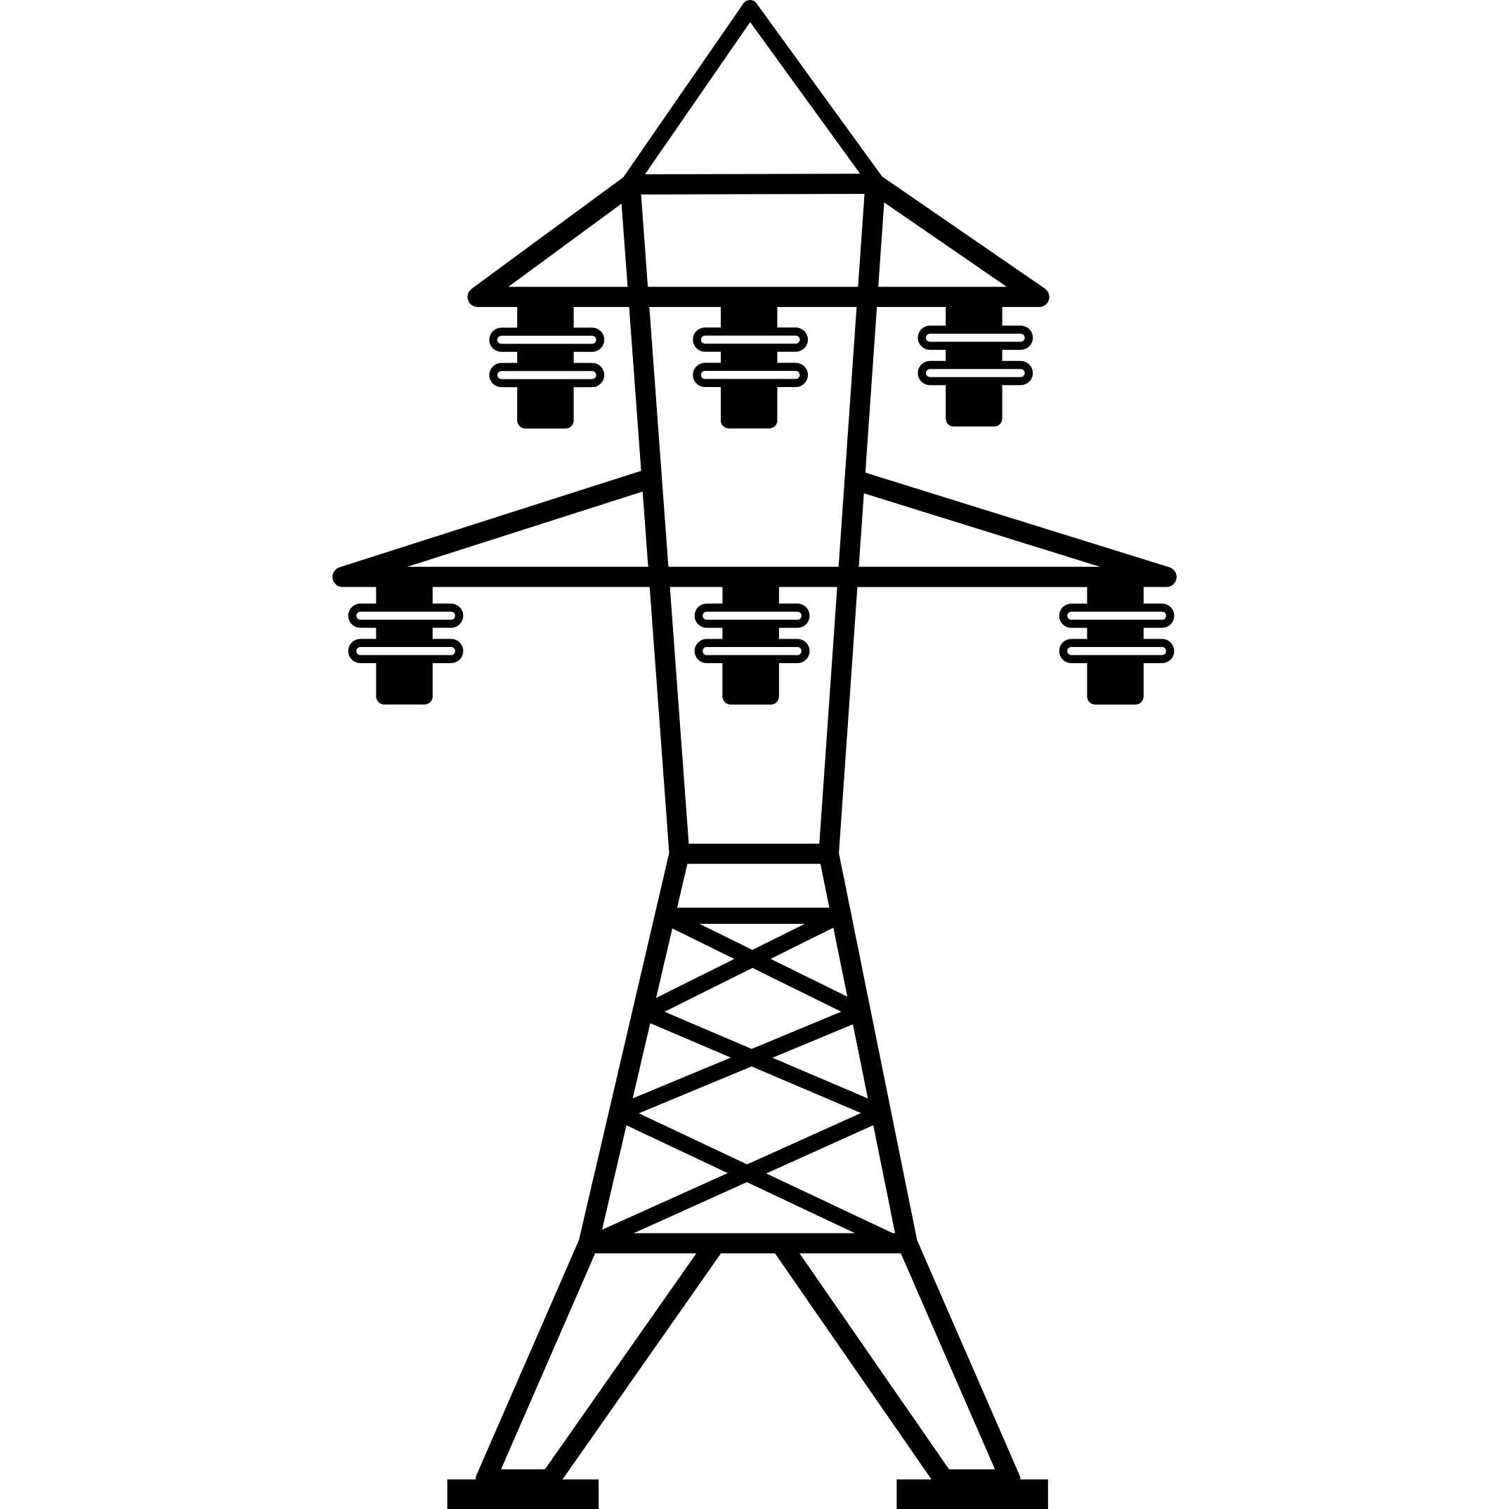
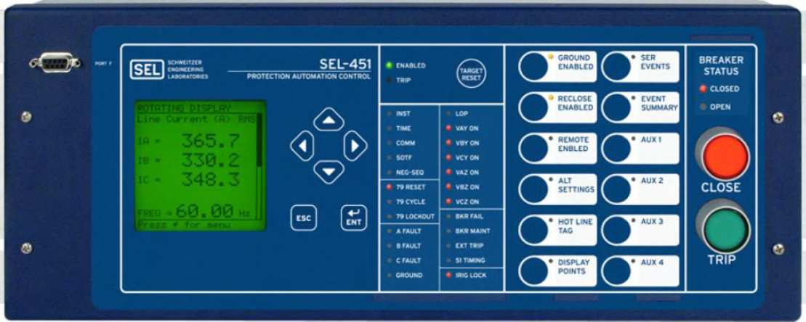
Wide area synchronization
Time synchronized measurements
Phasor measurement units (PMUs)
$$V_{n}$$
$$I_{nk}$$
$$I_{nj}$$
$$I_{nl}$$
n
k
j
l
m
Notes:
…
Universal time stamp!

Slide 5
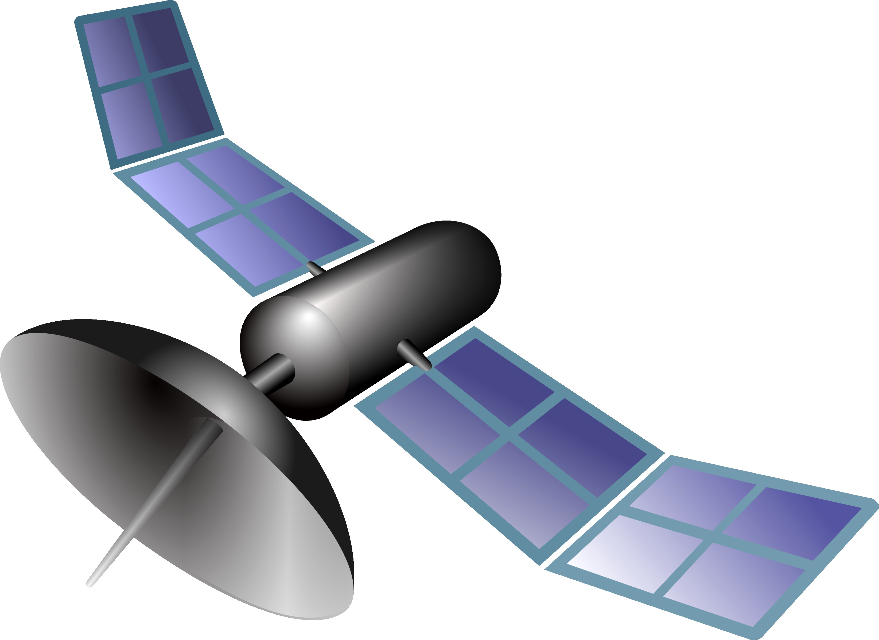
GPS based time synchronization
t
t
t

Slide 6
GPS spoofing attack on PMU
t
$$\overline{t}$$
t
t
t
Notes:
…
When the time stamp is shifted, measurements from that bus loose synchronization.

Slide 7
GPS spoofing attack on PMU
t
$$\overline{t}$$
t
t
t

Slide 8
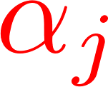
Unique property
All phase angle measurements from attacked PMU are affected by the same amount.
n
k
angle shift
=
j
$$\overline{t}$$
t
l
m

Slide 9
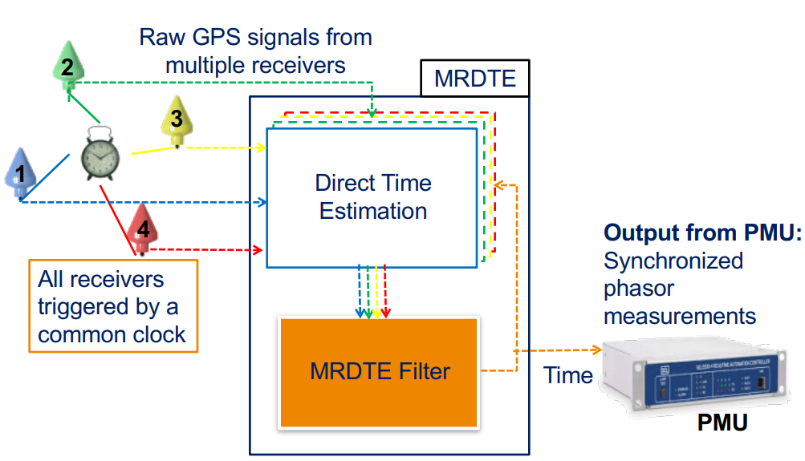
Related work
Bhamidipati ION 2016 : Multi-receiver GPS Based Direct Time Estimation for PMUs
Limitations - External hardware (etc. clocks, multiple receivers)

Slide 10
Related work
Fan IEEE Transactions on Smart Grid 2017 : Synchrophasor data correction under GPS spoofing attack - A state estimation based approach
Leverage unique property of GPS spoofing attacks
Estimate the angle shift using golden search algorithm
Limitations - Assume single PMU is spoofed in the network
Notes:
Exhaustive grid search (0 to 2*pi) -> Golden search successfully reduce the range of search. The objective duntion they are minimizing has a unimodal minimizer.

Slide 11
Related work
Risbud IEEE Transactions on Smart Grid 2018 : Vulnerability analysis of smart grids to GPS spoofing
Leverage unique property of GPS spoofing attacks
Alternate minimization algorithm for joint state estimation and attack reconstruction
Limitations - Requires observability of the network
Notes:
Sparsity of the attack has not been utilized

Slide 12
Our objective
Correct PMU data, exploiting
the unique property of GPS spoofing
the low dimensional space of legitimate PMU data
the sparse nature of attacks

Slide 13
PMU measurement model
Notes:
PMU measurements collected from a network of buses connected to the power grid is governed by the krchoff’s current and kirchoff’c voltage laws. Therefore we can model PMU measurements, that is current and voltage measurements using the network parameters and network topology.

Slide 14
Attack model
All phase angle measurements from attacked PMU are affected by the same amount.

Slide 15
Attack model
=
$$×$$

Slide 16
Attack model
=
Sparse vector
.
.
.
Attack Locations
Attack Magnitudes
Notes:
Alpha g

Slide 17
Combined model
Column space of
Notes:
…..
With true alpha , phi inverse alpha times z bar lies very close to column space of H. The distance is due to a small perturbation caused by measurement noise.

Slide 18
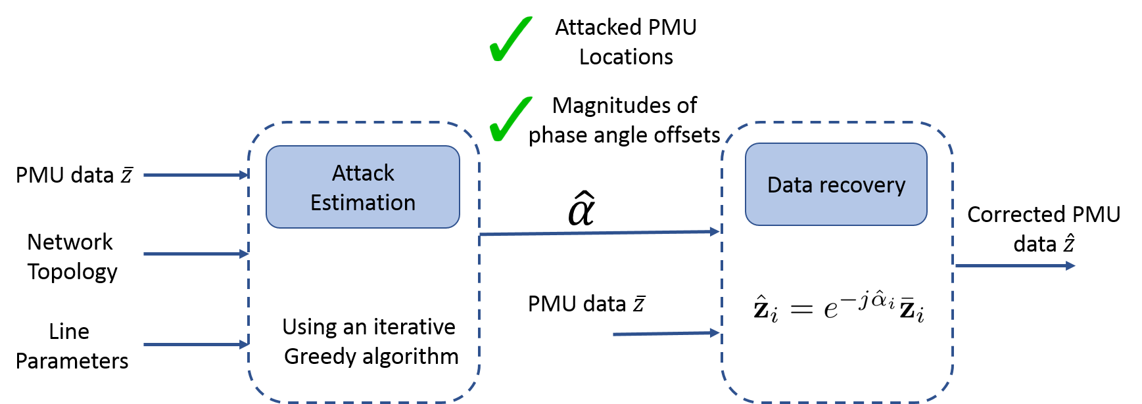
Approach

Slide 19
Optimization problem
Estimate
Notes:
We can address this problem as an optimization problem. Our objective is to find the sparsest alpha which gives a residue less than a threshold tau. Tau is set based on noise statistics.

Slide 20
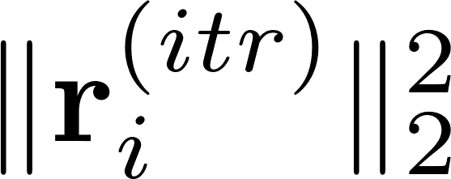
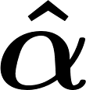
Greedy approach
Select the with largest average
$$\left[\begin{matrix}r_{1} \\ \begin{matrix}r_{2} \\ \begin{matrix}\begin{aligned}. \\ . \\ .\end{aligned} \\ r_{K}\end{matrix}\end{matrix}\end{matrix}\right]$$
Update the support of
Find that minimize
Iterate until
Update

Slide 21
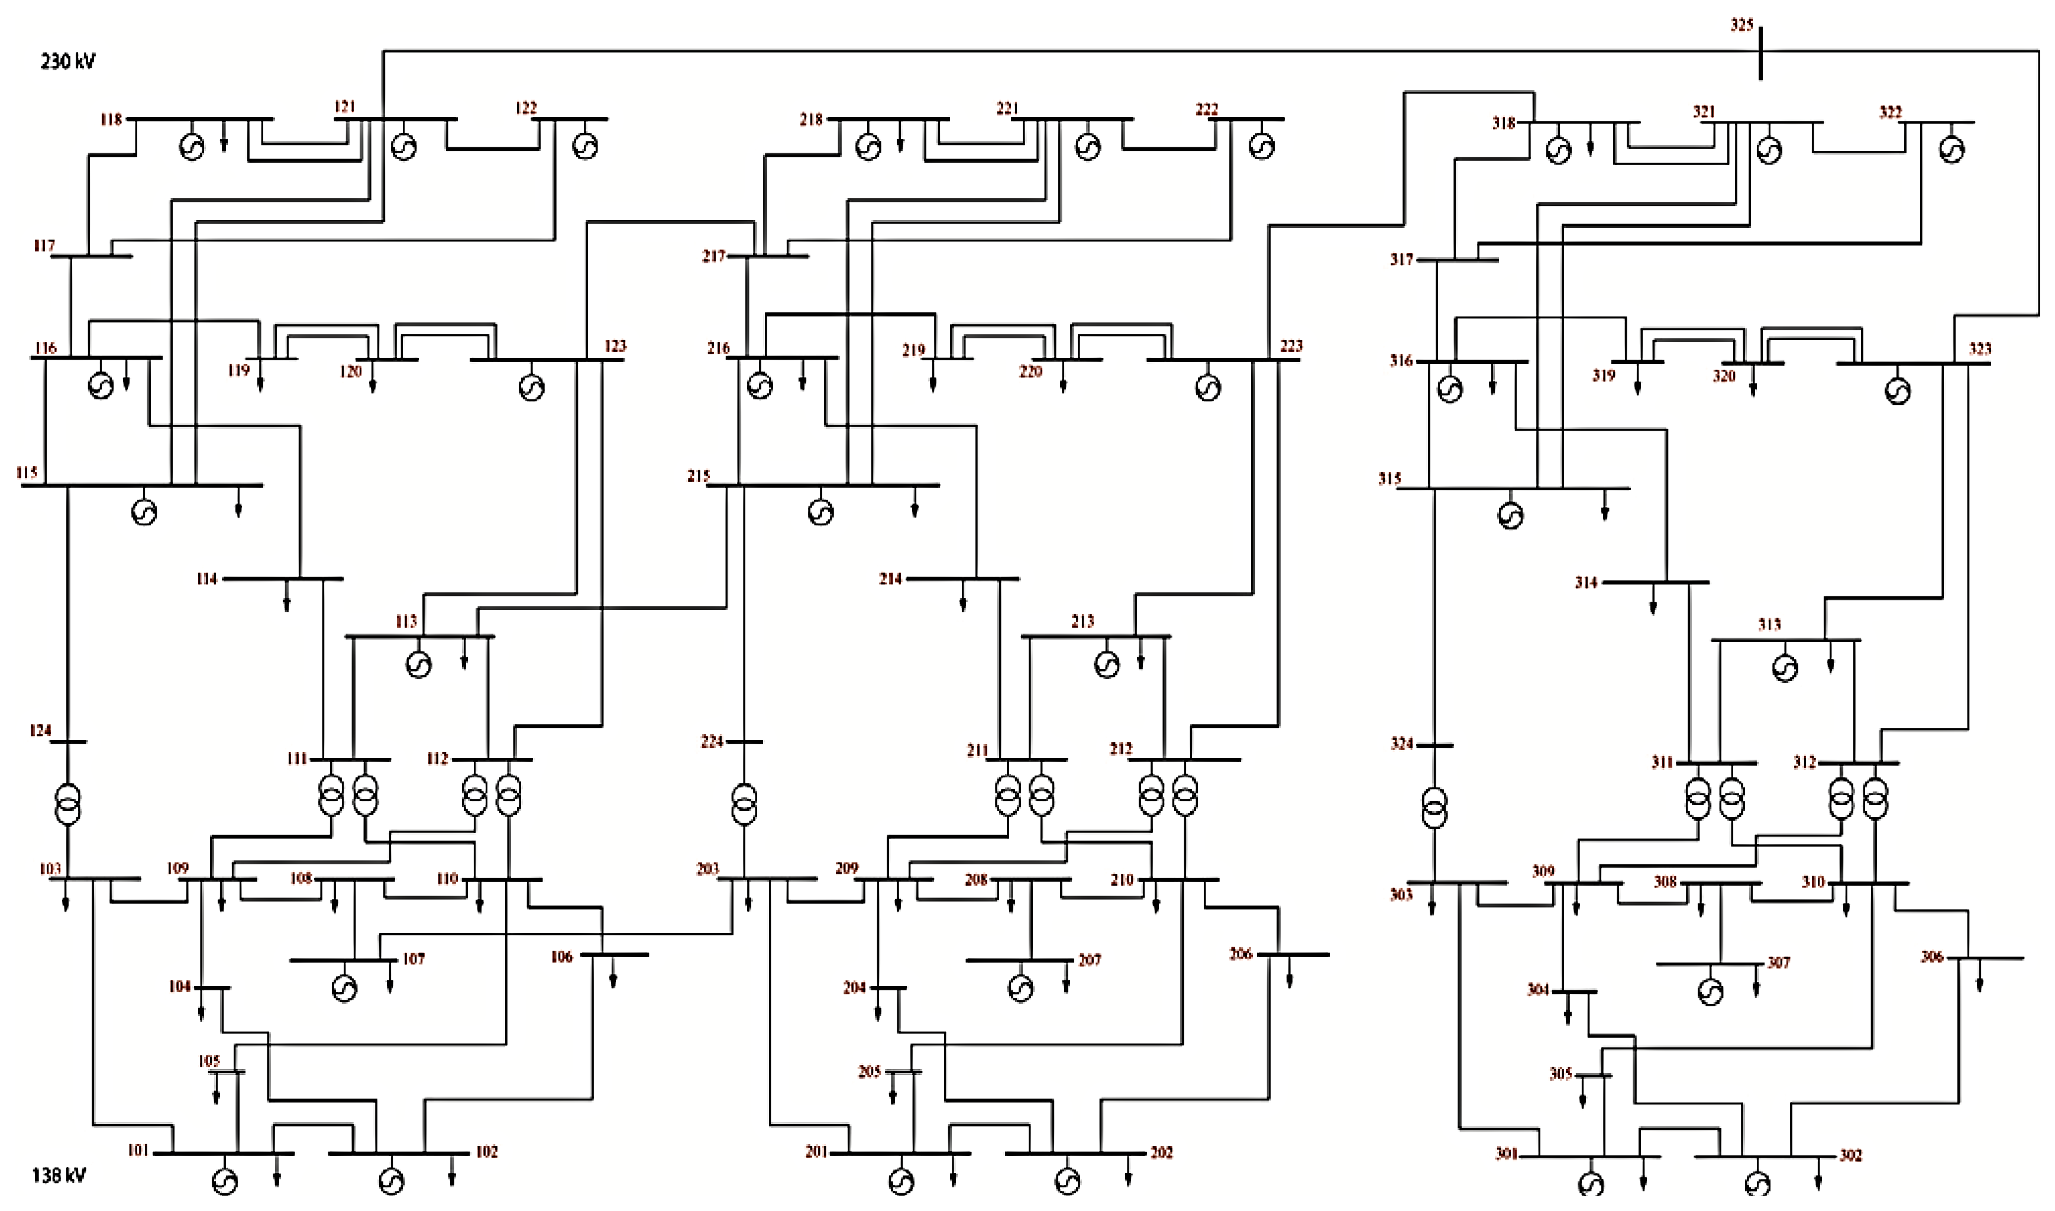
Experiments
IEEE RTS 96 test network
3 areas
73 buses
A
B
C
Notes:
Observability through PMUs is a luxury

Slide 22
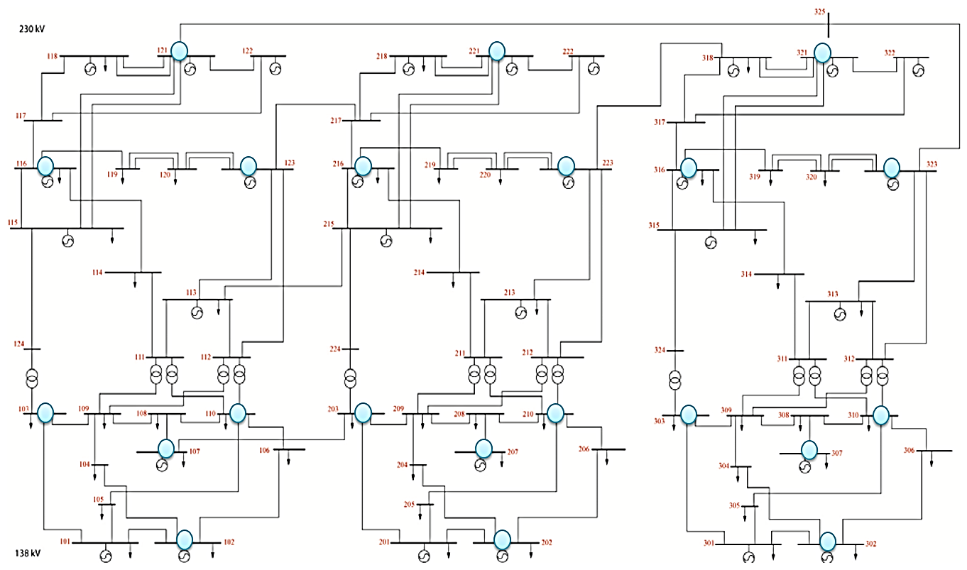
Observable PMU placement
IEEE RTS 96 test network
A bus with PMU
A
B
C

Slide 23
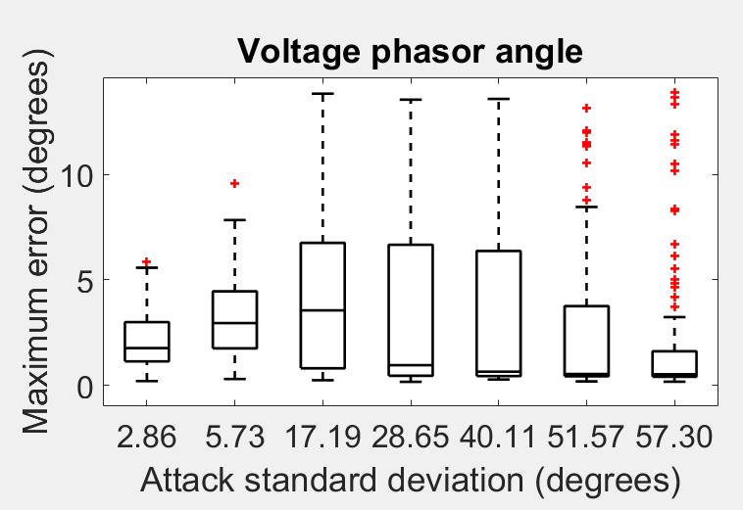
Results – observable network
Outliers
$Q_{3}$ + 1.5 ($Q_{3}$ - $Q_{1}$)
Maximum point which is not an outlier
Maximum absolute angle error (degrees)
Third quartile - $Q_{3}$
Median - $Q_{2}$
First quartile - $Q_{1}$
Minimum point which is not an outlier
$Q_{1}$ - 1.5 ($Q_{3}$ - $Q_{1}$)
Outliers

Slide 24
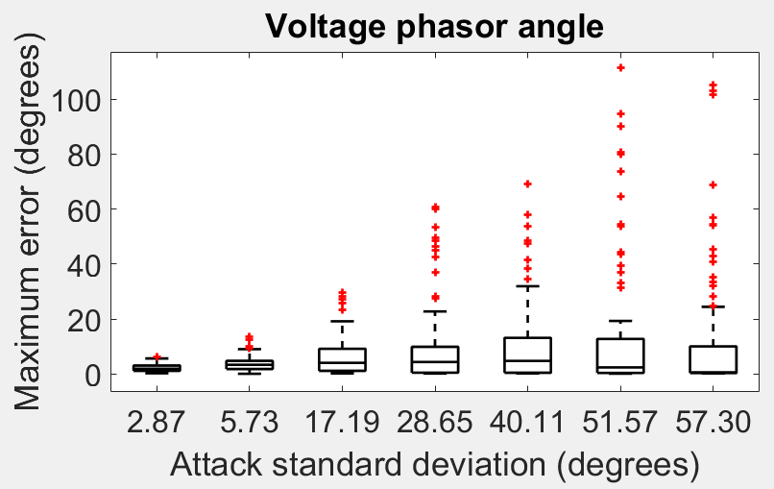
Results – unobservable network
Outliers
$Q_{3}$ + 1.5 ($Q_{3}$ - $Q_{1}$)
Maximum point which is not an outlier
Maximum absolute angle error (degrees)
Third quartile - $Q_{3}$
Median - $Q_{2}$
First quartile - $Q_{1}$
Minimum point which is not an outlier
$Q_{1}$ - 1.5 ($Q_{3}$ - $Q_{1}$)
Outliers
Notes:
Observability through PMUs is a luxury, since deploying PMUs are quite expensive.

Slide 25
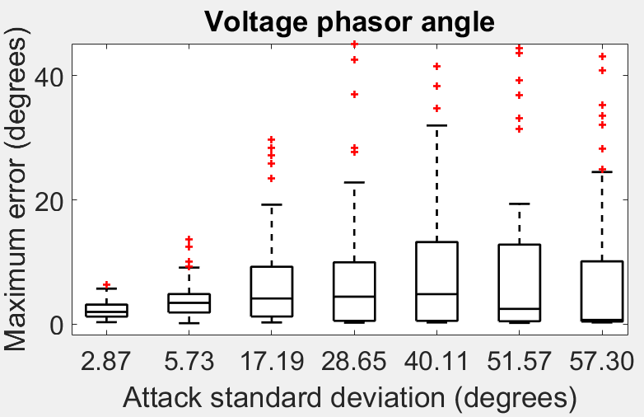
Results – unobservable network
Outliers
$Q_{3}$ + 1.5 ($Q_{3}$ - $Q_{1}$)
Maximum point which is not an outlier
Maximum absolute angle error (degrees)
Third quartile - $Q_{3}$
Median - $Q_{2}$
First quartile - $Q_{1}$
Minimum point which is not an outlier
$Q_{1}$ - 1.5 ($Q_{3}$ - $Q_{1}$)
Outliers
Notes:
Observability through PMUs is a luxury, since deploying PMUs are quite expensive.

Slide 26
Conclusion
What we did ?
Correct falsified PMU data under GPS spoofing attacks
How ?
Exploit the unique property of GPS spoofing attacks and sparse nature of attack
Future ?
Extend to leverage SCADA measurements
Vulnerability analysis

Slide 27
Thank you

Slide 28
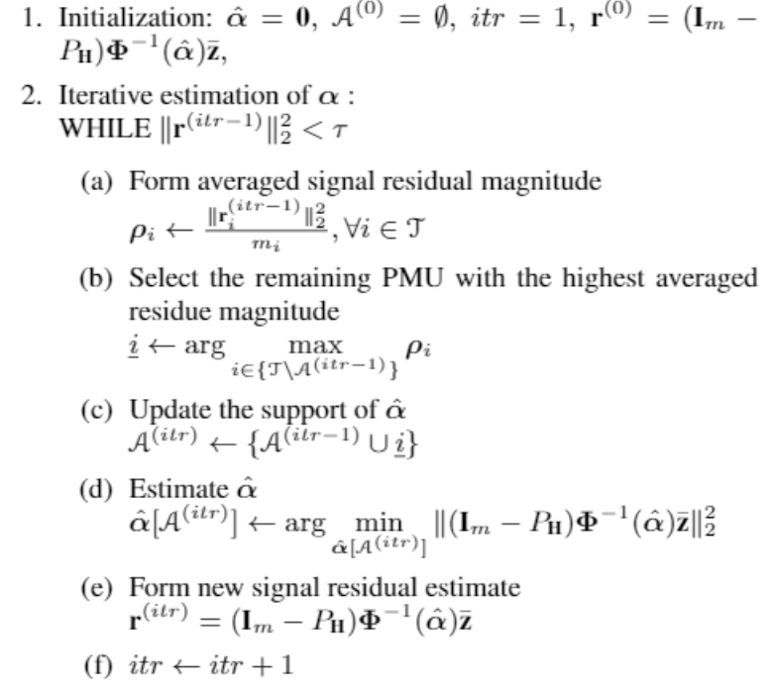

Slide 29
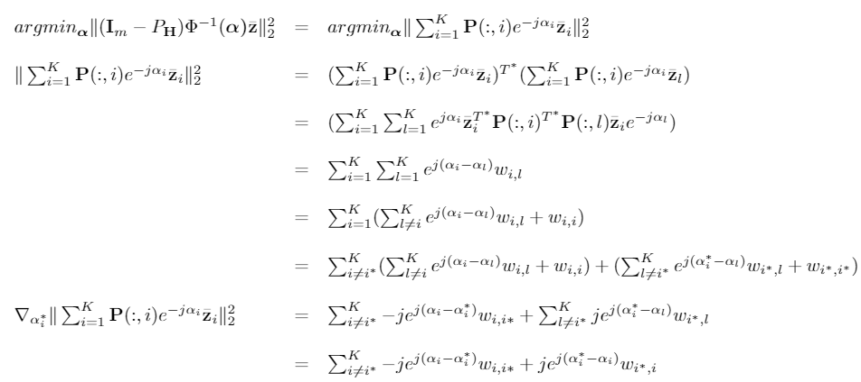
Gradient descent

Slide 30
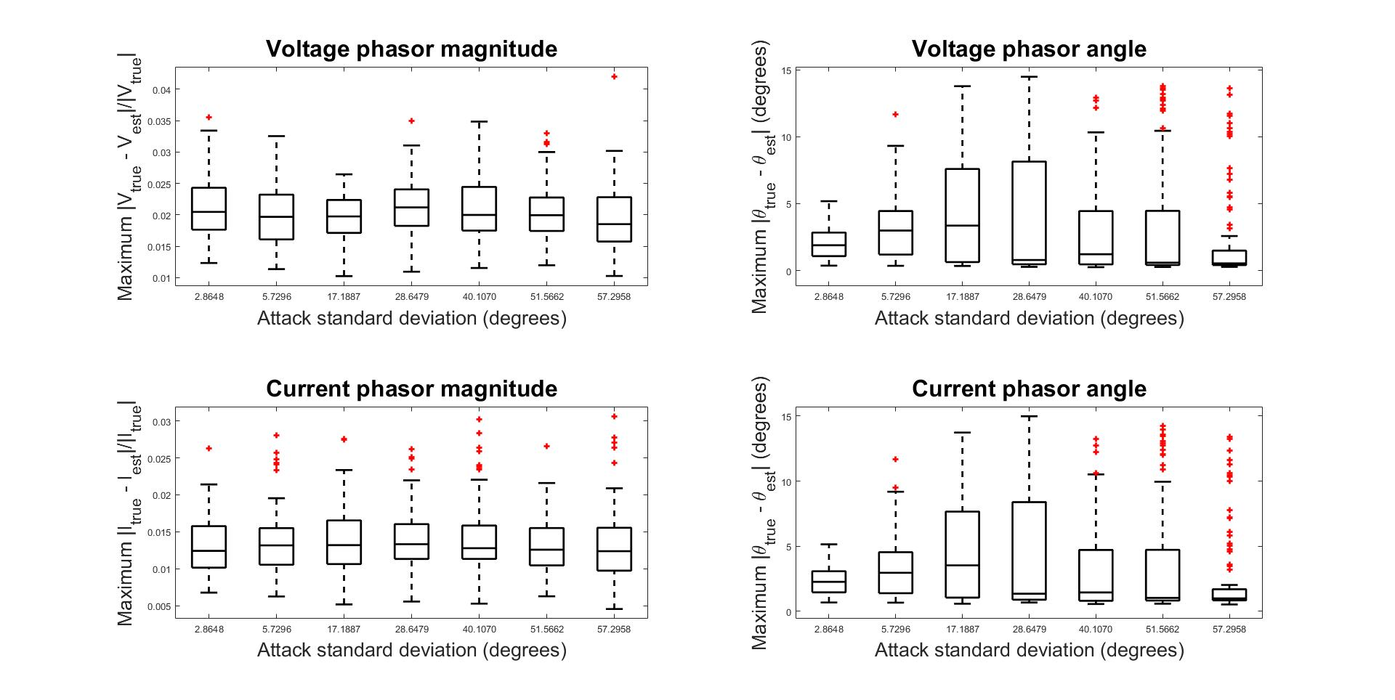
Results – observable network
Notes:
Observability through PMUs is a luxury

Slide 31
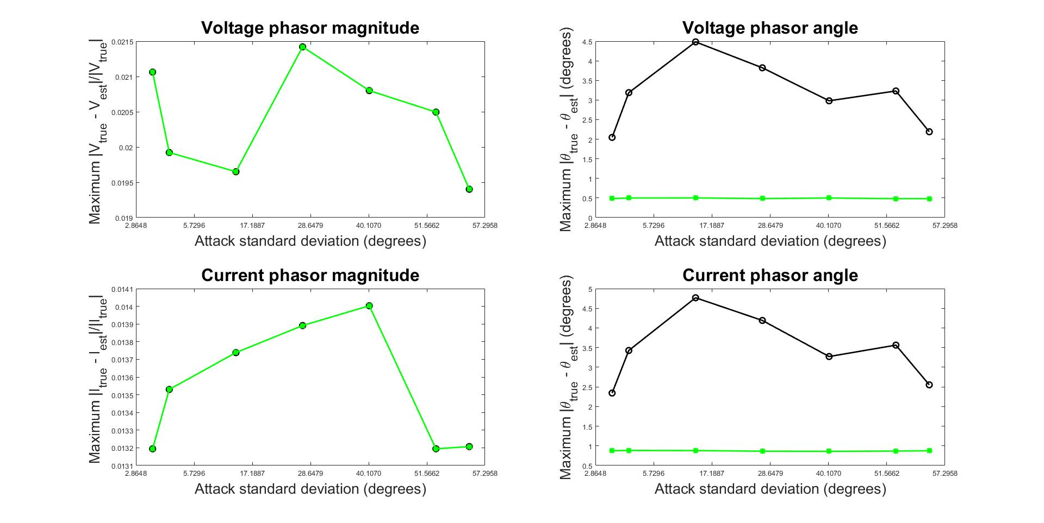
Results – observable network

Slide 32
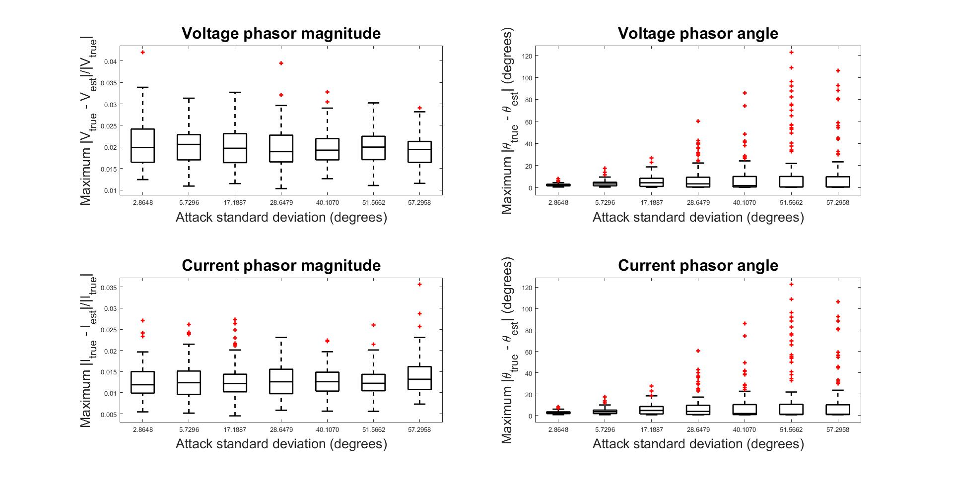
Results – unobservable network
Notes:
Observability through PMUs is a luxury

Slide 33
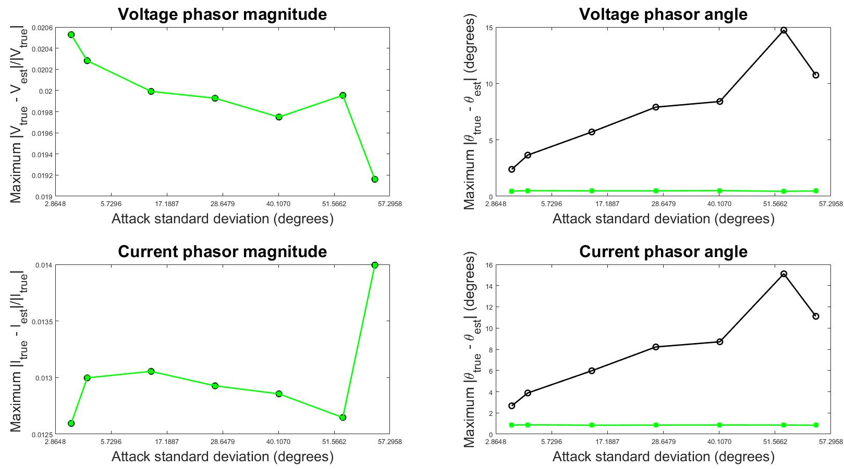
Results – unobservable network

Slide 34
Results – observable network
Outliers
$Q_{3}$ + 1.5 ($Q_{3}$ - $Q_{1}$)
Maximum point which is not an outlier
Maximum absolute angle error (degrees)
Third quartile - $Q_{3}$
Median - $Q_{2}$
First quartile - $Q_{1}$
Minimum point which is not an outlier
$Q_{1}$ - 1.5 ($Q_{3}$ - $Q_{1}$)
Outliers
Notes:
We randomly attacked two PMUs in the region C.
The attack was formed as a gaussian distribution with zero mean and a non zero standard deviation. The plot here shows the recovery performance in terms of the maximum absolute angle error happened in the network as we increase the attack standard deviation for 100 monte carlo runs . These plots are box plots, the legend here shows how to read these plots. ….

Slide 35
Results – unobservable network
Outliers
$Q_{3}$ + 1.5 ($Q_{3}$ - $Q_{1}$)
Maximum point which is not an outlier
Maximum absolute angle error (degrees)
Third quartile - $Q_{3}$
Median - $Q_{2}$
First quartile - $Q_{1}$
Minimum point which is not an outlier
$Q_{1}$ - 1.5 ($Q_{3}$ - $Q_{1}$)
Outliers

