Slide 1
FM-Indexing Grammars Induced by Suffix Sorting for Long Patterns
Jin-Jie Deng¹, Wing-Kai Hon¹, Dominik Köppl², Kunihiko Sadakane³
Tsing Hua University¹
Hsinchu, Taiwan
Tokyo Medical and Dental University²
Tokyo, Japan
The University of Tokyo³
Tokyo, Japan

Slide 2
Text index
Given an input text T on integer alphabet Σ
A text index is a data structure built on T supporting the following query for a pattern P:
count(T,P): return number of occurrences of P in T
Example:
T = abbabbababbab$
P = abbab
⇒ count(T,P) = 3
Special character being smaller than all characters in text

Slide 3
Text indexes
BWT-based
FM-index [Ferragina & Manzini ‘00]
RLFM [Mäkinen & Navarro ‘05]
RLCSA [Sirén ‘12]
Geometric BWT [Chien et al ‘15]
Faster-Minuter [Gog et al. ‘16]
r-index [Gagie et al. ‘20]
sr-index [Cobas et al. ‘21]
Grammar-based
GCIIS [Akagi et al. ‘21] [Diaź et al. ‘21]
Optimal-time dictionary-compressed indexes [Christiansen et al. ‘20]
ESP-index [Maruyama et al. ‘13]
LZ-index [Navarro ‘09]

Slide 4
FM-index: construction
BWT of T
[Burrows & Wheeler ‘94]
T = abbabbababbab$
|T| rotations of T
sorted in lexicographic order
FM-index
F L
$abbabbababbab
ab$abbabbababb
ababbab$abbabb
abbab$abbabbab
abbababbab$abb
abbabbababbab$
b$abbabbababba
bab$abbabbabab
bababbab$abbab
babbab$abbabba
babbababbab$ab
bbab$abbabbaba
bbababbab$abba
bbabbababbab$a
abbabbababbab$
bbabbababbab$a
babbababbab$ab
abbababbab$abb
bbababbab$abba
bababbab$abbab
ababbab$abbabb
babbab$abbabba
abbab$abbabbab
bbab$abbabbaba
bab$abbabbabab
ab$abbabbababb
b$abbabbababba
$abbabbababbab
$abbabbababbab
ab$abbabbababb
ababbab$abbabb
abbab$abbabbab
abbababbab$abb
abbabbababbab$
b$abbabbababba
bab$abbabbabab
bababbab$abbab
babbab$abbabba
babbababbab$ab
bbab$abbabbaba
bbababbab$abba
bbabbababbab$a

Slide 5
FM-index: counting
count(T,P) is reduced to |P| steps of backward-searching
rank(L,i,c) is the most expensive operation at each step
rank(L,i,c)
return number of occurrences of character c in L[1..i]
could be supported in O(log|Σ|)-time while storing L as wavelet tree [Grossi et al. ‘03]
F L
$₁abbabbababbab₁
a₁b$abbabbababb₂
a₂babbab$abbabb₃
a₃bbab$abbabbab₄
a₄bbababbab$abb₅
a₅bbabbababbab$₁
b₁$abbabbababba₁
b₂ab$abbabbabab₆
b₃ababbab$abbab₇
b₄abbab$abbabba₂
b₅abbababbab$ab₈
b₆bab$abbabbaba₃
b₇bababbab$abba₄
b₈babbababbab$a₅
Example:
T = abbabbababbab$
P = a b b a b
⇒ count(T,P) = 3

Slide 6
Geometric BWT [Chien et al. ‘15]
λ-factorization (λ : fixed integer)
grouping λ consecutive characters to a meta-character fitting into a single machine word
…
Separator of λ-factorization
(only for visualization)
Example:
λ = 2
T = ab·ba·bb·ab·ab·ba·b ·$
P = a·bb·ab (and ab·ba·b )
⇒ count(T,P) = 3
F L
$₁·ab·ba·bb·ab·ab·ba·b ₁
ab₁·ab·ba·b · $·ab·ba·bb₁
ab₂·ba·b · $·ab·ba·bb·ab₁
ab₃·ba·bb·ab·ab·ba·b · $₁
b ₁· $·ab·ba·bb·ab·ab·ba₁
ba₁·b · $·ab·ba·bb·ab·ab₂
ba₂·bb·ab·ab·ba·b · $·ab₃
bb₃·ab·ab·ba·b · $·ab·ba₂

Slide 7
S*-factorization
Borrowed from SAIS [Nong et al. ‘09] and applied in GCIS [Nunes et al. ‘18]
S-type
T [i] < T [i + 1] or
T [i] = T [i + 1] and T [i + 1] is S-type
L-type
T [i] > T [i + 1] or
T [i] = T [i + 1] and T [i + 1] is L-type
S*-type
$ or
T [i] is S-type or T [i - 1] is L-type
S*-factor
T [i .. j]
T [i] is S*-type and T [j + 1] is S*-type, or
i = 1 and T [j + 1] is S*-type
Example:
T = b | a a b | a b b | a b | $
L S* S L S* L L S* L S*
Separator of S*-factorization
(only for visualization)

Slide 8
FIGISS: construction
S*-λ-Factorization
T = a b b a b b a b a b b a b $
S* L L S* L L S* L S* L L S* L S*
applying S*-factorization on text
T = a b b | a b b | a b | a b b | a b | $
S* L L S* L L S* L S* L L S* L S*
applying λ-factorization on S*-factors
(e. g. λ = 2)
T = a b · b | a b · b | a b | a b · b | a b | $
S* L L S* L L S* L S* L L S* L S*

Slide 9
FIGISS: counting
Given a pattern P
Applying S*-λ-factorization on P
Matching P in T depending on its “length”
Long: multiple S*-factores
Short: single S*-factor and |P| > λ
Ultra-short: single S*-factor and |P| ≤ λ
Example:
T = a b · b | a b · b | a b | a b · b | a b | $
S* L L S* L L S* L S* L L S* L S*
Long
P = a b . b | a b
S* L L S* L
Short
P = a b . b
S* L L
Ultra-short
P = a b
S* L

Slide 10
FIGISS: counting long patterns
…
F L
$₁ ab b ab b ab ab b ab₁
ab₁ $ ab b ab b ab ab b ₁
ab₂ ab b ab $ ab b ab b ₂
ab₃ b ab $ ab b ab b ab₂
ab₄ b ab ab b ab $ ab b ₃
ab₅ b ab b ab ab b ab $₁
b ₁ ab $ ab b ab b ab ab₂
b ₂ ab ab b ab $ ab b ab₃
b ₃ ab b ab ab b ab $ ab₄
Example:
T = a b · b | a b · b | a b | a b · b | a b | $
S* L L S* L L S* L S* L L S* L S*
P = a b . b | a b
S* L L S* L

Slide 11
FIGISS: counting short patterns
Counting short pattern is as what geometric BWT does
Example:
T = a b · b | a b · b | a b | a b · b | a b | $
S* L L S* L L S* L S* L L S* L S*
P = a b . b
S* L L
⇒ Count(T,P) = 3

Slide 12
FIGISS: counting ultra-short patterns
Generalized suffix tree of all factors in the S*-λ-factorized text
Example:
T = a b · b | a b · b | a b | a b · b | a b | $
S* L L S* L L S* L S* L L S* L S*
P = a b
S* L
⇒ count(T,P) = 5
8
b
count of concatenated labels on root-to-node path
a
b
5
5

Slide 13
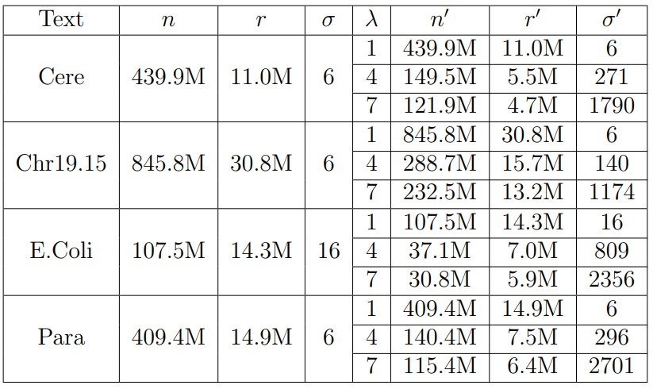
Experiments: dataset
Texts
Cere, E. Coli, and Para are from Pizza & Chili Repetitive Corpus
Chr19.15 is concatenation of 15 individual sequences of the human chromosome 19
n : length of text
r : number of maximal character runs in BWT (of text)
σ : size of alphabet
n’, r’, and σ’ are corresponding notation with respect to S*-λ-factorized text

Slide 14
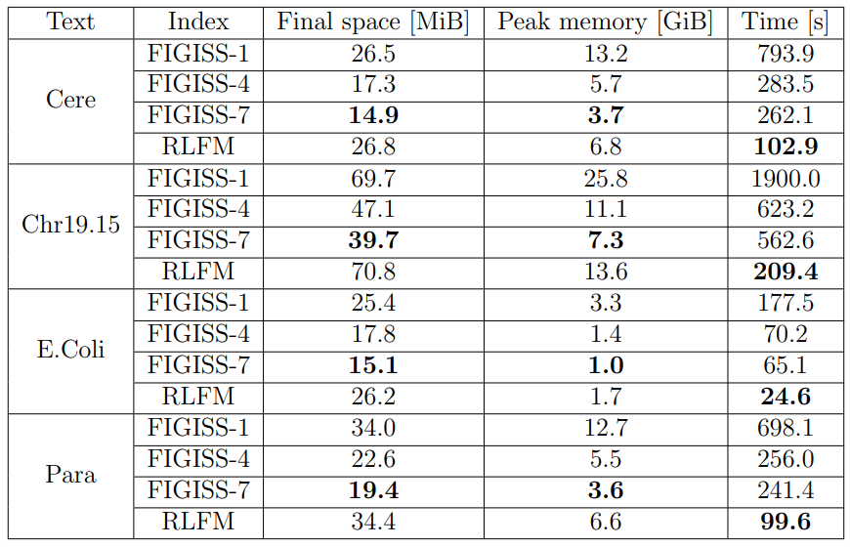
Experiments: construction
FIGISS-λ
λ = 1, 4, and 7
RLFM
[Mäkinen & Navarro ‘05]
Pros
Space-efficient
Final space
Peak memory
Cons
Slow construction time

Slide 15
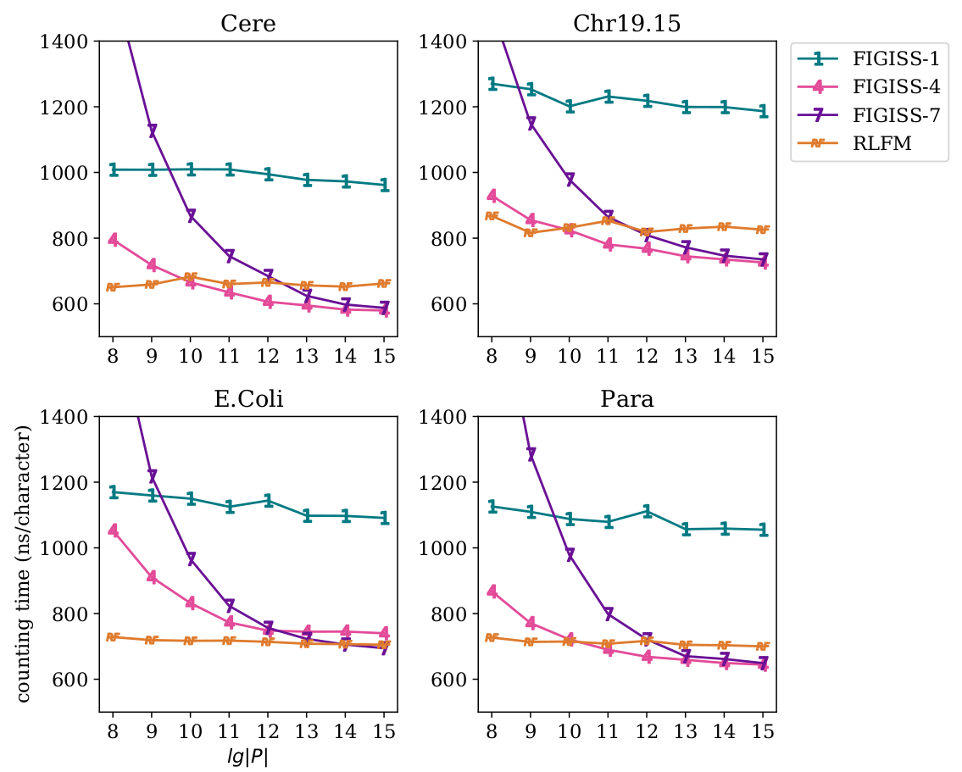
Experiments: counting time
Competitive with RLFM when counting long patterns

Slide 16
Summary
FIGISS is a text index supporting counting queries for a pattern P
Pros : S*-λ-factorization for compressing the text and skipping backward-searching steps
Cons : Additional costs for looking up grammar rules and factorizing P during counting
Experiments show that FIGISS is
space-efficient in terms of final index and peak memory during construction
suitable for counting long patterns
Future Work
Supporting locating queries via sampling on suffix array of S*-λ-factorized text
Recursive application of the S*-factorization like [Akagi et al. ‘21] [Diaź et al. ‘21]
Alternative factorization using string synchronizing sets [Kempa & Kociumaka ‘19]

