Slide 1
Dictionary Update for NMF-based Voice Conversion Using an Encoder-Decoder Network
Chin-Cheng (Jeremy) Hsu, Hsin-Te Hwang, Yi-Chiao Wu, Yu Tsao, and Hsin-Min Wang Institute of Information Science, Academia Sinica, Taipei, Taiwan
Research Center for Information Technology Innovation, Academia Sinica, Taipei, Taiwan
{jeremycchsu, hwanght, tedwu, whm}@iis.sinica.edu.tw, yu.tsao@citi.sinica.edu.tw
Notes:
Good morning, everyone. My name is Jeremy. Our team is from Academia Sinica, Taiwan.
I’d like to introduce our work: Dictionary Update for NMF-based Voice Conversion Using an Encoder-Decoder Network.
While the name is long, I’ll make sure that the story be short.

Slide 2
Outlines
The problem: Voice Conversion (1)
Prior work: Exemplar-based NMF (3)
Our method (5)
Demo (4)
Conclusions (1) & Future Work (2)
Notes:
Our introduction has 5 sections.
First, I’ll state the main task (which is Voice Conversion, or VC).
Second, I’ll briefly trace one of the most popular frameworks to deal with the task of VC.
Third, I’ll present our solution to the shortcomings of that conventional approach.
The fourth part is demonstration.
And finally, I’ll concludes this paper and point out our future work.

Slide 3
Problem: Voice Conversion
Goal:
convert “voice (perceived speaker identity)”
while preserving “contents.”
Simplified version:
convert “spectrum” from parallel corpora
Notes:
So let’s begin with the task we’re focusing on-- Voice Conversion.
I believe most of you watch the famous anime “Detective Conan” and know what voice conversion is.
For those who don’t, I shall explain it a little bit:
Given an utterance from a known source speaker, we want to convert it so that it sounds like another specified speaker.
Initially, the goal was to convert “voice,” or technically speaking, “the perceived speaker identity” to a target speaker.
However, in this work, we only focused on converting the smoothed spectral features.

Slide 4
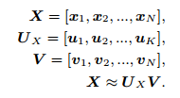
Prior Work: ENMF (1/2)
Exemplar-based NMF framework
Pre-select a source & a target dictionary.
Obtain an activation by reconstructing a source input.
Predict the ourput by activating the target dictionary.
Input frames
of source speaker
Dictionary
(Bases)
Activation
weights
Reconstructed frames
$$X≈U V$$
X
≈
$$U_{X}$$
$$×$$
V
$$=$$
$$\hat{X}$$
$$D×N$$
$$D×K$$
$$K×N$$
$$U_{Y}$$
$$×$$
$$=$$
$$\hat{Y}$$
parallel
dictionary
Converted frames
*shared weights
Notes:
Under this scenario, a perfect match for voice conversion is the Exemplar-based non-negative matrix factorization (ENMF, for short).
ENMF
Selects frames (usually randomly) of the source from the corpus as the source dictionary (Ux).
It then Finds corresponding frames of the target speaker as the target dictionary (Uy).
With these dictionaries keep fixed, the goal is to find the activation V that reconstructs the input.
Multiplying Uy to the shared V yields converted speech.

Slide 5
Prior Work: ENMF (2/2)
Advantages
Acceptable quality
Reasonable similarity to the target
Applicable on-the-fly (without training phases)
Disadvantages
Slow conversion (solving V iteratively during conversion)
Less scalable (voice quality of output is somewhat proportional to dictionary size)
Trade-off between performance and speed
Notes:
The framework of ENMF with the idea of shared activation has several advantages.
The resulting speech from conversion has acceptable voice quality and reasonable similarity to the target.
The biggest advantage is that the framework requires no training.
The system can be applied on the fly.
However, its shortcomings confine its applicability.
First, it’s Slow because ENMF has to iteratively find the solution during the conversion phase.
Second, it’s Less scalable because the quality is proportional to the dictionary size.
And then You have to settle to a point where the conversion time and the voice quality are both acceptable.
The solution is a trained parametric model.
But it requires dictionary update of a joint dictionary whose dimensionality is then doubled.
The problem is that we use STRAG=IGHT spectrum feature whose dim is 513.
Computation grows hugely under multiplicative update rules (or should I express it in another way?).
*Naively joining parallel dictionaries can be very time-consuming. That’s why we have to consider other means.
Retaining the first two adv.

Slide 6
Prior Work: ENMF (2/2)
ENMF (computational cost)
quality of conversion
Our desire
Level of performance saturation
NMF (expected)
ENMF
Level of acceptable performance
size of dictionary
Baseline 1
Baseline 2
Notes:
The framework of ENMF with the idea of shared activation has several advantages.
For one thing, The resulting speech from conversion has acceptable voice quality and reasonable similarity to the target.
For another, The biggest advantage is that the framework requires no training.
The system can be applied on the fly.
However, its shortcomings confine its applicability.
First, it’s Slow because ENMF has to iteratively find the solution during the conversion phase.
Second, it’s Less scalable because the quality is proportional to the dictionary size while the computational cost is quadratically proportional to the dictionary size.
Then You have to settle to a point where the conversion time and the voice quality are both acceptable.
The solution, as our title indicated, is dictionary update.
But it requires dictionary update of a joint dictionary whose dimensionality is then doubled.
The problem is that we use STRAIGHT spectral feature whose dim is 513.
Computation grows hugely under multiplicative update rules.
*Naively joining parallel dictionaries can be very time-consuming. That’s why we have to consider other means.
In our work, we reduce and amortize the cost by our network structure and the training techniques.
Before we turn to the details, let’s start from the principles.
I’ll make a conceptual explanation with a graph here.
The x-axis is the size of the dictionary; the y-axis is the quality of converted voices.
As the size of dictionary increase, the quality gets better.
This performance curve was expected, and was demonstrated previously by other researchers.
What we had expected was that the performance curve of an “authentic” NMF (with dictionary update) might outrun that of ENMF.
Therefore, we expected that an NMF with smaller dictionary might outperform an ENMF with larger dictionary.
Retaining the first two adv.

Slide 7
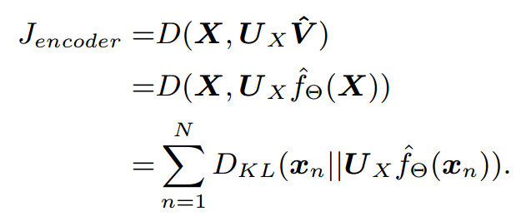
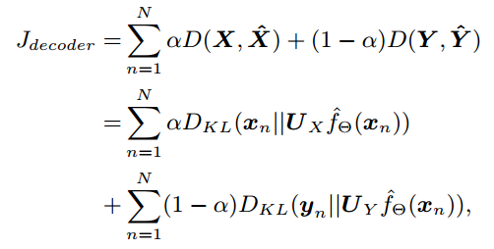
EDN: An auto-encoder re-formulation for NMF
NMF: $X ≈U_{X} V$
EDN:
1. Approximate V using an encoder
$$=D(X,\hat{X})$$
$$f\left(X\right)=\hat{V}, U_{X}\hat{V}=\hat{X}$$
2. Dictionary update using SGD
$${\hat{U}}_{X}\hat{V}=\tilde{X}$$
$${\hat{U}}_{Y}\hat{V}=\tilde{Y}$$
Source reconstruction
Target conversion
Notes:
Our solution was that we reformulated NMF as an auto-encoder.
Originally, NMF approximates an input X with a product of a dictionary U and activation V.
We then approximate the activation V via a deterministic function f.
Note that f is the encoder in auto-encoder terminology.
Then we can update the dictionaries that transform V into the source and the target, respectively.
Note that a dictionary (Ux or Uy) is the parameter set of a decoder in auto-encoder terminology.
Some readers might have found that our cost function, defined as the divergence between X and X hat, is similar to that of an NMF.
I’ll explain the training part with the next two slides.
*We chose Kullback-Leibeler divergence because the input were normalized to unit-sum.

Slide 8
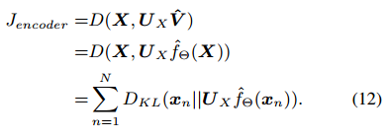
EDN: Training the Encoder
$$\hat{V}$$
$$\hat{X}$$
$$=D(X,\hat{X})$$
1. Initialize the decoder (namely, Ux) with pre-selected frames. 2. Keep Ux fixed for now.
Notes:
Training is divided into two phases.
In the first phase, training is focused on the encoder part.
The dictionary Ux was initialized using pre-selected frames and was kept fixed during this phase.
We can then feed frames from the source speaker so that the encoder learns the transformation function f(X) = V.
Multiplying V with Ux, we get the estimated X and compute the cost between X and X hat.
In our experiments, it usually took a few dozens of epoch for the encoder to converge.
To sum up, this training phase simulate an ENMF, whose dictionary is kept untouched.

Slide 9
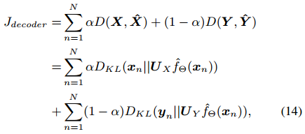
EDN: Training the whole network
$$\hat{V}$$
$$\hat{X}$$
Y
Training samples
Notes:
After the encoder training, we can then fine-tune the dictionaries (Ux and Uy).
We now update the decoders, namely, Ux and Uy through back-propagation, individually.
That’s how we avoiddc multiplicative update rule in NMF.
Here, the activation is shared, so the dimensionality is not doubled.
Dictionaries (Ux and Uy) can tehn be update “separately in form”, but “jointly in reality” with the help of the shared V.
Note that they both contribute to the encoder.
We aggregate the costs from the decoder to the source and that to the target by the equation here.
There a weighting coefficient between the two costs.
In extreme cases where alpha is set to 0, the EDN becomes a pure converter from X to Y.
While this may be tempting, the conversion result was not optimal.
We conjectured that it might have been due to the imperfect alignment of DTW.

Slide 10
EDN: Conversion
Notes:
The Conversion is straight-forward:
You feed a frame into the network, and you’ll get the activation V.
Multiplying V by the target dictionary Uy, you’ll get the converted voice.

Slide 11
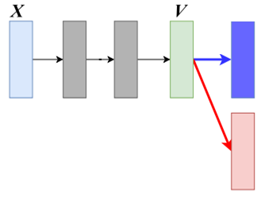
EDN: Non-Negativity
ReLU
Unit-sum
normalization
$$U_{X}$$
(same for ${\hat{U}}_{Y}$)
$${\hat{U}}_{X}$$
We used ReLU so that $V≥0$.
U’s and V’s are normalized to unit-sum.
$${\hat{U}}_{X}$$
Notes:
Finally, we are obliged to emphasize how we make U and V non-negative.
V is non-negative simply because we apply Rectifier layers as nonlinearity in the network.
For dictionaries (Us), they are non-negative for the same reason: we applied a rectifier to it, as shown in this figure.
After and during dictionary update, Ux are updated, rectified, and normalized.
The resulting Ux hat is our final dictionary.
Same for the target dictionary, Uy.
Finally, note that both U’s and V’s were normalized to unit-sum because our input X was also unit-summed.

Slide 12
Demo: Dataset & Baselines
Voice Conversion Challenge 2016
10 speakers
150 utterances/speaker for training, 12 for validation, 54 for testing.
Baselines: ENMF with sparse constraint
ENMF-512
ENMF-3000
Our model:
EDN-512
Notes:
Now let’s skim the results.
We used the data set provided by the VC challenge 2016, a freely available, compact size speech corpus.
There are 10 speakers in the corpus. 150 utt / speaker, …
Two ENMF-based systems are set to be the baselines.
One has dictionary size of 512, and the other has an expanded dictionary of size up to 3 thousand.
As for our proposed model, which we referred to as EDN, also has dictionary size of 512 (5 hundred and twelve).
We set the maximum tolerance time for conversion being that of ENMF with dictionary size of 3000.

Slide 13
Objective Evaluations
Target
Source
Notes:
Let’s take a look at the figure first.
Without conversion, the distortion between the source and the target were very high.
Applying ENMF-512 can reduce the distortion; expanding the dictionary size to 3 thousand helps reduce more.
With dictionary update by means of our proposal, the distortion can be further reduced.
Now let’s listen to the resulting audio files, starting from the source…
and the targets (one male and one female) … and the baseline… and our system.

Slide 14
Subjective Evaluations
EDN-512
EDN-512
EDN-512
EDN-512
Notes:
This subjective Evaluation were consistent with the objective Evaluations.
We found that over 80% of the results favored our output voices.

Slide 15
Samples of Activation from EDN
Notes:
As for sparsity and non-negativity, let’s look at this activation matrix.
Most of the entries are exactly zero, and only a few of the entries dominates.
I believe this can be regarded as an piece of evidence that our system truly simulates an NMF.

Slide 16
Conclusions
We proposed an AE approximation to the NMF and applied it to VC.
It improved voice quality.
It enabled NMF dictionary to be updated separately in form, jointly in reality.
Notes:
Comclusions:
…
But For real app …
First, we all want to convert voices when there is no parallel corpous which is usually difficult to obtain.
Second, we like to have one powerful model that can convert from and to many source or targets.
These desires lead us to some future work.

Slide 17
Future Work
For real applications, the following two conditions are more desirable:
VC from non-parallel corpora
One unified model (as opposed to many pairwise models)

Slide 18
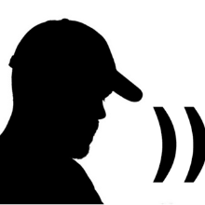
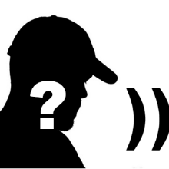
Future Work (1/2)
Non-parallel
Parallel
Alignment
Mechanism
:DTW
Pairwise
Model
Unified
Model
Specified
Source
Specified
Target
Unseen
Source
Unseen
Target
Notes:
So what’s left for the future?
For me, The core problem of VC is structured as follows:
First, you have to align frames or segments.
Second, you train a pairwise model or a unified one.
Then you train a model with all available resources.
In Some models, you might be able to develop the ability to tackle UNsee source or target.
That is the ultimate goal– the strength of generalization.
We are currently here:
Parallel corpora, DTW alignments, pairwise models, specified sources and targets.

Slide 19
Future Work (2/2)
Non-parallel
Parallel
Alignment
Mechanism
: (implicitly)
Pairwise
Model
Unified
Model
Specified
Source
Specified
Target
Unseen
Source
Unseen
Target
Notes:
We‘re moving to this framework:
Non-parallel corpora, no EXPLICIT alignment, and one unified model.
(Please refer to my paper submitted to APSIPA.)
That’s all for my presentation.
My name is Jeremy.
Thank you for your attention.

Slide 20
Thank you.
jeremycchsu@gmail.com

Slide 21
Choice of Dictionary Size for Baselines
Exemplar-Based Sparse Representation With Residual Compensation for Voice Conversion, Zhizheng Wu, Tuomas Virtanen, Eng Siong Chng, and Haizhou Li,
IEEE/ACM TRANSACTIONS ON AUDIO, SPEECH, AND LANGUAGE PROCESSING,
VOL. 22, NO. 10, OCTOBER 2014

