Slide 1
ColorFlow: A Conditional Normalizing Flow Network for Image Colorization
Wang Yin¹ , Peng Lu^{1∗} , Xujun Peng²
¹School of Artificial Intelligence, Beijing University of Posts and Telecommunications, Beijing, China
²Amazon Alexa AI, USA

Slide 2
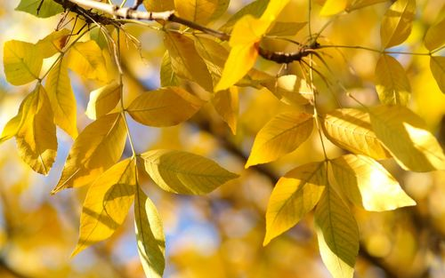
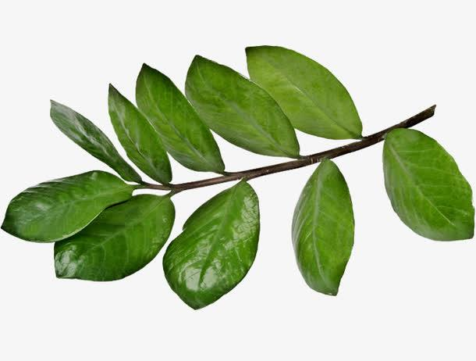
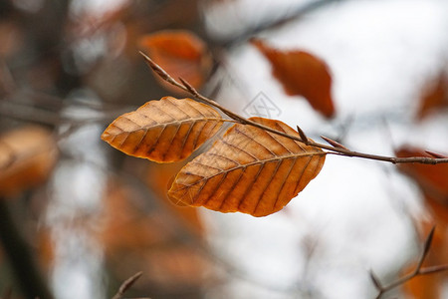
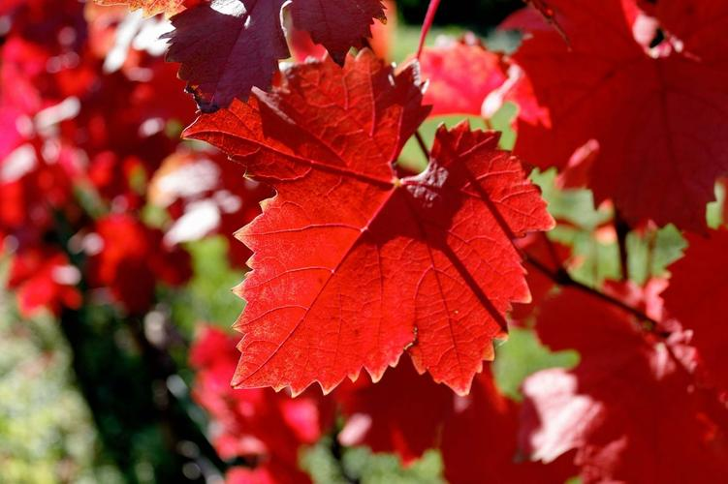
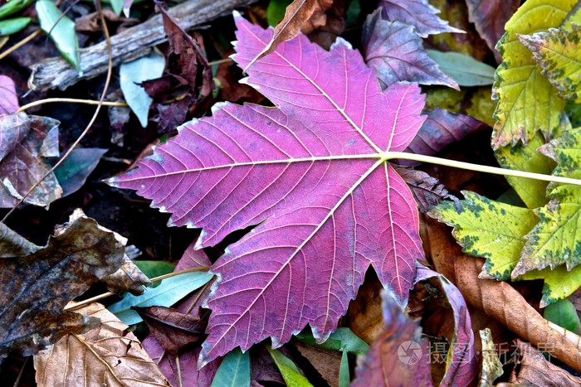
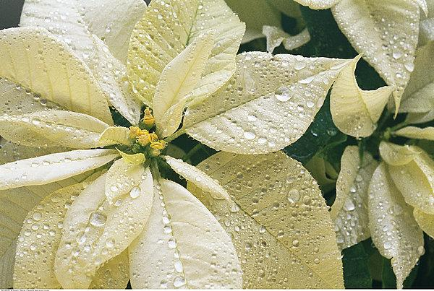
Motivation

Slide 3
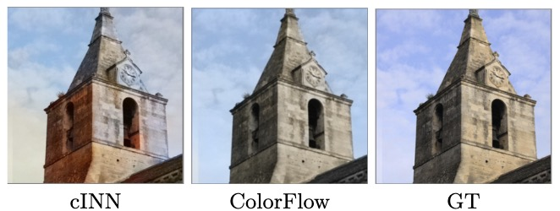
Solved Problem
Autoregressive methods
GAN-based methods
Flow-based methods

Slide 4
Our Contributions
We propose a conditional normalizing flow, named ColorFlow, to jointly learn the one-to-many relationships between object and its corresponding colors, and the color correlations between different objects within image.
To represent the color correlations between different objects, we predict the global color histogram of grayscale image and utilize it as the mean value of the prior distribution for the flow's latent variables. By integrate these global tones into flow, we generate more realistic colors than the classic flow.
The experimental results demonstrate that ColorFlow outperforms state-of-the-art approaches in terms of the visual quality, realism, and vividness.

Slide 5
Methodology

Slide 6
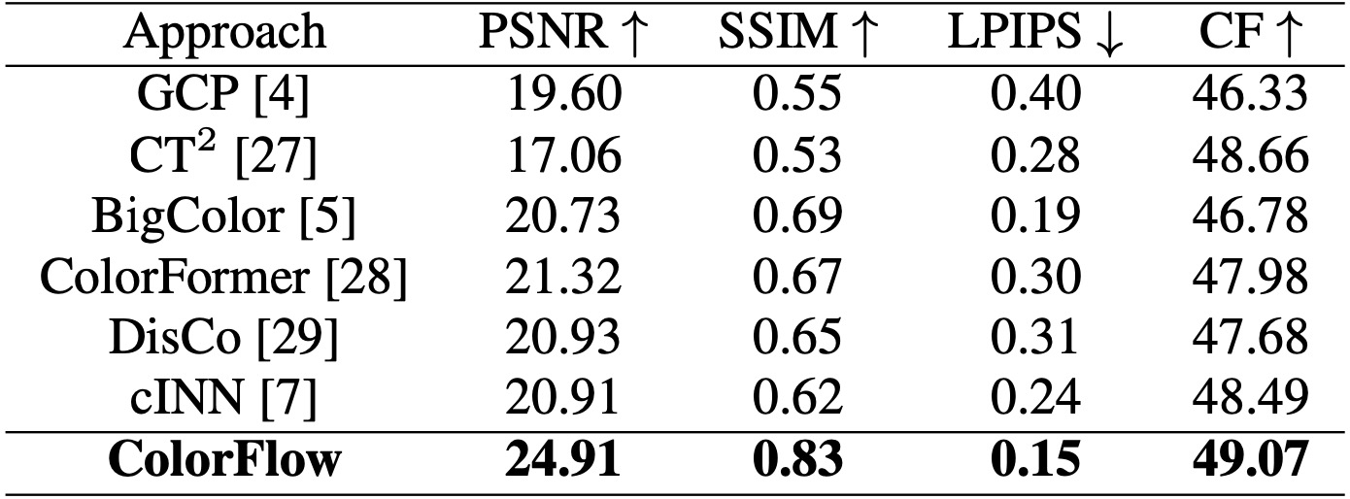
Experiments
Objective Function:
$$ℒ_{I}=λ_{NLL}∙ℒ_{NLL}+λ_{KL}∙ℒ_{KL}+λ_{content}∙ℒ_{content}$$

Slide 7
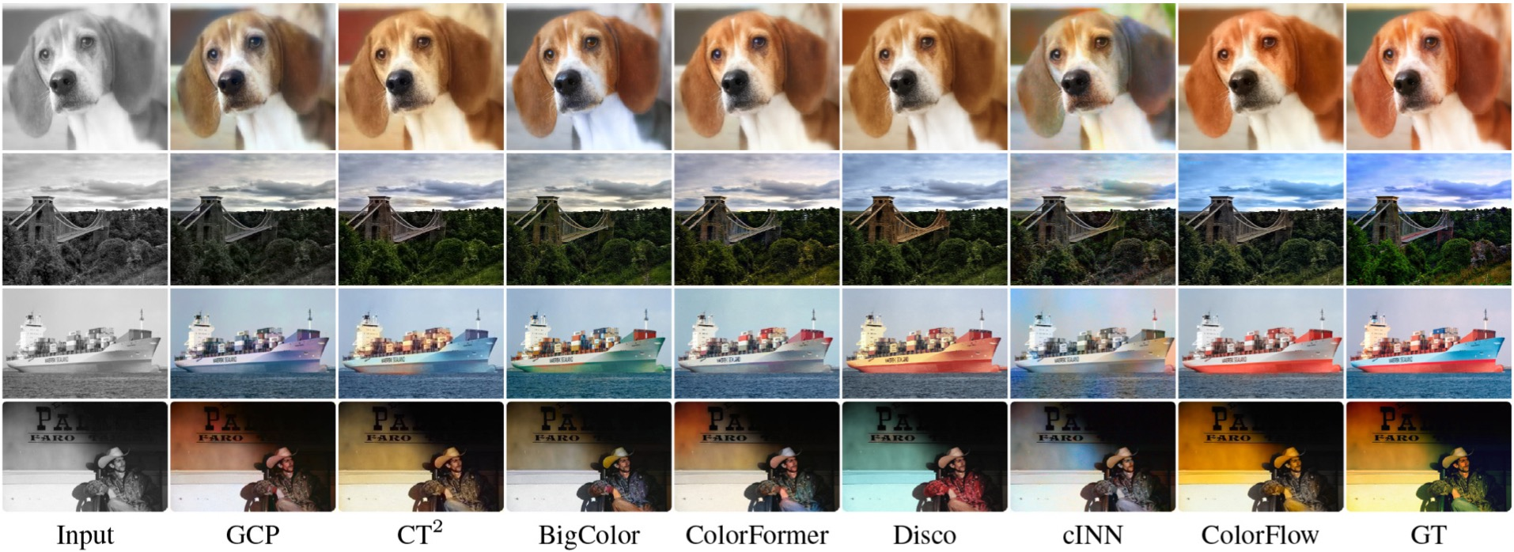
Experiments

Slide 8
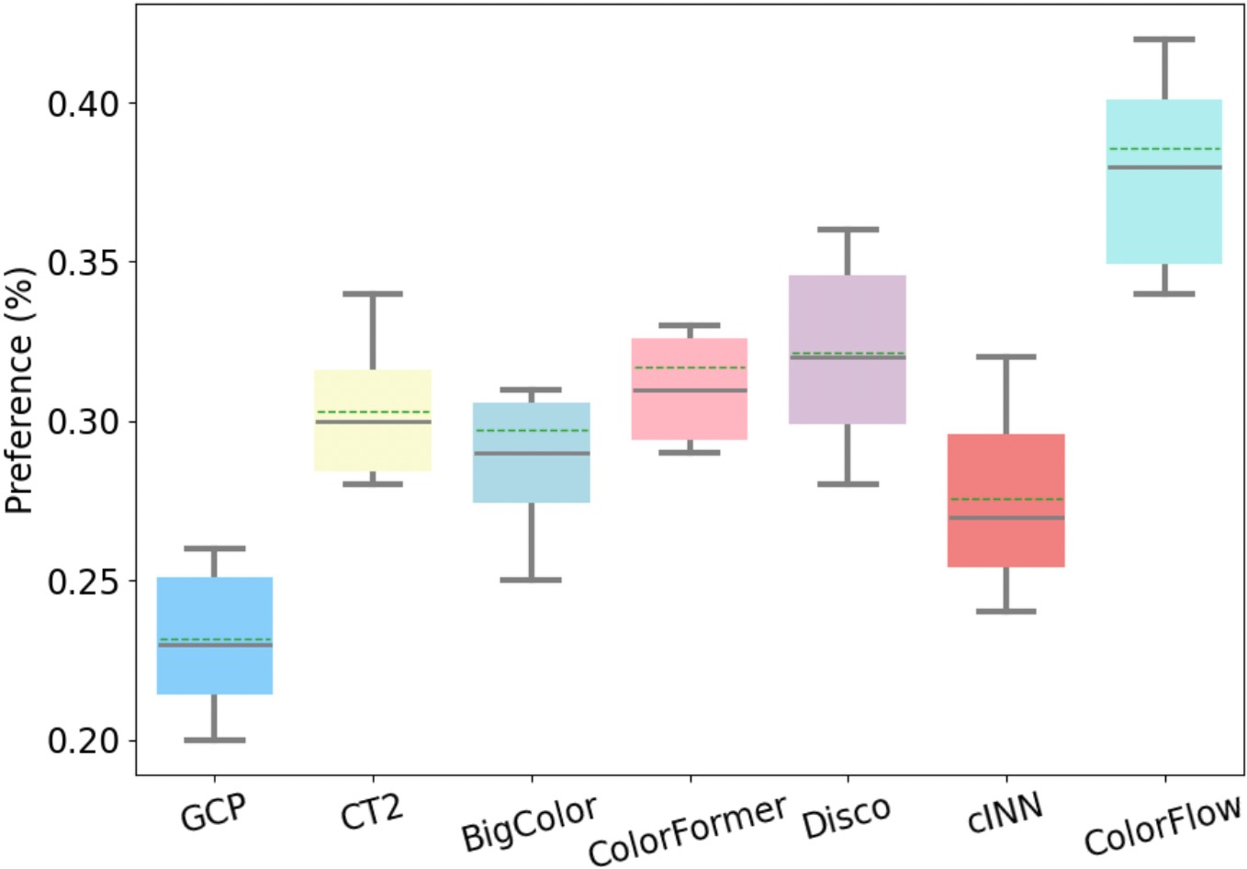
Experiments

Slide 9
Thank You

