Slide 1
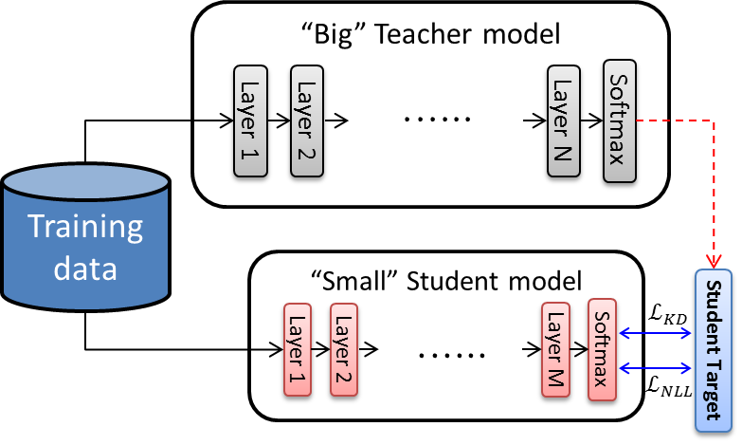
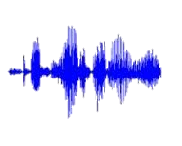
KNOWLEDGE DISTILLATION USING OUTPUT ERRORS FOR SELF-ATTENTION END-TO-END MODELS
Ho-Gyeong Kim*, Hwidong Na*, Hoshik Lee, Jihyun Lee, Tae Gyoon Kang, Min-Joong Lee, Young Sang Choi
Samsung Advanced Institute of Technology, Samsung Electronics, South Korea
Introduction
Knowledge Distillation using Output Errors
Comparison to Related Works
On-device ASR requires compressed models
Small memory footprint
Small battery consumption
(Fast running time)
Model Compression using Knowledge distillation (KD) [1]
$$ℒ=\left(1−α\right)ℒ_{NLL}+αℒ_{KD}$$
$ℒ_{NLL}$ : the training loss of the original task, e.g. cross-entropy
$ℒ_{KD}$: the differences between the teacher and student models e.g. Kullback–Leibler divergence
Teacher might be wrong ☹
Penalize less accurate recognition results from the teacher
Follow teacher’s output selectively
$$\exp\left(−βerr(y^{∗},\hat{y})\right)$$
$y^{∗}$: ground-truth sequence
$\hat{y}$: generated by teacher
$β$: smoothing factor
Metric’s error (e.g. WER) as penalty
$$ℒ_{ERR−KD}≅\exp\left(−βerr\left(y^{∗},\hat{y}\right)\right)\log{q\left(\hat{y}|x;θ_{S}\right)}$$
Higher error → Lower loss
Different unit granularity→ different point of view
Strong baseline, not tuned for easier cases (*-clean)
Model | WER [%]
 | dev-clean | dev-other | test-clean | test-other
Prior works
LAS [3] | 4.87 | 14.37 | 4.87 | 15.39
LAS + LM [3] | 3.54 | 11.52 | 3.82 | 12.76
CTC, PL [4] | 5.10 | 14.26 | 5.42 | 14.70
CTC [5] | - | - | 5.33 | 13.25
LAS+SpecAug [6] | - | - | 2.8 | 6.8
Our Implementation
Teacher | 5.62 | 14.19 | 5.75 | 14.36
Teacher + SA-LM | 4.42 | 10.65 | 4.73 | 10.90
ERR-KD | 5.83 | 14.26 | 6.16 | 14.22
ERR-KD + SA-LM | 4.67 | 11.03 | 5.13 | 11.20
Experimental Results
References
Teacher >= ERR-KD Student B (1/2) > ERR-KD Student A (1/4)
[1] G. Hinton, O. Vinyals and J. Dean, "Distilling the Knowledge in a Neural Network," in CoRR, 2015.
[2] L. Dong, S. Xu and B. Xu, "Speech-transformer: a No-recurrence Sequence-to-Sequence Model for Speech Recognition," in ICASSP, 2018.
[3] A. Zeyer, K. Irie, R. Schluter and H. Ney, "Improved training of end-to-end attention models for speech recognition," in ICASSP, 2018.
[4] Y. Zhou, C. Xiong and R. Socher, "Improving End-to-End Speech Recognition with Policy Learning," in ICASSP, 2018.
[5] D. Amodei, . R. Anubhai, E. Battenberg, . C. Case, J. Casper, B. Catanzaro, J. Chen, . M. Chrzanowski, . A. Coates, G. Diamos , E. Elsen, J. Engel , L. Fan, . C. Fougner, . T. Han , A. Y. Hannun, B. Jun, P. LeGresley, L. Lin, . S. Narang, A. Y. Ng, S. Ozair, R. Prenger, J. Raiman, S. Satheesh, . D. Seetapun, S. Sengupta , Y. Wang , Z. Wang, C. Wang , B. Xiao , D. Yogatama , J. Zhan and Z. Zhu, "Deep speech 2: End-to-end speech recognition in english and mandarin," in ICML, 2016.
[6] D. S. Park, W. Chan, Y. Zhang, C-C. Chiu, B. Zoph, E. D. Cubuk, Q. V. Le, “SpecAugment: A Simple Data Augmentation Method for Automatic Speech Recognition”, https://arxiv.org/abs/1904.08779
Why Self-Attention Model for End-to-End ASR?
Model | # Enc. Layers | # Dec. Layers | Hidden Size | Filter Size | Size (Bytes)
Teacher | 6 | 4 | 512 | 2,048 | 141M
Student A | 8 | 2 | 256 | 1,024 | 34.5M
Student B | 10 | 3 | 256 | 2,048 | 70.6M
SA-E2E is more efficient architecture than LSTM-E2E*
Reuse model parameters in every encoder steps ☺
Less training time [2] for comparable accuracy ☺
* It would be possible to reuse LSTM-E2E parameters if the size is very small. However, the size of an LSTM-E2E (>100Mbytes) is usually too large to load on static random-access memory (<2Mbytes) on a modern mobile device.
SA-E2E
LSTM-E2E
Model | WER [%]
 | dev-clean | dev-other | test-clean | test-other
Teacher | 5.62 | 14.19 | 5.75 | 14.36
Student A | 7.89 | 17.96 | 7.99 | 18.37
+SEQ-KD | 7.64 | 17.77 | 7.77 | 17.98
+ERR-KD | 7.62 | 17.79 | 7.79 | 17.76
Student B | 5.99 | 14.69 | 6.30 | 14.39
+SEQ-KD | 5.85 | 14.25 | 6.14 | 14.27
+ERR-KD | 5.83 | 14.26 | 6.16 | 14.22
Feature
Vectors
Feature
Vectors
Contact
Corresponding Authors: {hogyeong.kim, hwidong.na}@samsung.com
Hidden
Nodes
Hidden
Nodes

