Slide 1
Cube-based Video Coding Framework for Compressive Imaging
Jirayu Peetakul*, Yibo Fan⁺, Jinjia Zhou *⸸
*Hosei University
⁺Fudan University
⸸ JST, PRESTO
Data compression conference 2022, Snowbird, Utah, USA
22-24 March 2022
0/9

Slide 2
Problem
When resolution increases, the vector-based coding framework for block-based compressive imaging cannot perform efficiently.
Existing work proposed intra and inter-prediction for block-based compressive imaging, but further implementation was limited due to data structure constraints.
Most of works fixed framework functionality to specific sensing matrix, which is not universal.
Data compression conference 2022, Snowbird, Utah, USA
22-24 March 2022
1/9

Slide 3
Objectives
This study proposes alternative data structure for block-based compressive sensing and new coding framework.
The new data structure enables significant improvements in coding framework implementation using intra-prediction, inter-prediction, transform coding, and quantization, which have never been used in a compressive imaging coding framework before.
The proposed coding framework is not restricted by sensing matrices in terms of functionality compared to state-of-the-art works.
Data compression conference 2022, Snowbird, Utah, USA
22-24 March 2022
2/9

Slide 4
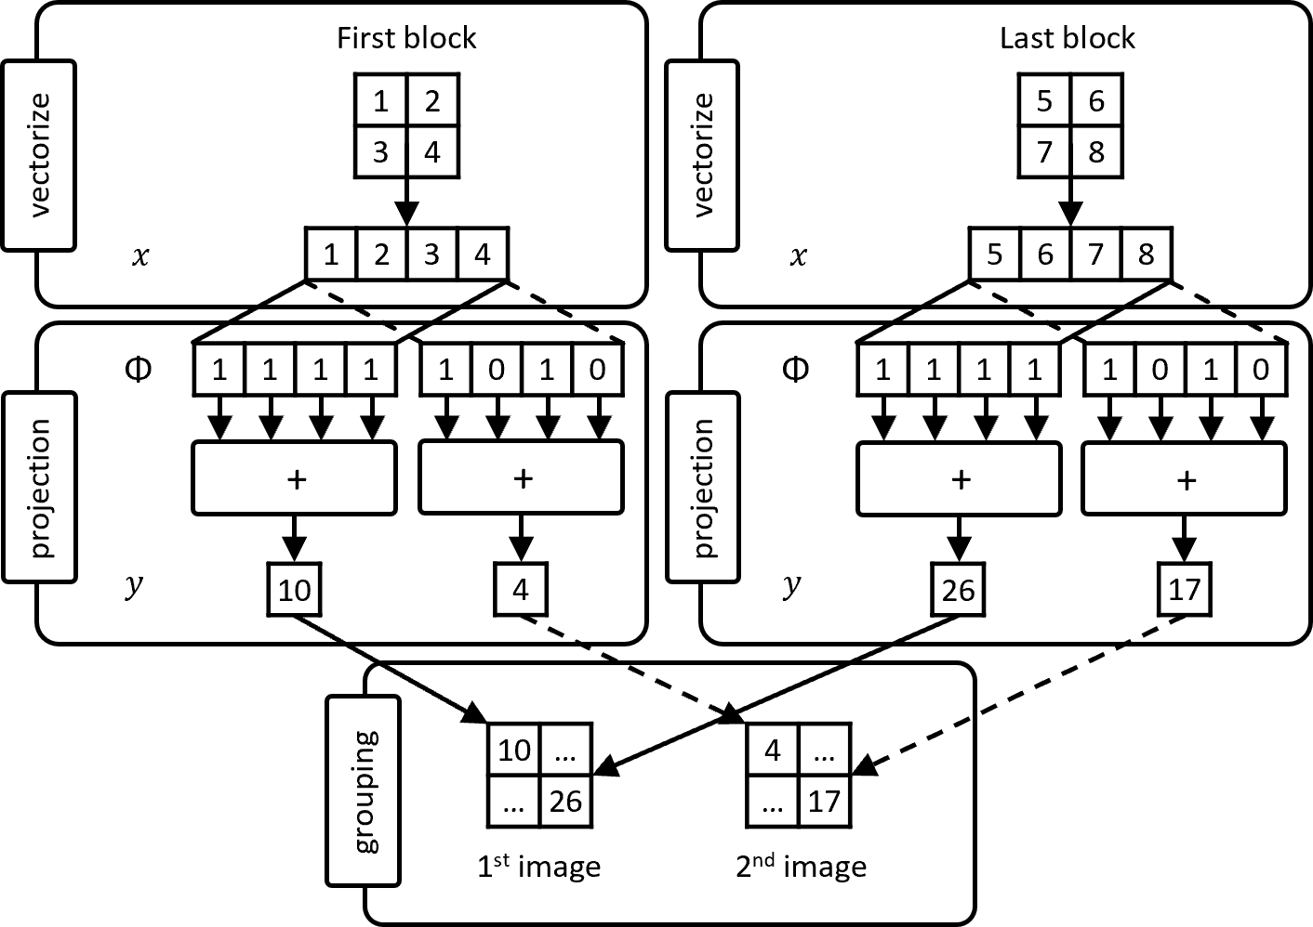
Method
Figure 2: example of downsampled procedure of block-based compressive sensing, where the block size equal to 16×16 and $m =8$.
Figure 1: An example of block-based CS procedure, where the block size is set to be $2×2$, $n = 4$, $m = 2$, which generate 2 downsampled image.
Data compression conference 2022, Snowbird, Utah, USA
22-24 March 2022
3/9

Slide 5
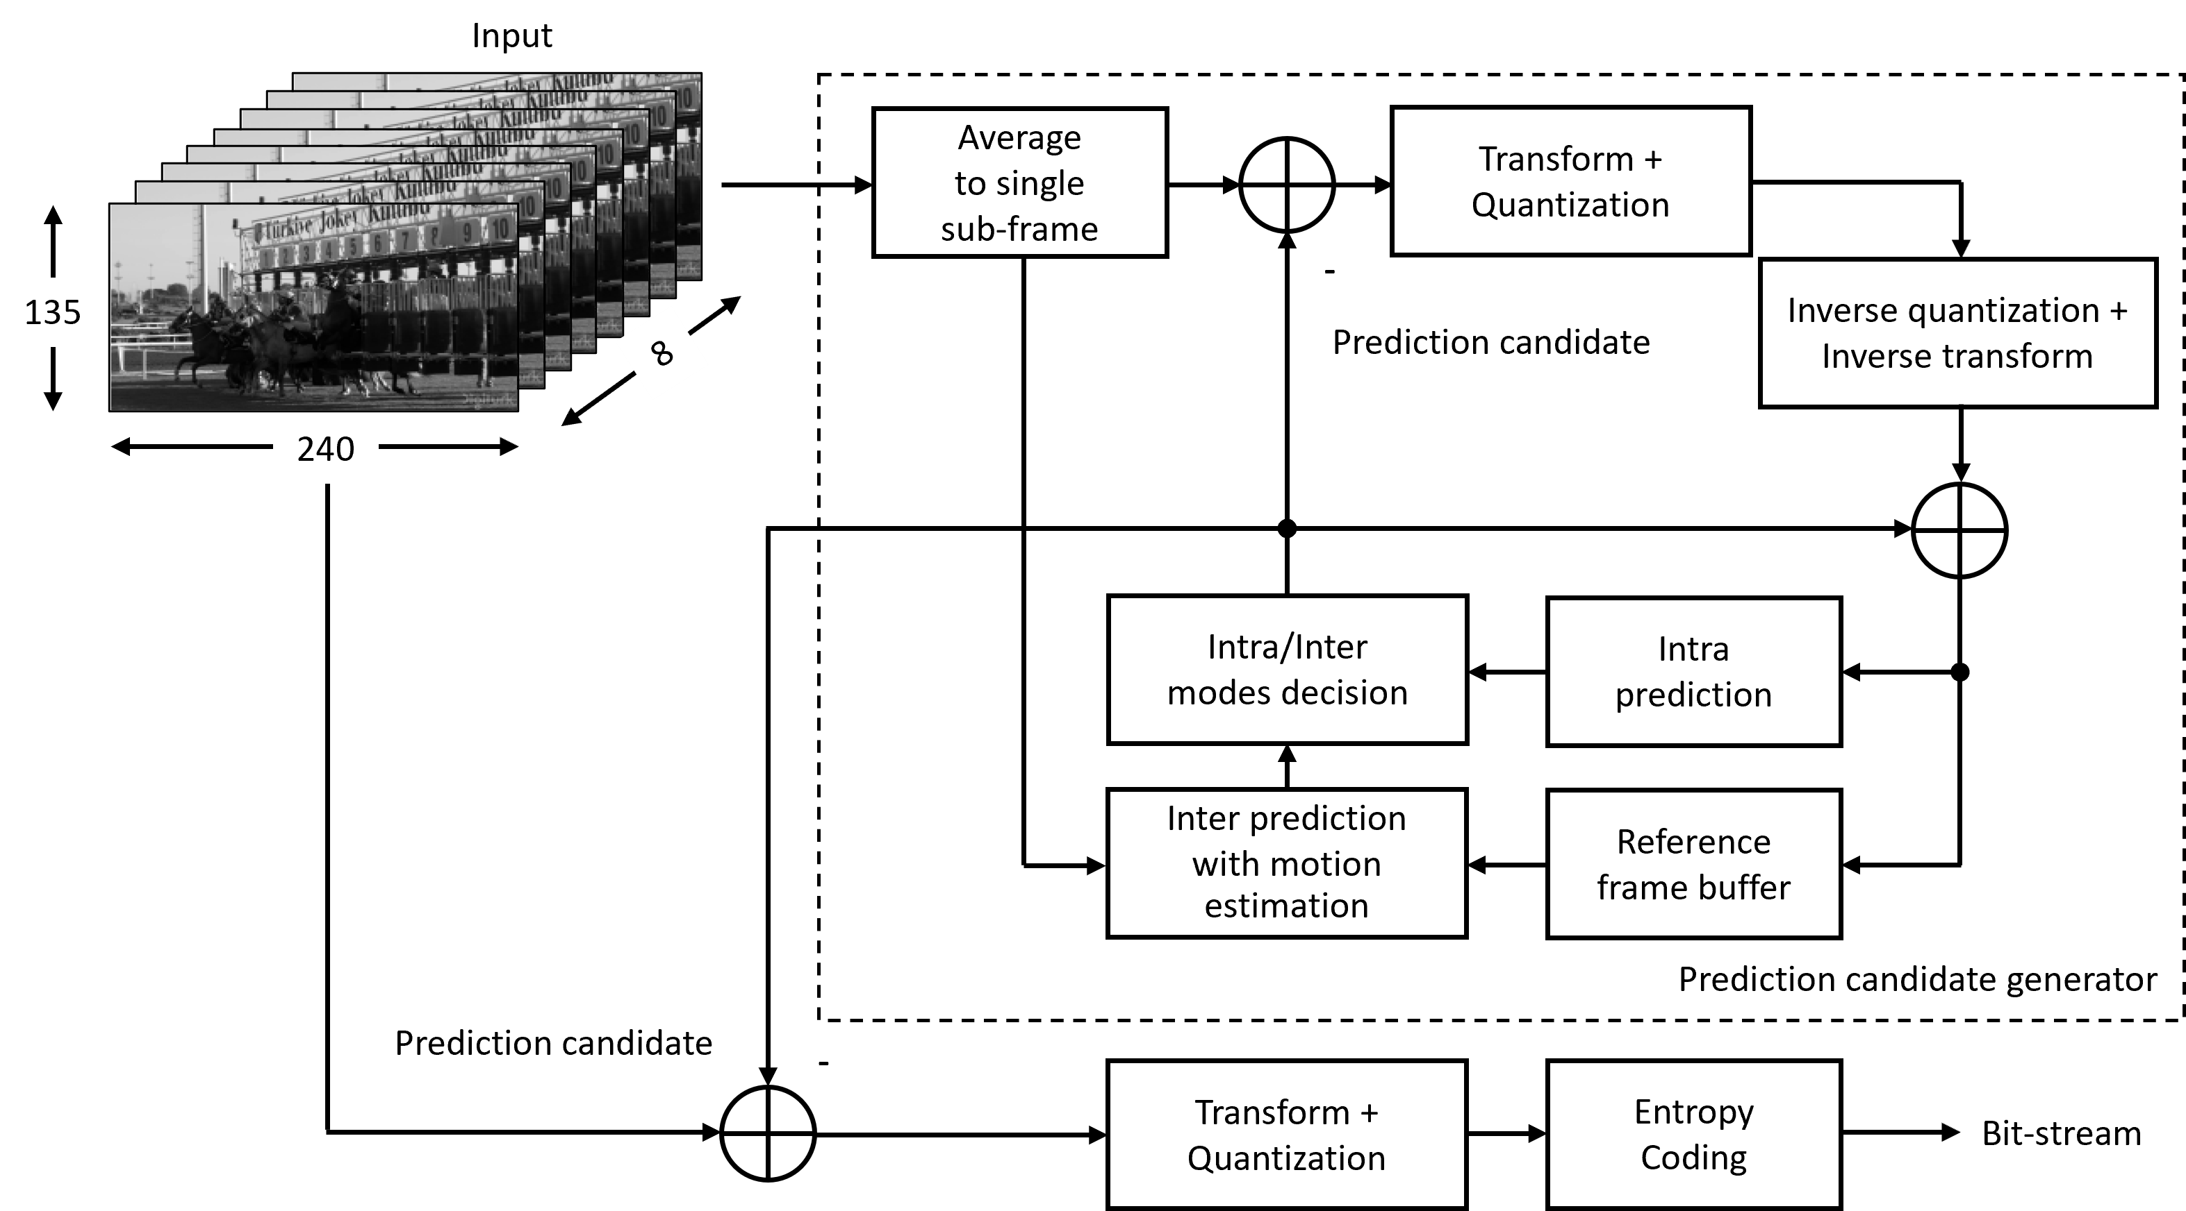
Method
Figure 3. The proposed framework architecture tailored to a data cube for compressive imaging.
Data compression conference 2022, Snowbird, Utah, USA
22-24 March 2022
4/9

Slide 6
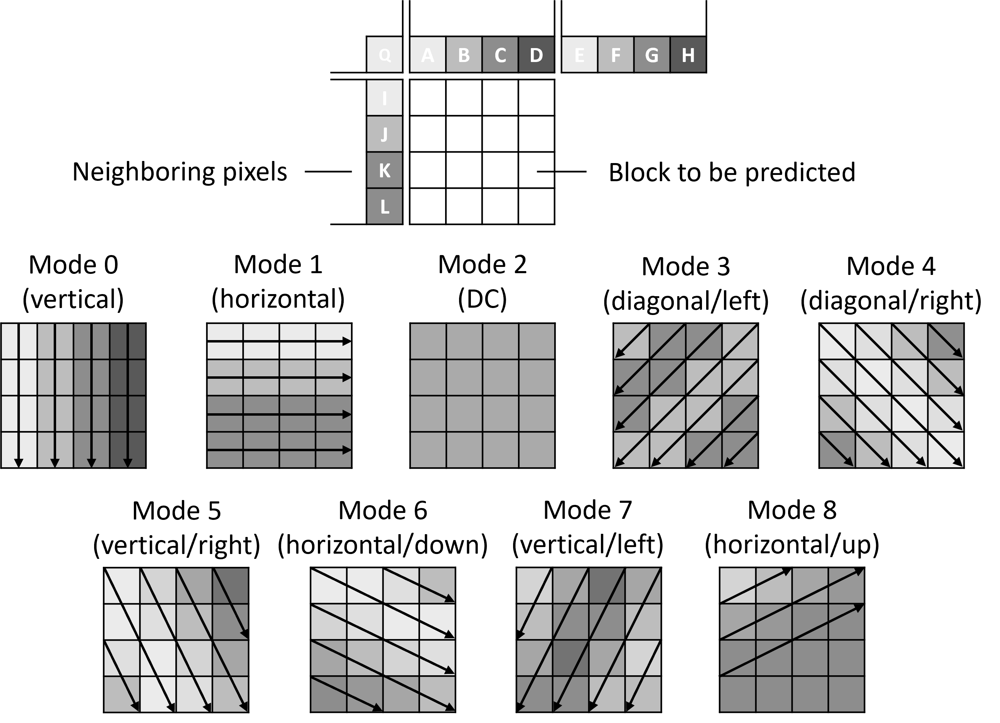
Method
Figure 4: Standard 4 ×4 block directional 9 modes intra-prediction.
Data compression conference 2022, Snowbird, Utah, USA
22-24 March 2022
5/9

Slide 7
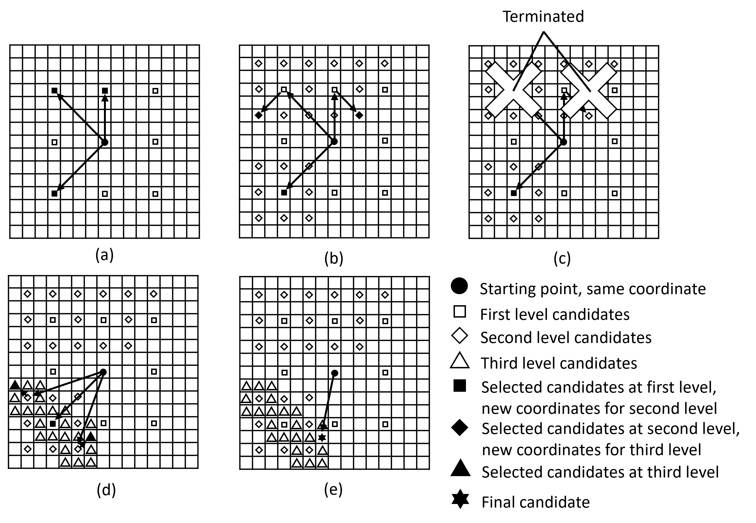
Method
Figure 5: Fast three-level hierarchical search motion estimation capable of stopping motion vectors with v equal to 3, where (a) the top-level of hierarchical motion estimation, (b) the middle-level of hierarchical motion estimation, (c) two motion vectors in the middle-level of hierarchical motion estimation are stopped, (d) the lowest-level of hierarchical motion estimation received computational resources to active motion vector, and (e) the matched candidate is returned.
Data compression conference 2022, Snowbird, Utah, USA
22-24 March 2022
6/9

Slide 8
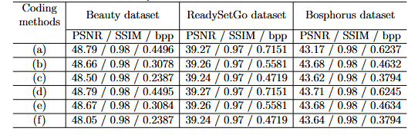
Simulation results
Table 1. Intra-prediction performance comparison with the state-of-the-art on various datasets, where b×b = n = 16 ×16, m = 64, (a) binary random matrix with DPCM-SQ [3], (b) binary random matrix with SDPC-SQ [4], (c) binary random matrix with modified-binary random matrix with 3 modes intra prediction-SQ [5], (d) hadamard with 4 modes intra prediction-SQ [6], (e) sequency-ordered walsh-hadamard with 7 modes intra prediction-SQ [7], (f) this work only intra-prediction with $Q_{p}$= 3, (g) this work only intra-prediction with $Q_{p}$ = 6, and (h) this work only intra-prediction with $Q_{p}$= 9.
[1] Lu Gan, "Block Compressed Sensing of Natural Images," 2007 15th International Conference on Digital Signal Processing, 2007, pp. 403-406, doi: 10.1109/ICDSP.2007.4288604.
[2] A. Mercat, M. Viitanen, and J. Vanne, “UVG dataset: 50/120fps 4K sequences for video codec analysis and development,” Accepted to ACM Multimedia Syst. Conf., Istanbul, Turkey, June 2020.
[3] S. Mun and J. E. Fowler, "DPCM for quantized block-based compressed sensing of images," 2012 Proceedings of the 20th European Signal Processing Conference (EUSIPCO), 2012, pp. 1424-1428.
[4] Zhang, J., Zhao, D. \& Jiang, F. Spatially directional predictive coding for block-based compressive sensing of natural images. {\em 2013 IEEE International Conference On Image Processing}. pp. 1021-1025 (2013)
[5] J. Zhou, D. Zhou, L. Guo, Y. Takeshi and S. Goto, "Measurement-domain intra prediction framework for compressively sensed images," 2017 IEEE International Symposium on Circuits and Systems (ISCAS), 2017, pp. 1-4, doi: 10.1109/ISCAS.2017.8050262.
[6] J. Peetakul, Y. Fan and J. Zhou, "Intra Prediction-Based Measurement Coding Algorithm for Block-Based Compressive Sensing Images," in IEEE Access, vol. 9, pp. 56031-56040, 2021, doi: 10.1109/ACCESS.2021.3068579.
[7] T. T. T. Tran, J. Peetakul, C. D. K. Pham and J. Zhou, "Bi-directional intra prediction based measurement coding for compressive sensing images," 2020 IEEE 22nd International Workshop on Multimedia Signal Processing (MMSP), 2020, pp. 1-6, doi: 10.1109/MMSP48831.2020.9287074.
Data compression conference 2022, Snowbird, Utah, USA
22-24 March 2022
7/9

Slide 9
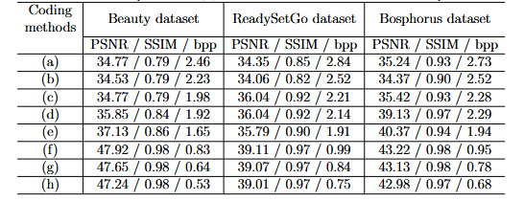
Simulation results
Table 2: Intra-prediction with 2 modes inter-prediction performance on 100 frames of various datasets, where b×b = n = 16×16, m = 64. The results in (a), (b), (c), represent intra-prediction with slow mode inter-prediction; (d), (e), (f), represent intra-prediction with fast mode inter-prediction, where $Q_{p}$= 3, 6, and 9, respectively.
Data compression conference 2022, Snowbird, Utah, USA
22-24 March 2022
8/9

Slide 10
Conclusion
This study presented a video coding framework for block-based compressive imaging, as well as changed our perspective of raw compressed sensing data as a cube composed of multiple downsampled images.
The proposed cube-based video coding framework significantly improved coding performance and provided more flexibility for future implementation.
Data compression conference 2022, Snowbird, Utah, USA
22-24 March 2022
9/9

