Slide 1
Deep Back Projection For Sparse-view CT Reconstruction
Dong Hye Ye*, Gregery Buzzard⁺, Max Ruby⁺, Charles Bouman⁺
*Marquette University
⁺Purdue University
November 27, 2018
Notes:
Thanks for the introduction. Today, I will talk about machine learning for image processing. This is a broad topic which I have been working for many years. So, I will give you the best highlight of my contribution.

Slide 2
Outline
Introduction to Sparse-view Computed Tomography (CT)
Convolutional Neural Network (CNN) for CT reconstruction
Challenge: Spatial Invariance in Sinogram
Stacked Back-Projection Tensor
Experimental Results
Notes:
In this talk, I will give you four examples how I advance image processing using machine learning techniques:
First, we develop a joint metal artifact reduction and segmentation method based on dictionary learning. We propose image-domain processing for metal artifact reduction for CT images using learned dictionary. In addition, we derive iterative optimization for MAR and segmentation which can have a synergistic effect.
Second, we improve model-based iterative CT reconstruction with a help of deep residual learning. We develop image de-noising method from the learned relation between FBP/MBIR pairs in the database. Then, we use novel plug-and-play optimization method to incorporate learning-based image de-noising into MBIR framework.
Third, we develop learning-based sparse sampling for high throughput microscopic imaging. Here, we estimate the entropy reduction with a new measurement based on supervised learning approach. By maximizing the entropy reduction, we can find the optimal scanning pattern to reduce the number of required samples.
Lastly, I will talk about deep learning for moving object detection from UAVs. The goal of this approach is to develop efficient and effective moving object detection algorithm for cheap and light-weight collision avoidance system. Toward this, we apply deep learning classification on estimated motion and appearance features to identify other UAVs.

Slide 3
Sparse-view CT
CT Applications
Diagnostic Radiology
Additive Manufacturing Inspection
Nyquist sampling
n views x n channels for n x n image
Sparse-view sampling
Manufacturing application: Reduce acquisition time/ cost
Scientific application: Enhance temporal resolution for dynamically changing objects
Notes:
Computed Tomography (CT) reconstruction is widely used for many applications. For example, CT image is used for routine clinical diagnosis in medical application. Due to recent advance in 3D printing, CT image becomes popular in inspecting parts by additive manufacturing.
Traditional CT approximately measures n views with n channels to ensure Nyquist sampling. However, for the high-resolution and large FOV imaging, n becomes very large resulting in very large number of measurements.
To tackle this challenge, sparse-view CT gained a lot of attention. For example, sparse-view CT can reduce the acquisition time in manufacturing application, which reduces the cost. For scientific application for dynamically changing objects, sparse-view CT can significantly enhance the temporal resolution.

Slide 4
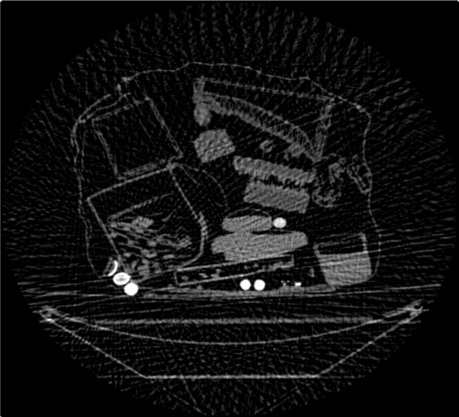
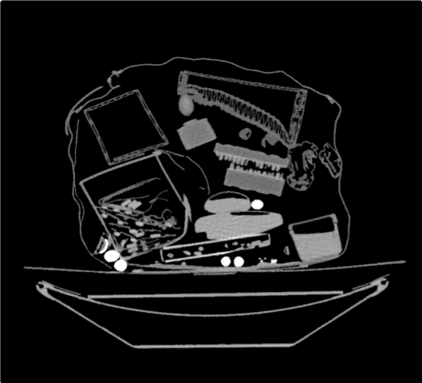
CT Reconstruction
Filtered Back Projection (FBP): Linear / Analytical
Model Based Iterative Recon. (MBIR): Regularized / Iterative
16 view | FBP | MBIR
Image Quality
Speed | FAST | SLOW
Notes:
Model-based Iterative Reconstruction (MBIR) is one of the state-of-the art algorithms for CT reconstruction. Unlike analytical reconstruction, MBIR incorporate forward model representing the physical detection system and the prior model based on the assumption about the object being imaged.
MBIR demonstrates significant advantages over standard analytic recon such as filtered-back projection.
These figures show the benefit of MBIR over FBP. You can note that MBIR reduces the noise level and enhance the spatial resolution compared with FBP in challenging 16 view reconstruction.
This allows us to reduce X-ray dosage on patients for medical application and decrease the scan time by sparse-view samples for industrial application.

Slide 5
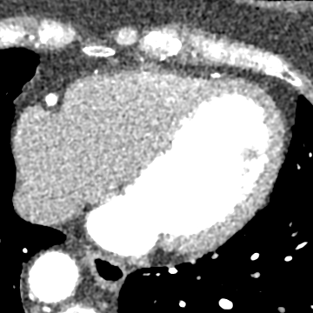
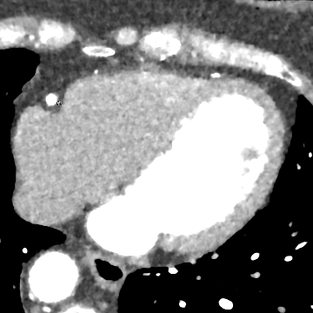
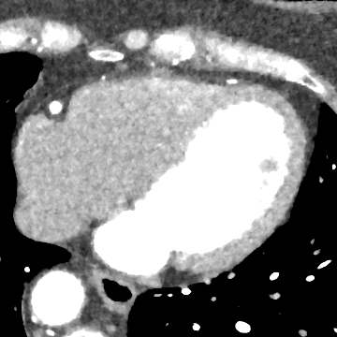
Deep Learning for CT Images
Deep Neural Networks
Powerful performance for vision tasks such as de-noising
Weights of a neural network learned on large training dataset
Image-domain processing as CT De-noising
FBP | Deep Residual Learning De-noising | Ground-Truth MBIR
PSNR: 18.7341 dB
PSNR: 19.6841 dB
Ye et al, ICCASP 2018
Notes:
Recently, a deep neural network shows powerful performance in computer vision applications such as image de-noising.
Here, the weights of a multi-layer network are trained on large dataset and then trained network is applied to remove noise of the unseen testing image.
These figures show the result of Deep Residual Learning De-noising on unseen testing images.
In the first column, we display input FBP images. You can note the noisy texture in soft tissue of the heart.
In the second column, we use trained deep neural network for de-noising.
For reference, we also illustrate Ground-Truth MBIR in the third column.
Our method can generate ground-truth MBIR-like image from FBP in terms of noise texture and image resolution.
For quantitative evaluation, we compute PSNR toward ground-truth MBIR.
For both cases, we achieve about 1dB increase of PSNR, which highlights the robustness and effectiveness of our denoising.

Slide 6
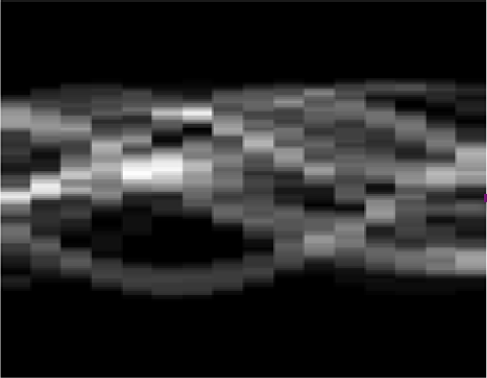
Deep Learning for CT Sinograms
CNN
Visual cortex: Neurons respond to stimuli only in the receptive field
Apply convolution to impose spatial invariance
Reduce the number of parameters
CNN for CT reconstruction from sinogram
Challenge: Sinogram is encoded in a spatially non-local way
Convolution Kernel
channel
view

Slide 7
Single-view Back-Projections
Back-project each view separately
16-view sinogram
Single-view Back-Projections for
16-view sinogram
Notes:
Even though MBIR shows promising results, accurate prior modeling plays a significant role in the quality of MBIR.
The general approach uses MRF as a prior model, which penalizes intensity fluctuations in the neighborhood pixels.
However, MRF is not sufficient to differentiate the noise-induced fluctuation from the underlying object.
We instead generate the prior model by applying machine learning to a large number of training images.
For example, we build data-driven prior model from FBP and corresponding Ground-Truth MBIR.
Here, for ground truth, we run 50 iterations of MBIR which takes a few hours.

Slide 8
Stacked Back-Projection Tensor
$y=[y_{1},y_{2},…,y_{m}]$ $∈R^{m×n}$: $m$-view sinogram for $y_{j}∈R^{n}$at $θ_{j}$
$B_{j}∈R^{n×n}$: single-view back project operator at $θ_{j}$
$Z=[Z_{1};Z_{2};…;Z_{m}]∈R^{n×n×m}$: Stacked Back-Projection Tensor
$${Z_{j}=B}_{j}y_{j}∈R^{n×n}$$
Reorganize the sinogram
to make it amenable for CNN
Notes:
Even though MBIR shows promising results, accurate prior modeling plays a significant role in the quality of MBIR.
The general approach uses MRF as a prior model, which penalizes intensity fluctuations in the neighborhood pixels.
However, MRF is not sufficient to differentiate the noise-induced fluctuation from the underlying object.
We instead generate the prior model by applying machine learning to a large number of training images.
For example, we build data-driven prior model from FBP and corresponding Ground-Truth MBIR.
Here, for ground truth, we run 50 iterations of MBIR which takes a few hours.

Slide 9
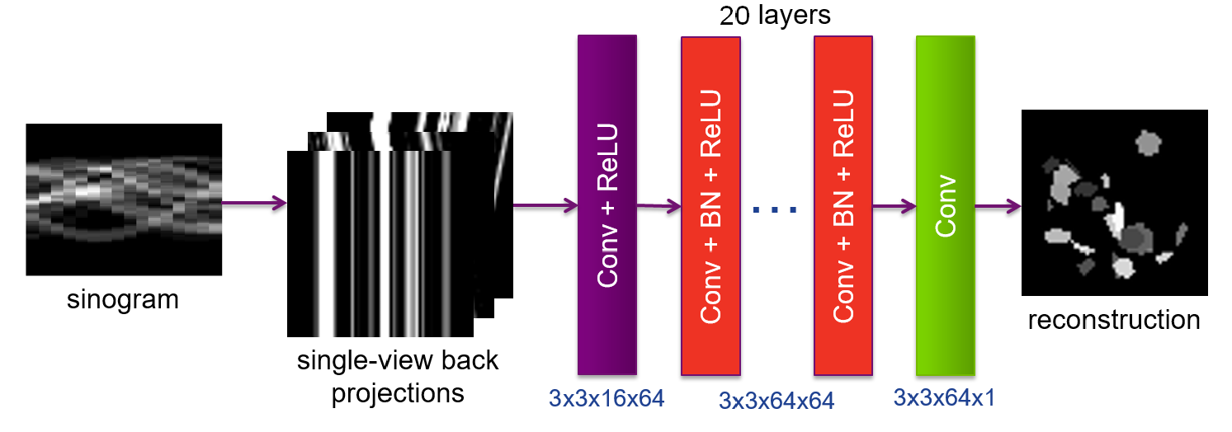
Deep Back Projection (DBP)
Network architecture
22-layer convolutional neural network
3x3 kernel
Batch Normalization + ReLU
Notes:
Then, we will use deep learning based de-noising for a prior model of MBIR.
Recently, a deep neural network shows powerful performance in computer vision applications such as image de-noising.
Here, the weights of a multi-layer network are trained on large dataset and then trained network is applied to remove noise of the unseen testing image.
One of the key challenge in applying deep learning to 3D volume is high training time.
To tackle the challenge, we design residual network which predicts difference image between FBP and ground-truth MBIR.
Since we by-pass low-frequency parts of images, we only need to learn the high-frequency noise characteristic.
This allows us to train relatively shallow network with 17 convolutional layers.
In addition, we use batch normalization and ReLU with multi-GPU implementation for efficient training.

Slide 10
Experimental Setup
100 synthetic noise-free images with size of 64 x 64
Training: 80
Testing: 20
Training DB for DBP
Stacked back projection tensor vs. clean image
256000 patches of size of 8 x 8 after data augmentation
Extract patches at the same location for all 16 view angles
Implementation
ADAM optimization
50 epochs: learning rates from 0.001 to 0.00001
128 mini-batch size
TITAN X GPU: 1 hour training/ 3ms testing

Slide 11
Qualitative Evaluation
FBP | DBP | Ground-Truth
Testing Scan #1
Testing Scan #2
SSIM: 0.49
SSIM: 0.73

Slide 12
Quantitative Evaluation
Results on 20 testing sparse-vie CT recon.
 | PSNR (dB) | SSIM
FBP | 18.43 ± 3.75 | 0.49 ± 0.11
DBP | 19.84 ± 2.44 | 0.73 ± 0.08
DBP significantly outperforms FBP!

Slide 13
Conclusion
Sparse-view CT
Stacked Back-Projection Tensor
Spatial Invariance: Effective to CNN
DBP
CNN for sparse-view CT recon. directly from sinogram
Results on simulated datasets show significant improvement in recon. quality compared with the traditional FBP.

