Slide 1
Selfish Learning: Leveraging the Greed in Social Learning
Ravi Kiran Raman
Joint work with Srilakshmi Pattabiraman
PhD Candidate
Coordinated Science Lab
This work was supported in part by NSF Grant CCF-1717530.

Slide 2
Distributed Decision Making
Decision-making systems detect true hypothesis using private signals
Performance is enhanced by making multiple observations
Private signals are costly to communicate
Multi-agent systems use local-decisions of individual agents to infer true hypothesis
Egs: Sensor fusion, social learning

Slide 3
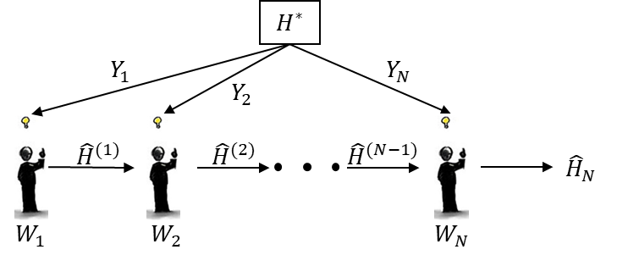
Social Learning
Multi-agent system where local decisions are made based on private signals, and beliefs/decisions of subsets of peers (public signals)
Pro: prior beliefs strengthened by other decisions made in the system
Con: possibility of errors to propagate through the system
Sequential Social Learning

Slide 4
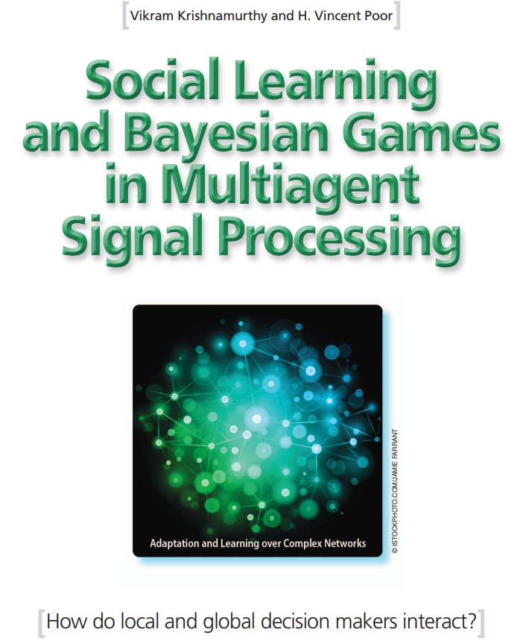
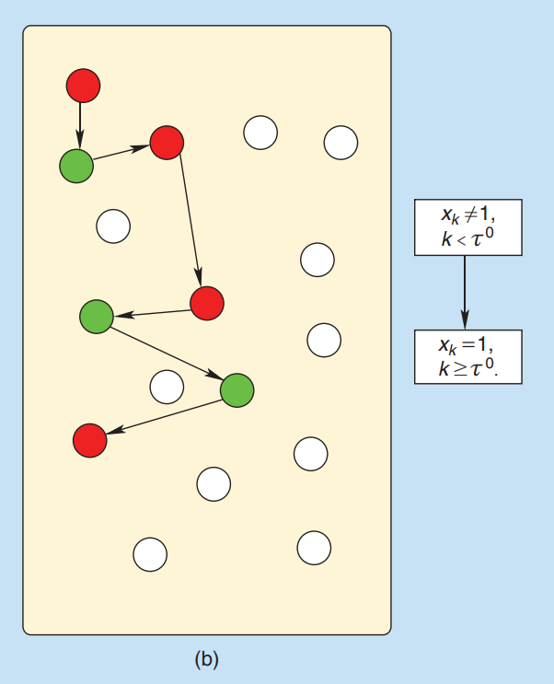

Slide 5
Prior Work
Abhijit V. Banerjee, “A simple model of herd behavior,” Quart. J. Econ., vol. 107, no. 3, Aug. 1992.
G.Ellison and D.Fudenberg, “Rules of thumb for social learning,” J. Polit. Econ., vol. 101, no. 4, Aug. 1993.
D.Acemoglu, M.A. Dahleh, I.Lobel, and A.Ozdaglar, “Bayesian learning in social networks,” Rev. Econ. Stud., vol. 78, no. 4, Oct. 2011.
J.B.Rhim and V.K.Goyal, “Social teaching: Being informative vs. being right in sequential decision making,” Proc. 2013 IEEE Int. Symp. Inf. Theory, July 2013.
V. Krishnamurthy, “Quickest detection POMDPs with social learning: Interaction of local and global decision makers,” IEEE Trans. Inf. Theory, vol. 58, no. 8, Aug. 2012.

Slide 6
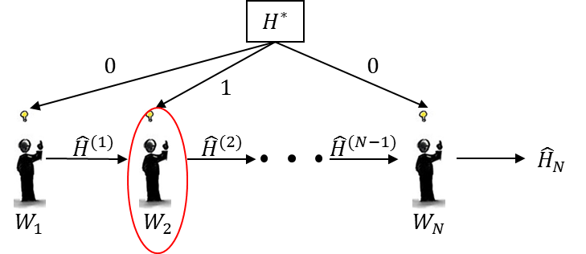
Costs of Social Learning
Social learning typically considers a fixed observation cost – private signals/agents/computational costs used in decision-making
For example, $Y_{i}=H^{∗}1\left\{Z_{i}=1\right\}, H^{∗}∈\left\{0,1\right\}, Z_{i}∼Bern(ε)$
Can we reduce cost of observations without loss in performance?
Is there a sequential hypothesis testing equivalent to social learning?

Slide 7
Leveraging Worker Greed
How do we incentivize human workers in social learning platforms to stop when they are sufficiently confident of their decision?
Expected Utility Theory: Rational agents behave in a manner that maximizes individual expected utility [Quiggin 1982]
In social learning:
local decisions are made s.t. expected individual reward is maximized
worker stops and declares when continuing is detrimental to personal reward
Individual worker reward decaying with number of agents used
Reduce fast – additional agents used only when doubtful of decision
Reduce slow – rash decisions are not made out of the greed

Slide 8
Hypothesis Test: Signaling in AWGN
Task – identifying existence of signal under Gaussian noise
True hypothesis: $H^{∗}∈\left\{0,1\right\}$; prior: $p_{0}=ℙ\left[H^{∗}=0\right]$
Private signals (i.i.d.): $Y_{n}=H^{∗}+Z_{n}, Z_{n}∼𝒩\left(0,1\right)$
Local decision about hypothesis by worker $n$: ${\hat{H}}_{n}∈\left\{0,1\right\}$
Public signal for worker $n$: ${\hat{H}}^{(n−1)}=\left\{{\hat{H}}_{1},…,{\hat{H}}_{n−1}\right\}$
Stopping decision: ${\hat{S}}_{n}∈\left\{0,1\right\}$ (stop at $n$ if ${\hat{S}}_{n}=1$)

Slide 9
Greedy Decision-making
Let $N$ be the stopping time i.e.,
$${\hat{S}}_{n}=\left\{\begin{matrix}0 & , for all N>n \\ 1 & , for N=n \end{matrix}\right.$$
Incentive, ${\left\{g_{n}\right\}}_{n∈ℕ}$, is non-increasing
All workers involved in decision-making are paid $g_{N}$ if the decision is correct, ${\hat{H}}_{N}=H^{∗}$, i.e., reward for worker $i$ is
$$R_{n}=g_{N}1\left\{{\hat{H}}_{N}=H^{∗},n≤N\right\}$$
Local decisions maximize utility:
$$\left({\hat{H}}_{n},{\hat{S}}_{n}\right)=\arg{\max_{H,S}{𝔼\left[R_{n}| {\hat{H}}^{\left(n\right)},{\hat{S}}^{(n)}\right]}}$$

Slide 10
Two Worker System: Cost vs Accuracy

Slide 11
Two Worker System: Optimal Incentive

Slide 12
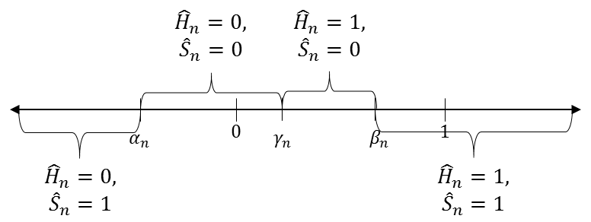
Decision Boundaries
Posterior for worker $n+1$, given public signals, given by
$$q_{n+1}=ℙ\left[H^{∗}=0|{\hat{H}}^{\left(n\right)},{\hat{S}}^{(n)} \right], \frac{q_{n+1}}{1−q_{n+1}}=\frac{q_{n}}{1−q_{n}}\frac{ℙ_{0}\left[{\hat{H}}_{n}|{\hat{H}}^{(n−1)}\right]}{ℙ_{1}\left[{\hat{H}}_{n}|{\hat{H}}^{(n−1)}\right]}$$
Gaussian model: decision regions determined by signal thresholds

Slide 13
Computing Decision Thresholds
Local decisions only need posterior probability and private signal:
$$γ_{n}=\frac{1}{2}+\log{\frac{q_{n}}{1−q_{n}}}$$
At stopping boundary, expected reward for stopping, and that for passing are equal:
$$β_{n}=\{y: 𝔼_{q_{n}}\left[R_{N}|N=n,{\hat{H}}_{n}=1\right]=𝔼_{q_{n}}\left[R_{N}|N>n,{\hat{H}}_{n}=1\right]\}$$
Solving,
$$α_{n}=γ_{n}−{\left[\log\left[\frac{𝔼_{1}\left[R_{N}|{\hat{H}}^{\left(n\right)},N>n\right]}{g_{n}−𝔼_{0}\left[R_{N}|{\hat{H}}^{\left(n\right)},N>n\right]}\right]\right]}^{+}$$
$$β_{n}=γ_{n}+{\left[\log\left[\frac{𝔼_{0}\left[R_{N}|{\hat{H}}^{\left(n\right)},N>n\right]}{g_{n}−𝔼_{1}\left[R_{N}|{\hat{H}}^{\left(n\right)},N>n\right]}\right]\right]}^{+}$$
Regret from passing correct answer
Gain from eventual decision reversal

Slide 14
Learning in the Finite Horizon
Finite set of $M$ workers in the system
Last worker always declares: $α_{M}=β_{M}=γ_{M}$
Interested in tradeoff between early stopping, accuracy, and total cost
That is, greed leads to quicker, more accurate detection
Theorem 1: For any $M ≥2,$if $g_{n}=1$for all $n∈M,$then $𝔼 \left[N\right]<M$ and$ℙ \left[ {\hat{H}}_{N}=H^{∗} \right]≥ℙ \left[{\hat{H}}_{M}=H^{∗} \right]$.

Slide 15
Learning in the Infinite Horizon
Unlimited resources (workers) available
Geometric payoff structure, $g_{n}=ρ^{n−1}, ρ∈\left(1/2,1\right)$
Problem restarts at $n$-th worker with an effective prior of $q_{n}$
Let conditional expected reward for prior $p$ be $ℛ_{h}(p)=𝔼_{h}\left[R_{N};p\right]$
Then decision boundaries are
$$α_{n}=γ_{n}−{\left[\log\left[\frac{ℛ_{1}\left(q_{n+1}\right)}{g_{n}−ℛ_{0}\left(q_{n+1}\right)}\right]\right]}^{+},β_{n}=γ_{n}+{\left[\log\left[\frac{ℛ_{0}(q_{n+1})}{g_{n}−ℛ_{1}(q_{n+1})}\right]\right]}^{+}$$
Expected payoff function characterizes all decisions!

Slide 16
Payoff as a Discounted MDP
$ℛ_{h}\left(⋅\right)$ is the value function of discounted cost Markov Decision Process (MDP) parametrized by $\left(\left[0,1\right], ℝ^{2},P^{(h)}, C^{(h)},ρ\right)$, where
$$C^{\left(h\right)}\left(q,(α,β)\right)=\left\{\begin{matrix}1−Q(α) & , if h=0 \\ Q(β−1) & ,if h=1\end{matrix}\right.$$
$$P_{q,q^{′}}^{\left(h\right)}\left(α,β\right)=\left\{\begin{matrix}ℙ_{h}\left[Y∈(α,γ)\right] & , if\frac{q^{′}}{1−q′}=\frac{q}{1−q}\frac{ℙ_{0}\left[Y∈(α,γ)\right]}{ℙ_{1}\left[Y∈(α,γ)\right]} \\ ℙ_{h}\left[Y∈(γ,β)\right] & , if\frac{q^{′}}{1−q′}=\frac{q}{1−q}\frac{ℙ_{0}\left[Y∈(γ,β)\right]}{ℙ_{1}\left[Y∈(γ,β)\right]} \\ ℙ_{h}\left[Y∉(α,β)\right] & , if stopping \end{matrix}\right.$$
Bellman equation:
$$ℛ_{h}\left(p\right)=T_{h}\left(ℛ_{h}\right)\left(p\right)=\max_{u∈ℝ^{2}}{C^{\left(h\right)}\left(p,u\right)+ρ𝔼_{P_{p,q}^{\left(h\right)}\left(u\right)}\left[ℛ_{h}(q)\right]}$$

Slide 17
Value Function Learning
Use value iteration on quantized prior space with linear interpolation to estimate value function
Theorem 2: $T_{h}$ are contraction mappings under ${\left\|⋅\right\|}_{∞}$ norm. Thus there exists a unique solution $ℛ_{h}^{∗}$ to $ℛ_{h}=T_{h}\left(ℛ_{h}\right)$.
Lemma 1: For any ${\hat{ℛ}}_{h,0},$if ${\hat{ℛ}}_{h,n+1}=T_{h}\left({\hat{ℛ}}_{h,n}\right),$ for all $n≥0,$then
$${\left\|{\hat{ℛ}}_{h,n}−ℛ_{h}^{∗}\right\|}_{∞}≤\frac{ρ^{n}}{1−ρ}{\left\|{\hat{ℛ}}_{h,1}−{\hat{ℛ}}_{h,0}\right\|}_{∞}.$$

Slide 18
Conclusion
We can leverage worker greed for early stopping in social learning
In the infinite horizon, learning value function of a discounted MDP completely characterizes decision regions
Appropriate incentivization reduces the expected cost and time for decision-making, and improves accuracy over seq. social learning
Future Work:
Identify optimal incentivization schemes by learning value functions
Explore effects of perceptual bias and expertise variance in agents
Study problem under computational limitations of agents
Use sequential analysis framework to understand the problem

