Slide 1
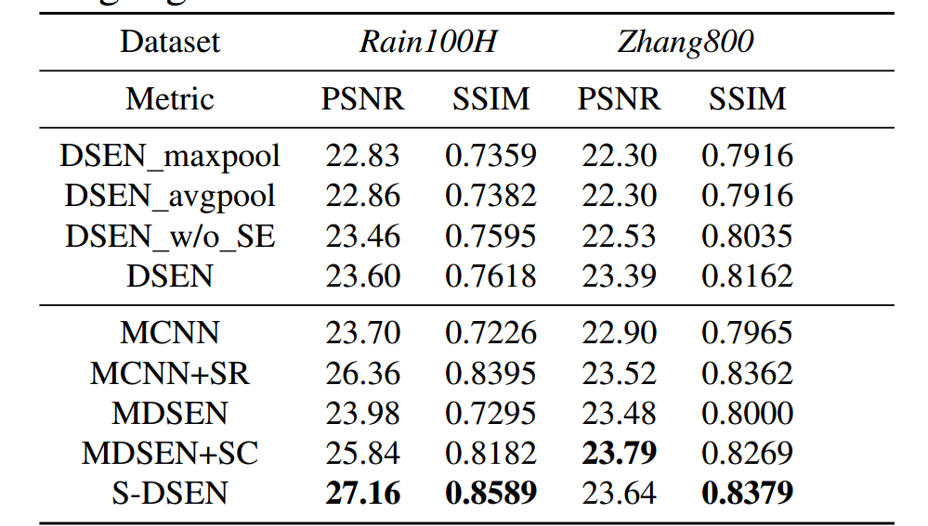
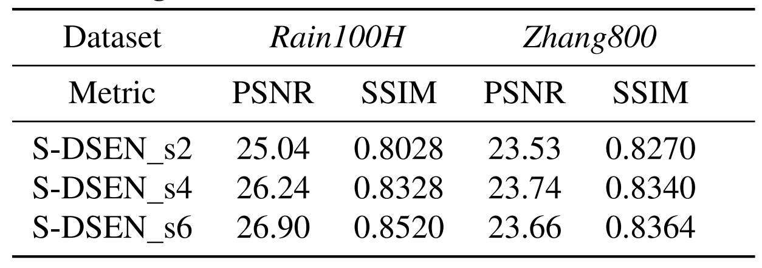
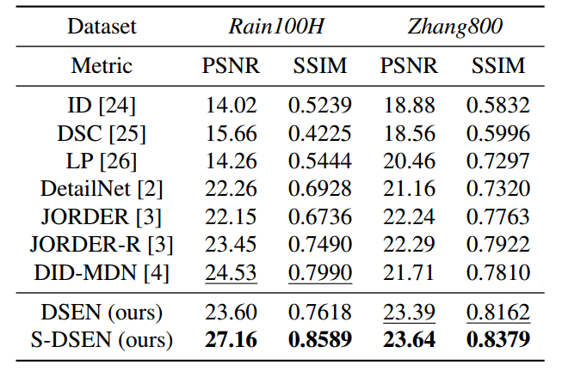
SDSEN: Self-Refining Deep Symmetry Enhanced Network
for Rain Removal
Hong Liu, Hanrong Ye*, Xia Li, Wei Shi, Mengyuan Liu, Qianru Sun
Key Laboratory of Machine Perception, Peking University, China
*Corresponding Author: leoyhr@pku.edu. CODE: https://github.com/prismformore/SDSEN Please STAR and FORK!
Ⅰ
Group Equivariant Convolution
INTRODUCTION
Ⅵ
Ⅳ
EXPERIMENTAL RESULTS
As a natural phenomenon, rain degenerates the visibility of images and affects vision algorithms severely. By restoring background information in rain scenes, rain removal is helpful for many computer vision systems including autonomous driving, intelligent photography and surveillance camera.
A family of symmetry enhanced CNNs theoretically designed with rotation equivariance.
Mathematically, regular convolution could be formulated as：
G-convolution is formulated as:
here g denotes a symmetry transformation (e.g. rotation, translation).
Transformation g of group p4 could be decomposed into a translation t and a rotation s : g = ts. Therefore, G-convolution could be rewritten as:
Thus, to compute the p4 G-convolution we can first compute filter transformation for all 4 rotations, and then call a regular convolution routine on ƒ and the augmented filter bank.
Symmetry enhanced convolutional block P4 G-convolution composes of two types: p4 G-Convolution on Z2 (P4ConvZ2) and p4 G-convolution on p4 (P4ConvP4).
Symmetry aggregation block We propose to apply a 5 × 5 convolution on all orientation channels of G-feature maps to avoid the information loss of pooling.
Ablation Study
Comparisons with state-of-arts
Ⅱ
OBSERVATION AND CONTRIBUTION
The state-of-the-art methods are mostly based on Convolutional Neural Network (CNN). However, as CNN is not equivariant to object rotation, these methods are unsuitable for dealing with the tilted rain streaks.
Contribution: We propose Deep Symmetry Enhanced Network (DSEN), which is able to explicitly extract the rotation equivariant features from rain images.
The overlapping rain streaks make rain removal difficult to remove at a glance.
Contribution: We design a self-refining mechanism to remove the accumulated rain streaks in a coarse-to-fine manner. This mechanism reuses DSEN with a novel information link which passes the gradient flow to the higher stages.
Ⅲ
PIPELINE OF IMPROVED PERSON SEARCH NETWORK
Ⅶ
REFERENCES
DATASETS
Ⅴ
[1] Hong Liu et al., “Self-Refining Deep Symmetry Enhanced Network”, in ICIP, 2019, pp. 2786-2790.
[2] Taco S. Cohen et al., “Group equivariant convolutional networks,” in ICML, 2016, pp. 2990– 2999.
[3] Wenhan Yang et al., “Deep joint rain detection and removal from a single image,” in CVPR, 2017, pp. 1357–1366.
[4] He Zhang et al., “Image de-raining using a conditional generative adversarial network,” arXiv preprint arXiv:1701.05957,2017.
The statistics of the Rain100H and Zhang800 datasets.
Dataset | Images | Training Set | Testing Set
Rain100H | 1900 | 1800 | 100
Zhang800 | 800 | 700 | 100
A two-stage example of Self-refining DSEN. The output of stage I (O´) is reused as the input of stage II. P4ConvZ2 (yellow) contains one filter with four rotations (corresponding to 90°, 180°, 270° and 360°). P4ConvP4 (blue) contains four filters with four rotations.

