Slide 1
Low-Complexity Recursive Convolutional Precoding for OFDM-based Large-Scale Antenna Systems
Presented by Wei Han
wayne.hanwei@huawei.com

Slide 2
Authors
Yinsheng Liu
Beijing Jiaotong University, China
Email: ys.liu@bjtu.edu.cn.
Geoffrey Ye Li
Georgia Institute of Technology, USA
Email: liye@ece.gatech.edu.

Slide 3
Outlines
Introduction
System Model
Recursive Convolutional Precoding
Performances
Conclusions

Slide 4
Introduction
Large-Scale Antenna (LSA) system
Key technology for 5G
Large amount of antennas at the base-station
Improved spectrum- and energy-efficiencies
LSA-OFDM: combination of LSA and OFDM
Straightforward evolution from MIMO-OFDM
Provide frequency-selective channels for LSA systems

Slide 5
Introduction
Drawback: large complexity of LSA-OFDM due to
Huge number of IFFT/FFT modules
Matrix inverse for ZF/MMSE precodings
Our Solution: recursive convolutional precoding
Recursive: no need of matrix inverse
Convolutional: reduce the number of IFFT/FFTs

Slide 6
System Model
Scenario: Downlink multiuser precoding
M antennas at the BS
P users with single antenna for each user
Received signal at n-th OFDM block and k-th subcarrier
Channel statistics with differenet large-scale gain
P-by-1
receive vector
M-by-P
precoding matrix
P-by-1
noise vector
P-by-M
channel matrix
P-by-1
transmit vector

Slide 7
Recursive Convolutional Precoding
Low-complexity of recursive convolutional precoding
Recursive: no need of matrix inverse
Convolutional: reduce the number of IFFT/FFTs
From traditional to recursive convolutional precoding
Step I: conversion from traditional frequency-domain (FD)
precoding to recursive FD precoding
Step II: conversion from recursive FD precoding to
convolutional precoding in time domain (TD)

Slide 8
Step I
Traditional FD precoding (e.g. ZF)
Taylor expansion (matrix form)
Taylor expansion (vector form)
Recursive FD precoding
Taylor expression
Q+1-th order Taylor expression of
Matrix form to vector form
p-th column of
From order recursion to time recursion

Slide 9
Step II
Recursive FD precoding
Re-arrang vector representation
Converted to convolutional precoding
vector includes precoding coefficients on al l antennas
vector re-arrange
vector includes precoding coefficients on al l subcarriers
DFT
Estimation error for adaptive control

Slide 10
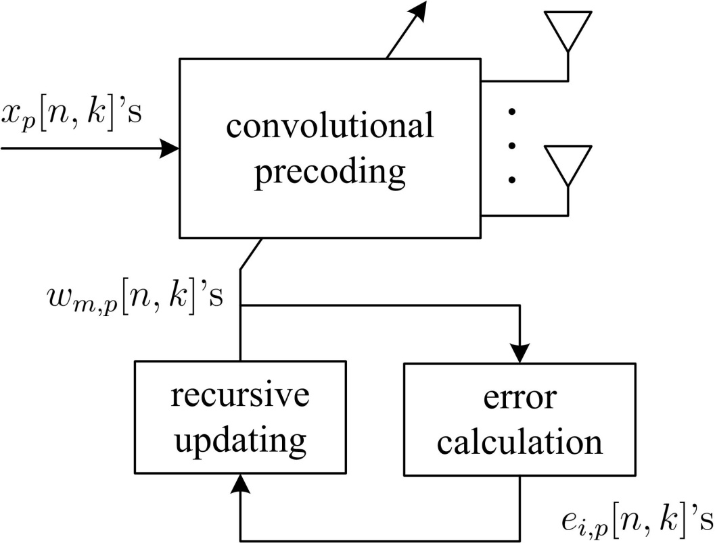
Structure
Recursive convolutional precoding includes
convolutional precoding
recursive updating
error calculation

Slide 11
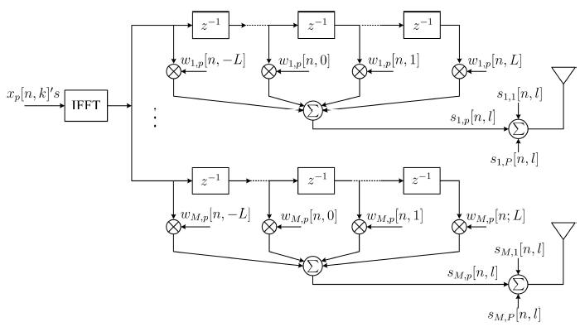
Convolutional precoding

Slide 12
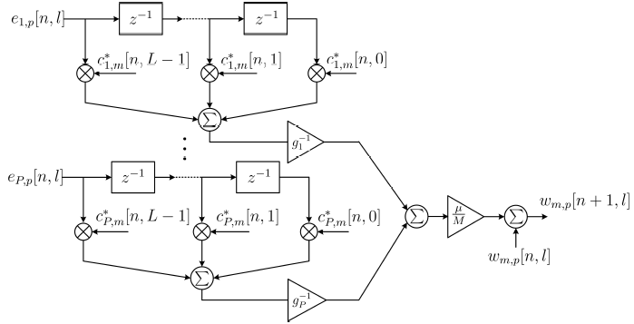
Recursive updating

Slide 13
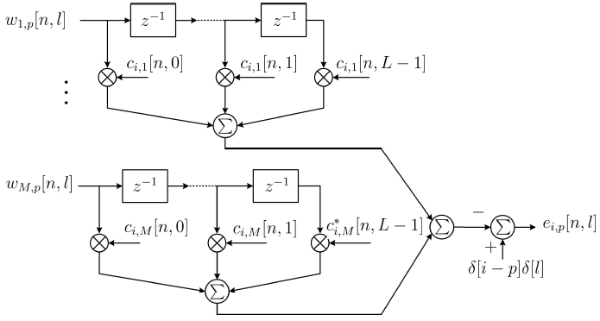
Error Calculation

Slide 14
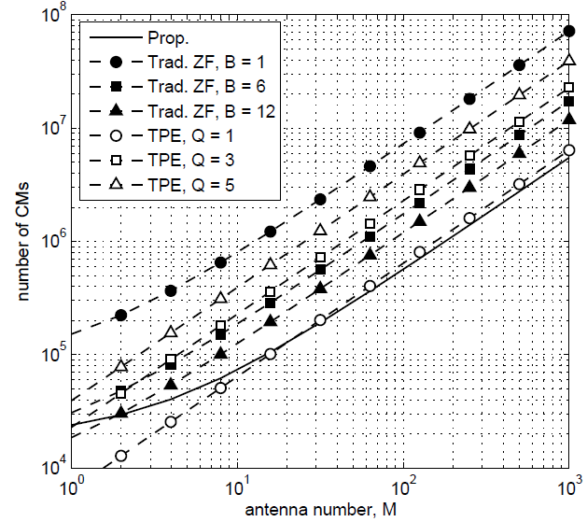
Performances
Significant complexity reduction

Slide 15
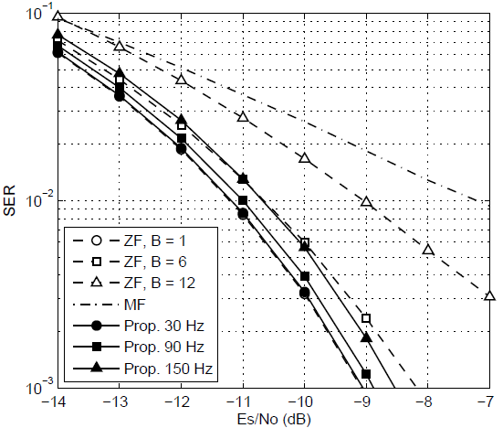
Performances
Significant improvement than MF
Better performance than ZF with similar complexity

Slide 16
Conclusions
Recursive convolutional precoding can achieve lower complexity than traditional LSA-OFDM while maintaining satisfied performance

